Slide 1
MARKETPLACE APP
HAARIS NASEEB
JANIS GRIKSTAS
JULIUS MITCHELL
SHAIKE RUSHAPI

Slide 2
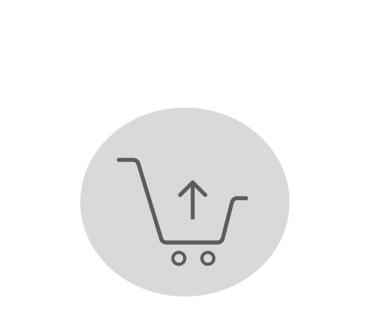
INTRODUCTION
An E-commerce marketplace site
Users are able to research, review, and buy products.
Users will be given the opportunity to sign-up or login.
Frontend
Backend
React.js
HTML
CSS
MySQL
PHP
MongoDB

Slide 3
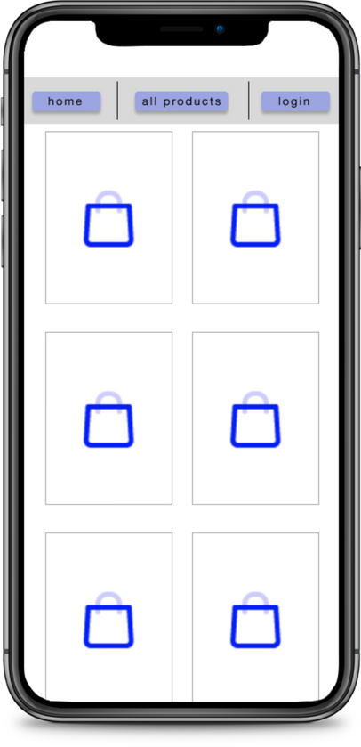
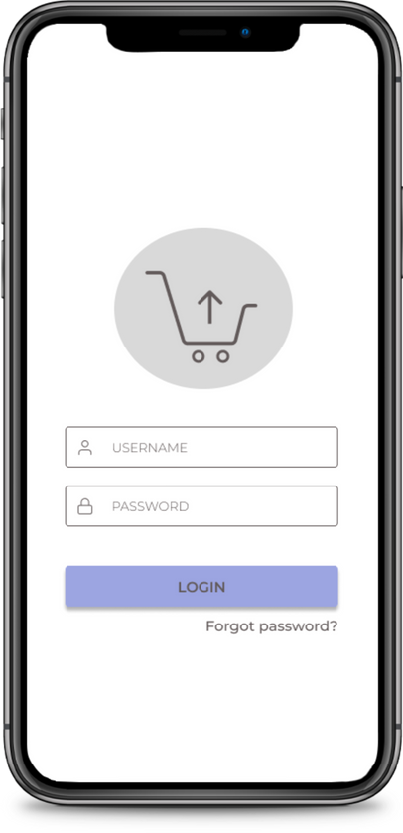
LOGGING IN
A user first lands on the All Products page.
If they want to login, the login button on the top right will lead them to the sign-in page.
Authentication will be processed through our User database.
When Authentication passes, they'll be logged in and brought back to the All Products page.

Slide 4
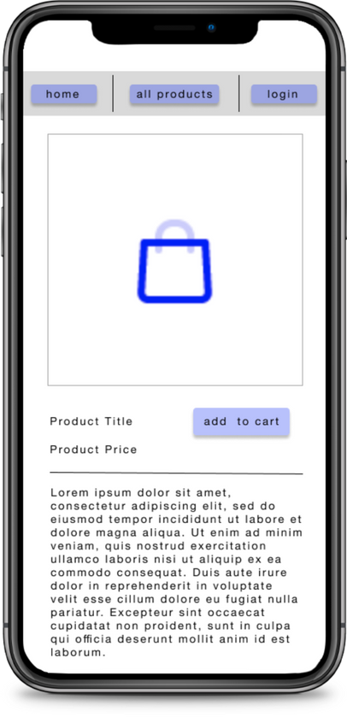
BROWSING PRODUCTS
As a user is browsing products, clicking on an individual product's picture will bring them to and individual product page
Individual Product pages display more details
Individual Products pages also allow the customer to add the product into their cart

Slide 5
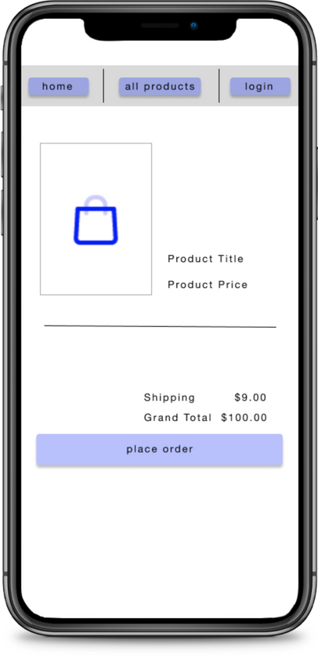
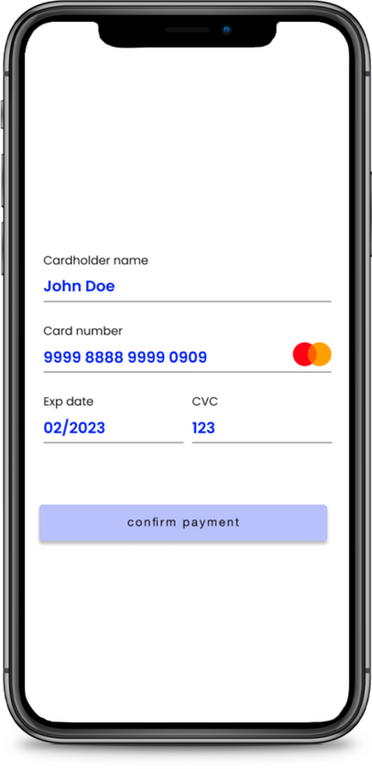
CHECKING OUT
After a user adds a product to their cart, they are brought to their cart.
The user can then place the order, then they are brought to a credit card processing page
When the user clicks "confirm payment" basic logic/regex will be used to "mock" a credit card payments process

Slide 6
THANK YOU

