Slide 1
GSU Poster Day Judging App
Group: Lolade Kasumu, David Jones, Carlos Guerrero, Razat Sutradhar

Slide 2
Software Purpose
Assists judges in determining winners of CSC & SWE Showcases.
Eliminates the need for paper rubrics and manual scoring making the judging process easier.
Judges will make their submissions based on student classification, and can differentiate between poster and demonstration submissions.
Allows judges to start and stop the voting/submission period.
Aggregates and lists the highest scoring posters.

Slide 3
Technical Platform
Frontend (Flutter):
Login page
Project selection page
Grading page
Thanks for grading page
Backend:
DataStore: FireStore
Login data
Functional data
Project info
Grader info
Cloud Functions (python)
Determining results
User Input:
Log in
Score a project
System Outputs:
Email results to admin
Notes:
Razat

Slide 4
Storyboard - Technical
Story | Story point | To-Do | In Dev | Testing | Done
UI (Flutter) | 3 |  | ✓-Lolade
DataBase (FireStore) | 3 |  | ✓ - Razat
Security (LogIn System) | 3 |  | ✓ - David
Winner Calculator (Cloud function) | 3 | ✓ - Razat & Carlos

Slide 5
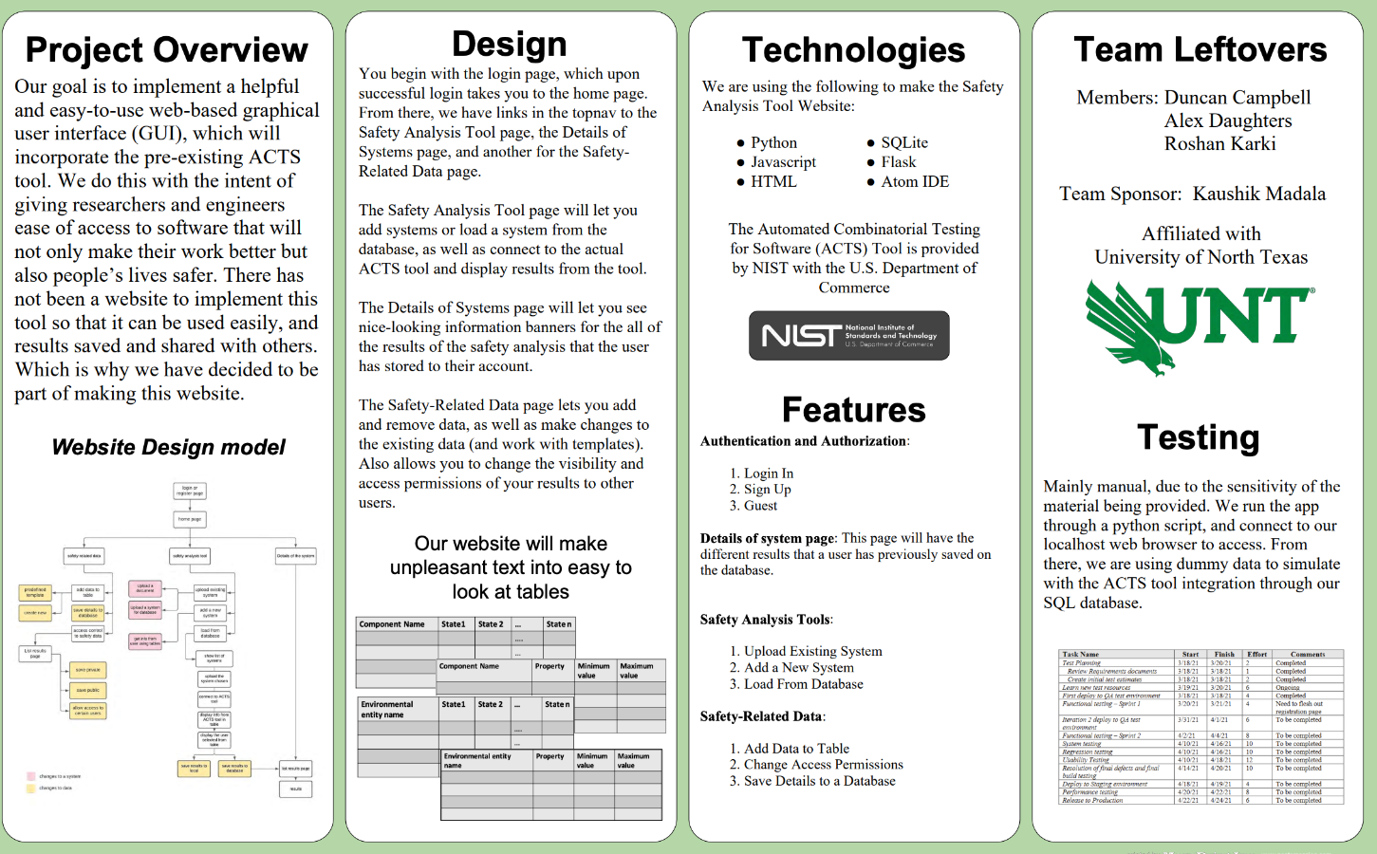
Storyboard - User Story
To: Grader Subject: Projects you will be grading “You will be grading the projects of ___, ___, ___ between the times of _:_ and _:_” | Username: __________ Password: __________ | Team Name and Project Name
Generate Grade Schedule | Log In | View Assigned Posters
Team Name and Project Name Abstract: _/5 Background: _/5 Purpose: _/5 Discussion: _/5 Design: _/5 Narration: _/5 | Reminder: you have 10 minutes left to grade! | To: Head Grader Subject: Winner! “Congratulations to ____ for having the highest score”
Enter Grades | Notification for Time Approaching | Determine Winner

