Slide 1

Hospitality Management
By: Paradis, Jesu, Khalid, & Nusayba

Slide 2

Functional Requirements
The system allows the users to connect with similar individuals
User should not be able to see everyone around them
The system allows users to find chronological and geographical relevant events
The system should show transportation system schedules
The system should automatically redner social media when profile is shown
Notes:
The functional requirements in the system helps users to connect with others, finding events in their geographical location and showing the users the available transportation schedules that the user needs. The system will also show the users other social media profiles of different users and etc.

Slide 3
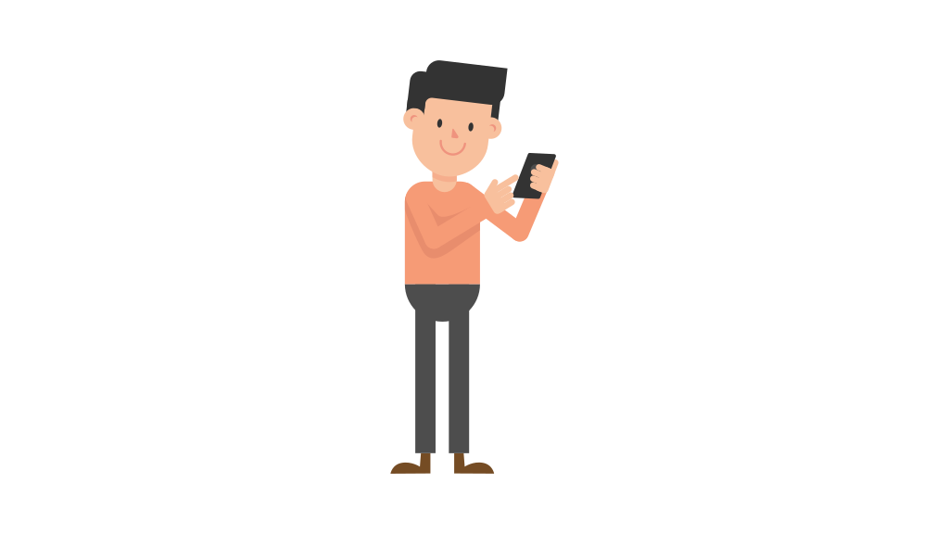
Non-Functional Requirements
App should be simple to navigate
The onus of security should ultimately be on part of the user
The app should communicate with MySQL database and filter out irrelevant users
Ideally app should be available and usable regardless of location
Users should be presented with live timings of events based on proximity and date.
Notes:
-The system should be easily accessible to the user with simple ways to navigate the app, and allows users to be presented with live timings and transportation.
-

Slide 4

Possible Improvements
Better planning and reactions
Better work separation/coalescence (Use GIT more)
Unified vision before work starts
Notes:
Agile approach was looser than ought to be and should have reevaluated at road blocks instead of pushing through
Didn’t fully utilize the power of GIT and kept things on separate machines for majority of time
Different expectations and different results

Slide 5

Conclusion
Initial goal was to build application that helped facilitate travel
Great learning experience working with unfamiliar technologies; slow learning curve
Were able to achieve the bare bones of an application that could possibly become what we wanted
Notes:
Fell short of goal one continuously reduced our ideals as time progressed and realized what it would've taken to achieve our original design

Slide 6


Slide 7


