Slide 1

Hospitality Management
Presentation 2
By: Pardis, Jesu, Khalid, & Nusayba

Slide 2
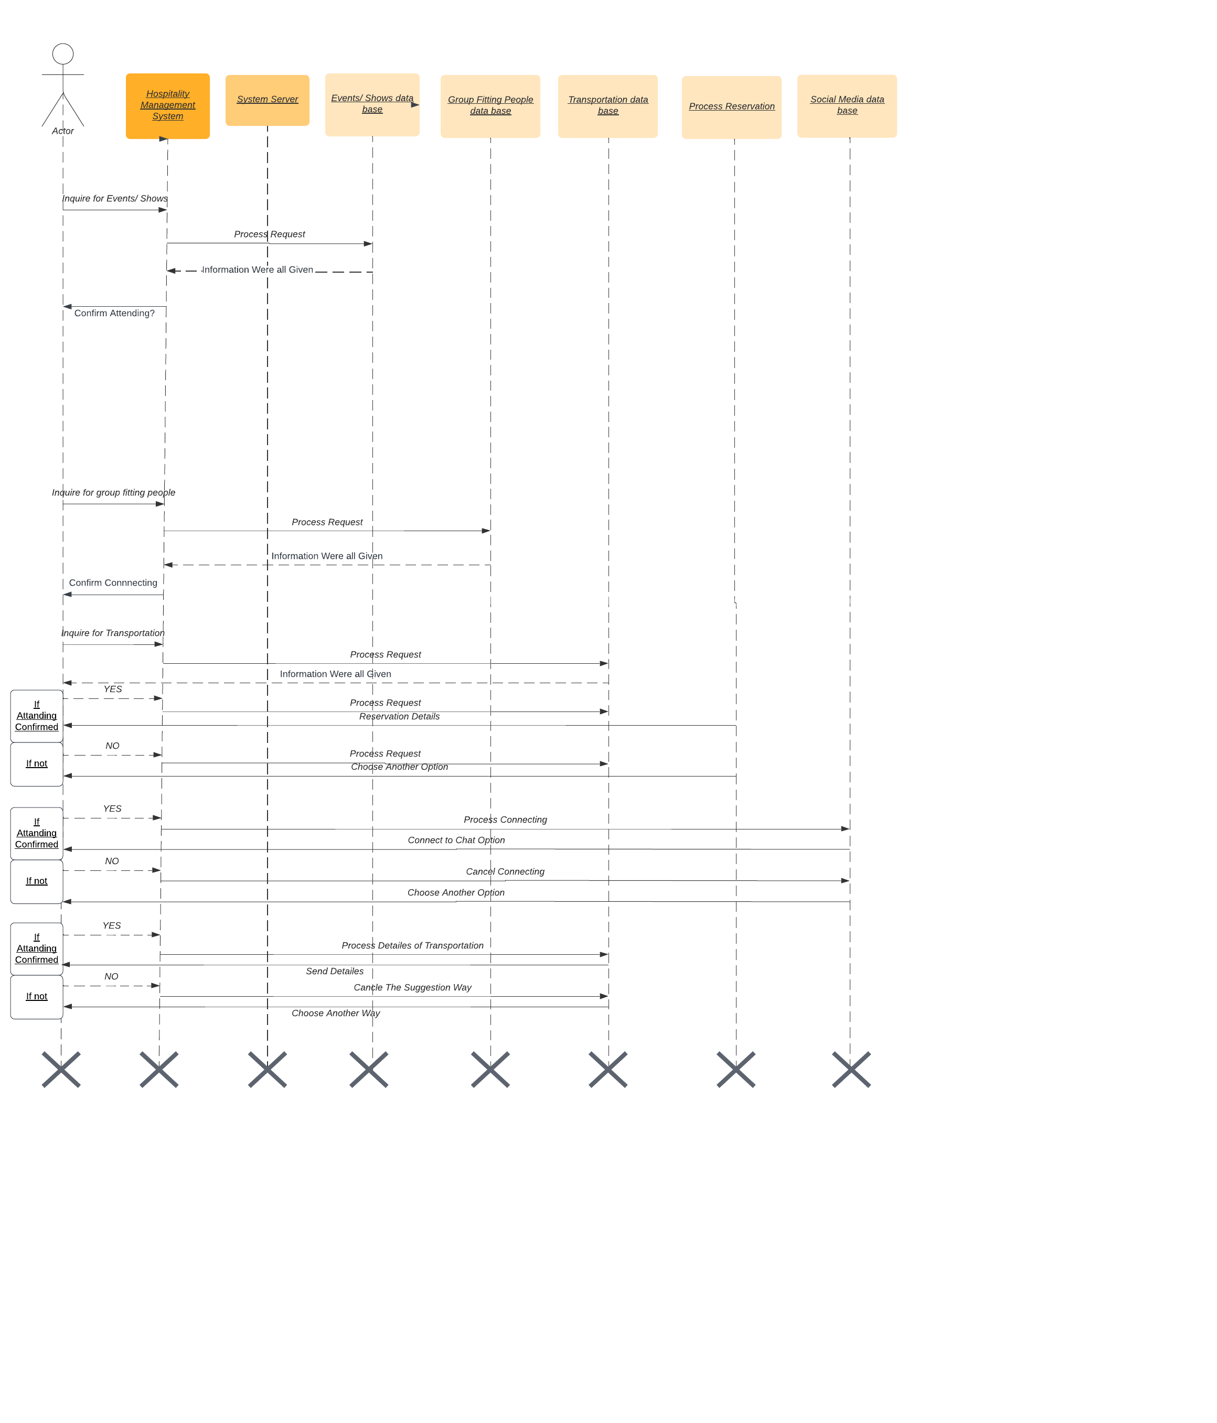
Diagram
Sequence Diagram
UML 1
UML 2

Slide 3
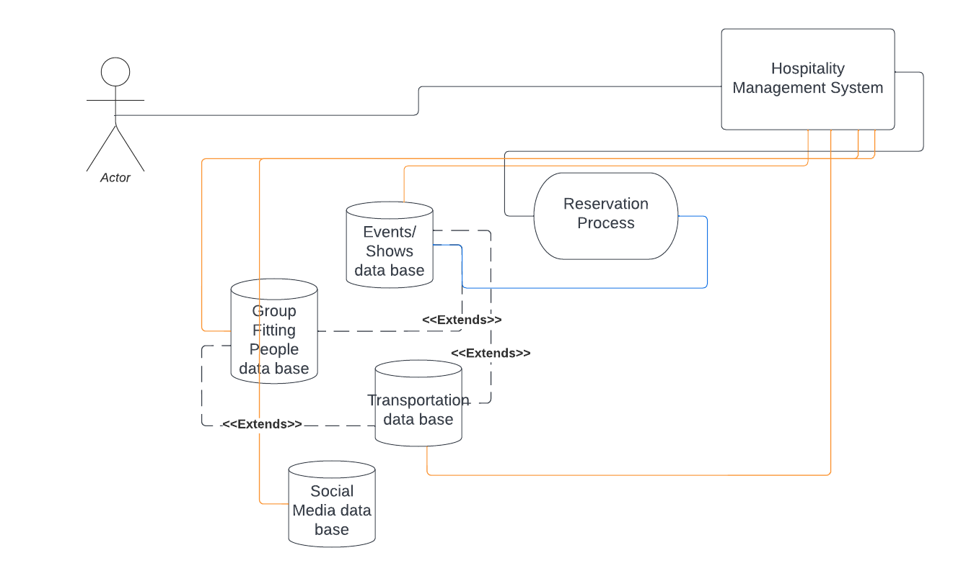
Diagram
Sequence Diagram
Use Case Diagram 1
Use Case Diagram 2

Slide 4
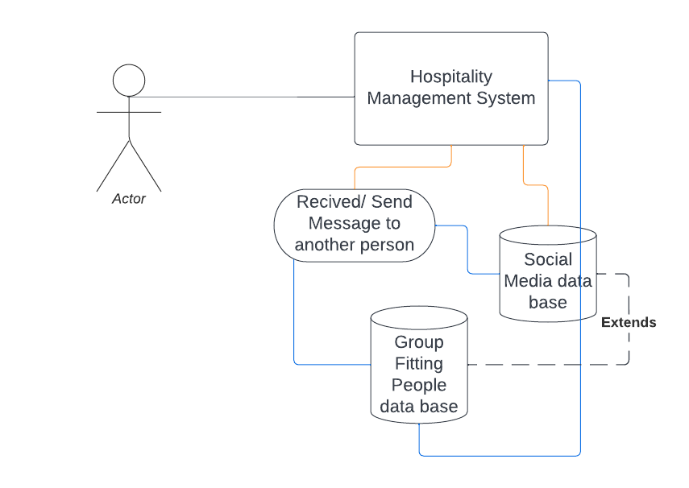
Diagram
Sequence Diagram
Use Case Diagram 1
Use Case Diagram 2

Slide 5

Test Scenario 1
 | Verify the users with similar features are connected while making sure that multiple features are similar between user before matching

Slide 6

Test Scenario 2
 | Verify that the events tab appropriately updates and filters out irrelevant events so that user only view geographically and chronologically relevant events.

Slide 7
Thank you for listening!

