Slide 1
Attend-In

Slide 2
Functional Requirements
User shall be able to select a student or professor view of the app
User shall be able to input their name and select class CRN, class time, and class location in student view
User shall be able to click a submit button in the student’s view
The system shall send a confirmation if verification was successful in the student’s view
From the professor’s view, the system shall display students that have inputted their attendance correctly

Slide 3
Non-functional Requirements
The system shall be able to compare user location and class location for verification
The system shall verify user’s information if they are acceptable to be saved or not
The system shall save the user’s data into a database after verification in student’s view
The system shall be easy and clear for user to use to prevent any errors when navigating and inputting information
The system shall navigate user to the appropriate error or confirmation page in student’s view after submitting their information

Slide 4
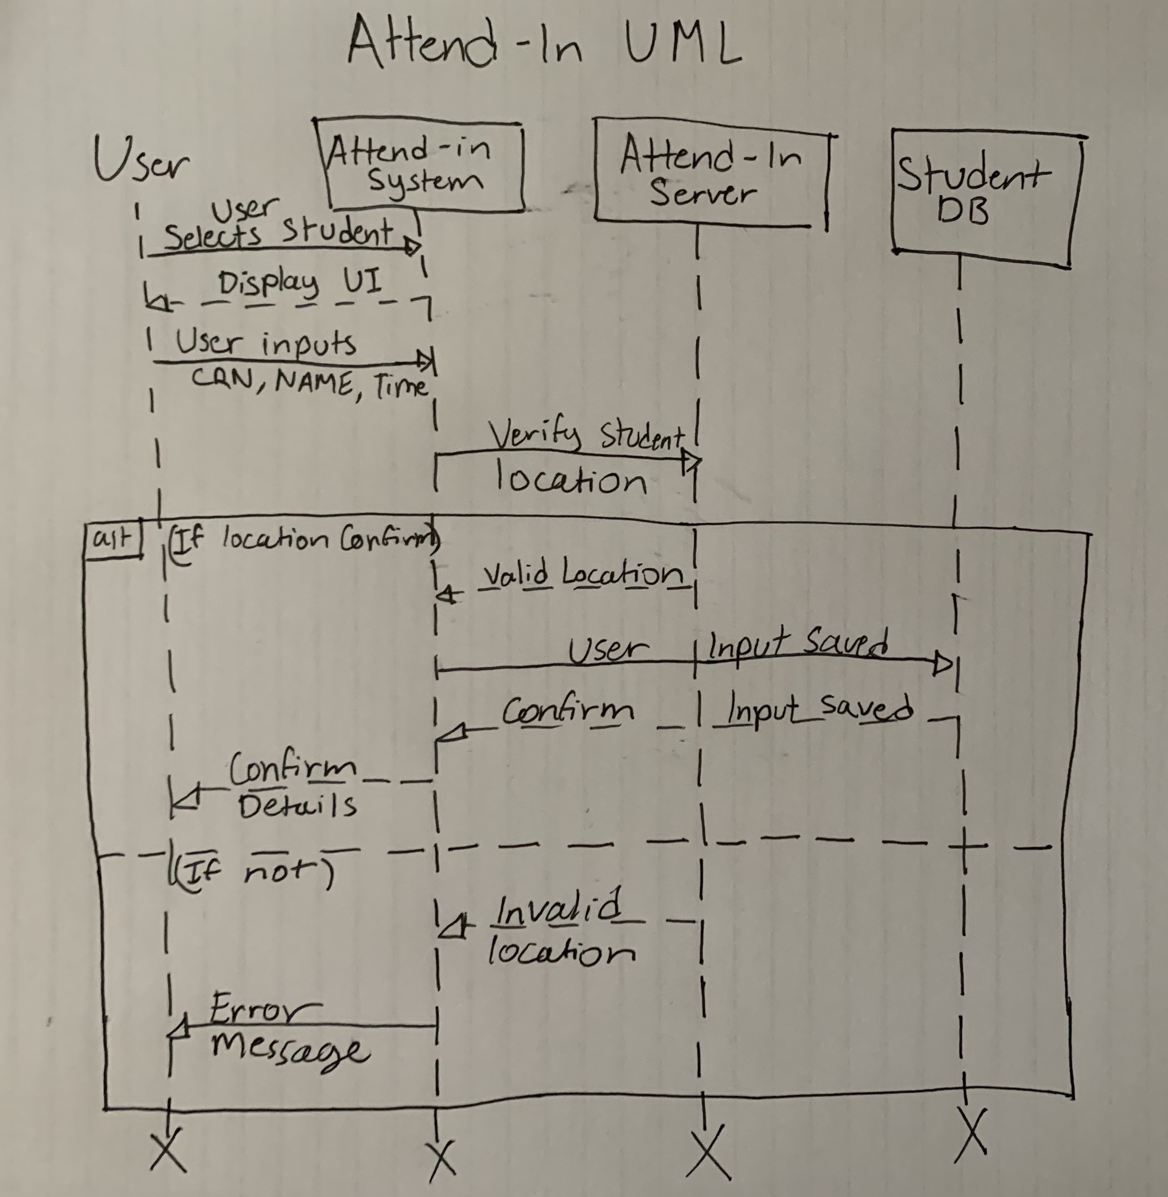
Updated UML Diagram – Student’s View

Slide 5
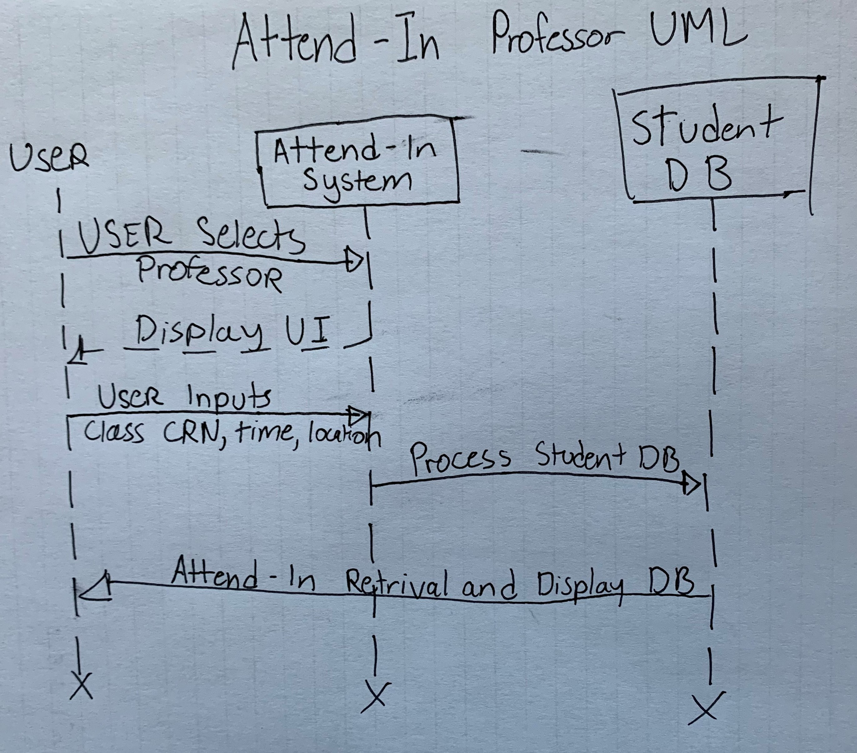
Updated UML Diagram – Professor’s View

Slide 6
Demo

Slide 7
Team Experience Summary - Goal
Create an application to make the process of recording attendance easier for both students and professors
Allow location tracking so professors can verify if students were in class

Slide 8
Team Experience Summary
The team delivered a functional product with all required features
Able to communicate and assign tasks aligning with the requirements
The team used the waterfall process to deliver the product
Tested and reviewed all required requirements after creating the product

Slide 9
Team Experience Summary - Achieved
Created an application to save student’s information into a database
Verify the user’s location if they are near their class
Professors can check attendance using professor’s option in the application
Display all student with verified location and attendance in the professor’s view

Slide 10
Thank you

