Slide 1
Password scrambler
​

Slide 2
Purpose
To give users a new method of login through means of picture orientation and visual memorization. Instead of the normal string password.
Our scrambler with images will make it harder for anyone to brute force or gain access to our site. In short trying to make our site more secure for our users.
Login more accessible for users.
Free to use.
9x9 images will be used.

Slide 3



Technical platforms
REACT JS
SQL (for database)
Spring Boot
Shutter stock API
Pexels Backup API
Heroku for deployment

Slide 4
Technical Info.
User is asked to create account if they don’t already have one.
If they have one, they type in their username and arrange image to what they previously selected to grant access.
If they don’t have an account, they fill in the required information then choose a photo and arrange into the order they select for their chosen password.

Slide 5
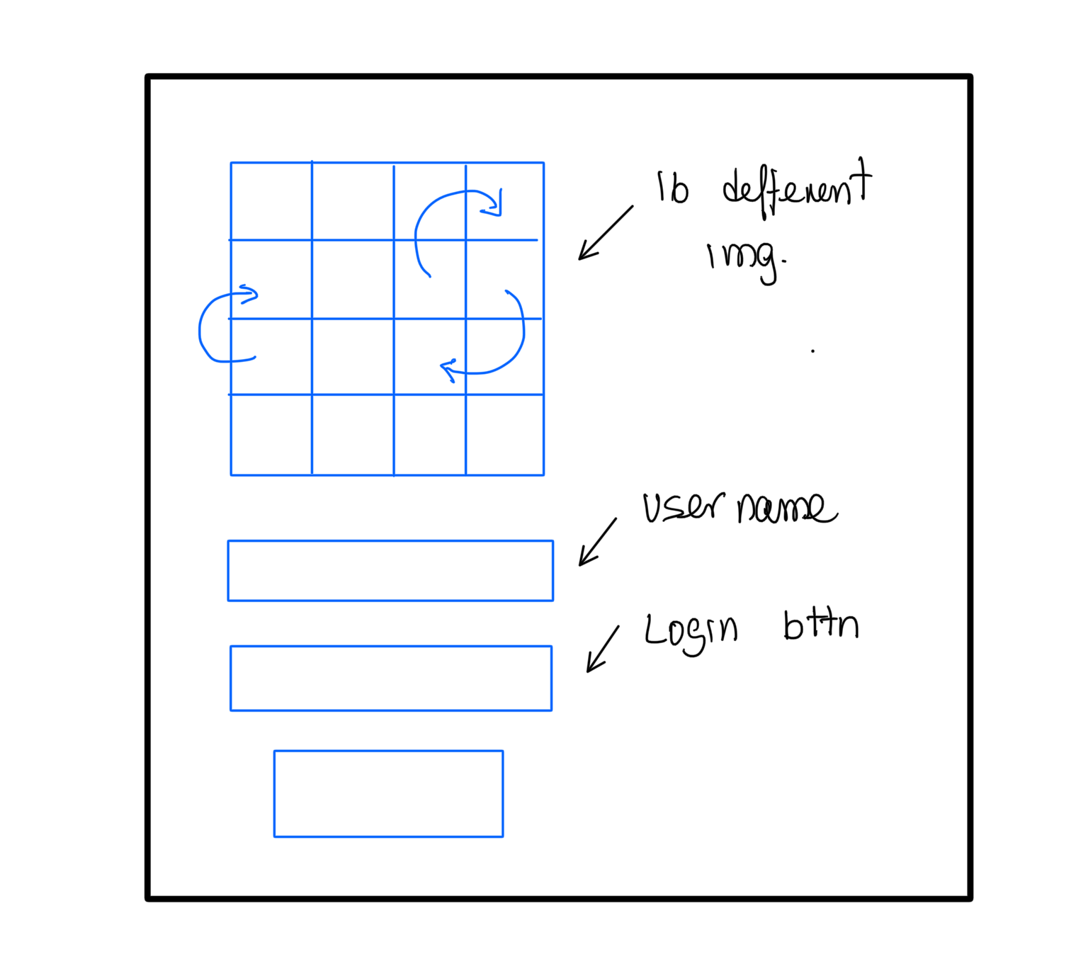
STORY BOARDS
1
Register new user

Slide 6
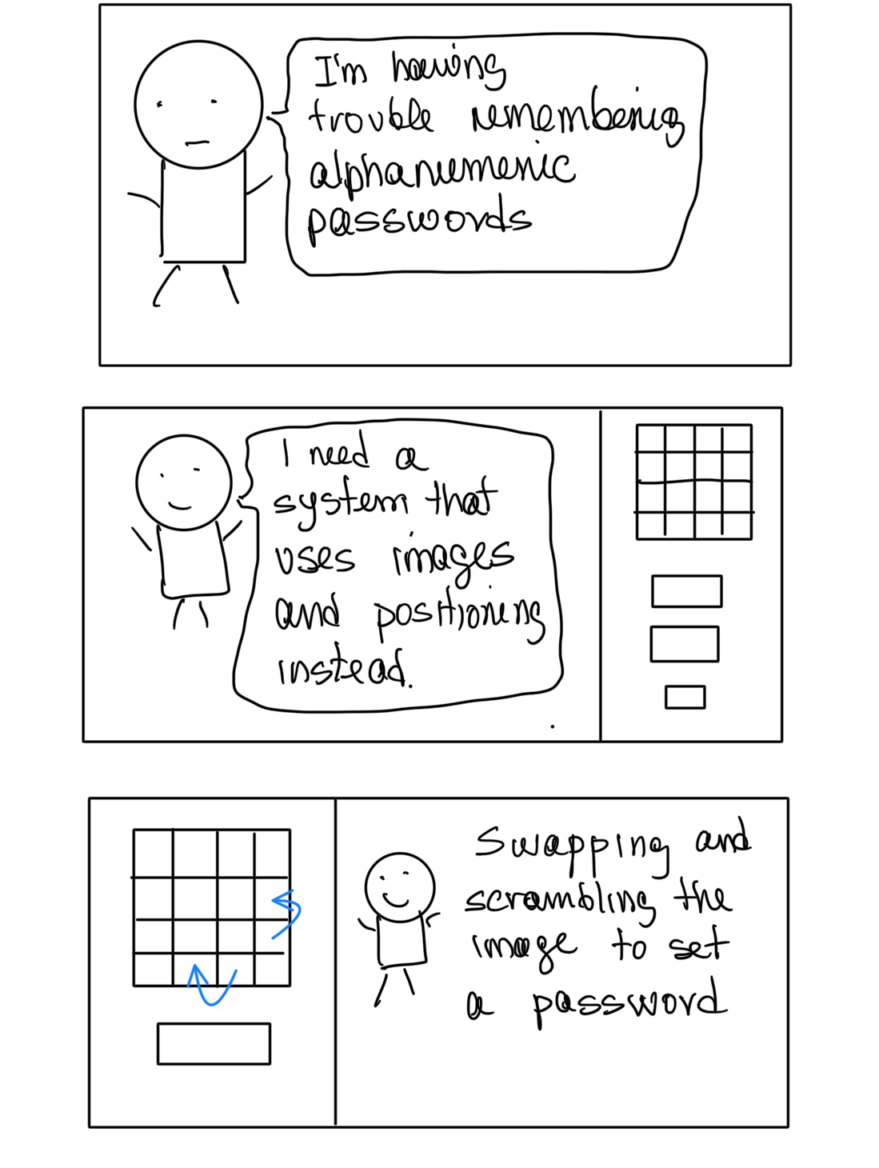
STORY BOARDS
2
Register new user

