Slide 1
Password Scrambler

Slide 2
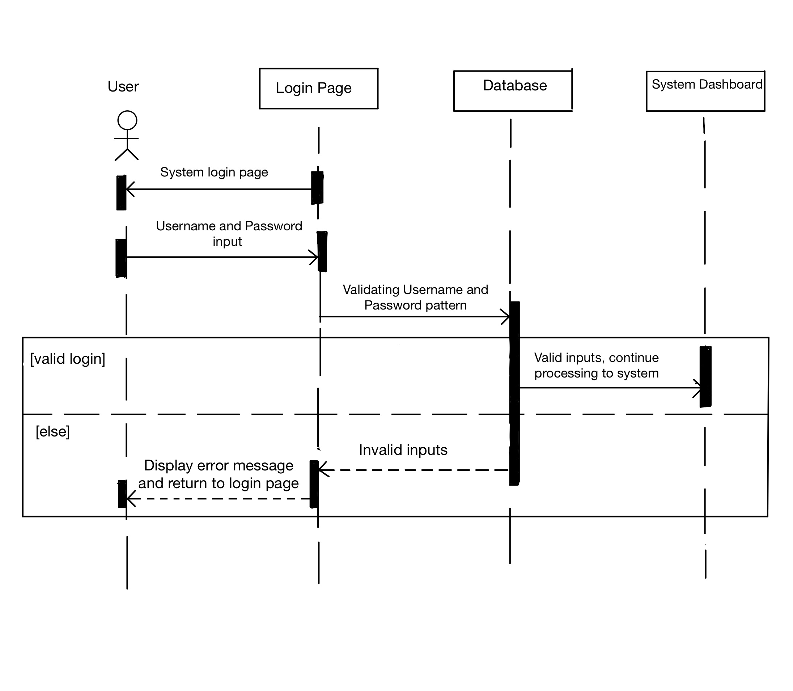
UML Diagram

Slide 3
UML Diagram
New Username and Password input
Validating New Username and valid password
Valid registration
Valid/unique Username
Invalid input, username already exists

Slide 4
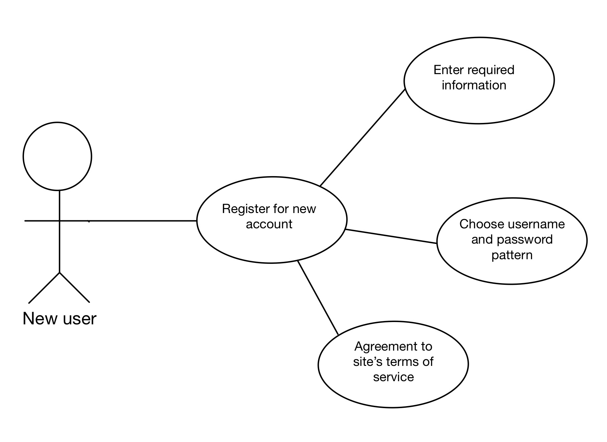
Use Case Diagram

Slide 5
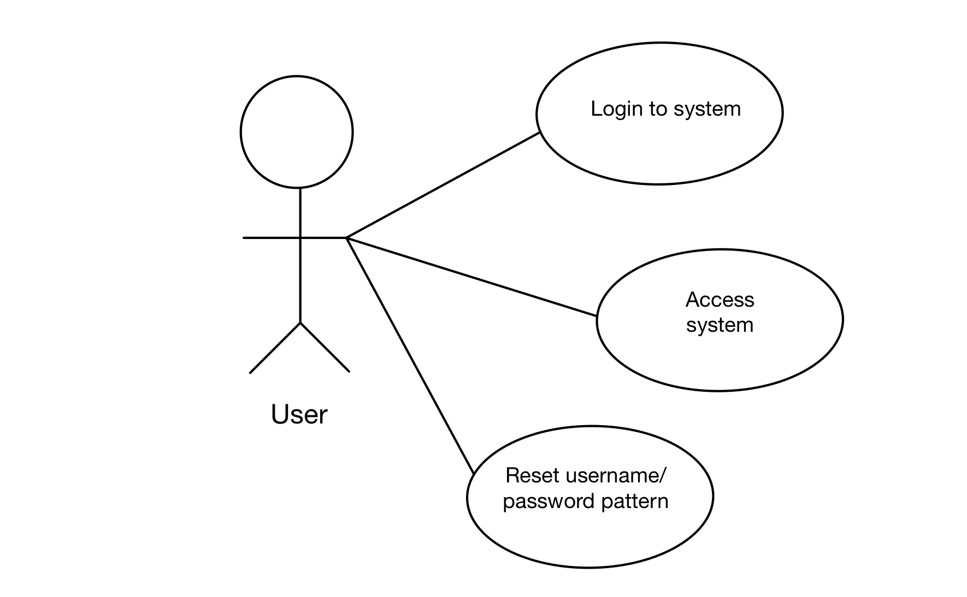
Use Case Diagram (cont.)

Slide 6
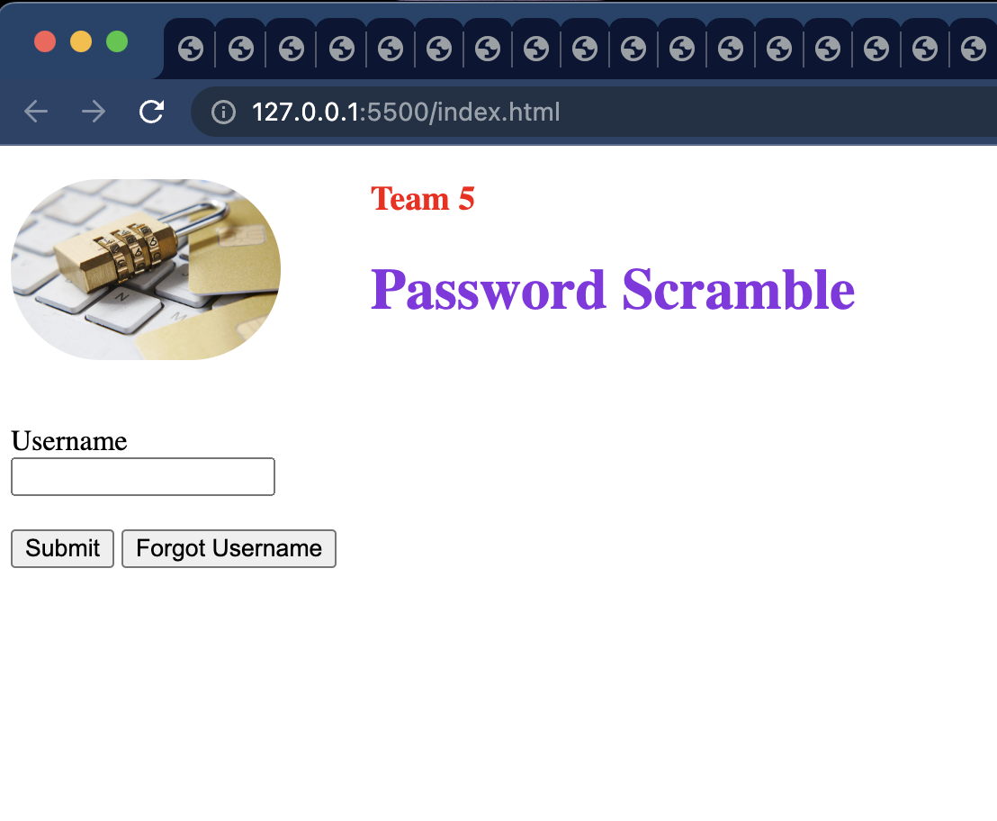
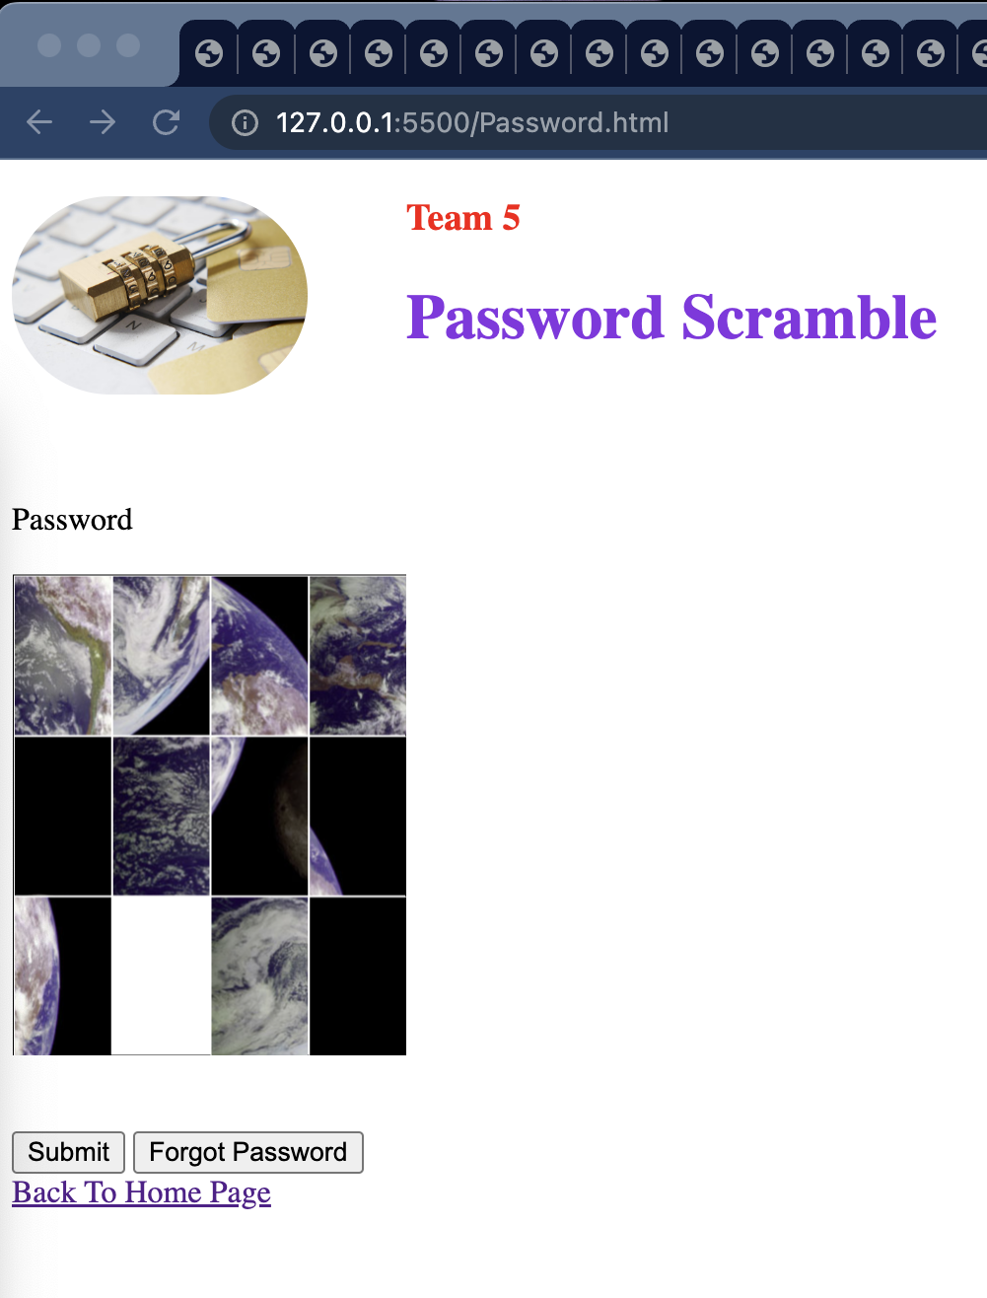
Test Case Scenarios
Verify all login related elements and fields are presented on login page

Slide 7
Test Case Scenarios
Error: number of attempts is over 10
Please reset password
Output an error message if user has tried to login
more than 10 times to then rest their image password

Slide 8
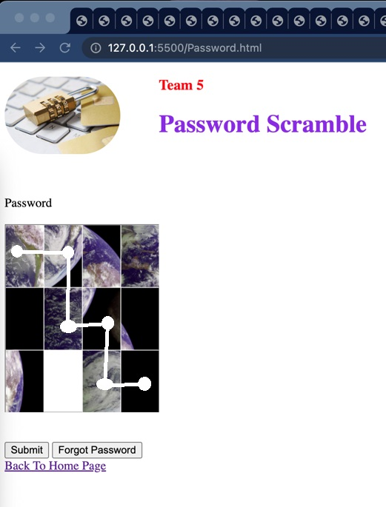
Test Case Scenarios
Data Base: Sequence Values to be stored
Sequence
Ensure that the sequence inputted matches the values stored in the database.

Slide 9
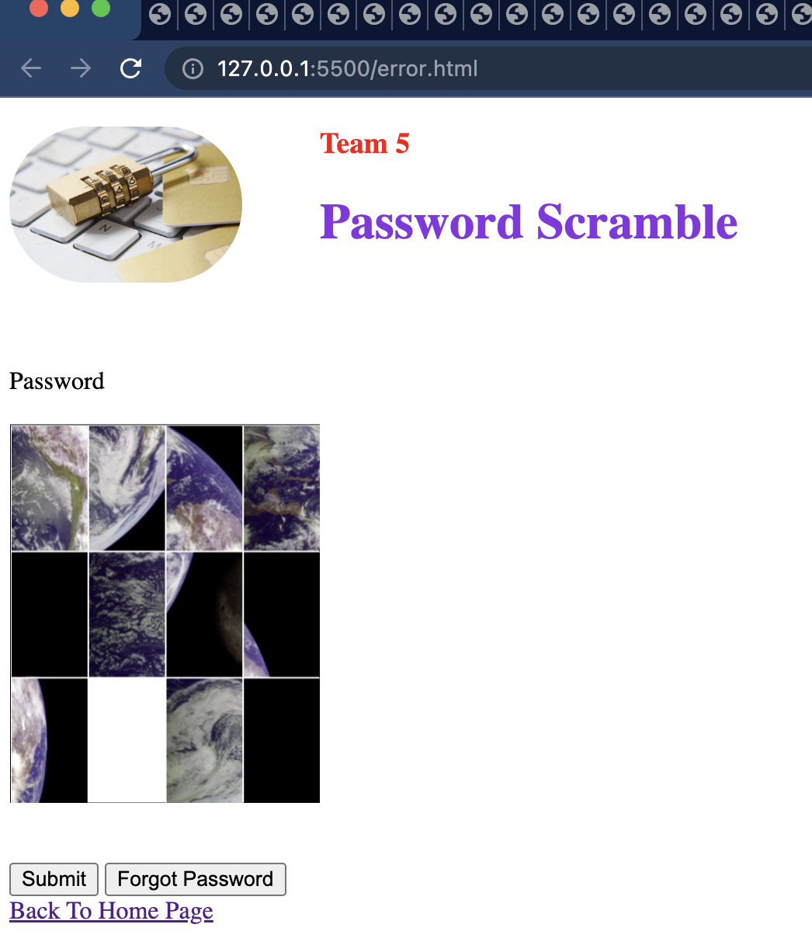
Test case scenario(cont.)
ERROR: invalid credentials
The error message should display after entering invalid credentials.

