Slide 1
GitHub Go
By Team 10
CSc-4350 TR

Slide 2
UML Sequence Diagram

Slide 3
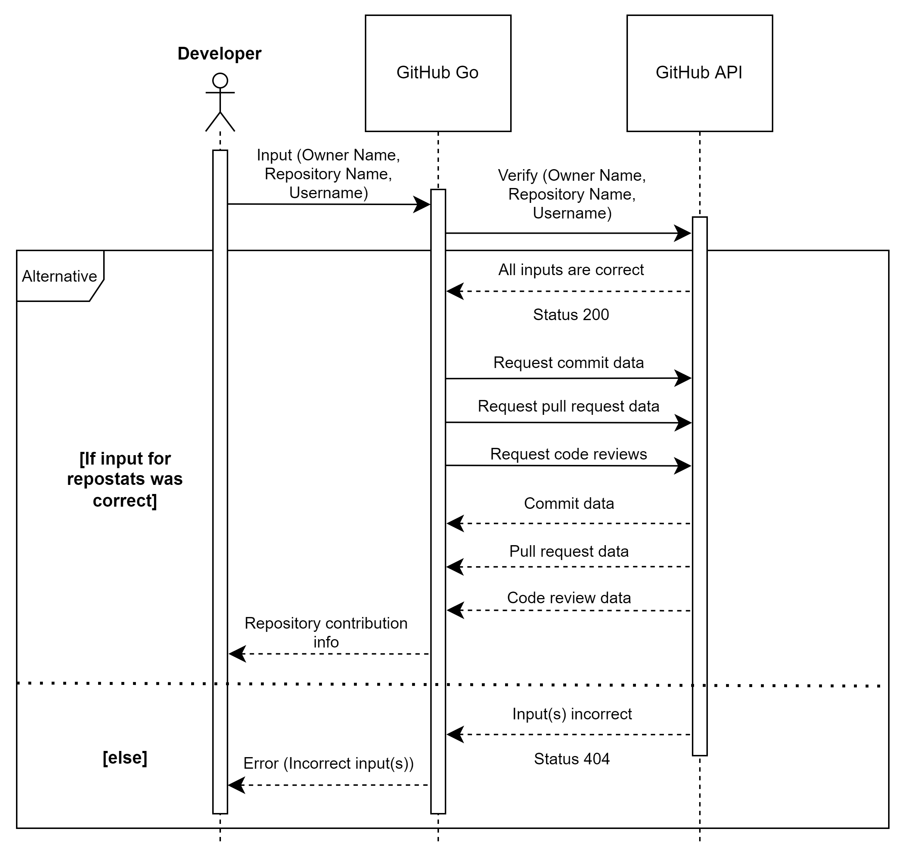

Slide 4
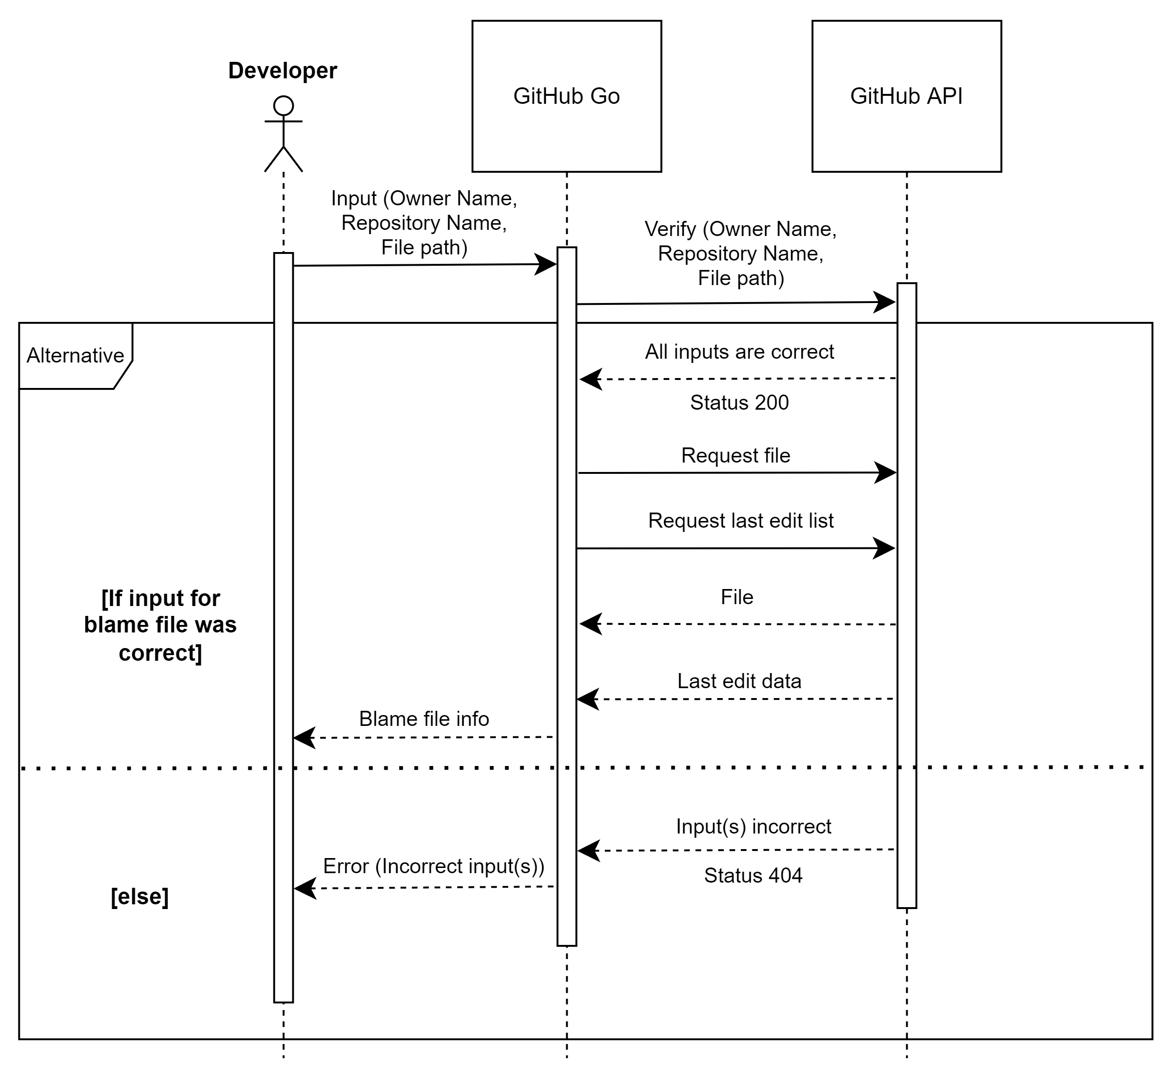

Slide 5
Use Case Diagrams

Slide 6
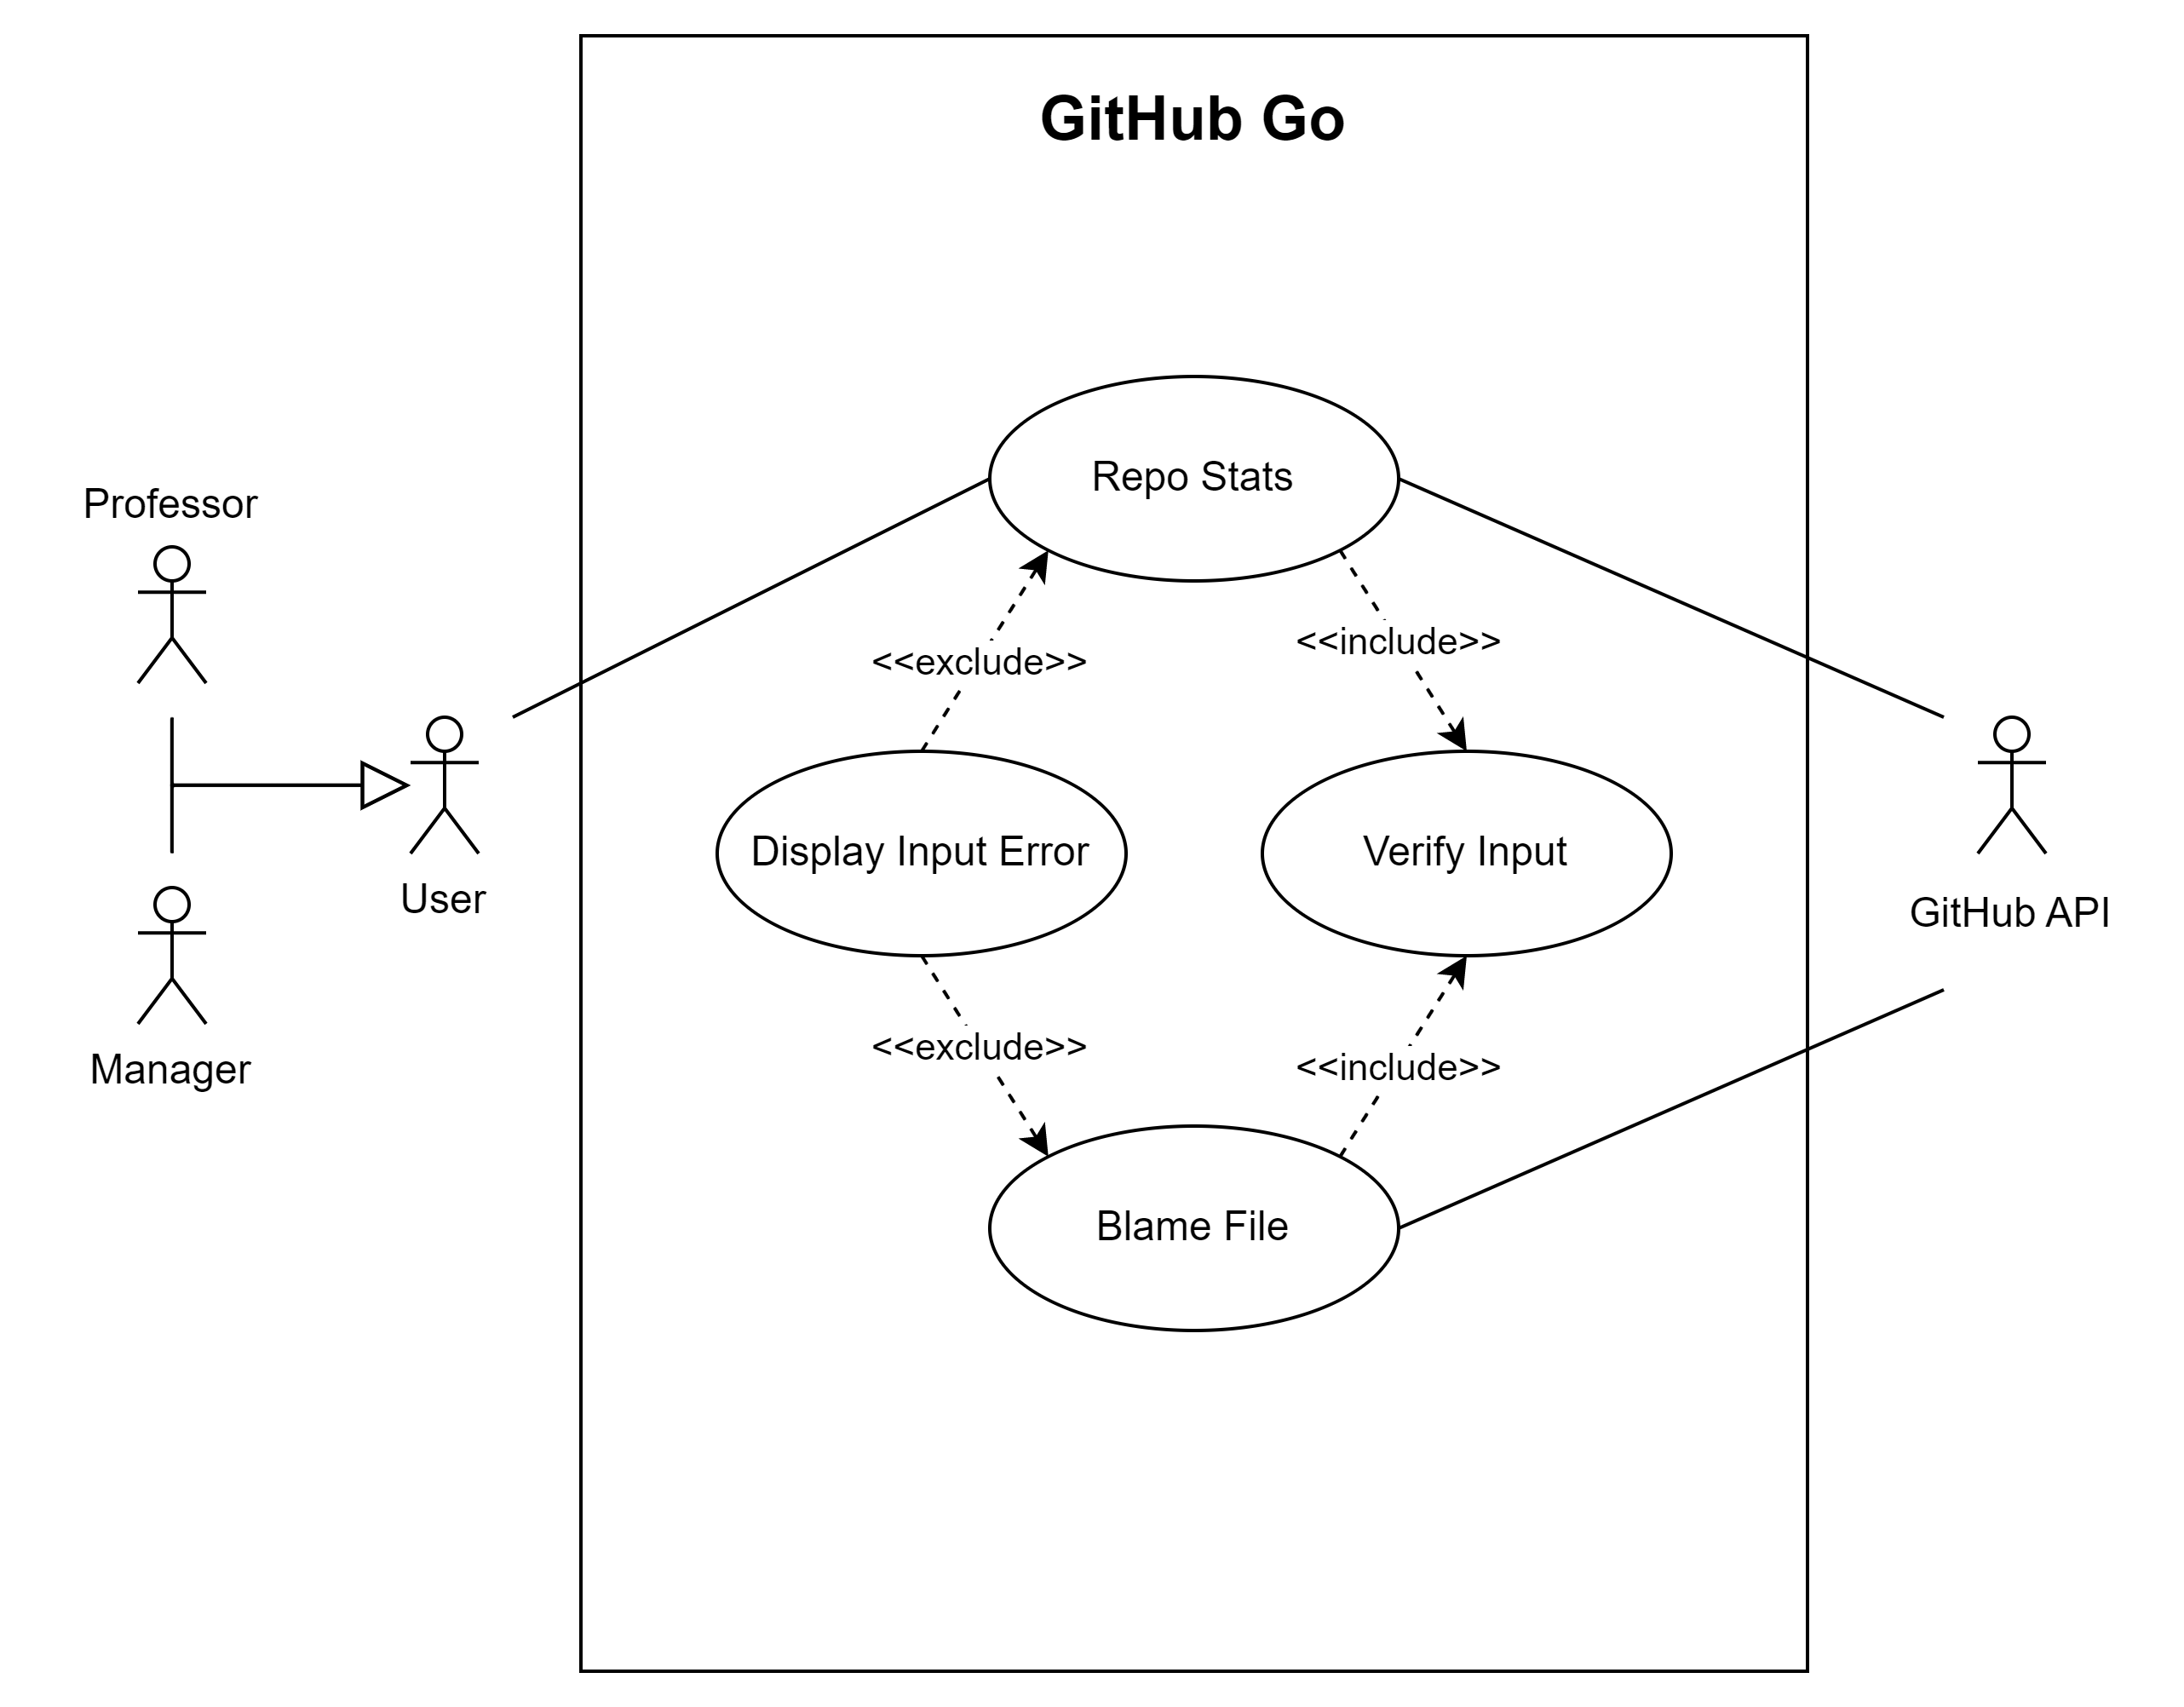

Slide 7


Slide 8
Test Case Scenarios

Slide 9
Scenario 1: Front-End
Scene
User leaves some input blank in the input fields
Test
Verify that the user needs to fill in all the fields – username, repository name, owner name, and file path
Output
GitHub Go will prompt a warning/message to the user to enter valid information in all the input fields

Slide 10
Scenario 2: API
Scene
User filled in all the inputs; however, at least one input doesn’t exist in GitHub API
Test
Validate user inputs with GitHub API before start requesting the data from the GitHub API
Output
GitHub Go will prompt the error(s) below the input field(s) based on which field(s) doesn’t exist in GitHub API

Slide 11
Thank you!

