Slide 1
MealPlanR
Chris Pak, Johnson Vu, Jean Guo, and Abner Noel

Slide 2
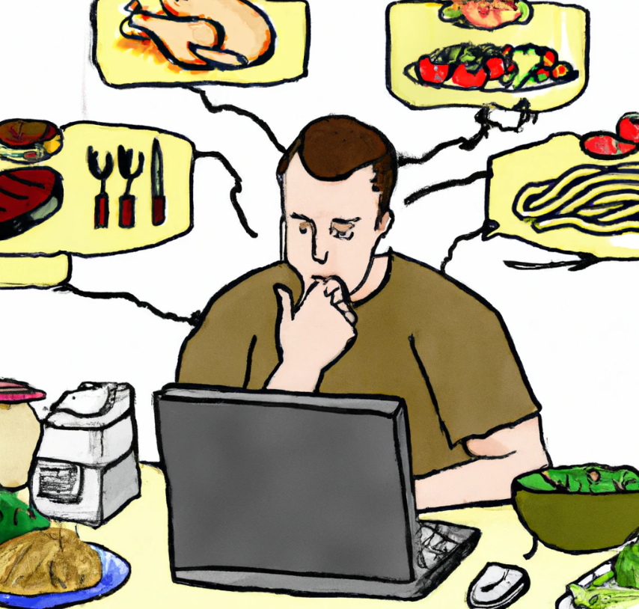

Purpose of Software System
A web app that allows users to:
Search for recipes
Save favorite recipes
Create weekly meal plan
Add user defined recipes *

Slide 3
Technical Platform
React frontend
Express backend
MongoDB NoSQL database to manage user information, meal plans, and recipes
Consume third-party API (Edamam Recipe Search API) to fetch data pertaining to recipes.
JSON Web Token (JWT)-based authentication allowing users to sign-up, log in, and log out.
Model-View-Controller (MVC) pattern for the overall architecture.
Asynchronous JavaScript and XML (AJAX) to communicate with Express backend

Slide 4
Story card - Adding a meal to a meal plan
Bob is a busy software engineer who wishes to not spend time on cooking during workdays. He has already registered and logged into the app. There is a “Meal Plan” button displayed in the nav bar, so he clicks on it. He is directed to a page that displays a table where each cell represents a particular meal on a particular day (the rows represent the 3 meals of the day and the columns the 7 days of the week).
He clicks on a cell which directs him to a search bar. He inputs keywords related to the name of the recipe he wants to add. The system returns a list of matching recipes that displays basic information of each recipe. He clicks on a list item to view detailed recipe information and a button to add that recipe to his meal plan. He clicks on the add button which saves the recipe into the database.
After Bob has added the recipe, he is directed back to his weekly meal planner where the corresponding cell is updated to display the name of the recipe that was just added. He clicks on another cell and reenters the “Adding a meal” process.

Slide 5
Story card - Saving a recipe to a favorites list
Trish is a mom of three young children who wishes to save a variety of healthy recipes. She has already registered and signed into the app. A search bar is already displayed so she clicks in the search field and can enter keywords relating to the name of a recipe.
After clicking the Search button, the system returns a list of matching recipes that displays basic information of each recipe. She clicks on a list item to view detailed recipe information and a save button to add to her favorite recipes list. She clicks on the save button and the corresponding recipe is saved into the database and to her favorite recipes list.
After Trish has saved a recipe to her favorite recipes list, she is directed back to a search bar and reenters the “Saving a recipe” process. When she finishes making her healthy recipe list, she views her saved list and shows her kids to let them choose what they want for dinner.

Slide 6
Thank you for your Time

