Slide 1



I-Schedule
Team 12 Members:
Mostofa Kaiser
Andre Nguyenphuc
Daniel Wekesa
Jamie Lopez

Slide 2
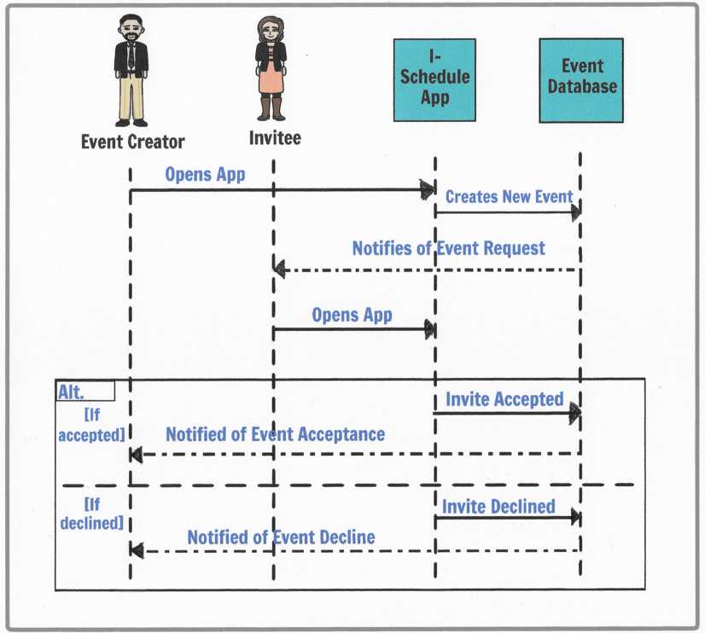
UML Sequence Diagram

Slide 3
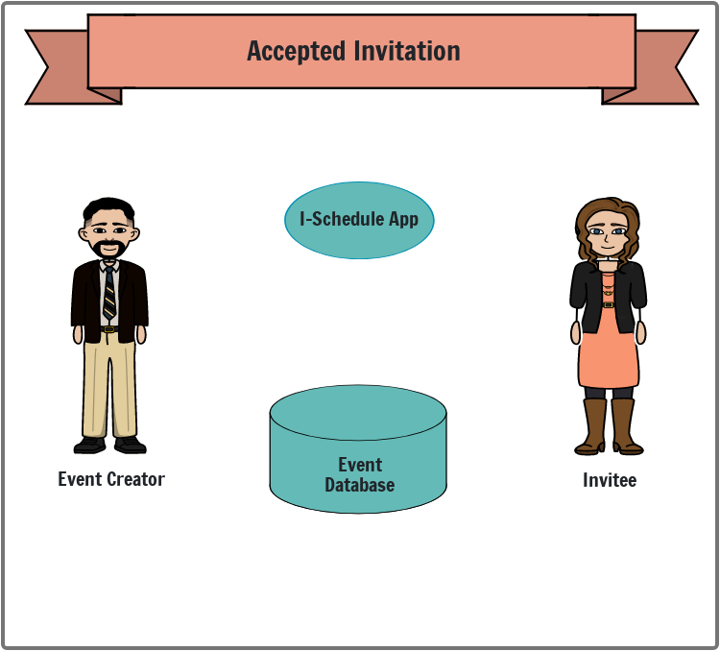

Use Case Diagram: System Components
<<includes>>
<<includes>>

Slide 4
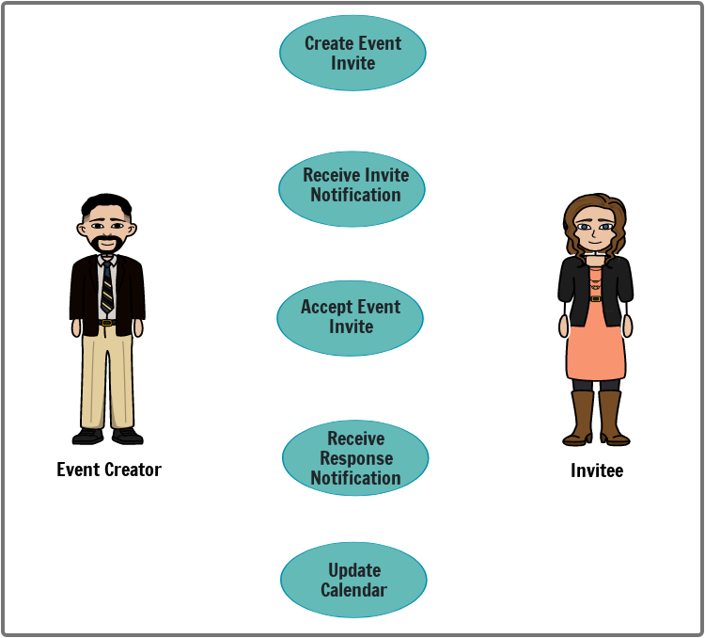
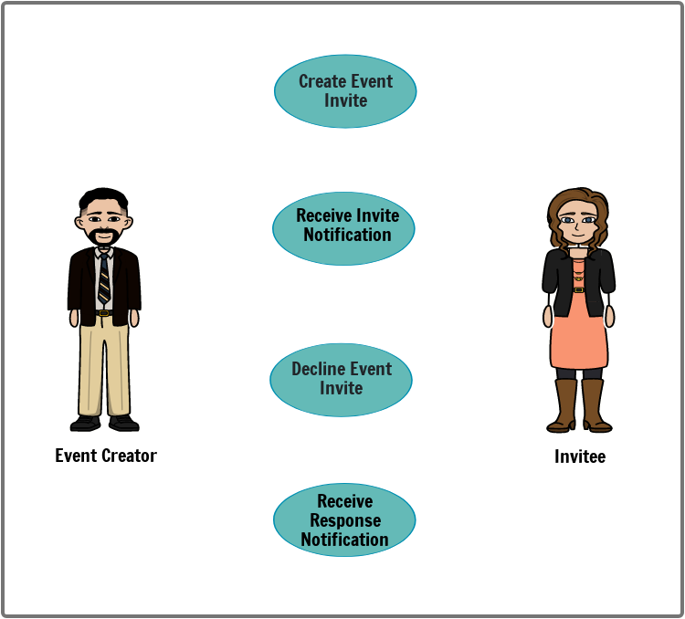
Use Case Diagram: Functionality
<<extends>>

Slide 5
Test Case Scenarios
Event invitation is accepted; event calendar is updated with details for event creator and invitee.
Event invitation is declined; event calendar no longer shows details for event creator and invitee.
Event invitation is in pending status; details show pending on the calendar for event creator and invitee.

