Slide 1



I-Schedule
Team 12 Members:
Mostofa Kaiser
Andre Nguyenphuc
Daniel Wekesa
Jamie Lopez

Slide 2
Objective The purpose of the I-Schedule app is to allow a user to create and send a meeting invitation. The invitee can accept or decline the invitation which will notify the sender of their response and update the calendar.

Slide 3

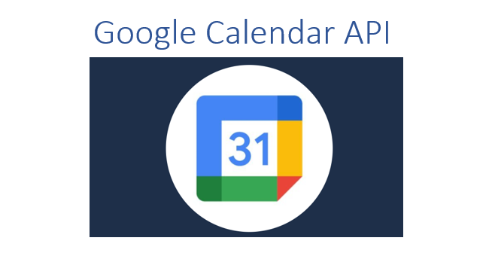

Technical Platform
Flexible, scalable noSQL cloud database
Will use Google Calendar API to create new events
Platform for building mobile apps
Used to store and sync data for client- and server-side development
Understand calendars and events
Sends push notification
Helps you develop an application concurrently for 6 various platforms, including Windows, Android, and iOS

Slide 4
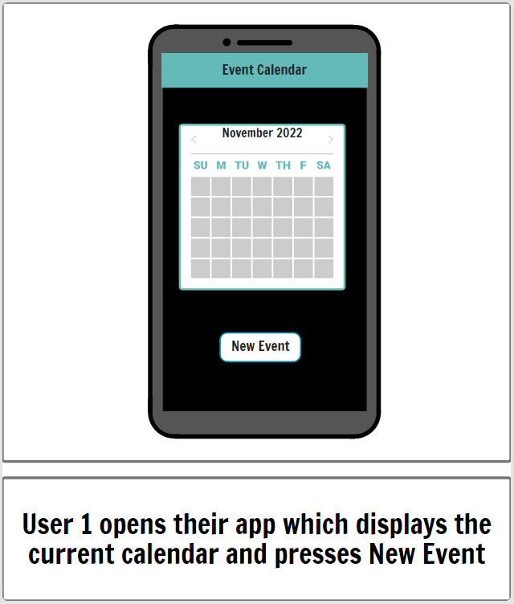
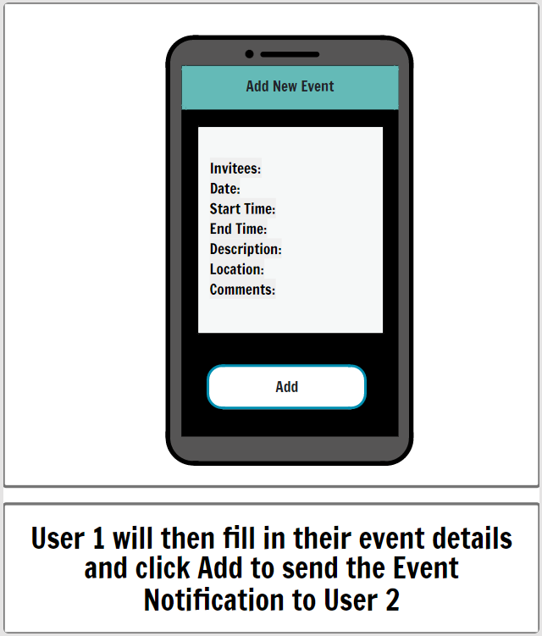
Storyboards

Slide 5
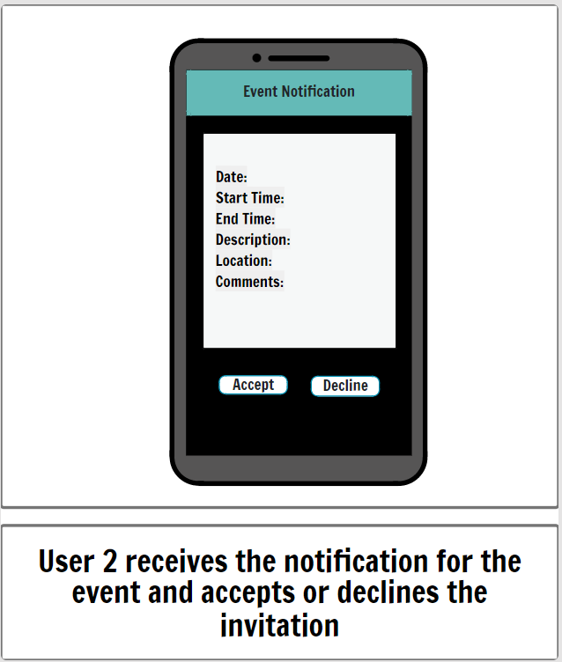
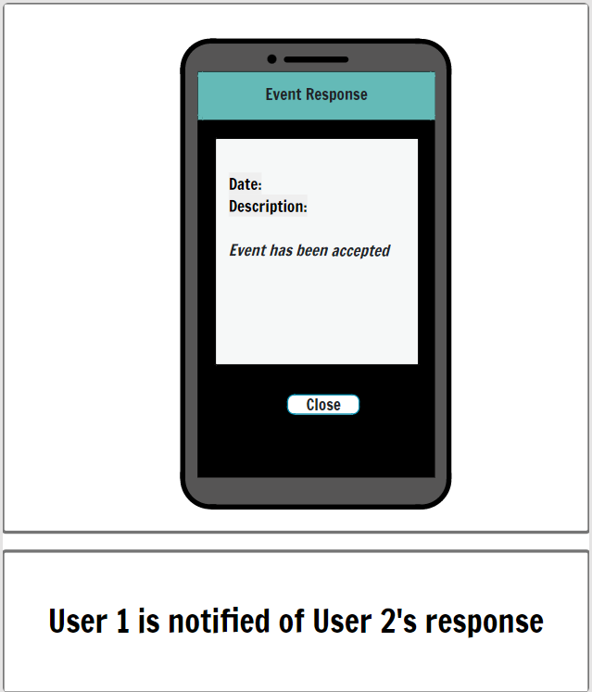
Storyboards

