Slide 1


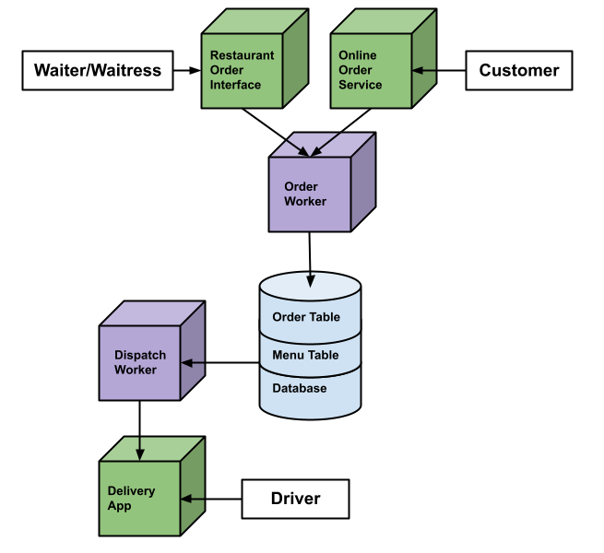
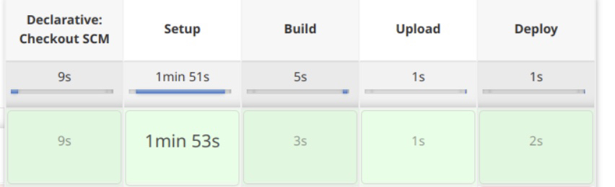
Nassirdine Djibo, Emma Loch, Joseph McDowell, Evan Older, Kieran Petrosky https://github.com/CSC468-project/cloudlab-project
Team Vision
Technical Diagram
Design
Cloud Cooked is a cloud-based restaurant order interface and delivery management service targeted at restaurants who employ their own drivers. The service can accept orders in two ways through an optimized UI for cashiers and a customer facing online website. Additionally, the service provides a means of optimally dispatching drivers based on factors such as order time and geographical location so that delivery routes are as quick and direct as possible.
Frontend components:
Three websites are constructed using Flask and ReactJavaScript; the restaurant order interface, online order service, and the delivery management application.
Backend components:
Two worker components communicate directly with the database. The order worker directs all incoming order information into the database. The dispatch worker pulls order information on delivery orders directly from the database.
Database:
One database server organizes customers, menu, and orders.
CI/CD Application
CI/CD
Utilizing Jenkins, an open-source automation server, Cloud Cooked servers are able to perform seamless in-place upgrades of production applications without downtime.
Notes:
https://github.com/CSC468-project/cloudlab-project

