Slide 1
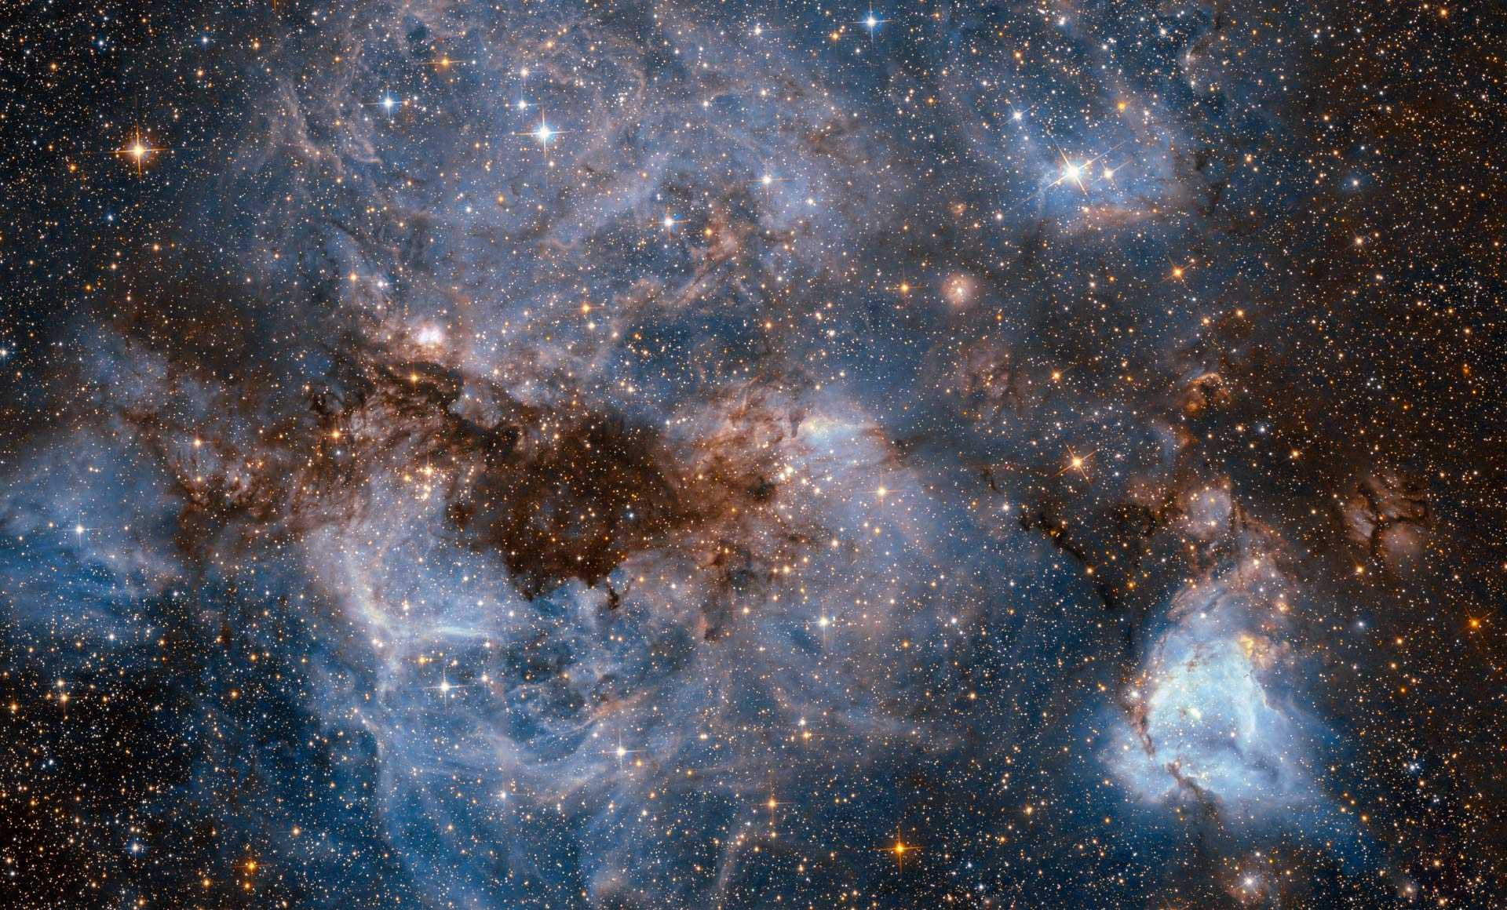
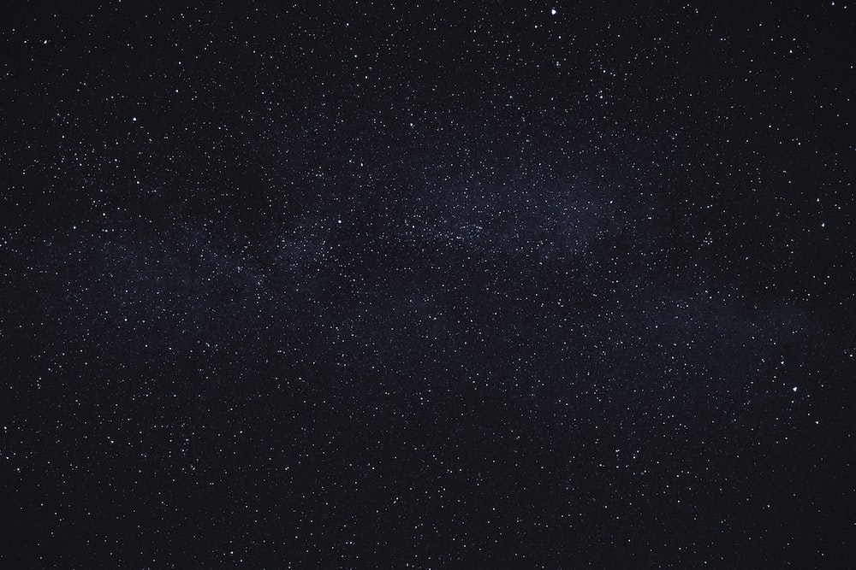
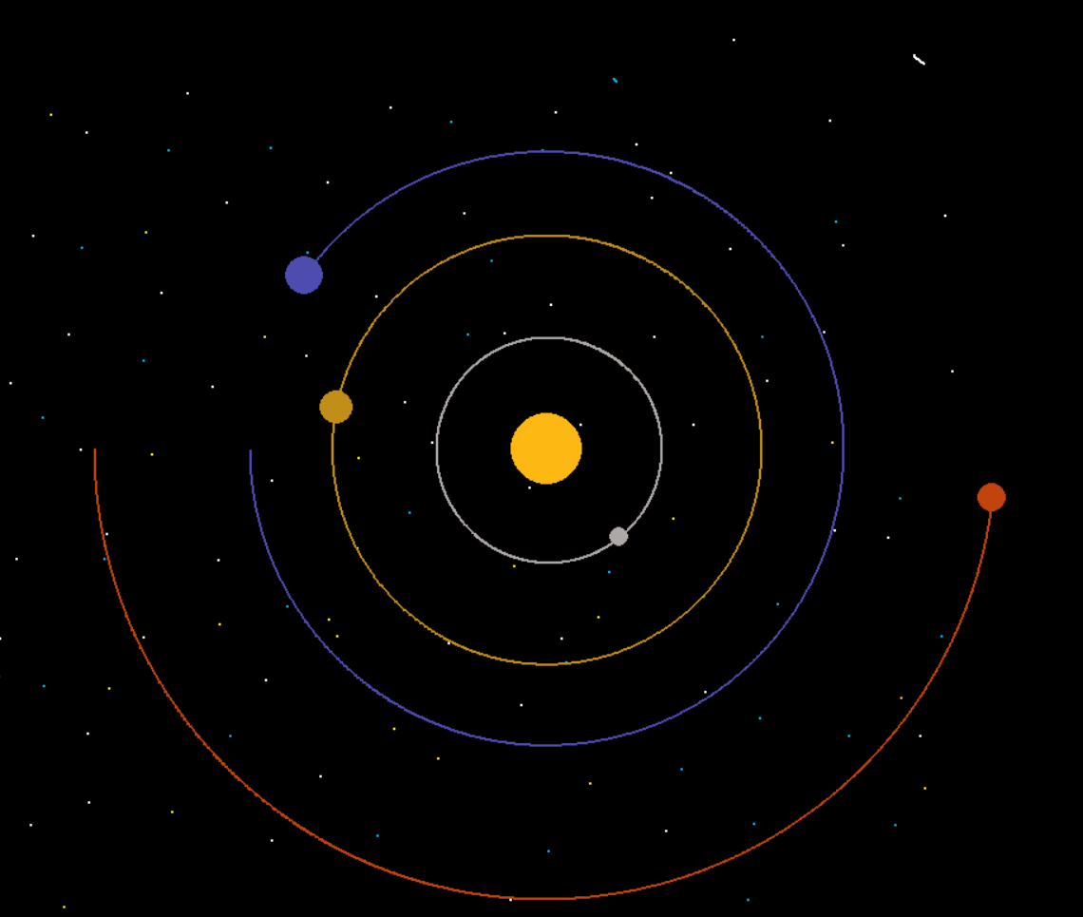

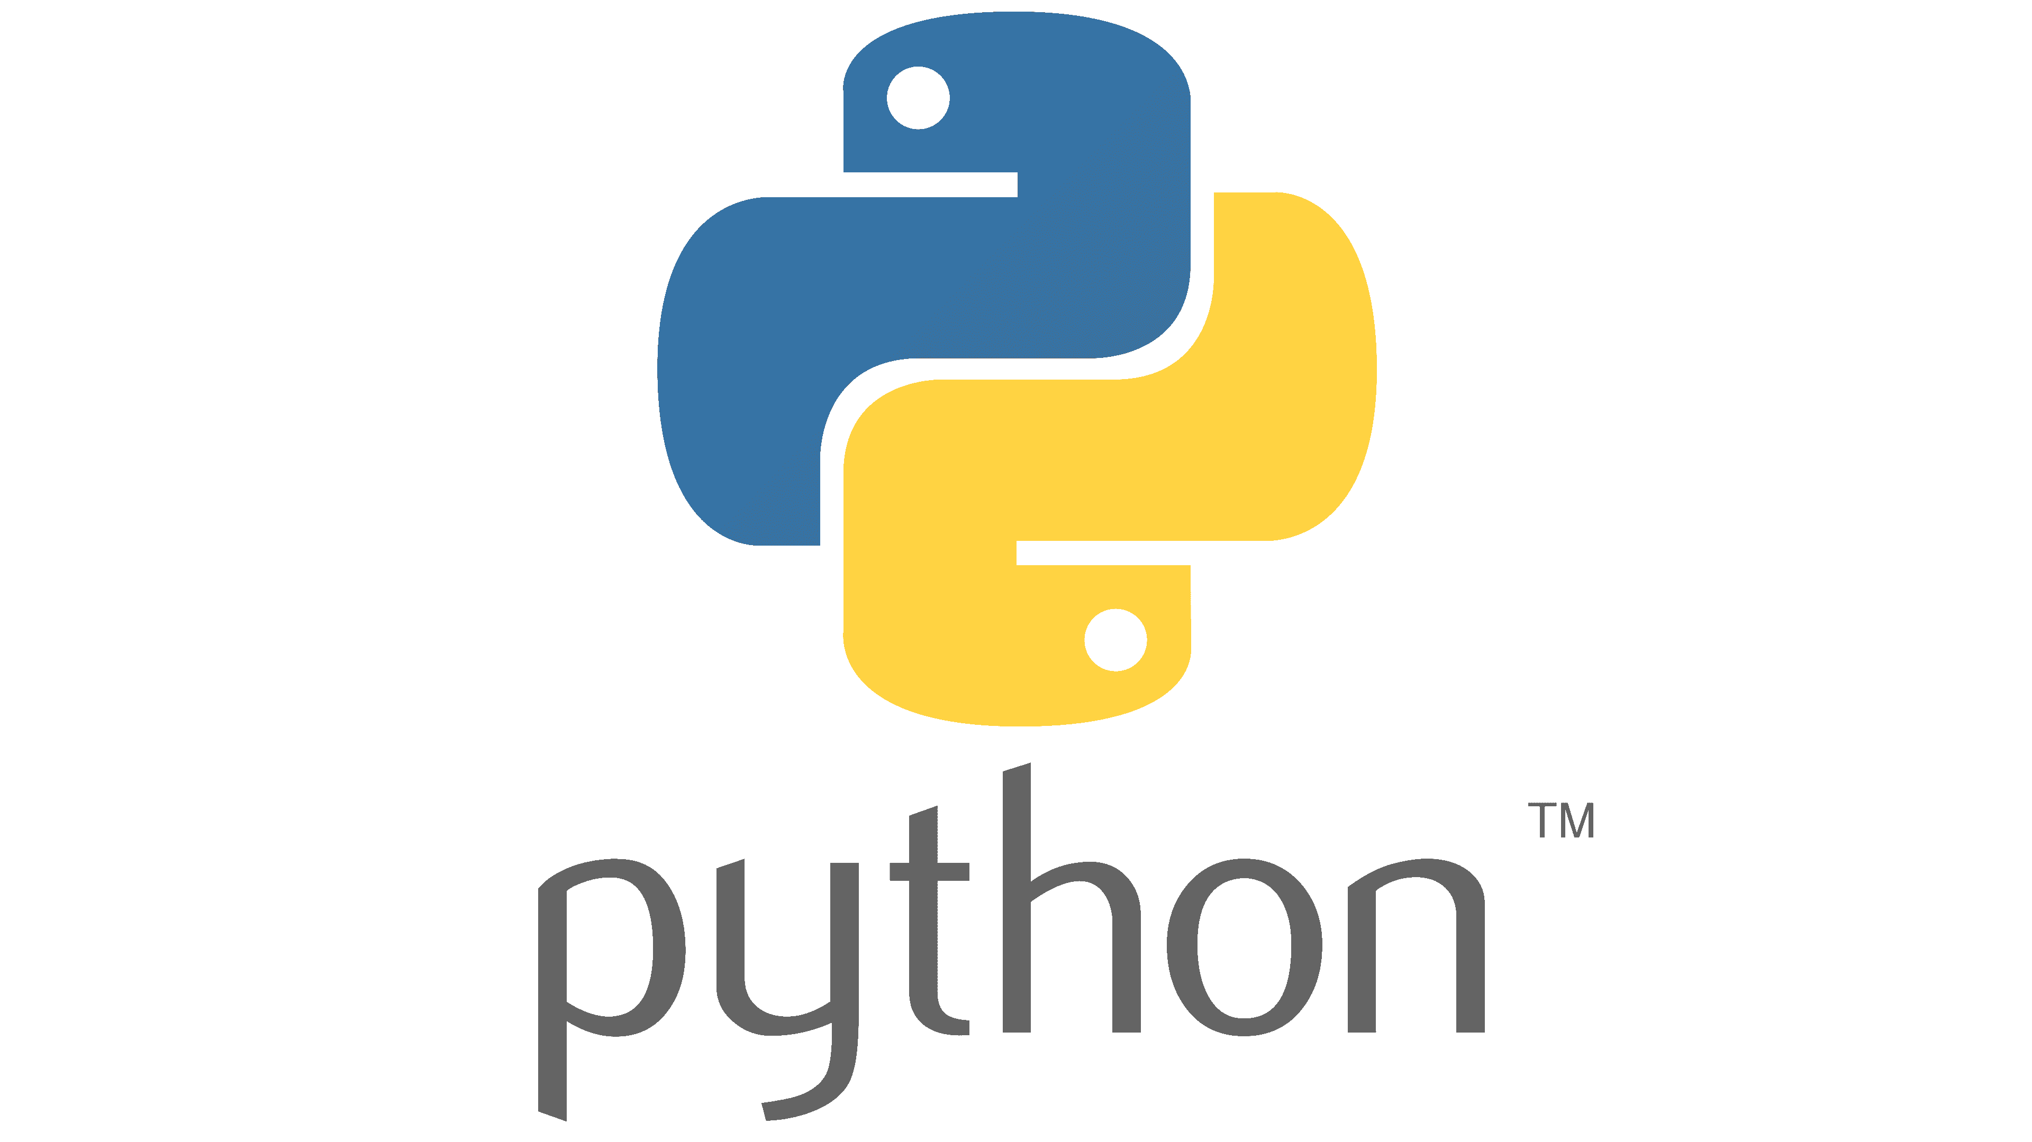
CSC 493: Computer Design Practicum
Space gravity simulation
Capstone project by Hoang Nguyen
Project Abstract:
A simulation of a part of the solar system, which includes real data to demonstrate the orbits of planets.
Methods
The Space Gravity Simulation Project is programmed in Python language, using the Pygame module. The Planets class include real data of the Sun, Mercury, Venus, Earth, and Mars and apply it to the planet orbit formula to realistically make the planets orbit around the Sun.
Most space gravity simulations are too complex, and hard to navigate for children. Therefore, the topics of Astro Physics has been struggling to reach young minds. The Space Gravity Simulation project will include real data and formular while keeping the visual clear, and simple to navigate.
Problem Statement
Acknowledgements
Prof. Deanna Wilborne
Physics with Elliot
Jean Joubert
Clear Code
Computer Science

