Slide 1
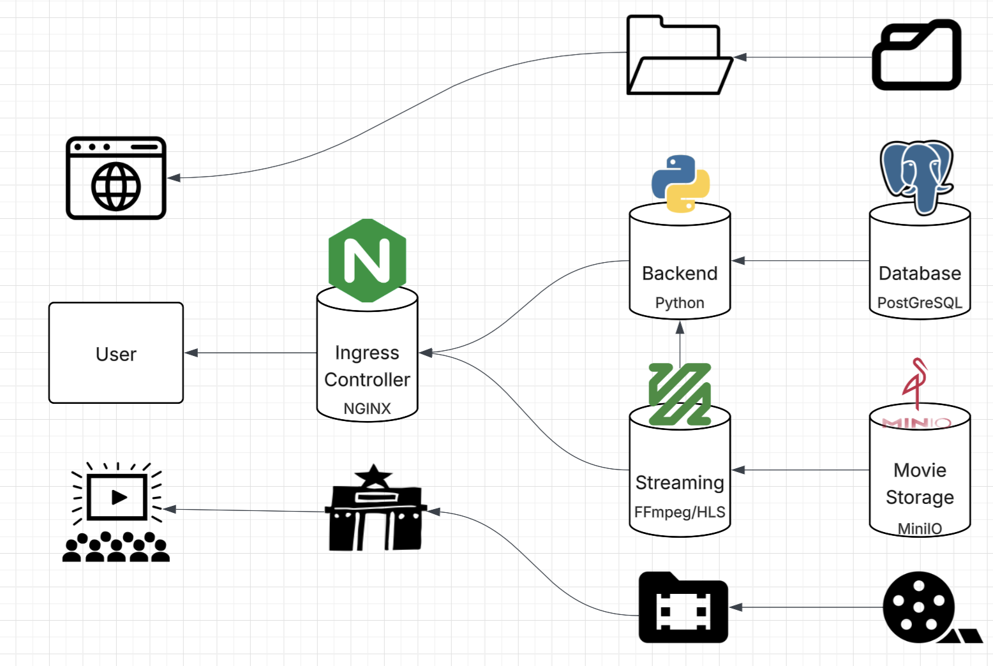
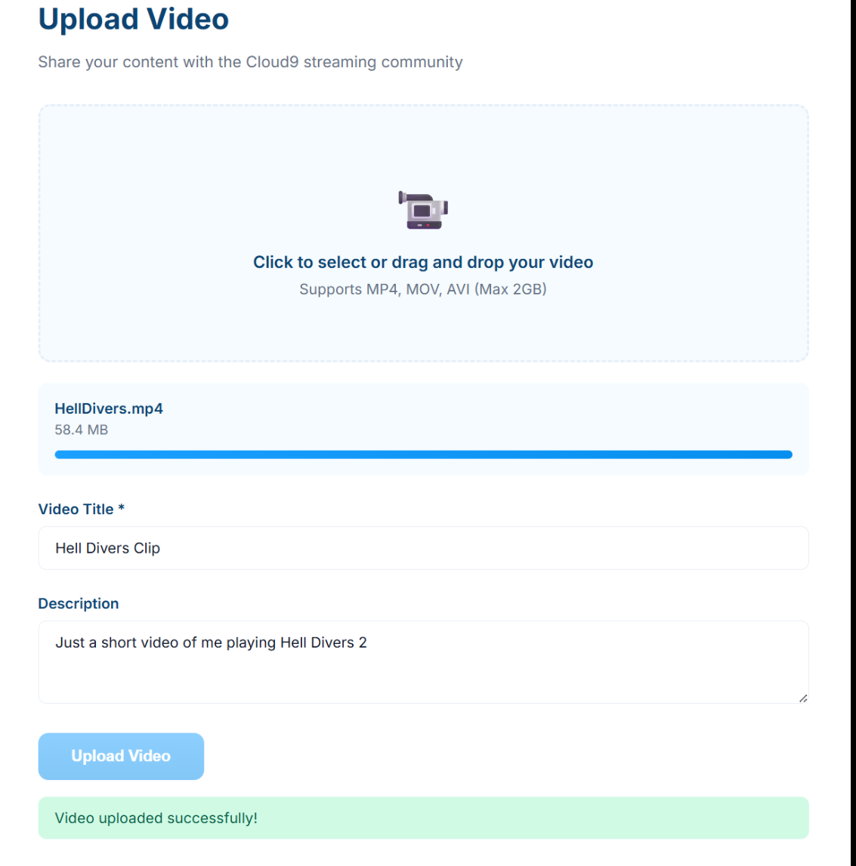
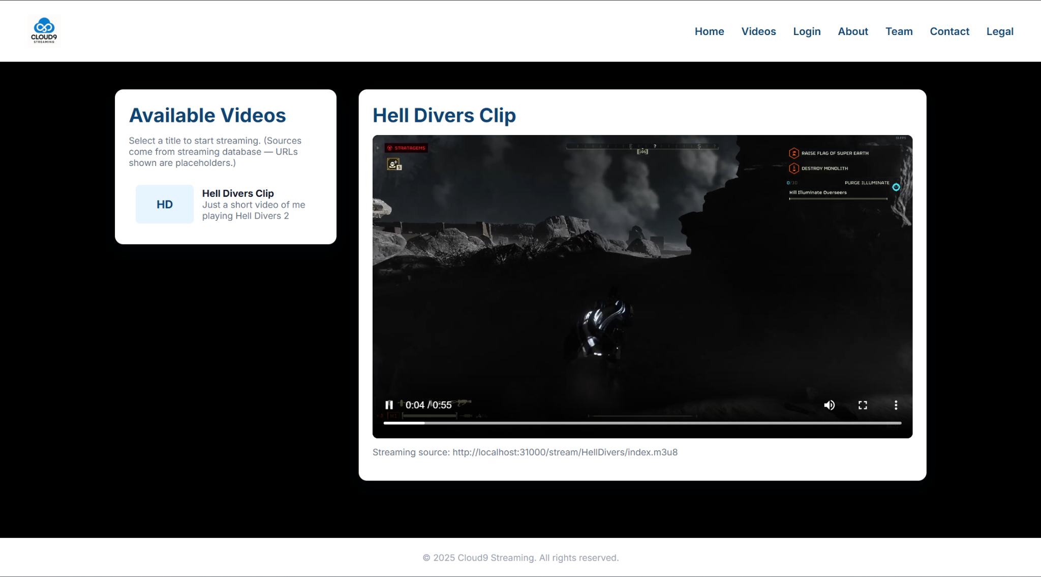
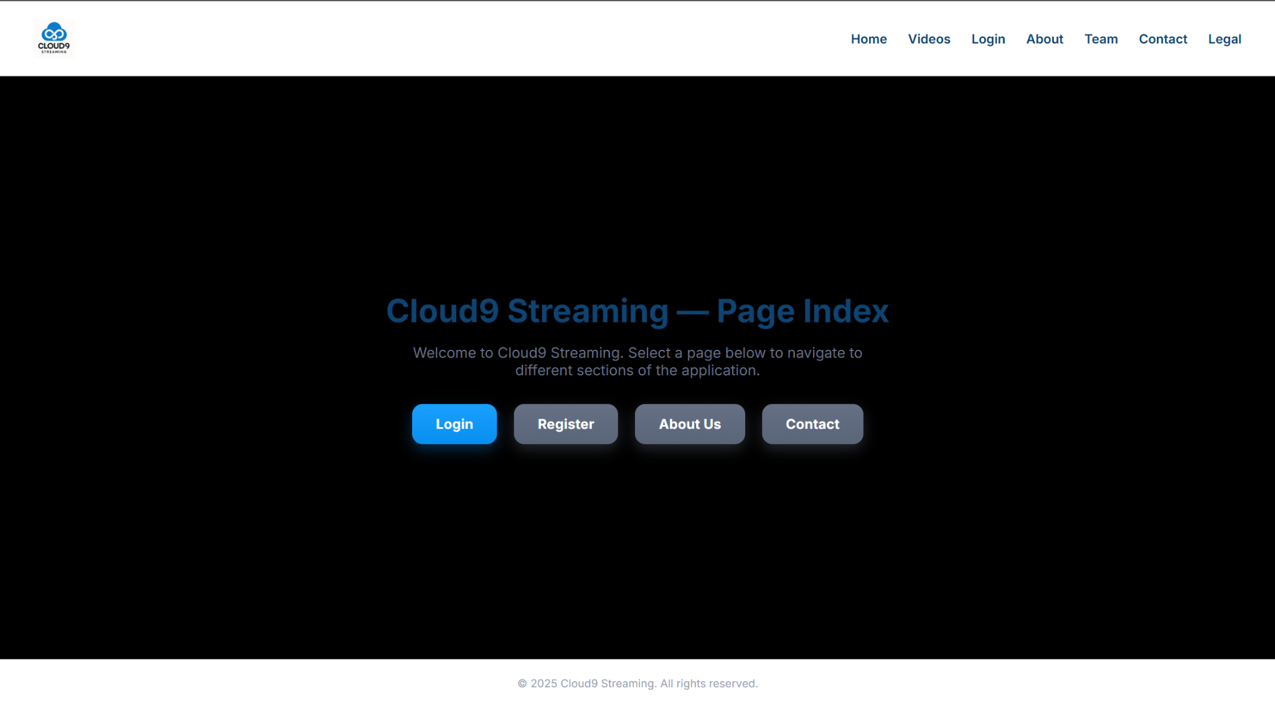
Cloud Nine
Zaki Baker Javon, David Carangan, Jordan Finch, Jack Goehringer, Jeffrey Kjelstrom
https://github.com/CSC495-Cloud-Nine/Cloud-Nine
Project Overview
Cloud Nine is a cloud-native streaming service designed using Kubernetes. The service provides a simple place to stream videos that have been uploaded to the cloud systems. Cloud Nine allows for seamless streaming through browser-support HLS.
Architecture
Ingress (NGINX - LoadBalancer)
Acts as the unified entry point for all user traffic. It routes incoming requests to the backend and streaming services while enforcing clean, secure, and balanced communication.
Backend (Python - ClusterIP)
Handles API logic, user actions, metadata retrieval, and communication with the streaming and database pods. It orchestrates all data communications excluding streaming videos.
Database (PostgreSQL - ClusterIP)
Stores user information and media metadata. PostgreSQL was chosen for its strong relational modeling and reliability.
Streaming (FFmpeg/HLS - ClusterIP)
Responsible for transcoding media files into adaptive HLS streams. It manages the serving of playlist and video files.
Storage (MinIO - ClusterIP)
Object storage for all media files and transcoded chunks. MinIO was chosen for its ability to function with multiple connections and its implementation of the S3 API.
Persistence
Both data storage pods (PostgreSQL and MinIO) have persistent storage, allowing data to carry on between system drops.
Redundancy
Each deployment utilizes 2-3 replicas to allow for redundancy throughout the system (excluding PostgreSQL).

