Slide 1
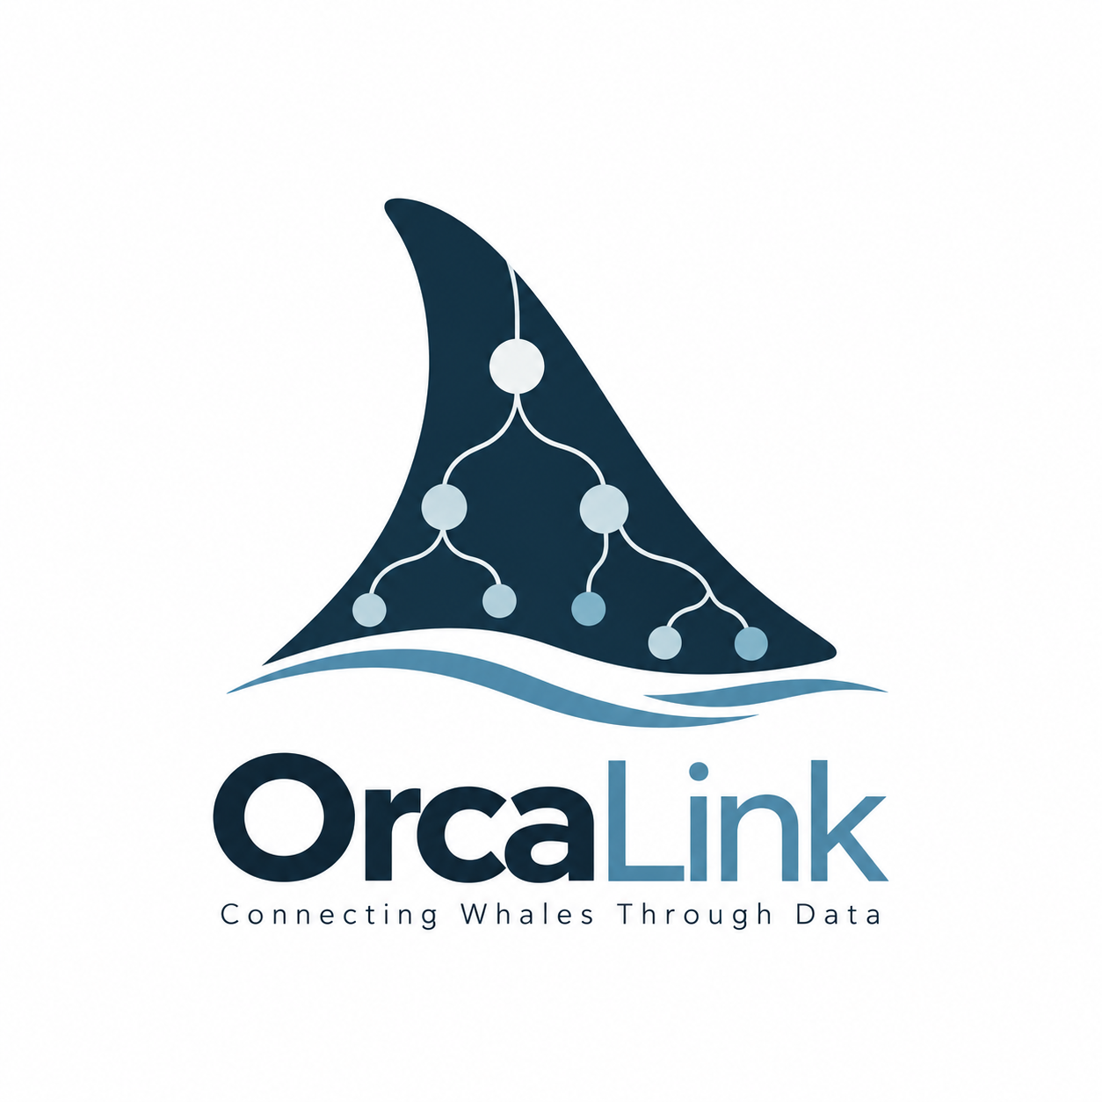
OrcaLink
Modeling Potential Social Ties in Southern Resident Killer Whales
Aung Htut and Bowen Zhang
Connecting family records and sightings while preserving the evidence behind each connection
Existing sources
Proposed model
Why it matters
two whale roles
CWR [1]
Matriline
includes
Whale
Kinship
Assertion
Researchers could query family connections alongside repeated sightings and inspect the supporting evidence.
Individual identity and family
identifies
participants
Dryad [2]
Whale records linked to sightings
Modeling decisions
has
Individual
Observation
Association
Sighting
Kinship and co-sightings stay separate.
Group reports retain identification detail.
Connections keep their sources.
The Whale Museum [3]
Group reports across dates
and locations
has
source
Group
Observation
source
Data Source
The integration gap
evidence
Sources differ in identification detail. Connecting them must retain that distinction.
Planned knowledge graph
Sources also support kinship assertions
Labeled links support queries about family, co-sightings and indirect connections.
Simplified conceptual sketch, draft. Attributes and participation limits omitted.
[1] CWR, Orca Identification. [2] Thompson et al., Dryad (2026), doi:10.5061/dryad.gf1vhhn2f. [3] The Whale Museum, supplied sighting records.
github.com/CSC501-OrcaLink/orcalink
Notes:
Our project, OrcaLink, asks how we can connect records about Southern Resident killer whales to explore their potential social ties. These whales have family relationships, but records of their families and records of sightings describe different things.
Our goal is to bring those records together while keeping the evidence behind each connection clear. This could help researchers examine family relationships alongside repeated sightings, and trace a connection back to the records supporting it.
Whale recording has developed from handwritten logs and film photographs to digital identification and databases. Our review compares sources by what they represent. The Center for Whale Research describes individual identities and family groups. The Dryad dataset links whale records to sightings. The Whale Museum records reported groups, dates, and locations.
Each source is useful, but their level of detail differs. A group report might name a pod without identifying every whale. Some individual identifiers in the Dryad data come from group reports. So an identifier alone does not always mean someone individually confirmed that whale.
There is another distinction: two whales recorded together are not necessarily close social partners. Our modeling challenge is to connect family and sighting records without losing these differences or overstating what the evidence shows.
In the diagram, whales connect to their maternal family groups, called matrilines. Kinship assertions record relationships between whales. Sightings connect to individual observations and group observations separately. This lets us keep a report even when the individual whales are unknown.
Associations represent recorded co-sightings or potential connections. Their type, method, and time window help distinguish the results. Source information preserves where the observations and relationship evidence came from.
We plan to develop this conceptual model into a relational database, then a knowledge graph. The graph will represent whales and records as connected nodes with labeled relationships. We aim to query family connections, repeated co-sightings, and indirect connections while checking their supporting evidence.
OrcaLink is still a proposed model. A potential connection would be a candidate for further investigation, not proof of friendship. The aim is to make the records easier to connect and the meaning of each connection easier to examine.

