Slide 1
Efficiently Democratizing Medical LLMs for 50 Languages via a Mixture of Language Family Experts 2024.11.29
Xidong Wang
School of Data Science
Chinese University of Hong Kong, Shenzhen
Notes:
Hello, everyone, My name is Wang xidong, the second year phd of Prof.WANG. Today, I am honored to give you guys a presentation about our recent study on multilingual and Medical LLM, here we go.

Slide 2
Outline
Introduction (10 min)
A preliminary scaling to 12 languages (5 min)
Scaling with MoE and its routing analysis (25 min)
A language-specific hybrid routing
Interpretable routing analysis: information flow circuit
Post-MoE variant inspired by the ‘Spread Out in the End’ Phenomenon
Further Scaling to 50 Languages (15 min)
Mixture of language family experts
Results and Ablation Study
Q&A (5 min)
Notes:
Today's presentation will be devided into 4 parts, first I will briefly introduce the background to emphsis the importance and fill the context for this presentaion, and then I’ll show the preliminary scaling to 12 languages to help get the first-hand feeling about the task. Then i will introduce our exploration of multilingual machenism, covering the new analysis tool, new phenomenon, and the new MoE variant inspired by this. Finally, I will how we efficiently scale the method to more languages and larger models and the main results and ablation study of it.

Slide 3
Outline
Introduction (10 min)
A preliminary scaling to 12 languages (5 min)
Scaling with MoE and its routing analysis (25 min)
A language-specific hybrid routing
Interpretable routing analysis: information flow circuit
Post-MoE variant inspired by the ‘Spread Out in the End’ Phenomenon
Further Scaling to 50 Languages (15 min)
Mixture of language family experts
Results and Ablation Study
Q&A (5 min)
Notes:
Let’s begin with filling the context of today’s topic.

Slide 4

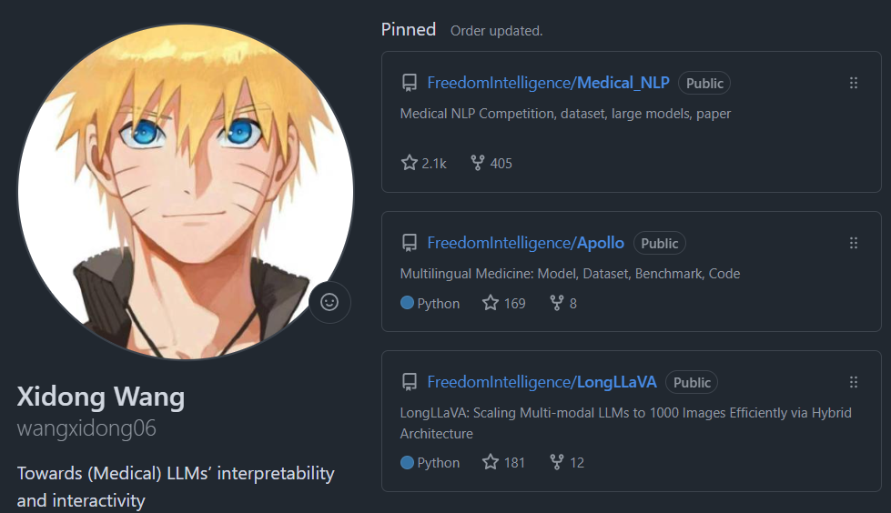
Self Background Introduction
A Second-Year LLM-Traing Guy~
Focus on (Medical) LLM’s Interactivity
CMB, Apollo, LongLLaVA, ApolloMoE ...
https://github.com/wangxidong06
Notes:
before the presentation, let me briefly introduce my self, I’m a second-year LLm-Training guy, I mainly focus on Medical LLM’s and LLMs’Interactivity, And I did train a lot of models that get popular and gain some impact within the community, both in code repo star and citations.

Slide 5


Why Multilingual Medical is so important?
Serve the community with more warmth
Notes:
First, communicating with patients in a language that is consistent with local culture can lead to smoother conversations with patients, and patients are more likely to experience better services and listen to advice. In addition, if we consider some extreme cases, such as death notifications, cancer notifications, and depression treatment, using the local language can comfort patients and the meaning of the expression can be more euphemistic or profound.

Slide 6
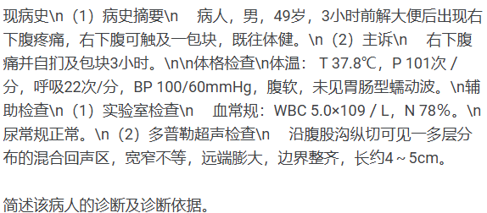

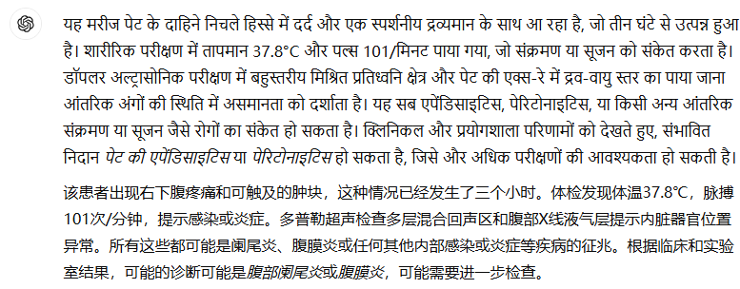
What is the current capability of large models?
English
Hindi
Notes:
Since multilingual healthcare is so important, what can the existing big models do? Let's take a look at an example.
This is an example of a complex patient described in Chinese.
When I translated the question into English and asked chatgpt, I saw that the answer was clear and detailed.
When I translated the question into Hindi, I saw that the answer was very rough and the words did not express the meaning and did not solve the problem.
In theory, we say that the LLM knows how to answer questions, and also how to translate between Hindi and English, that is, the knowledge is complete in this case. But even so, the big model's answer in multiple languages ​​is still not satisfactory.
Not to mention, it is necessary to combine local living habits, cultural customs, applicable drugs, and accessible drugs for local adaptive diagnosis and treatment.

Slide 7


Why open source medical models are needed ?
Privacy Considerations
Community Accessibility
Notes:
Having said the current progress of LLM's capabilities, I would like to talk more about the importance of open source medical models.
As well known, medical information is extremely sensitive. In the foreseeable future, no hospital in any country or region will agree to directly query the LLMs through the Internet for patient information. This reflects the importance of open source medical models. Hospitals can completely deploy services locally to eliminate the risk of patient privacy leakage.
There is another angle that people rarely consider, that is, not all countries and regions have Internet access as widely as China. They may still need to obtain information through radios, let alone obtain online AI services. However, open source medical models can be deployed on devices with the same price and hardware level as radios to provide medical services to local people. In this case, it is better have something than never.

Slide 8
Outline
Introduction (10 min)
A preliminary scaling to 12 languages (5 min)
Scaling with MoE and its routing analysis (25 min)
A language-specific hybrid routing
Interpretable routing analysis: information flow circuit
Post-MoE variant inspired by the ‘Spread Out in the End’ Phenomenon
Further Scaling to 50 Languages (15 min)
Mixture of language family experts
Results and Ablation Study
Q&A (5 min)
Notes:
After understanding the relevant background and motivation, let's use data and experimental results to get a first-hand sense of the development of the field and make our subsequent methods reasonable.

Slide 9
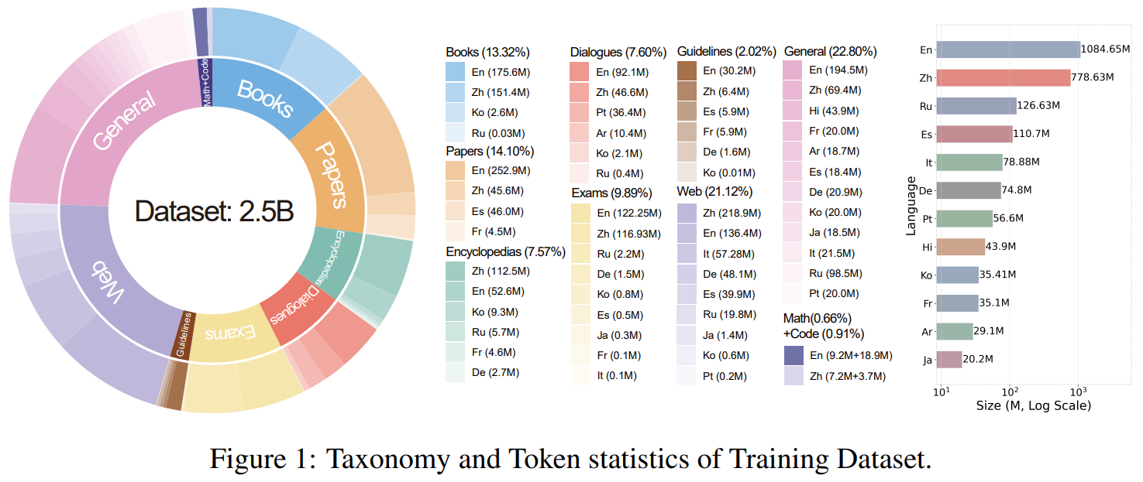
Always Start with Data ! ! !
In order to adapt to more rare languages, the difficulty of data collection has increased sharply.
Notes:
As we said, data is the foundation and premise of all delicious ideas. A dirty, uncleaned data set can make a wonderful idea dim and shatter your confidence at the beginning. So only data that matters maybe make sense at the start of a project.
The logic of collecting data in this article is to completely replicate the information sources of doctors during their growth. Through communication with doctors and medical students, we summarized 10 their information sources as shown in the picture, and used this as a catalog and entry point for collecting data, and carried out heavy data collection and cleaning work. Finally, the statistical distribution of data by language is shown in the right part of figure. It can be seen that even among the 12 languages, the distribution of data volume is extremely reduced, which also reminds us that in order to adapt to more rare languages, the difficulty of data collection has increased sharply.

Slide 10
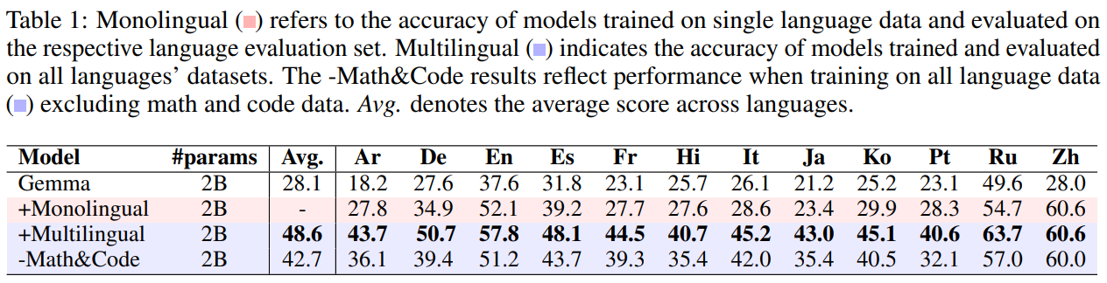
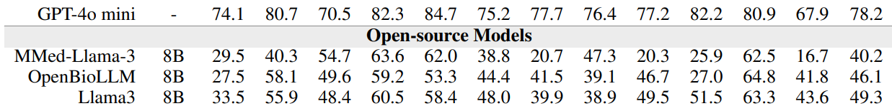
Preliminary results
Multilingual Training Helps! Math & Code data Helps! Existing Model sucks!
Notes:
We used the collected data to train a small model to verify the data quality and performance improvement.
The second row in the table shows the results of our evaluation after training with the data of each language separately. It can be seen that the performance has improved, which further verifies our data quality.
The third row is trained with data from all languages. It can be seen that compared with individual training, the performance of joint training continues to improve, which verifies the effectiveness of multi-language training and further motivates our article method.
The fourth row is to explore the impact of code and mathematical data on model performance. It can be seen that after not using this part of the data, the model performance will decline, highlighting the necessity of this part of the data.
We also tested some closed-source and open-source models. The results show that there is still a lot of room for improvement in the performance of open-source models

Slide 11
Outline
Introduction (10 min)
A preliminary scaling to 12 languages (5 min)
Scaling with MoE and its routing analysis (25 min)
A language-specific hybrid routing
Interpretable routing analysis: information flow circuit
Post-MoE variant inspired by the ‘Spread Out in the End’ Phenomenon
Further Scaling to 50 Languages (15 min)
Mixture of language family experts
Results and Ablation Study
Q&A (5 min)
Notes:
Getting here basically means that we have built a solid and low-limit stage for our work (i.e., innovation of methods),
and at the same time we have gained some first-hand experience, such as the performance of existing open source models is not as good as boasted, and the difficulty of collecting data in other rare languages.
So on this basis, considering the previous case, since we have relatively complete medical knowledge of minor languages saved in major language, can we generalize medical languages ​​by generalizing between languages?
If this can be done, then there is no need for collecting a lot of minor language data.
Starting from this point, we conducted research on multilingual generalization.

Slide 12
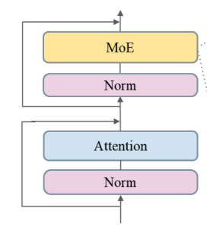
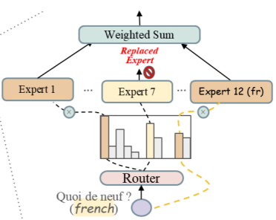
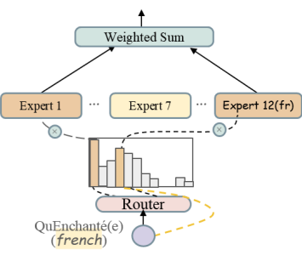
A language-specific hybrid routing
Mechanism -> Iinterpretability and Generalization -> MoE Modularity
Notes:
Because we want to study the generalization and interpretability of language,
we need to know which part of the model parameters are related to which language.
Only in this way can we easily study the relationship between different languages.
We use the word modularity to describe this relationship.
The MoE architecture is very compatible with modularity. Here is a brief explanation of what MoE is.
As described in the picture, we all know that a transformer block can be abstracted as the architecture on the left, which consists of attention MLP and norm modules.
Generally, a module has only one MLP, while the module of the MOE architecture has many MLPs,
and a routing weight (actually also a small MLP) is used to select several MLPs with larger weights based on the token input (usually called activation).
As shown in the figure, for the training data of a specific language such as French, in addition to the MLP activation with high weight, we let it specify the route to a certain MLP. In this way, from the perspective of the training of the MLP, it has trained all the data about the language.
Some students may ask, why do we still keep the MLP activation with high weight, why not just activate the specified MLP, we thought so at first, but unfortunately, it doesn’t end well .
One possible explanation is that the reason why MoE works is because of its robustness. That is, from the perspective of knowledge storage, the same knowledge is stored in different MLPs, and all eggs are not put in one basket.
From the perspective of MLP, MLP not only learns the knowledge we ask it to learn, but also learns the knowledge of other experts to improve its own performance and learn by analogy.
as shown in the results in the table (Lang spec. row), the model performance is seriously impaired under this method.
One possible explanation is that the reason why MoE works is because of its robustness. That is, from the perspective of knowledge storage, the same knowledge is stored in different MLPs, and all eggs are not put in one basket. From the perspective of MLP, MLP not only learns the knowledge we ask it to learn, but also learns the knowledge of other experts to improve its own performance and learn by analogy.

Slide 13
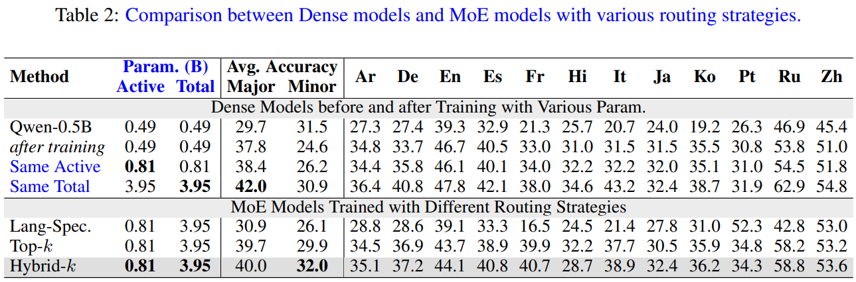
A language-specific hybrid routing
Mechanism -> Iinterpretability and Generalization -> MoE Modularity
Notes:
as shown in the results in the table (Lang spec. row), the model performance is seriously impaired under this method.
(上一页)One possible explanation is that the reason why MoE works is because of its robustness. That is, from the perspective of knowledge storage, the same knowledge is stored in different MLPs, and all eggs are not put in one basket.
From the perspective of MLP, MLP not only learns the knowledge we ask it to learn, but also learns the knowledge of other experts to improve its own performance and learn by analogy.
So, in the end, as we can see in the table, after our small changes, our method (hybrid routing) balances performance while maintaining interpretability, and even shows good generalization. To be honest, the generalization here is indeed reasonable but unexpected, which is a bonus.
At this point, we have prepared the tools to study multilingual mechanisms without compromising model performance, and the formal exploration begins now.

Slide 14
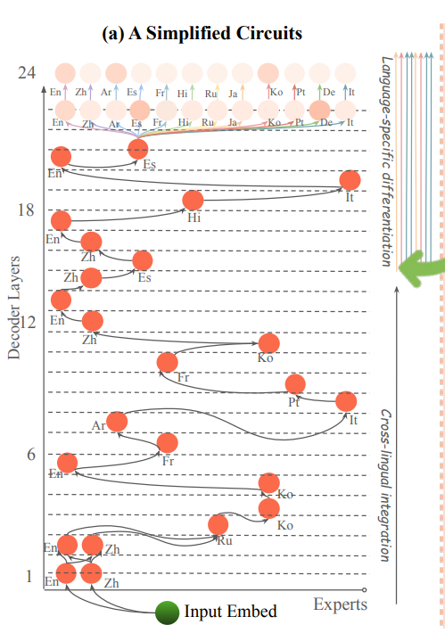
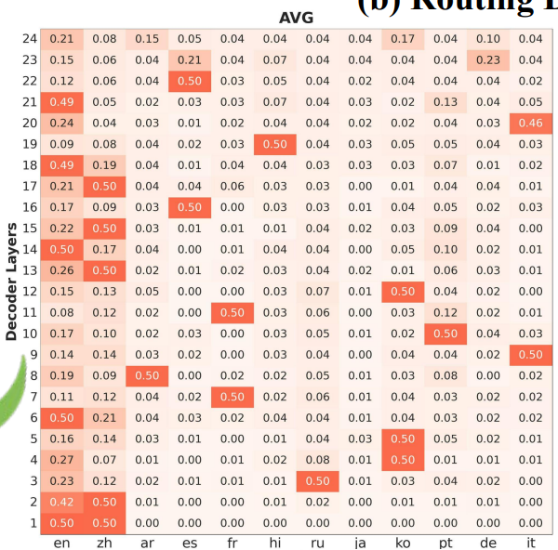
Interpretable routing analysis
Maybe only the last 2 need to be MOE!
Notes:
Specifically, we conducted a statistical analysis of MoE's routing strategy and counted the distribution of model routing on data of 5,000 tokens sampled from 12 language grids.
As shown in the figure on the right, the horizontal axis of the picture represents different language experts, and the vertical axis represents the number of model layers.
The figure on the left is an abstract summary of the routing paradigm shown in the figure on the right.
We can see from the routing analysis that except for the last two layers, the routing experts in the remaining layers are relatively concentrated, and only the last two layers are decentralized.
This tells us that only the last two layers need MoE modularization, while the previous layers actually only need ordinary transformer blocks.

Slide 15
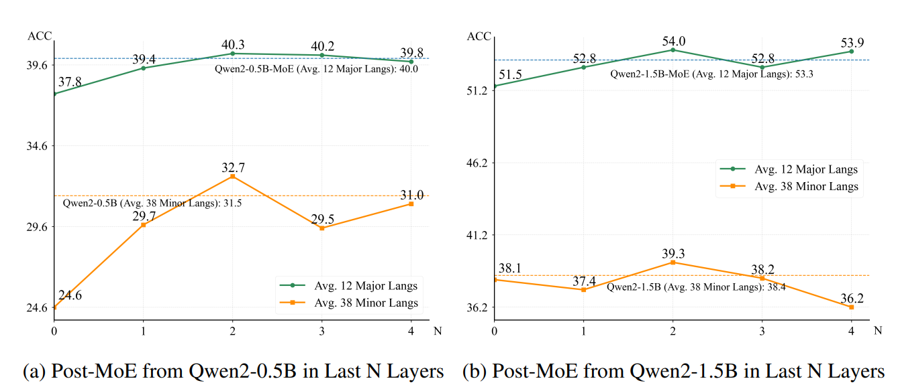
Post-MoE variant inspired by the ‘Spread Out in the End’ Phenomenon
Yes! Only the last 2 need to be MOE!
An architecture (Post-MoE) and training method (Hybrid) that is both efficient, generalizable, and interpretable.
Notes:
To verify this hypothesis, we conducted the following experiment. We MoE the last 1, 2, 3, and 4 layers respectively and compared their performance.
We found that in terms of performance and generalization, the model reached the peak when only the last two layers were MoE, and even exceeded the modularization of all layers.
So we got an architecture (Post-MoE) and training method (Hybrid) that is both efficient, generalizable, and interpretable.

Slide 16
Outline
Introduction (10 min)
A preliminary scaling to 12 languages (5 min)
Scaling with MoE and its routing analysis (25 min)
A language-specific hybrid routing
Interpretable routing analysis: information flow circuit
Post-MoE variant inspired by the ‘Spread Out in the End’ Phenomenon
Further Scaling to 50 Languages (15 min)
Mixture of language family experts
Results and Ablation Study
Q&A (5 min)
Notes:
At this point, we are about to start achieving our goal, a medical LLM who can speak many, many languages

Slide 17
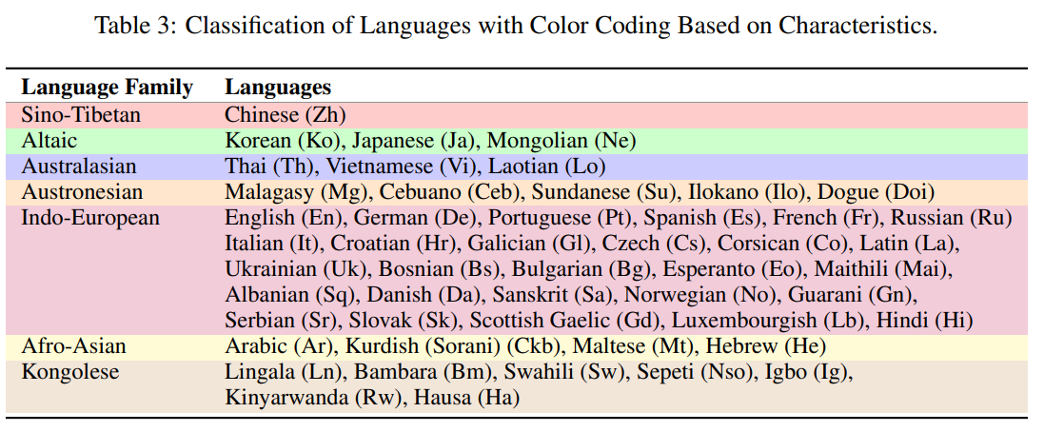
Mixture of language family experts
An architecture (Post-MoE) and training method (Hybrid) that is both efficient, generalizable, and interpretable.
50 Language !!! Huge Parameter !!! Still not efficient enough !!!
Notes:
Earlier, we obtained the architecture (Post-MoE) and training method (Hybrid) method. Although it is very efficient, we also found that if we use this method directly for 50 languages, we need 50 experts, which is obviously a huge cost.
A very intuitive idea is to merge experts. So how to merge? We merged the language families according to the linguistic priors, and finally obtained a Post-MoE model that only requires 7 experts

Slide 18
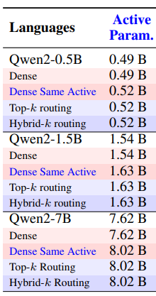
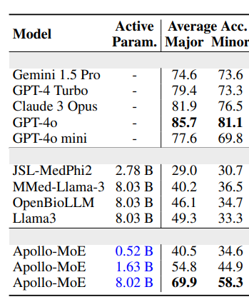
Results and Ablation Study
IT WORK !!! With Scalability !!!
Notes:
Finally, we compared our method with existing models, and the results were much better than the open source model and close to the closed source model.
At the same time, we also verified the effectiveness of our method on various model scales, and finally convinced that it is a beneficial contribution to the community.

Slide 19
Outline
Introduction (10 min)
A preliminary scaling to 12 languages (5 min)
Scaling with MoE and its routing analysis (25 min)
A language-specific hybrid routing
Interpretable routing analysis: information flow circuit
Post-MoE variant inspired by the ‘Spread Out in the End’ Phenomenon
Further Scaling to 50 Languages (15 min)
Mixture of language family experts
Results and Ablation Study
Q&A (5 min)
Notes:
That’s

