Slide 1
Cell Type Annotation of Single-Cell Data
David G. Smith, PhD

Slide 2
Premise of cell type identification
Model expression variance
  PCA
  Autoencoders
Find neighbors
  CCA/RPCA, scArches, Symphony, so many more…
  Manually annotate clusters
Domain expertise

Slide 3
Overview
The easy way
  Finding a reference
  Label transfer
The hard way
  Domain knowledge, clustering, marker genes
Validation
  Visualize (physical space or UMAP/tSNE)
  Benchmarking
  Synthesize

Slide 4
Finding a reference
While not necessary, the best reference should match:
  Species
  Chemistry
  Technology
Use a reference portal (e.g. Azimuth)
Use an independent dataset (e.g. GEO)
  The ideal reference is one where an author has already annotated and published a dataset generated with your exact experiment design
  BEWARE: Most datasets on GEO do not have the annotations or just link to the raw data. Annotations may be included as a supplemental table in the publication.
Easy way Hard way Validation

Slide 5
Reference Atlas Resources
Azimuth, https://azimuth.hubmapconsortium.org/references/
CZI, https://cellxgene.cziscience.com/datasets
Human Cell Atlas, https://data.humancellatlas.org/
HuBMAP, https://portal.hubmapconsortium.org/
GTEx, https://gtexportal.org/home/singleCellOverviewPage
DISCO, https://www.immunesinglecell.com/
Allen institute, https://brain-map.org/atlases
Panglao, https://panglaodb.se/index.html
Easy way Hard way Validation

Slide 6
Common (solvable) problems with reference data
Different gene identities
  Conversion
    [R] org.Hs.eg.db, databases available for most species
    Alternate IDs are often included in feature metadata
  Ensembl/Entrez > Symbol
    Collapse expression to symbol
Processing pipeline
  Some transfer algos require count data. Some references don’t have raw count data
  Normalization (which affects subsequent scaling and PCA) may differ. You may need to redo processing of reference and/or query
Too many cells
  100k is usually sufficient
Conversion between datatypes
  Published tools exist, but they’re not great. Don’t be afraid to reconstruct yourself
Easy way Hard way Validation

Slide 7
My favorite transfer algorithms
PCA-based
  [R] Seurat RPCA
  [R] Seurat CCA (slower than RPCA)
  [R] Harmony/Symphony (now included in Seurat v5)
VAE
  [Python] scVI/scANVI
  [Python] scPoli
Cross-technology
  [Python] MaxFuse
Easy way Hard way Validation

Slide 8
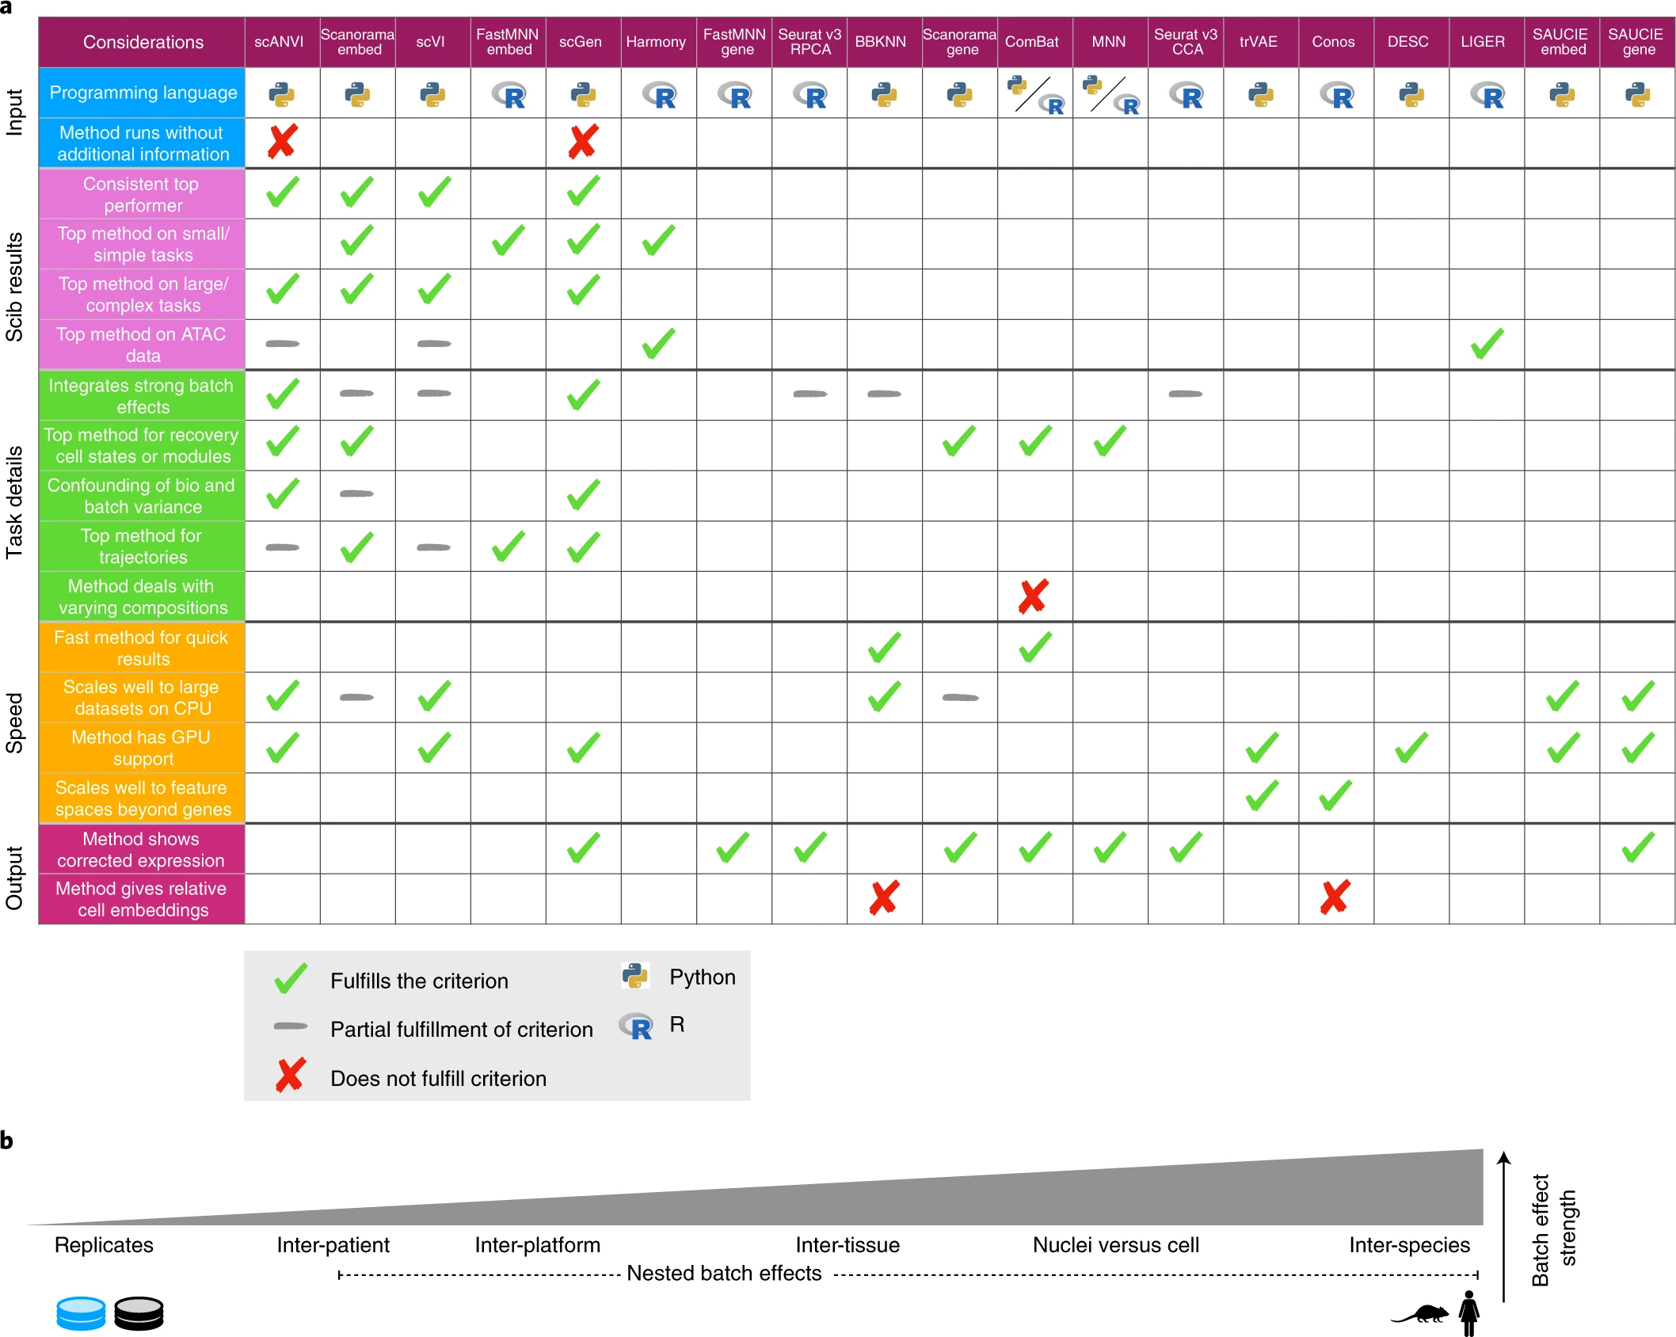
Benchmarking atlas-level data integration in single-cell genomics
https://doi.org/10.1038/s41592-021-01336-8
Easy way Hard way Validation

Slide 9
Considerations for transfer algorithms
Exclude rare cell types (<1% abundance)
  You can find these later
If reference is composed of multiple samples, exclude cell labels only found in 1-2 samples
  This is mostly important for PCA-based algos
What highly variable features are you using?
  If reference HVG have little overlap with query HVG, then it’s probably a bad reference. If you want to continue, reprocess using a union of features.
Trade off between biological vs. technical variation
Bias towards one prediction can be an indication of problematic features in the query. Consider filters on query data.
Easy way Hard way Validation

Slide 10
Validate!
Even if you have the perfect reference, there will be mistakes
Are cell label proportions sensible?
Within predictions, do you find the expected marker genes for your system?
Do any of your experiment variables seem to adversely affect label transfer?
  Most transfer algos include a confidence score
Easy way Hard way Validation

Slide 11
Manual annotation (the hard way)
If you’re not confident in the “Easy way” results…
You couldn’t find an appropriate reference…
Too many error messages…
You know best…Domain knowledge is the gold standard for cell type annotation
  The hard way is the best way
Easy way Hard way Validation

Slide 12
A recent example
10X Visium HD
Lymph node and breast tissue, 33 samples
~7m cells
Mean UMI/cell range: 10-300
Thank you Dr. Jenny Zhang!
Easy way Hard way Validation

Slide 13
Easy Way: Sketching (Seurat)
Convenient computational strategy when # cells >> 100k
Like subsampling, but subset has a path back to full set to predict labels
Used an online reference from cellxgene:
  “Single cell atlas of large B-cell lymphoma” (includes healthy lymph nodes too)
Sketched 100k+ cells > 50k
Used Seurat RPCA, mostly default options
Easy way Hard way Validation

Slide 14
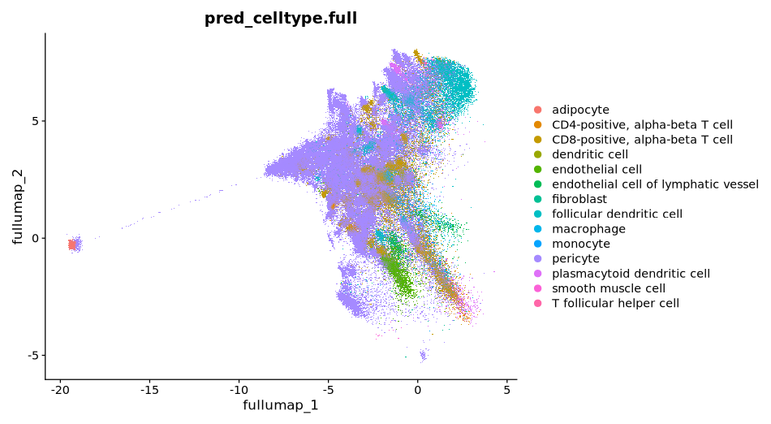
Easy way: Seurat label transfer (single sample)
Easy way Hard way Validation

Slide 15
Making a custom reference
Manually annotate representative samples
  1 good QC
  1 bad QC
  1 experiment variable (male)
Unsupervised approach
  Iteratively, cluster > find markers > test enrichment
Supervised approach
  Score gene modules against cells > threshold
Integrate reference samples
Easy way Hard way Validation

Slide 16
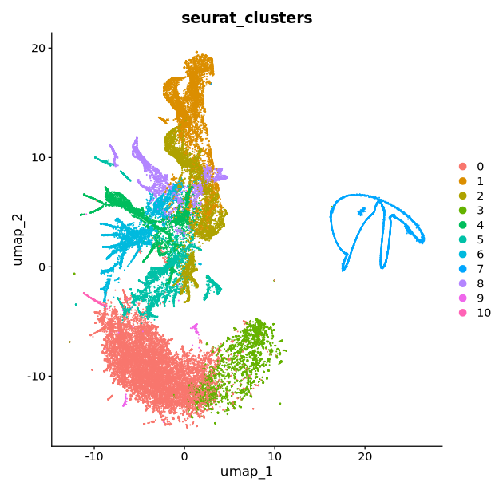
Starting from scratch: sample 1
Start from unsupervised clusters—theoretically, these represent distinct cell phenotypes
Tinker, tinker, tinker…
  PCA
    Exclude “erroneous” genes from PCA
    Adjust the number of variable features (in this case, lower)
    Include relevant covariates in the scaling step (e.g. cell cycle)
  Clustering
    Adjust the number PCs
    Adjust the number of neighbors
    Adjust the resolution
    Try different algos (e.g. Leiden)
  UMAP
    This is a convenience for visualization, don’t stress about parameter optimization unless you just want a pretty picture
Easy way Hard way Validation

Slide 17
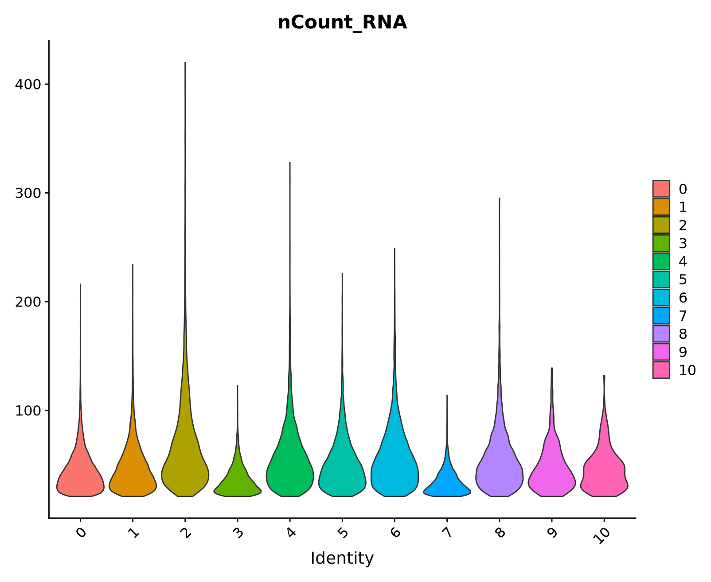
Cleaning

Slide 18
Supervised cell assignment: gene modules
If you know what cell types should be in the data, and you know what markers those cells express—then quantify it. An effective, rational method for identifying cell clusters.
Some informatic options:
  [R] AUCell
  [R] Seurat::AddModuleScore
  [Python] scimap.tl.phenotype_cells
  Expression mean…or write your own rules
    If you’re taking the manual route, then you probably already have some rationale to go against the grain
Easy way Hard way Validation

Slide 19
Think cellular biology
Construct a lineage:
TIER 3
Epithelial
TIER 2
Lymphatic
Vascular
Epithelial
Reticular
TIER 1
FDC
Endothelial
Stromal lineage
Neutrophil
Fibroblast
M1
M2
Granulocyte
CDC1
Macrophage
CDC2
Myeloid lineage
Dendritic Cell
CD4 Effector
CD4 Naive
T lineage
CD8 Cytotoxic
Lymphoid lineage
CD8 Naive
B lineage
Plasma
B activated
Easy way Hard way Validation

Slide 20
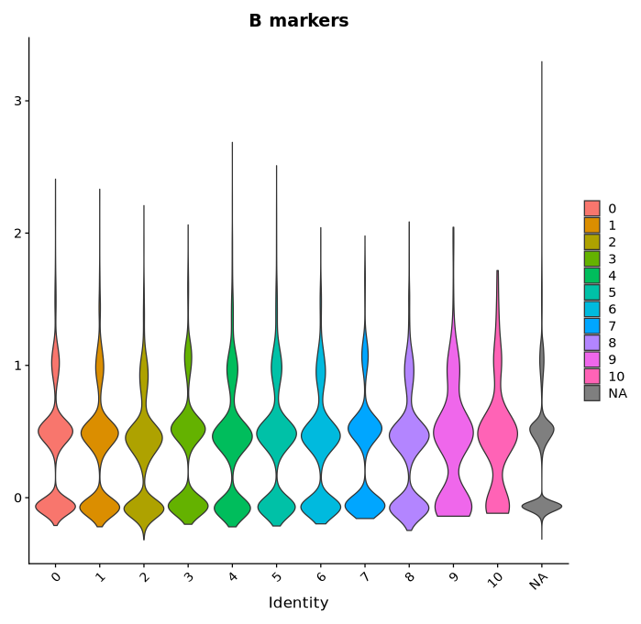
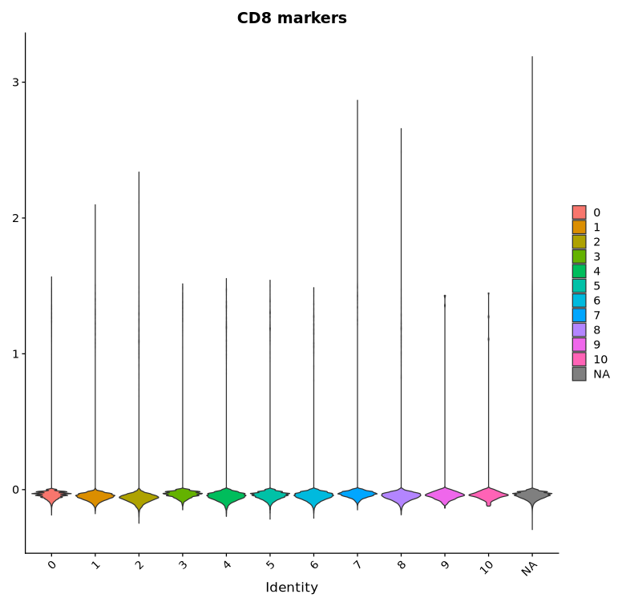
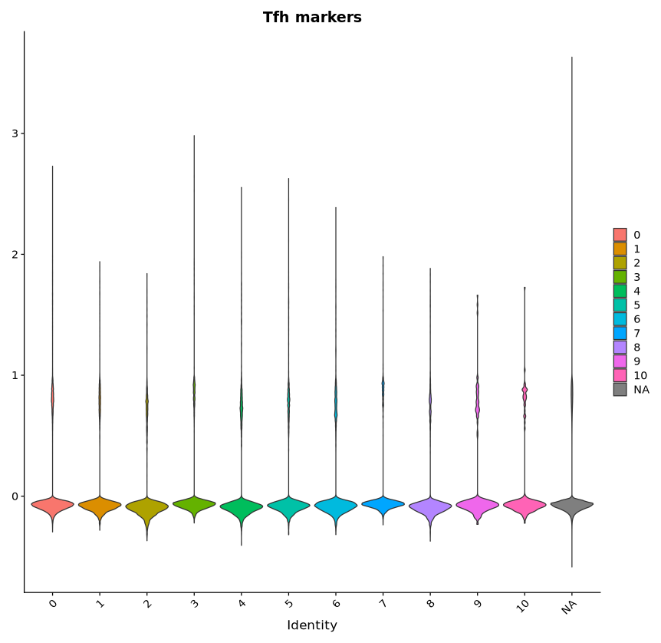

Gene module scores
Prominent marker genes don’t seem to exist in the data…
Easy way Hard way Validation

Slide 21

Starting (entirely) from scratch: sample 1
[Cell Label]
Subcluster
YES
Can you confidently assign a tier label?
“Unknown”
Find Markers (DE)
Filter and test gene lists
NO
“Unknown”
Human protein atlas
Enrichr
Easy way Hard way Validation

Slide 22
Interpret cluster marker genes
Test enrichment in significant markers
  Enirchr, https://maayanlab.cloud/Enrichr/
High pct.1
  search human protein atlas
  Ask AI
  Ask your advisor, an expert, a collaborator
Visualize
Filter results for uniqueness
  Exclude genes appearing in multiple cluster DEG lists
Easy way Hard way Validation

Slide 23
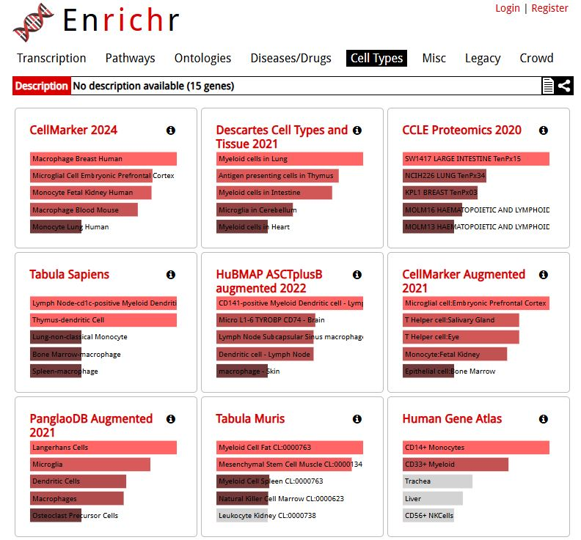
Iteration 1…
p_val | avg_log2FC | pct.1 | pct.2 | p_val_adj | cluster | gene
0 | 6.386292 | 0.431 | 0.007 | 0 | 4 | LYZ
2.04E-18 | 0.256428 | 0.295 | 0.228 | 3.63E-14 | 4 | CD74
6.24E-06 | 0.108098 | 0.137 | 0.111 | 0.111132 | 4 | MT-ND3
0 | 6.587606 | 0.132 | 0.002 | 0 | 4 | C3
1.28E-07 | 0.173696 | 0.128 | 0.1 | 0.002277 | 4 | MT-CO2
0 | 6.588392 | 0.127 | 0.002 | 0 | 4 | ITGAX
0 | 7.26094 | 0.108 | 0.001 | 0 | 4 | FGL2
0 | 6.447549 | 0.108 | 0.002 | 0 | 4 | FOS
0 | 4.116674 | 0.099 | 0.007 | 0 | 4 | LAMTOR1
1.19E-06 | 0.209 | 0.088 | 0.068 | 0.021171 | 4 | PFN1
0.000393 | 0.113869 | 0.084 | 0.069 | 1 | 4 | OAZ1
0.000101 | 0.157536 | 0.082 | 0.066 | 1 | 4 | UBA52
8.64E-284 | 3.647087 | 0.072 | 0.007 | 1.54E-279 | 4 | UBE2R2
1.64E-07 | 0.282846 | 0.06 | 0.043 | 0.002926 | 4 | APOE
9.94E-06 | 0.151005 | 0.055 | 0.041 | 0.177022 | 4 | MT-ND2
4.63E-08 | 0.1682 | 0.272 | 0.23 | 0.000825 | 5 | ACTB
0 | 3.227129 | 0.24 | 0.035 | 0 | 5 | CLU
0.00292 | 0.100097 | 0.118 | 0.102 | 1 | 5 | EVL
0 | 3.955135 | 0.097 | 0.008 | 0 | 5 | DDX6
0.008748 | 0.139188 | 0.093 | 0.081 | 1 | 5 | TRBC2
0.000726 | 0.149919 | 0.084 | 0.069 | 1 | 5 | SELL
0 | 4.262113 | 0.067 | 0.005 | 0 | 5 | BICDL1
0.006225 | 0.135163 | 0.054 | 0.044 | 1 | 5 | TCF7
2.15E-118 | 3.058043 | 0.053 | 0.01 | 3.84E-114 | 5 | POU2AF1
1.15E-185 | 3.632954 | 0.052 | 0.006 | 2.04E-181 | 5 | ATP6V1G1
0.000377 | 0.275182 | 0.052 | 0.04 | 1 | 5 | TBC1D10C
3.71E-170 | 3.552015 | 0.05 | 0.006 | 6.61E-166 | 5 | CD40
0.000918 | 0.228154 | 0.049 | 0.038 | 1 | 5 | CYTIP
0.005788 | 0.23369 | 0.049 | 0.04 | 1 | 5 | SLC38A1
1.30E-05 | 0.40323 | 0.048 | 0.035 | 0.230729 | 5 | MSN
*I sorted marker genes by LogFoldChange, filtered by p-value, and sliced top 20 genes/cluster. Do whatever feels appropriate to your data
Easy way Hard way Validation

Slide 24
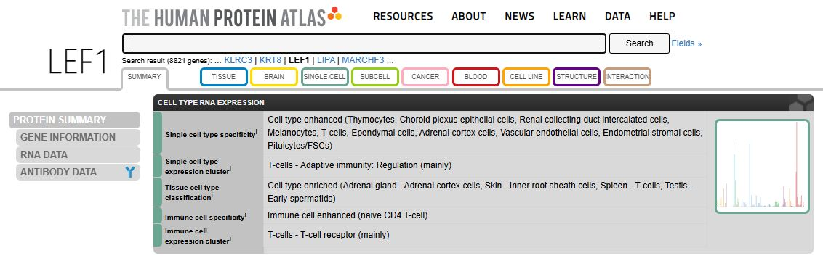
Iteration 2…
p_val | avg_log2FC | pct.1 | pct.2 | p_val_adj | cluster | gene
3.21E-220 | 2.734268 | 0.995 | 0.165 | 5.22E-216 | Stromal_1 | LEF1
0.000541 | 0.879699 | 0.154 | 0.096 | 1 | Stromal_1 | TRAC
0.000488 | 0.839234 | 0.133 | 0.078 | 1 | Stromal_1 | PFN1
0.000166 | 1.101591 | 0.101 | 0.051 | 1 | Stromal_1 | DGKA
0.00273 | 0.742535 | 0.094 | 0.054 | 1 | Stromal_1 | FXYD5
0.009144 | 0.730956 | 0.094 | 0.058 | 1 | Stromal_1 | TRBC1
0.003168 | 0.93107 | 0.08 | 0.044 | 1 | Stromal_1 | TBC1D10C
0.003169 | 1.09026 | 0.072 | 0.039 | 1 | Stromal_1 | TCF7
0.002806 | 1.180416 | 0.063 | 0.031 | 1 | Stromal_1 | MBNL1
0.001046 | 1.103496 | 0.058 | 0.026 | 1 | Stromal_1 | CD28
0.0023 | 1.043401 | 0.055 | 0.026 | 1 | Stromal_1 | MSN
0.000244 | 1.726841 | 0.046 | 0.016 | 1 | Stromal_1 | RCAN3
0.003518 | 1.506445 | 0.041 | 0.017 | 1 | Stromal_1 | ANKHD1
0.007414 | 0.980168 | 0.041 | 0.019 | 1 | Stromal_1 | GIMAP4
Oops, “T lineage”
Easy way Hard way Validation

Slide 25
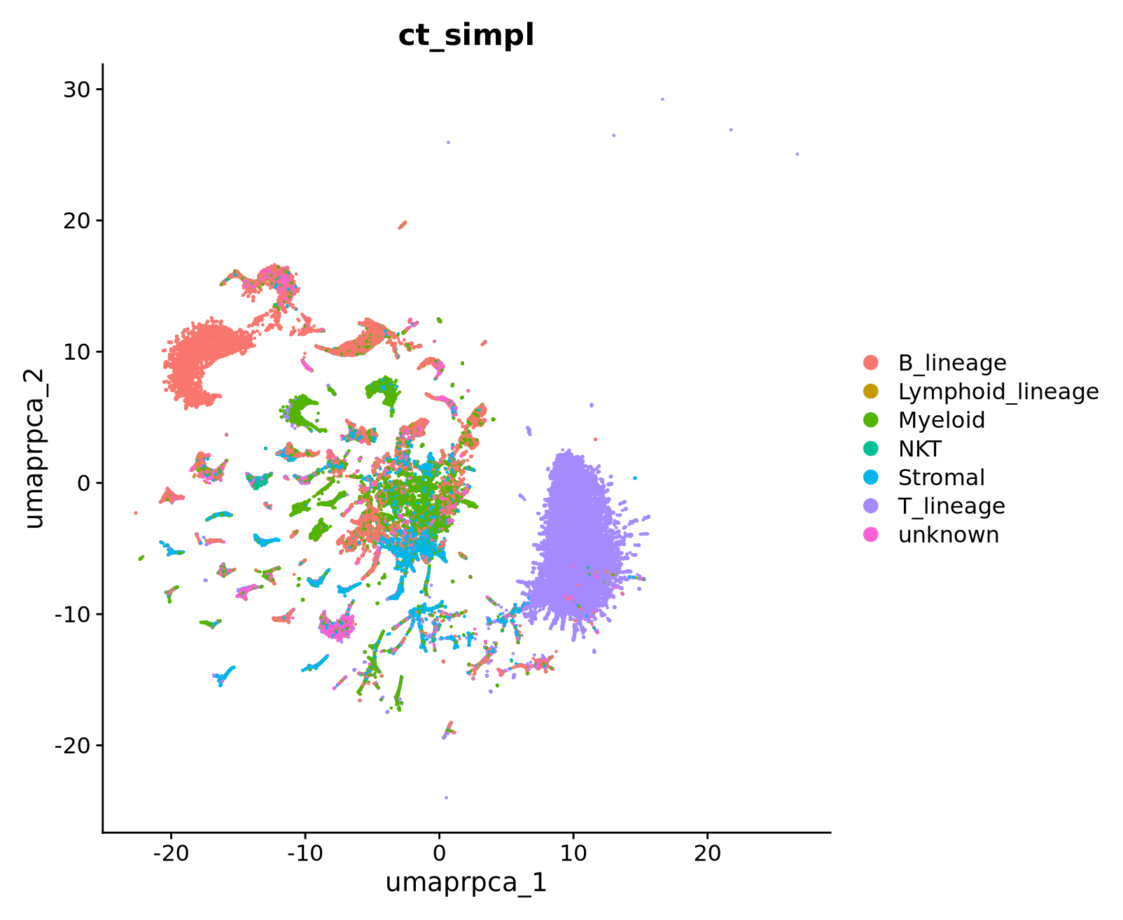
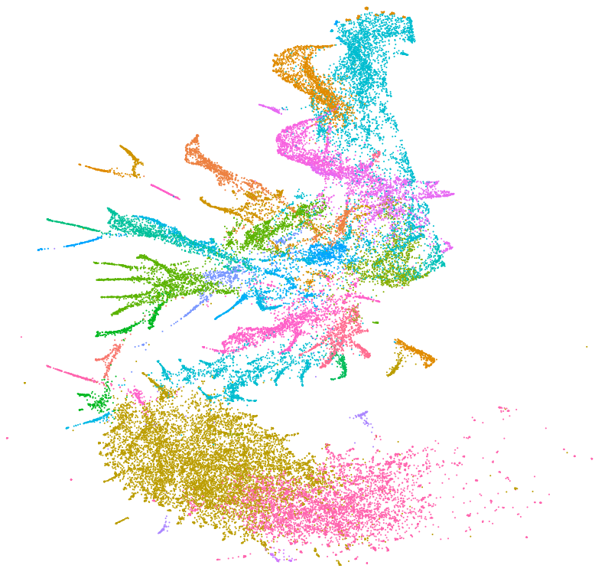
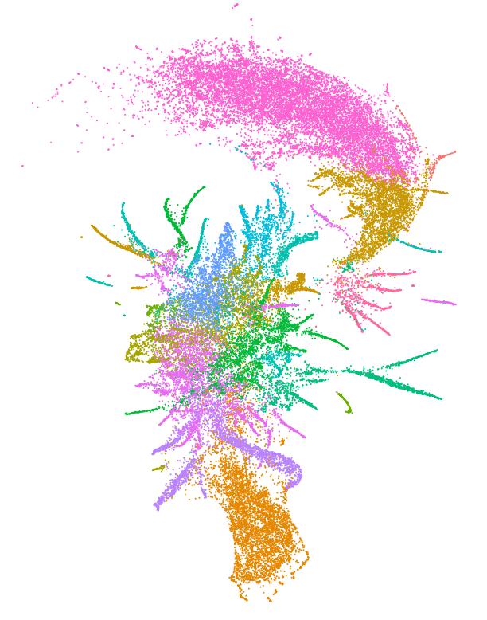
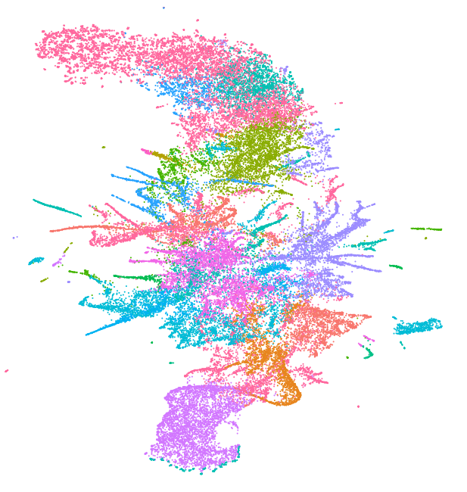
Make a reference
Ref sample 1
Ref sample 2
Integrate and some other clean up…
Ref sample 3
Label transfer
Easy way Hard way Validation

Slide 26
Important takeaways
Quality >> quantity
  (There was very little filtering on these reference data)
You don’t need to label everything. “Unknown” is better than a mislabel
The absence of evidence is not evidence of absence (re: marker genes)
This process is iterative. Expect multiple rounds of corrections and refinement
Easy way Hard way Validation

Slide 27
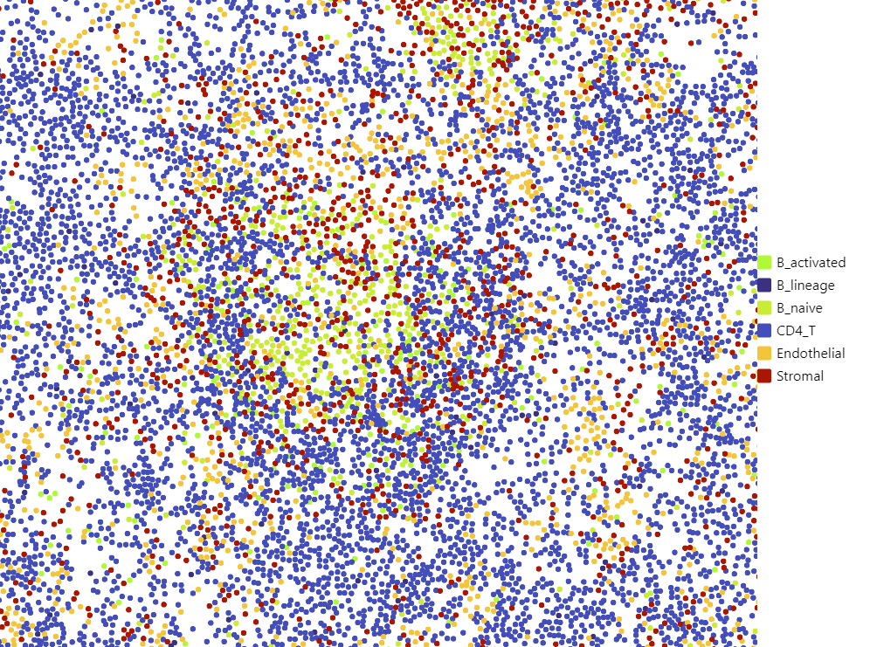
Validation
*Normally I would check these overlayed with secondary data (e.g. brightfield, H&E, IHC, etc.)
Easy way Hard way Validation

Slide 28
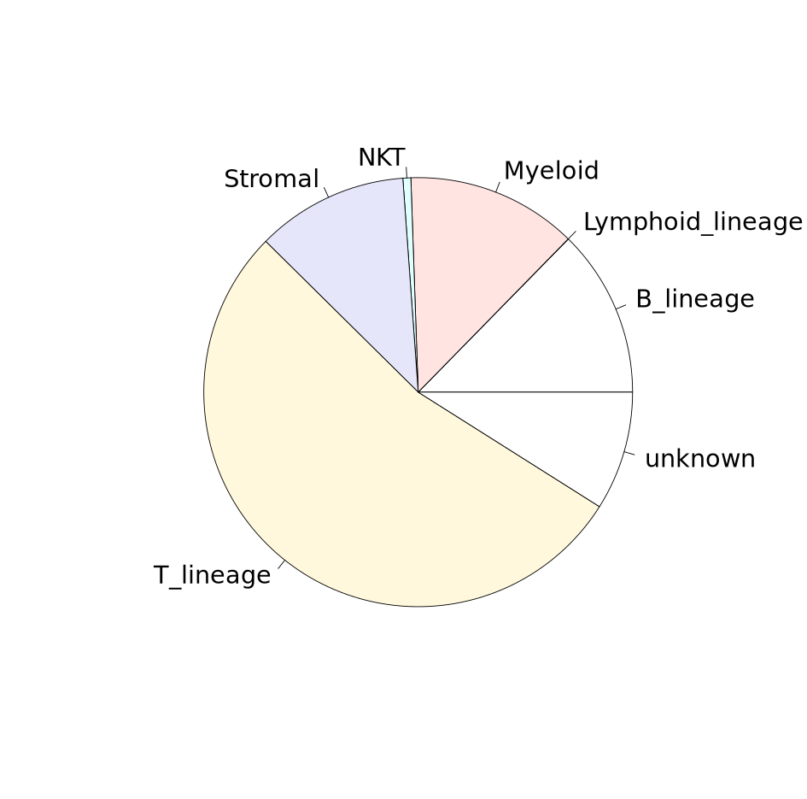
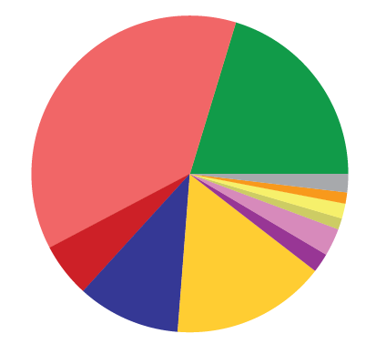
Are proportions reasonable?
B cells
T cells
Endo
Myeloid
Easy way Hard way Validation

Slide 29
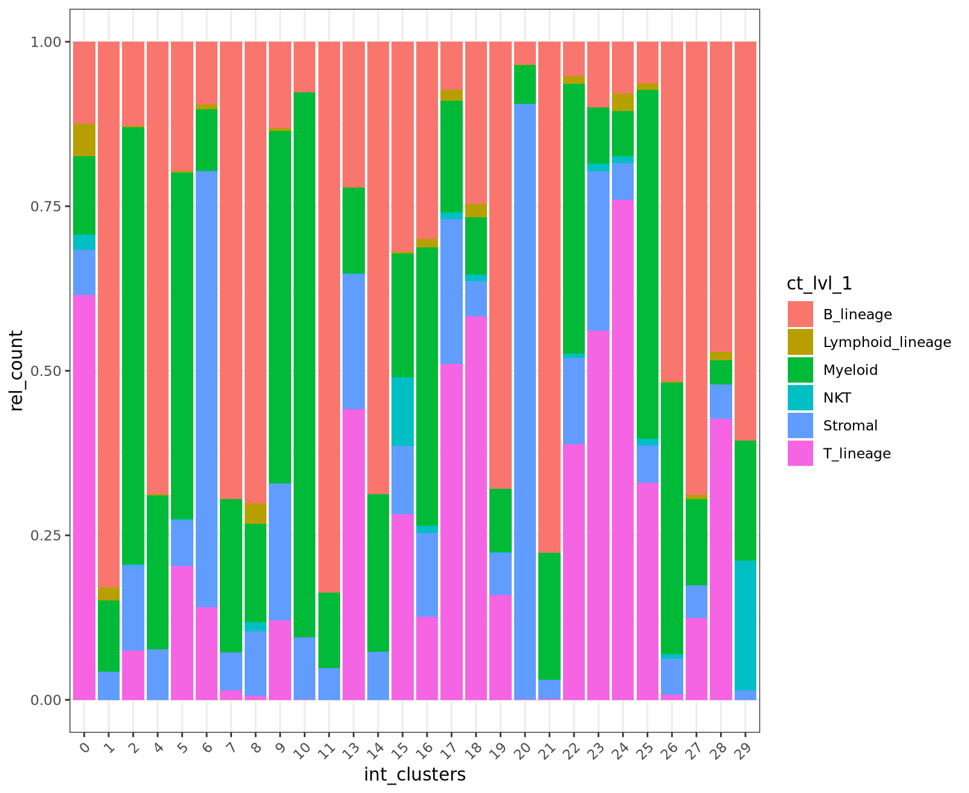
Agreement with unsupervised clusters
Easy way Hard way Validation

Slide 30
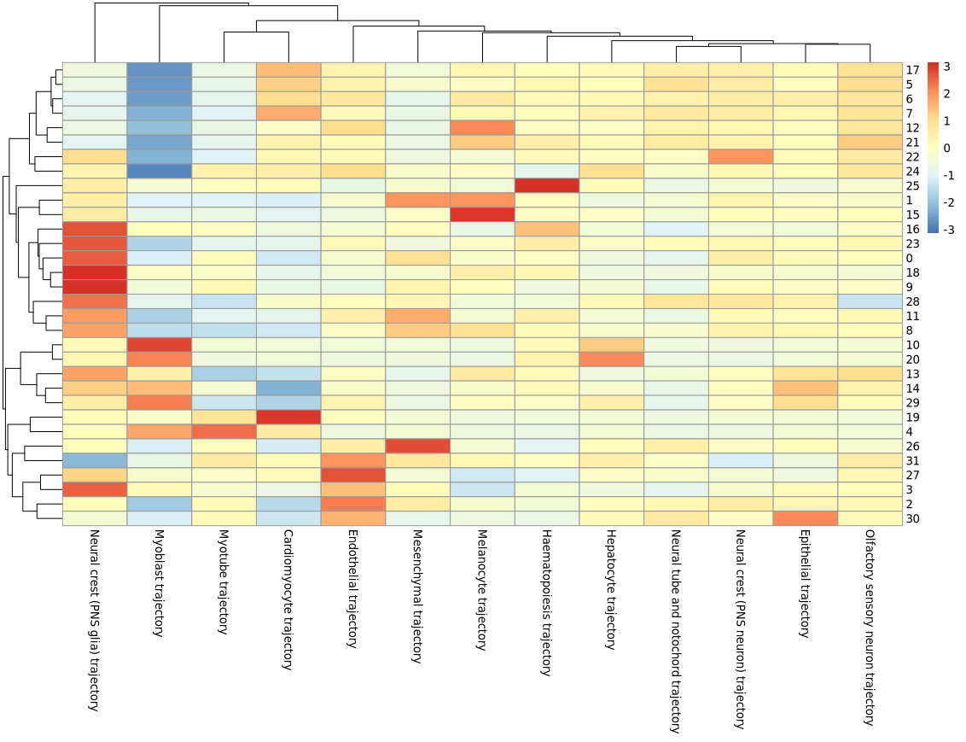
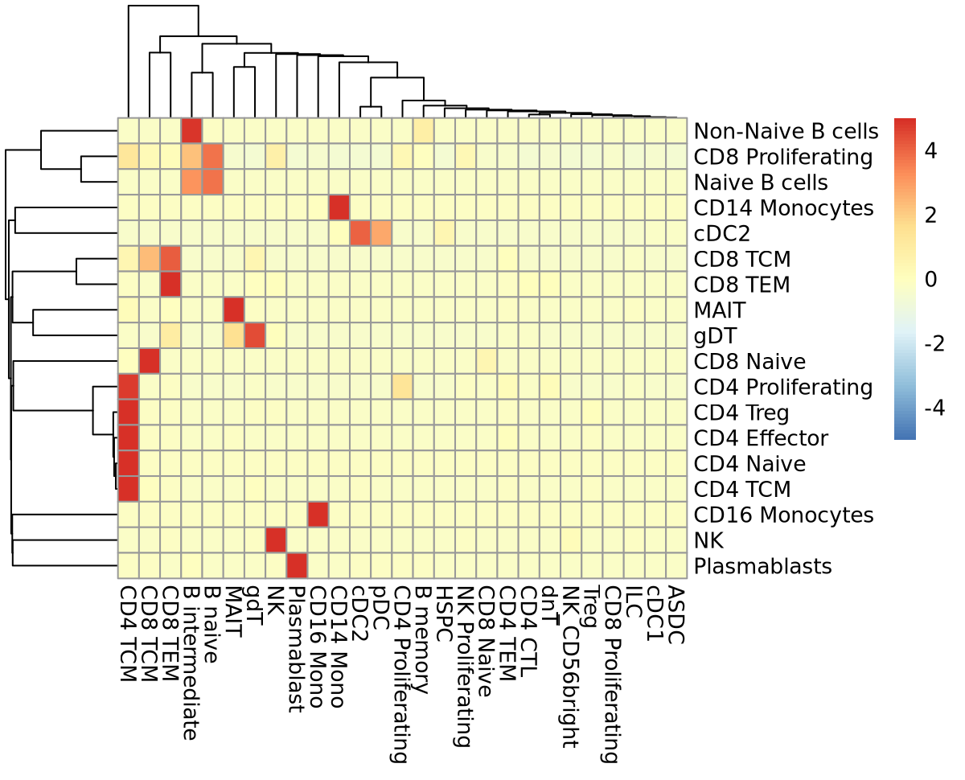
Lots of visualization…
Confusion matrices
(re)test cell type gene modules
Easy way Hard way Validation

Slide 31
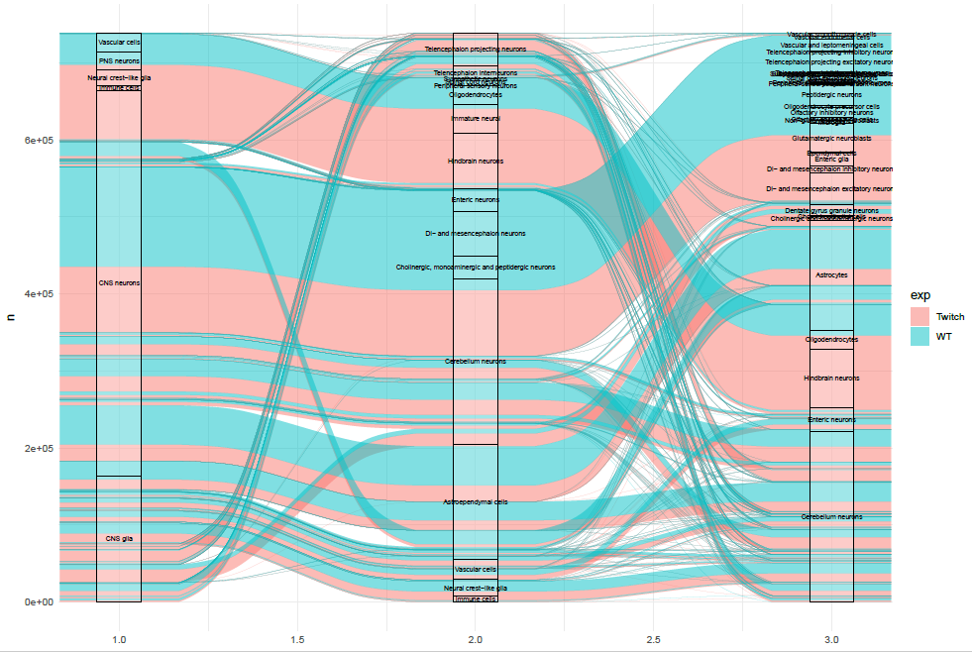
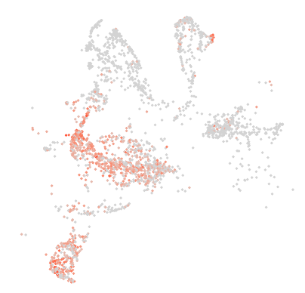
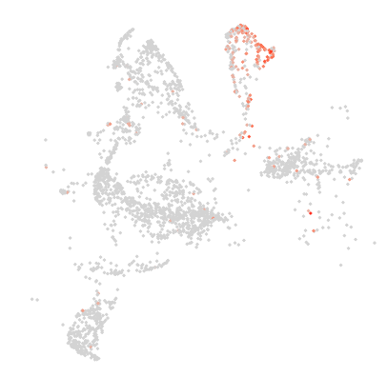
Lots of visualization…
Consistent hierarchy
Marker gene expression
Easy way Hard way Validation

Slide 32
Synthesize labels
Barcode | azi_pct_anno | td_pct_anno | AUCell_pred_t | AUCell_pred_az | scPoli_3_Pred_lvl1 | seu_pred_anno_lvl1 | scPoli_1_Pred_lvl1 | scPoli_2_Pred_lvl1
s_008um_00506_00359-1 | Plasma | Plasma.cell.filter | Plasma_cells | Plasma_cells | Cholangiocytes | T-cells | Cholangiocytes | Cholangiocytes
s_008um_00499_00098-1 | Myeloid | Myeloid.filter | B-cells | KC_Myeloid | Cholangiocytes | Cholangiocytes | Cholangiocytes | Cholangiocytes
s_008um_00439_00573-1 | HSC.mFB | HSC_fibroblasts.markers.filter | T-cells | T-cells | Cholangiocytes | Cholangiocytes | Cholangiocytes | Cholangiocytes
s_008um_00478_00055-1 | Hepatocyte | Hepatocyte | Hepatocyte | Hepatocyte | Hepatocyte | Hepatocyte | Hepatocyte | Hepatocyte
s_008um_00501_00833-1 | Plasma_cells | Plasma_cells | Plasma_cells | Plasma_cells | Plasma_cells | Hepatocyte | Arterial_smooth_muscle | Plasma_cells
s_008um_00474_00251-1 | LSEC | LSEC | LSEC | LSEC | LSEC | LSEC | LSEC | LSEC
s_008um_00433_00599-1 | Fibroblasts | Fibroblasts | Fibroblasts | Fibroblasts | Fibroblasts | LSEC | Arterial_smooth_muscle | Cholangiocytes
s_008um_00524_00140-1 | Plasma_cells | Plasma_cells | Plasma_cells | Plasma_cells | Plasma_cells | Fibroblasts | Arterial_smooth_muscle | Plasma_cells
s_008um_00469_00254-1 | Myeloid | Myeloid | Myeloid | Myeloid | Myeloid | Myeloid | Monocytes_Macs | Myeloid
s_008um_00435_00710-1 | Myeloid | Myeloid | Myeloid | Myeloid | Myeloid | Fibroblasts | Arterial_smooth_muscle | B-cells
Easy way Hard way Validation

Slide 33
Important takeaways
Most time-consuming step of analysis
Interact with the data
  [Python] Cellxgene
  [Python] Napari
  [10X] Loupe
Never a linear process

Slide 34
Thank you!

