Slide 1
Introduction to Epigenetic Analysis

Slide 2
Outline
ATAC-seq Basics
Annotation
Resources
Multimodal analysis

Slide 3
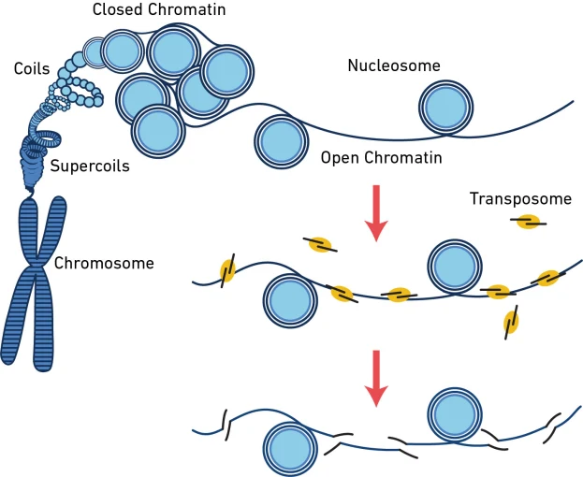
What does ATAC measure?
Basics
Annotation
Resources
Analysis

Slide 4
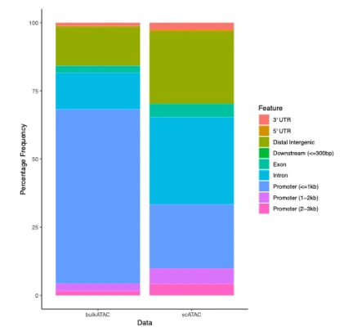
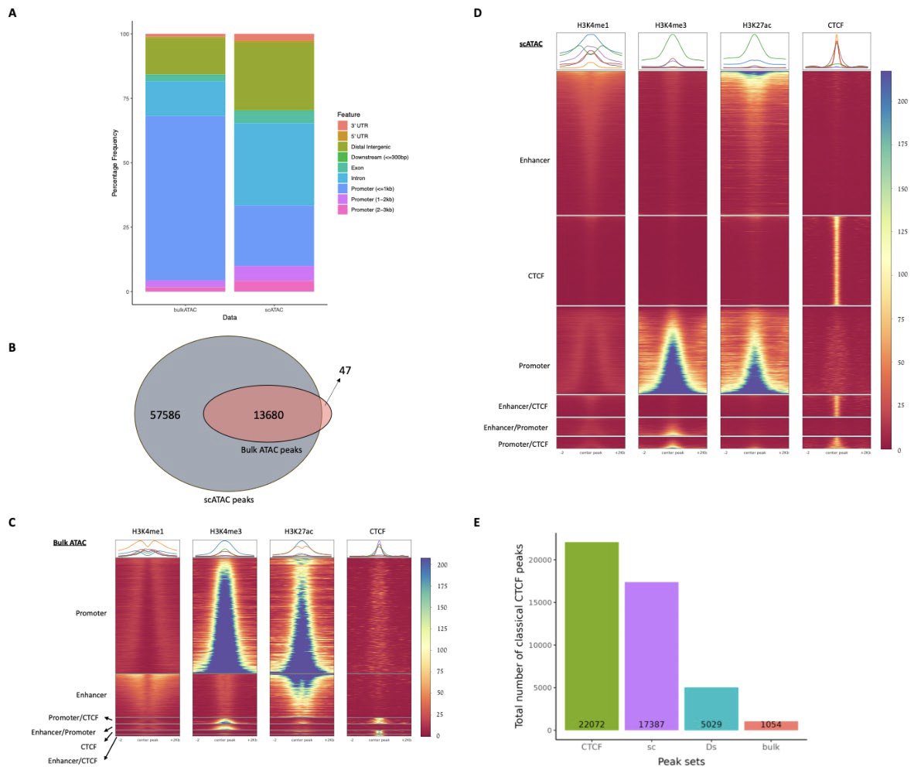
scATAC-seq is very sensitive
Gur ER, Hughes JR Scientific Reports (2025)
Basics
Annotation
Resources
Analysis

Slide 5
File Formats
.bam
  Binary alignment file. Contains the coordinates of where fragments align to the genome reference as well quality scores and mismatches for each base.
.bed
  Tab-delimited file with “chromosome”, “start”, “stop”, and some measurement variable(s). Rows are fragments.
.wig
  “wiggle”
  Formatted for plotting. Data are represented by genomic intervals.
.bigwig
  Binarized version of .wig
  Faster loading
Basics
Annotation
Resources
Analysis

Slide 6
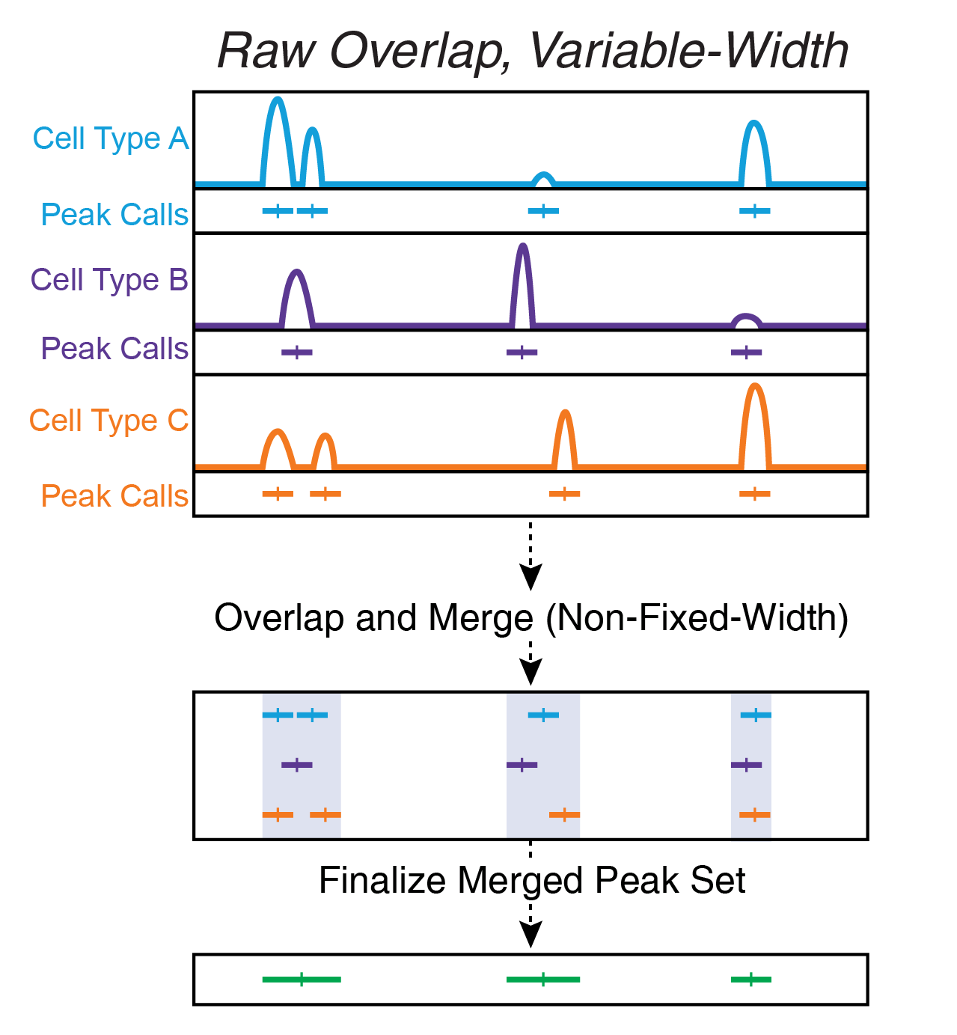
What does data look like?
“chrN:[start]-[end]”
>100k peaks
For a single, diploid cell, there are 2 possible locations to detect peaks. However, multiple fragments can reside within the same peak.
  Basically, any given observation usually ranges 0-2+
To start, all we know are genomic coordinates
Basics
Annotation
Resources
Analysis

Slide 7
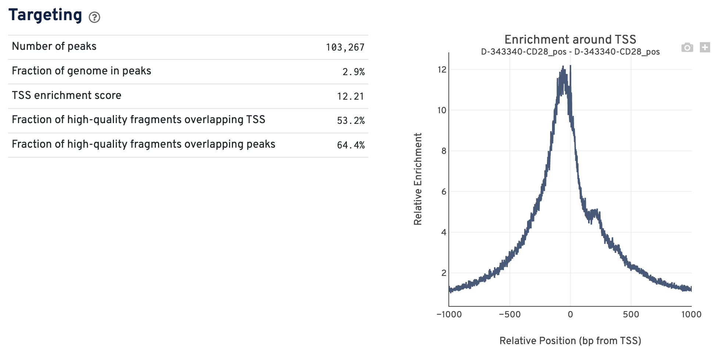
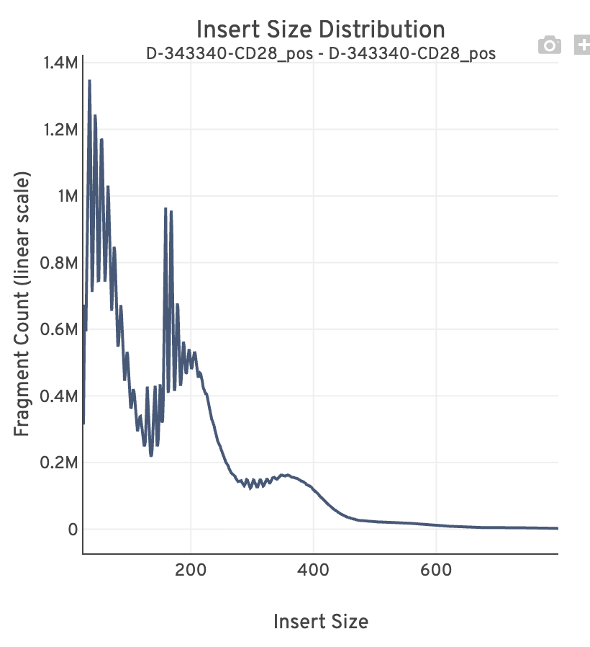
CellRanger Output
Basics
Annotation
Resources
Analysis

Slide 8
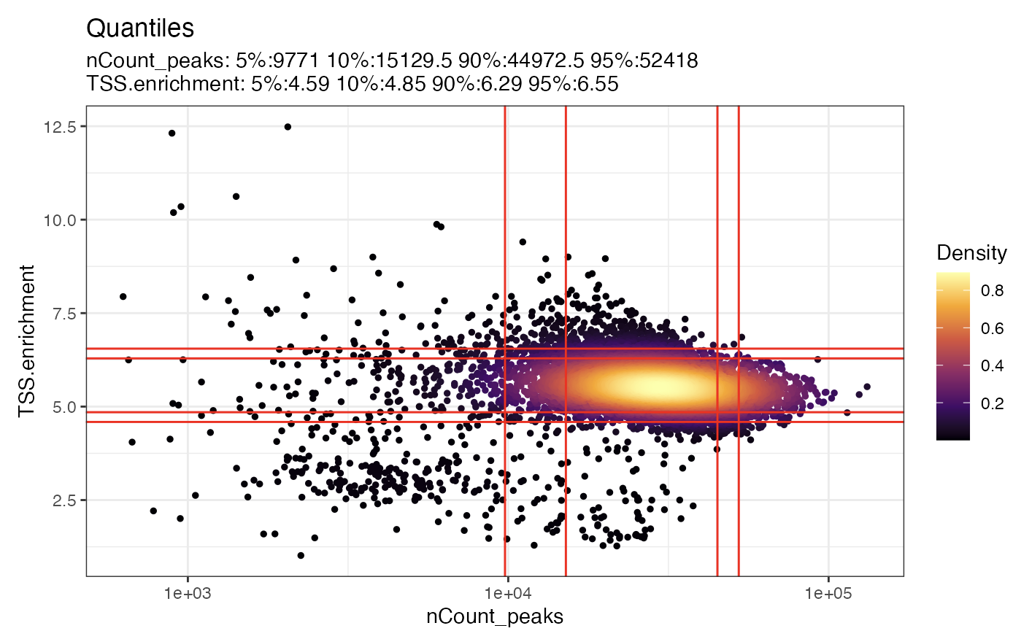
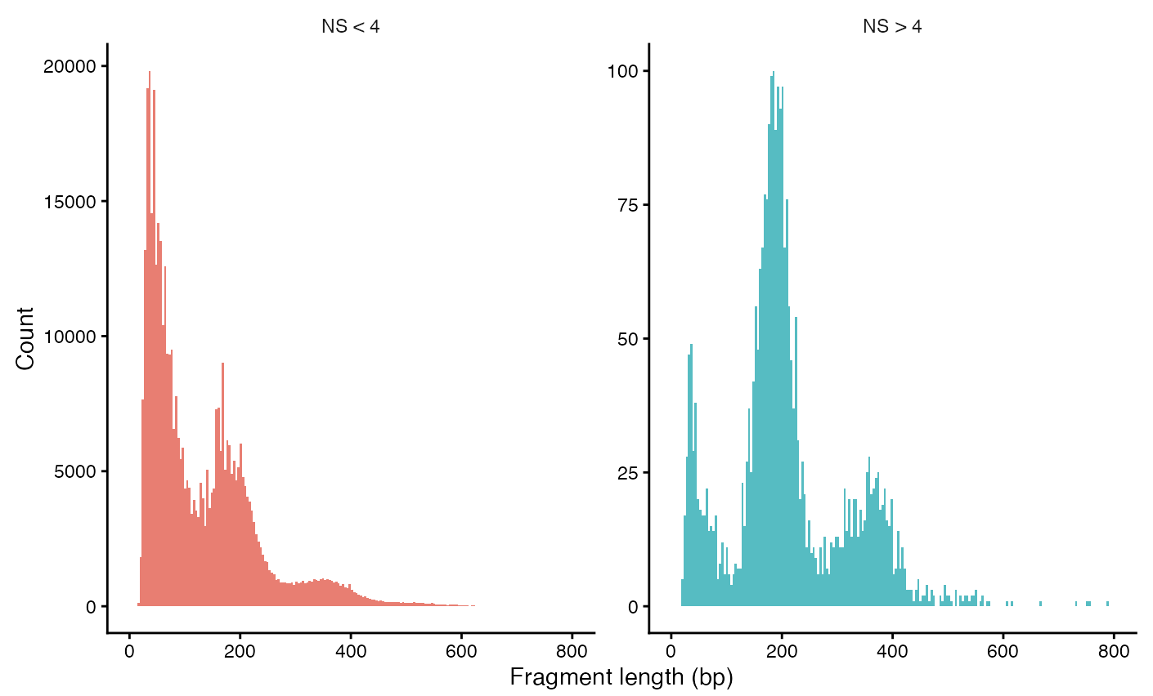
QC
Use Signac (R library)
  https://stuartlab.org/signac/articles/pbmc_vignette
Basics
Annotation
Resources
Analysis

Slide 9
Dimension Reduction
scRNA-seq: Normalize > Scale > PCA
scATAC-seq: TF-IDF > SVD: latent semantic indexing (LSI)
  PCA is SVD run on the centered (the scaling step) data.
Term Frequency–Inverse Document Frequency (TF-IDF)
  TF = Normalize each peak to total cell fragments
  IDF = Weight each peak by the frequency it occurs across all other cells
  The goal is to (1) make cells comparable and (2) amplify rare peaks and dampen ubiquitous peaks
We skip scaling because it kind of destroys the intention of IDF normalization
Basics
Annotation
Resources
Analysis

Slide 10
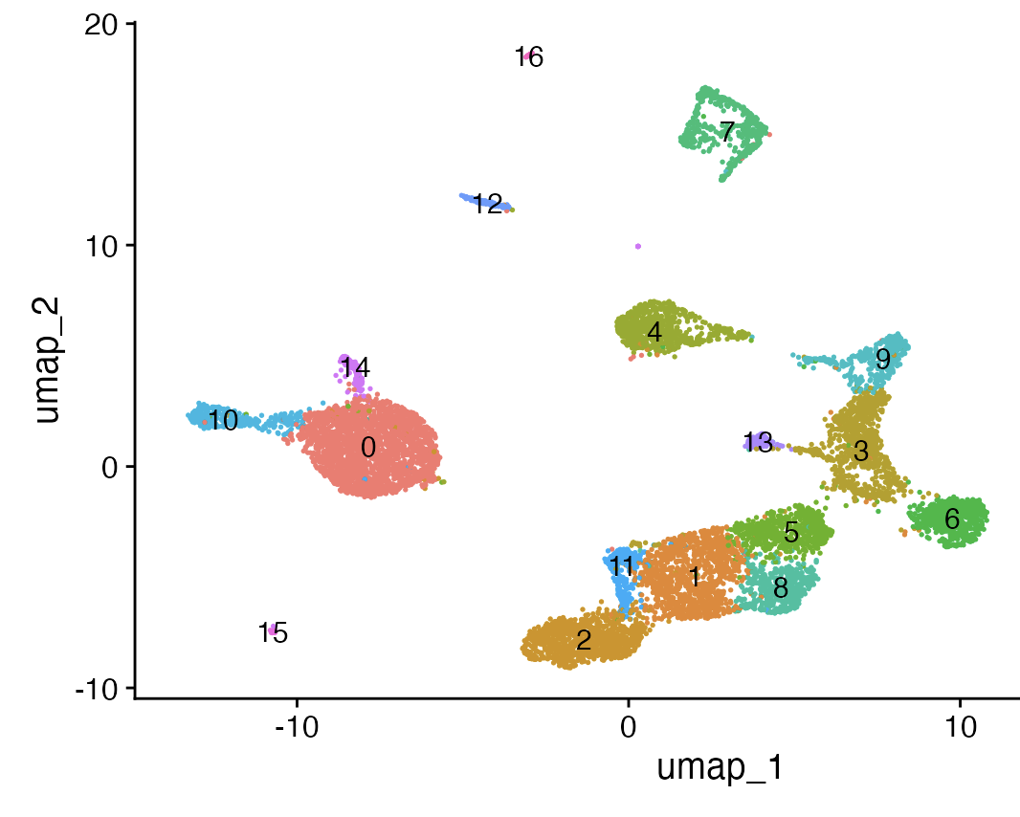
Analysis basics
Peak annotations from ENCODE
  Signac or ArchR
Neighbors/clustering/UMAP calculated from LSI
Differential abundance, same statistical test as scRNA-seq
Basics
Annotation
Resources
Analysis

Slide 11
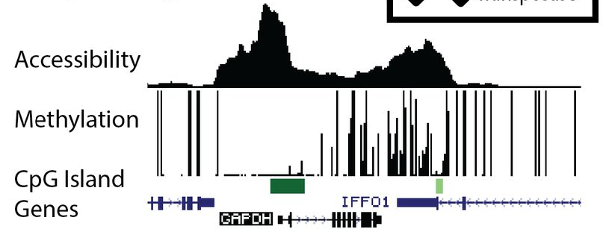
Analysis basics
Accessibility ~ Expression
Most analyses where you’re using marker genes, you can use accessibility
  Gene set enrichment
  Cell typing
  Network/graph interactions

Slide 12
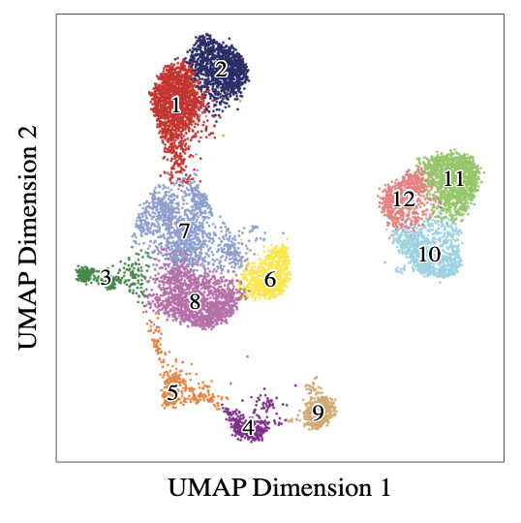
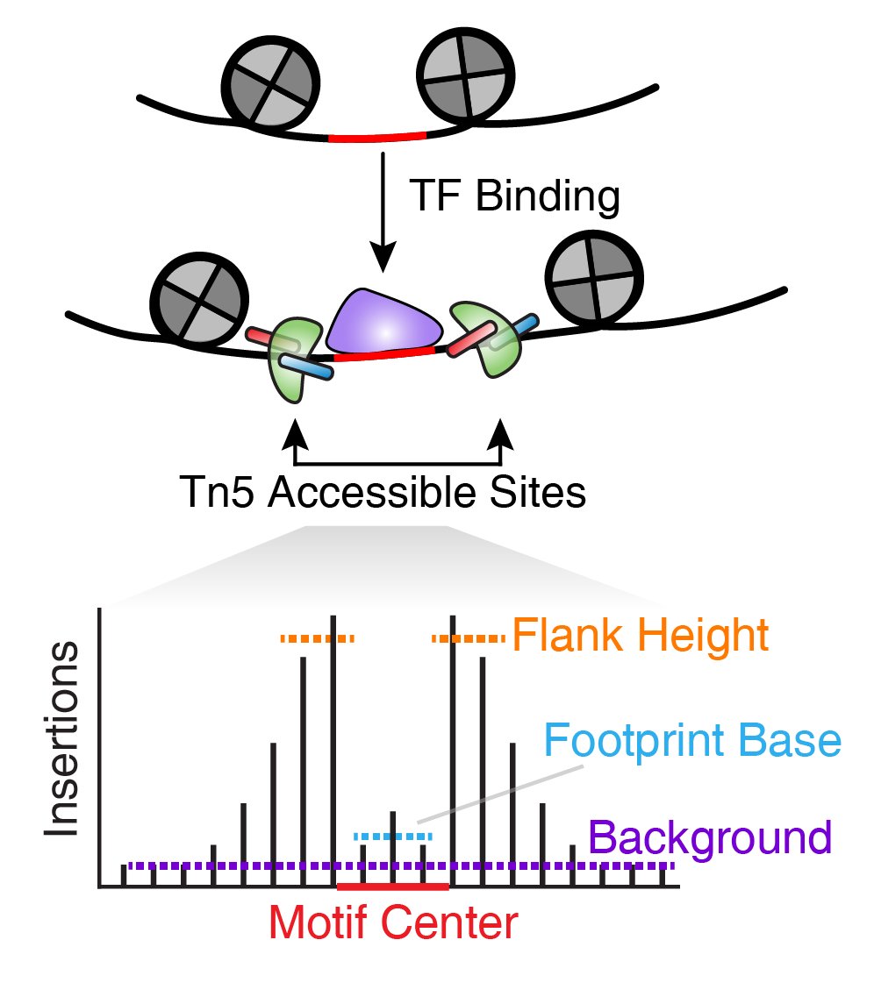


Footprints
Everything else
Basics
Annotation
Resources
Analysis

Slide 13
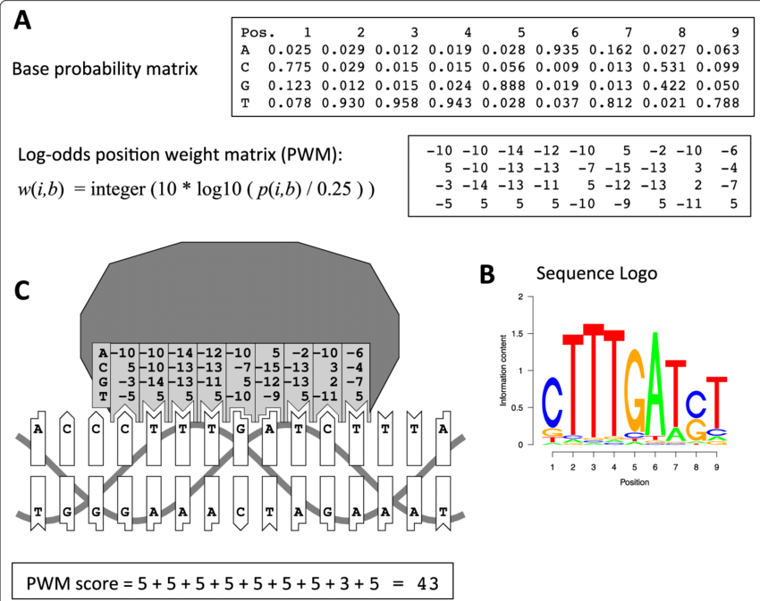
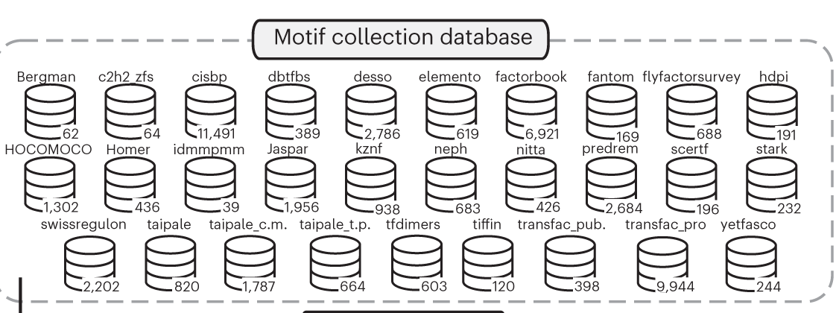
Annotations: Motif Enrichment
After a bunch of ChIP-seq experiments…
Basics
Annotation
Resources
Analysis

Slide 14
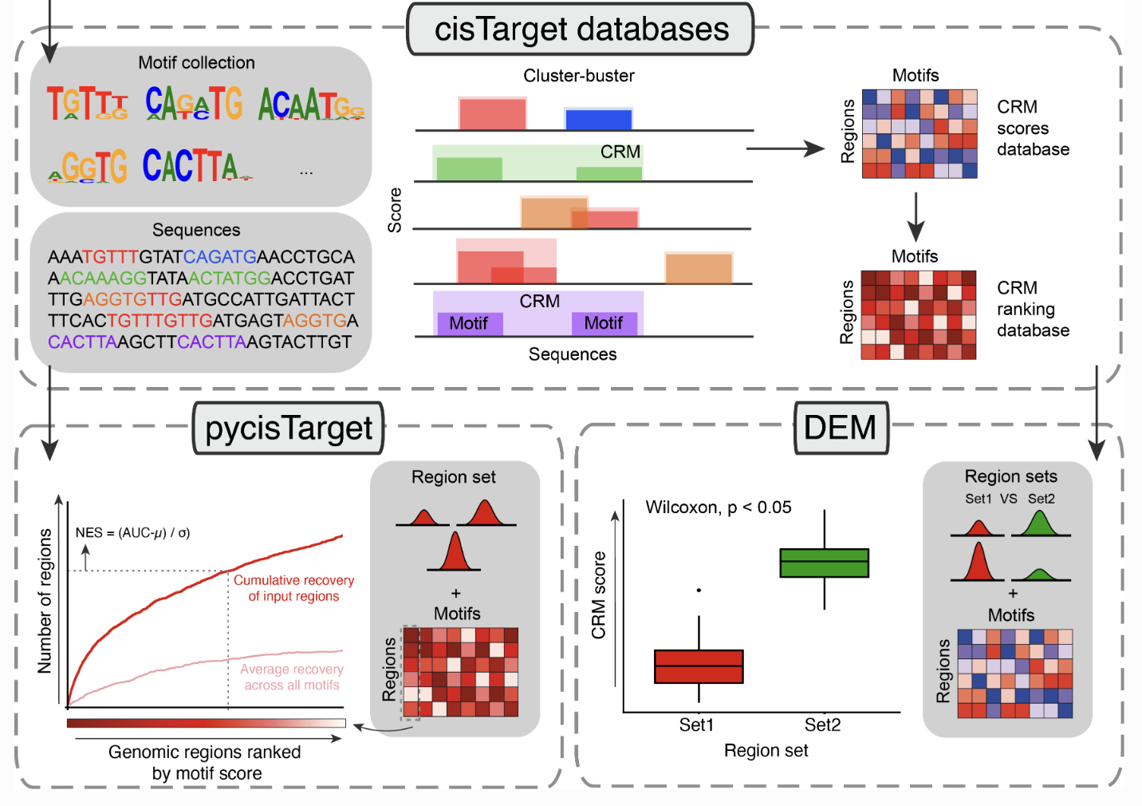
Annotations: Motif Enrichment
Basics
Annotation
Resources
Analysis

Slide 15
Resources
ENCODE
  https://www.encodeproject.org/
UCSC
  https://genome.ucsc.edu/
JASPAR
  https://jaspar.elixir.no/
Basics
Annotation
Resources
Analysis

Slide 16
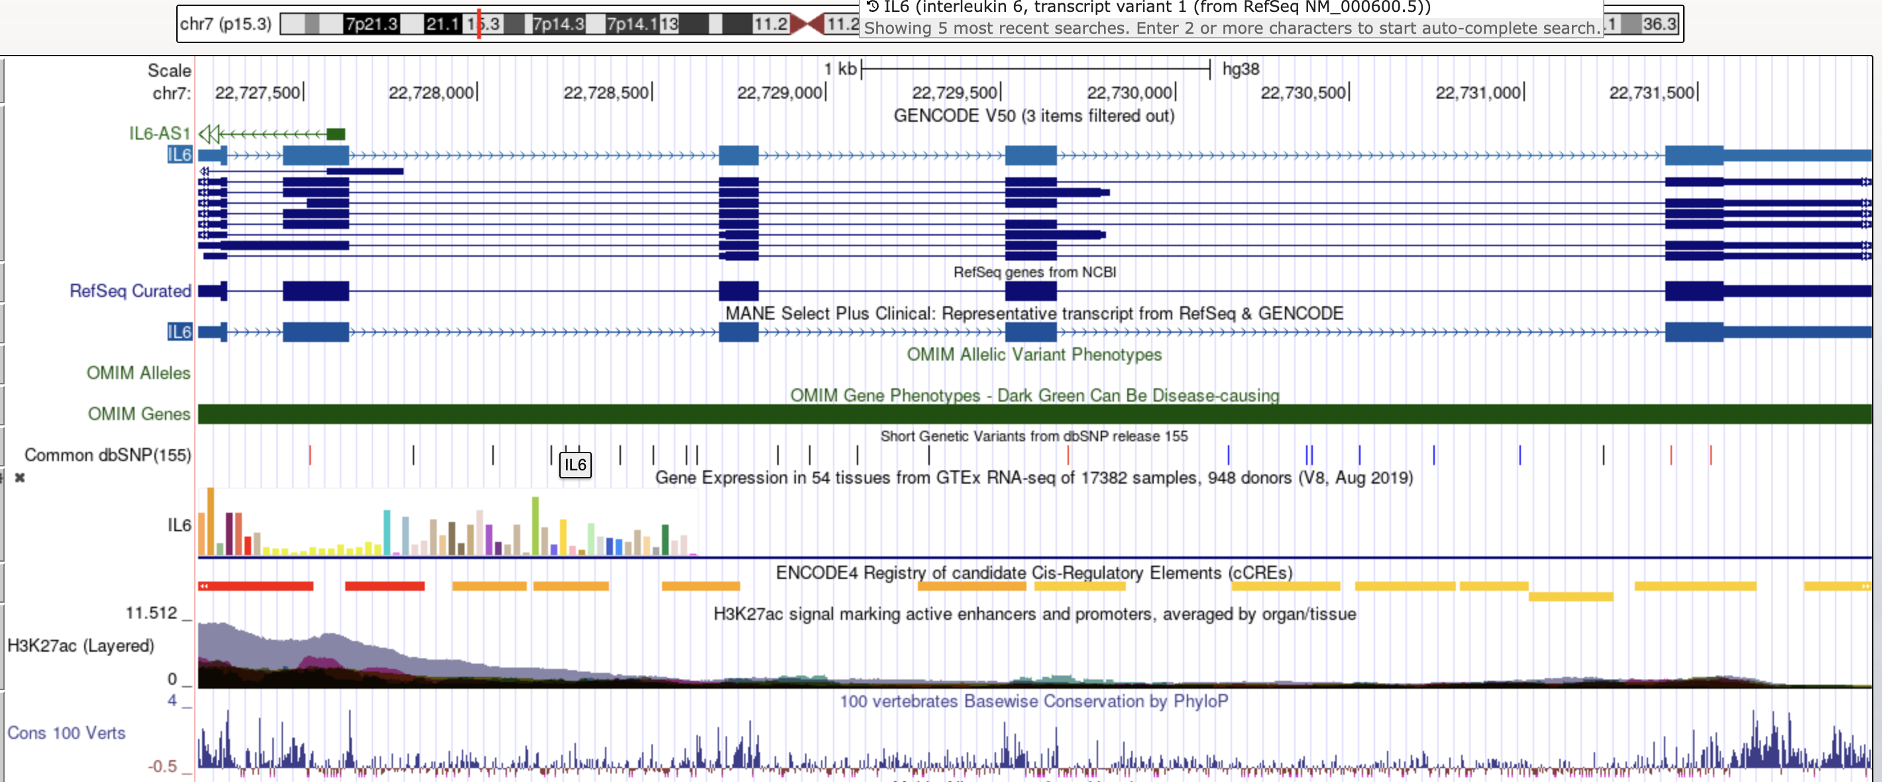
Resources: UCSC Genome Browser
Basics
Annotation
Resources
Analysis

Slide 17
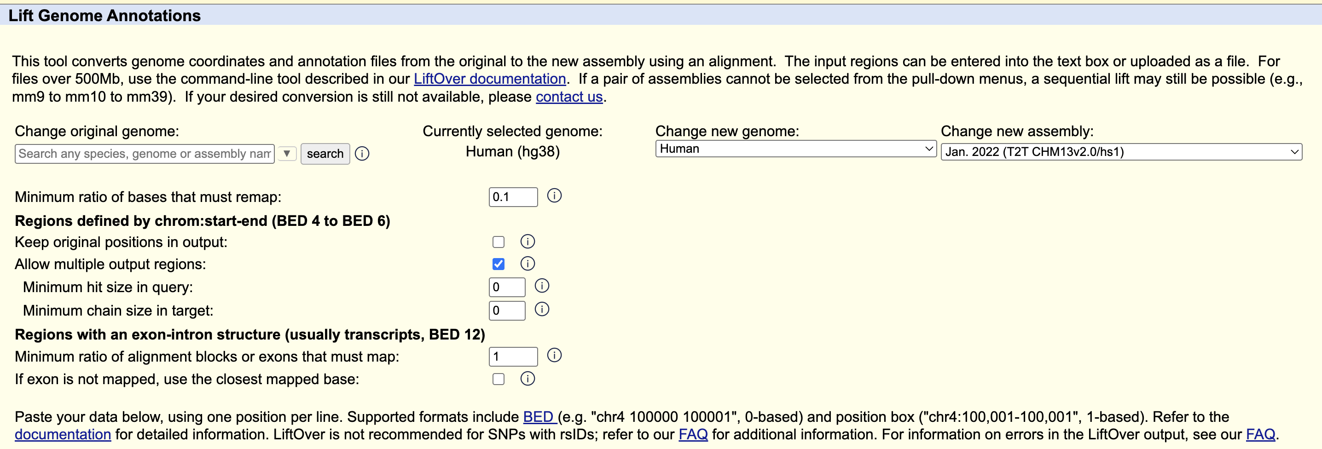
Resources: UCSC Genome Browser
Huge bias of species for transcription factor motifs, enhancer annotations
Basics
Annotation
Resources
Analysis

Slide 18
My Favorite Software
Signac
  R
  Great support, vignettes and integrates with Seurat.
scATAC-pro
  https://github.com/wbaopaul/scATAC-pro
  Dockerized, very thorough analysis and reporting
scMEGA
  R
  https://costalab.github.io/scMEGA/
  Integrated workflow
archR
  R
  https://www.archrproject.com/index.html
  Versatile suite for processing, like Seurat
Basics
Annotation
Resources
Analysis

Slide 19
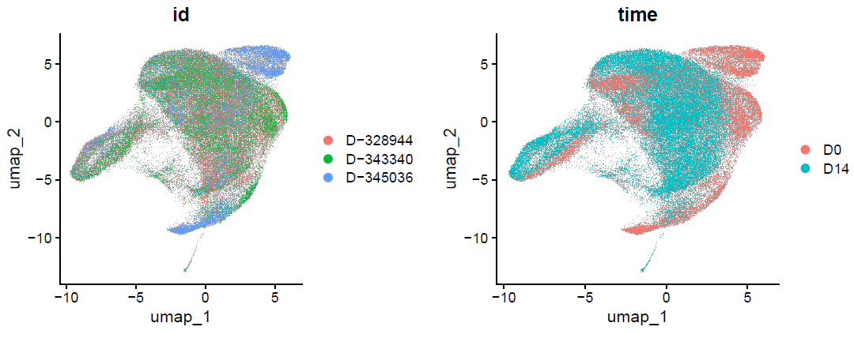
Multimodal analysis
RNA
Basics
Annotation
Resources
Analysis

Slide 20
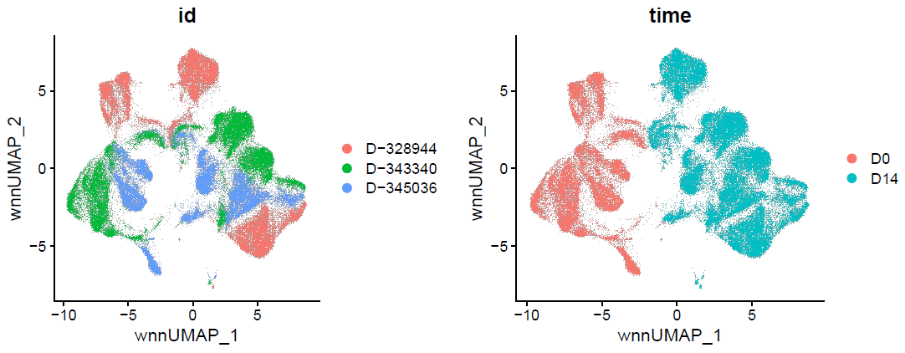
Multimodal analysis
RNA + ATAC
Basics
Annotation
Resources
Analysis

Slide 21
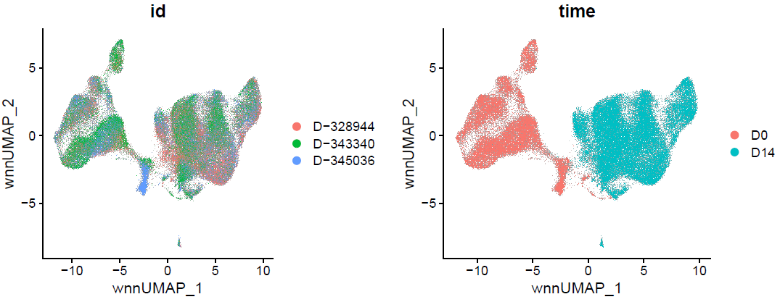
Multimodal analysis
RNA + ATAC, integrated
Basics
Annotation
Resources
Analysis

Slide 22
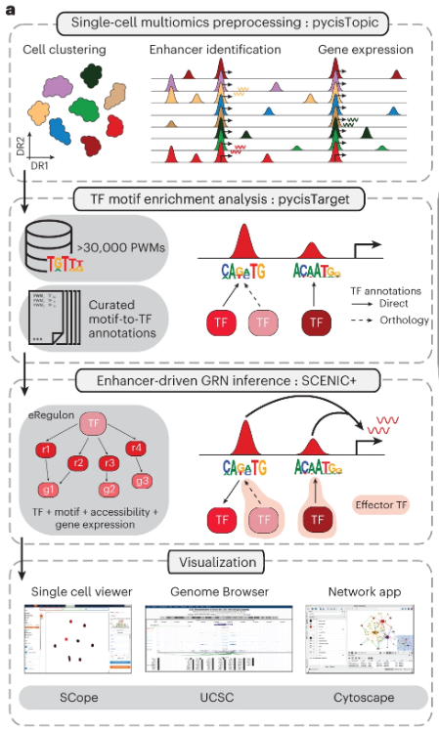
All together: regulons
Popular software:
  scMTNI
  FigR
  SCENIC+
For a specific cell cluster…
  what are the differentially accessible peaks?
    what transcription factors could be binding?
      how is region accessibility related to gene expression?
        How does TF/region set/gene expression compare to other cell types
Lots of measurements and statistics…
González-Blas CD, et al. Nature Methods (2023)
Basics
Annotation
Resources
Analysis

Slide 23
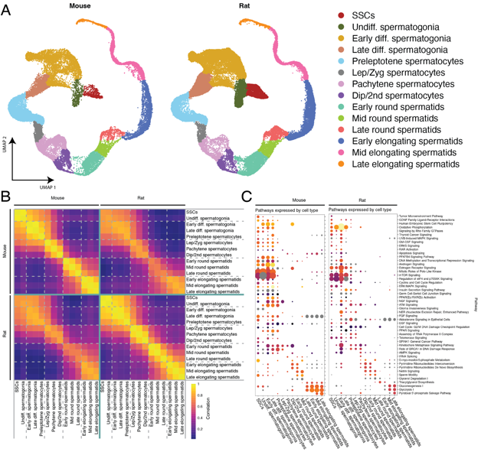
SCENIC+ example
Whelan EC, et al. Stem Cell Reports (2025)
Basics
Annotation
Resources
Analysis

Slide 25
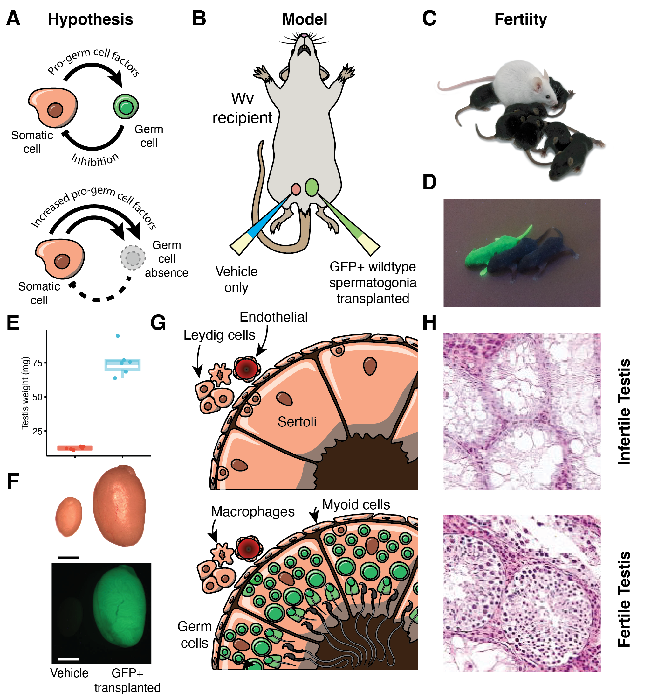
Another example
Whelan EC, et al. Science Advances (2026)
Basics
Annotation
Resources
Analysis

Slide 26
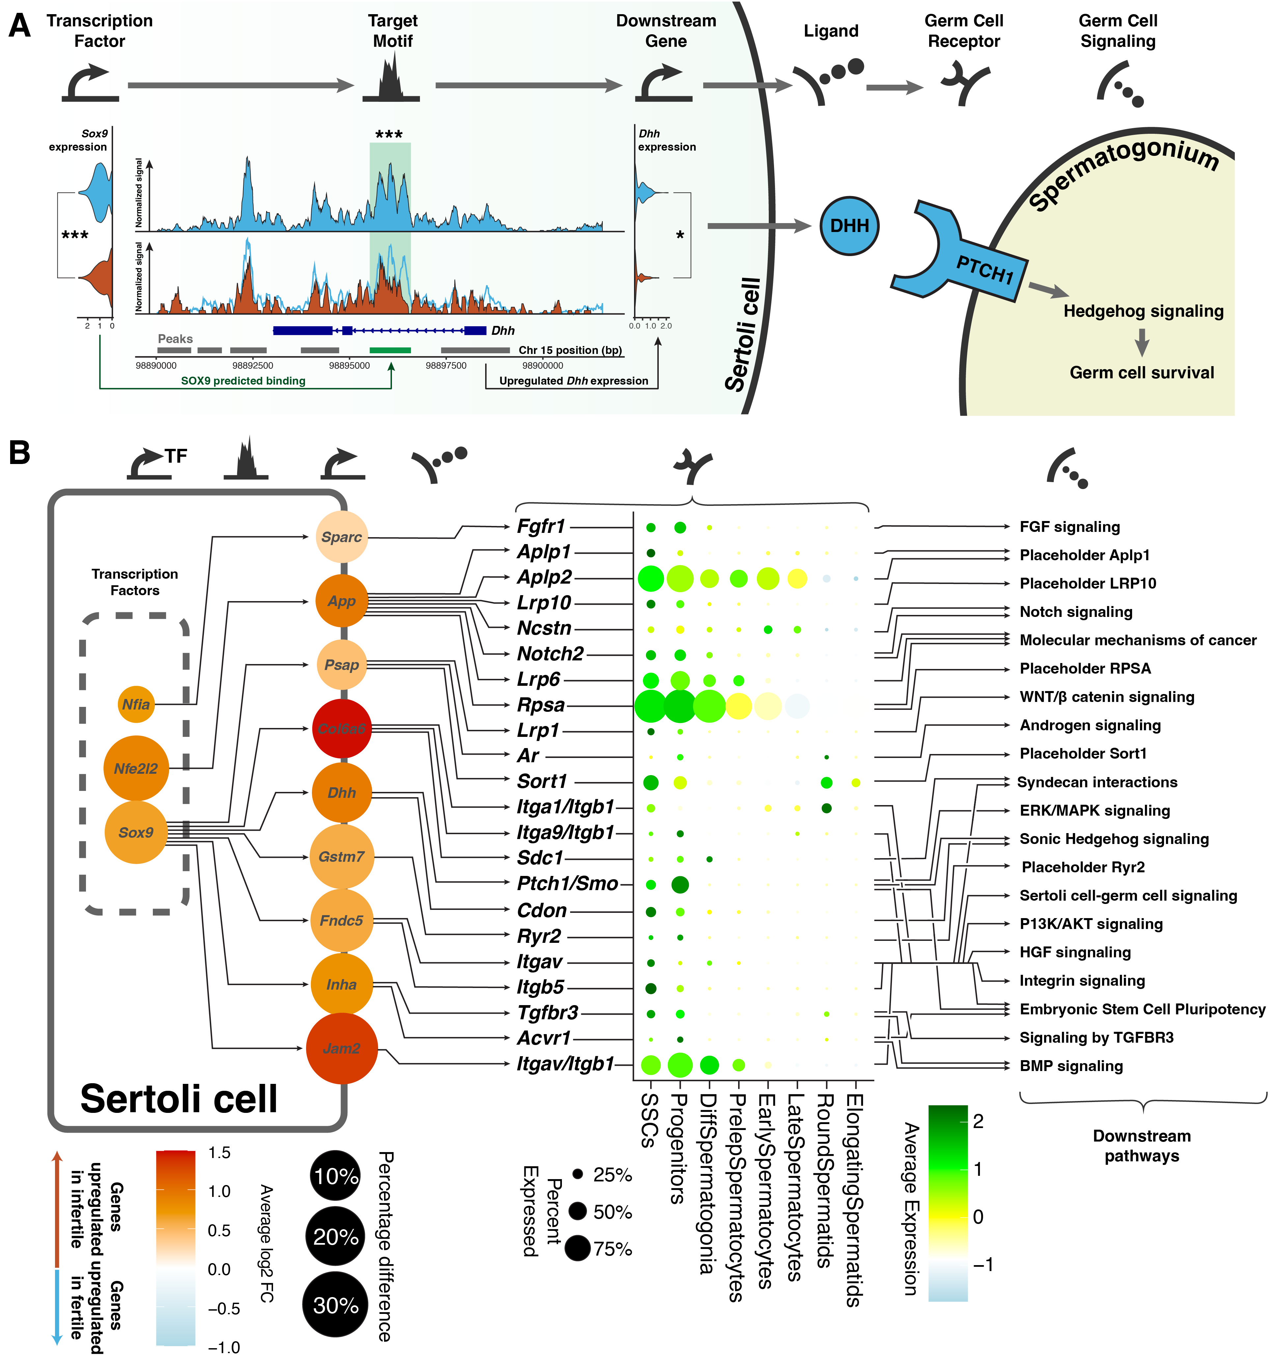

Slide 27

Thank you!
https://github.com/CSCB-Core/CSCT_resources

