Slide 1
Spatial Analysis 2
Useful software and ideas for analysis of spatial-omic data

Slide 2
Overview
(my favorite) third-party softwares
Common functions
Analysis examples

Slide 3
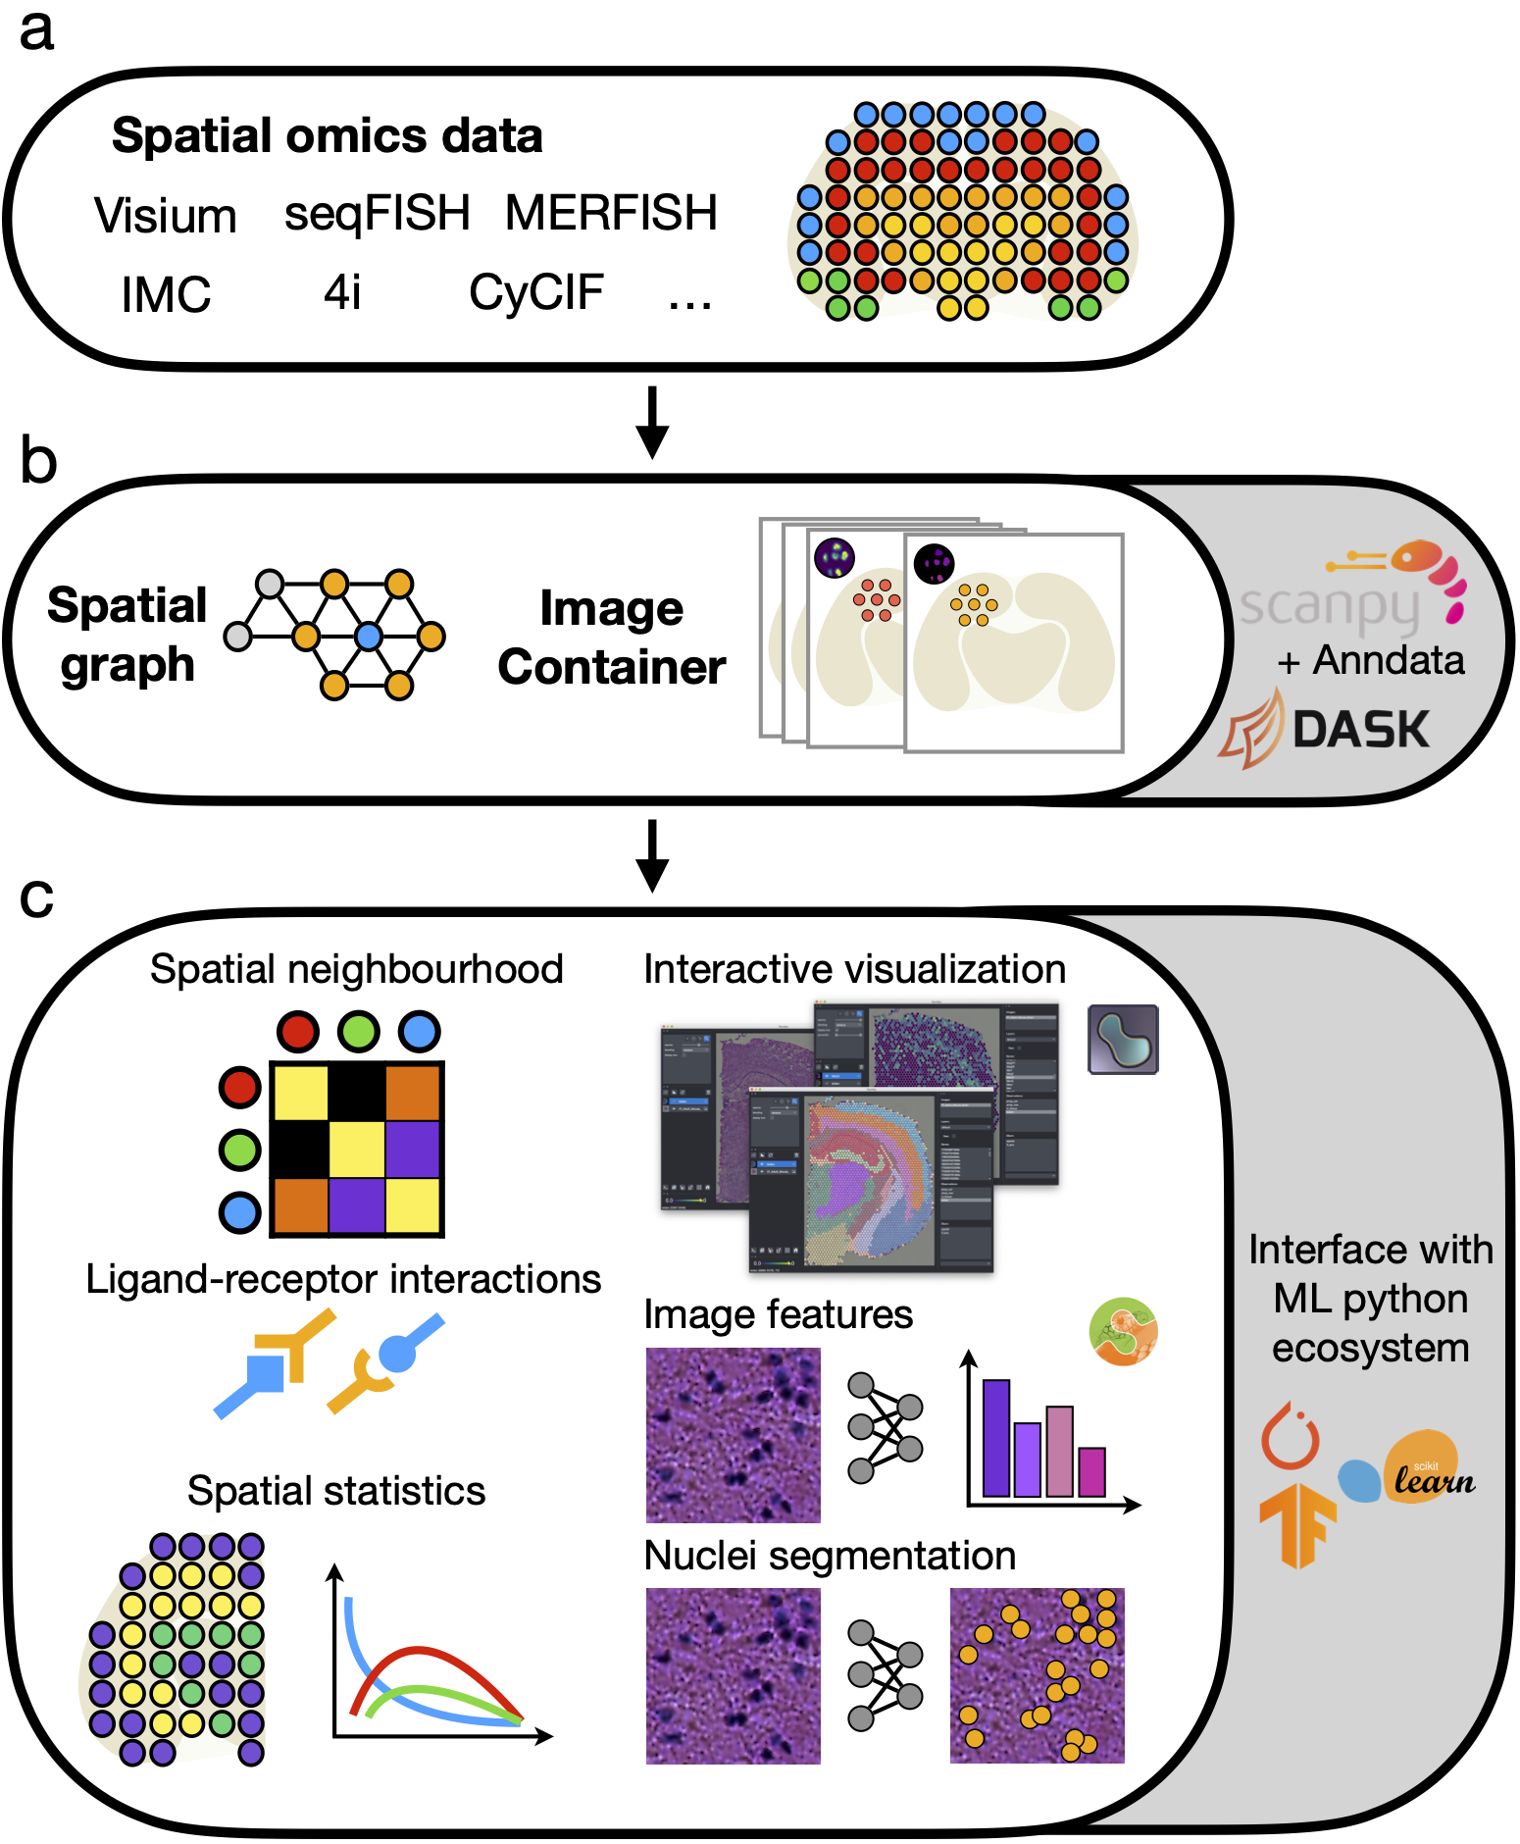
Squidpy
Part of scVerse
Diverse set of tools
Great documentation, reliable code
Third-party softwares
Spatial functions
Examples

Slide 4
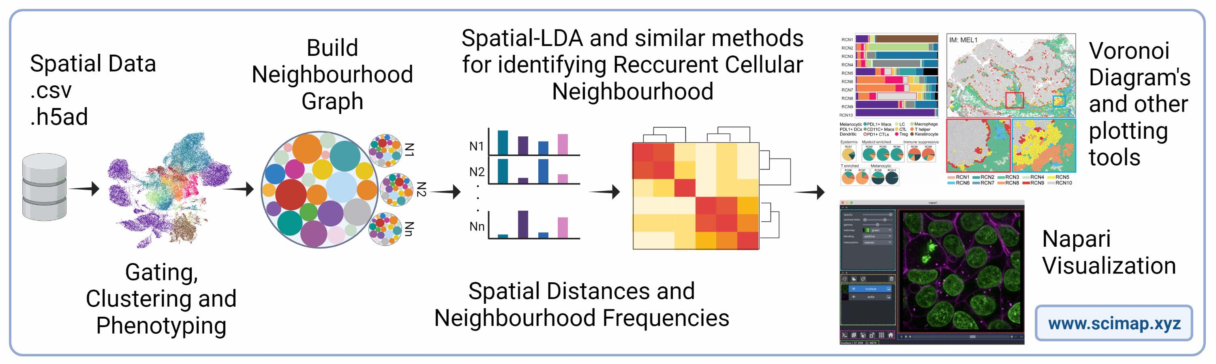
SCIMAP
Similar to scVerse
Independent development
Mostly geared for how cell labels interact
Third-party softwares
Spatial functions
Examples

Slide 5
Image analysis
Scikit-image
  Quintessential package for all things image processing (e.g. filtering, deconvolution, thresholding, measuring, etc.)
CuPy
  GPU-accelerated numpy and scipy
Dask
  Parallelization of data arrays
Shapely
  Tools for working with geometries
Third-party softwares
Spatial functions
Examples

Slide 6
Niche software
Spacexr, https://github.com/dmcable/spacexr
  Visium deconvolution, expression inference
stLearn, https://github.com/BiomedicalMachineLearning/stLearn
  Graph-based spatial trajectory inference
Sopa, https://github.com/prism-oncology/sopa
  All-in-one spatial processing pipeline
Bin2cell, https://github.com/Teichlab/bin2cell
  Combines cell segmentation with VisiumHD data
Baysor, https://github.com/kharchenkolab/Baysor
  Image-free cell segmentation
ENVI, https://github.com/dpeerlab/ENVI
  Integration of scRNA-seq with spatial
Third-party softwares
Spatial functions
Examples

Slide 7
Common functions
Neighbor graph
Co-occurrence/distance
Spatial interaction
Motif analysis
Spatial differential expression
Third-party softwares
Spatial functions
Examples

Slide 8
The neighbor graph
Cell table (N x 3)
Distance matrix (N x N)
Neighbor graph (M x 3)
BC | X | Y
1_1 | 10 | 12
1_2 | 8 | 4
1_3 | 25 | 5
1_4 | 15 | 15
1_5 | 2 | 6
… | … | …
1_N | 35 | 11
1_1
…
1_N
Node1 | Node2 | value
1_1 | 1_4 | 3.2
1_1 | 1_2 | 8.6
1_1 | 1_N | 21.23
1_2 | 1_3 | 9.6
1_2 | 1_5 | 16.8
… | … | …
1_N | 1_16 | 5.1
0
…
21.23
1_1
…
1_N
Third-party softwares
Spatial functions
Examples

Slide 9
Co-occurance/distance
20
20
10
Directional
Constrained by nearest neighbors or radius
“Interaction” counts shared edges
sq.gr.co_occurrence()
sm.tl.spatial_distance()
30
Third-party softwares
Spatial functions
Examples

Slide 10

Spatial interaction
Constrained by nearest neighbors or radius
*sq.gr.interaction_matrix()
sm.tl.spatial_interaction()
  This uses an enrichment term based on permutation
  Directional
  sq.gr.spatial_neighbors
Third-party softwares
Spatial functions
Examples

Slide 11
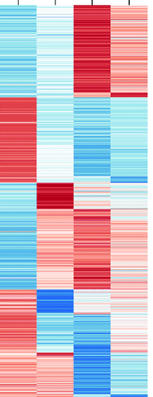
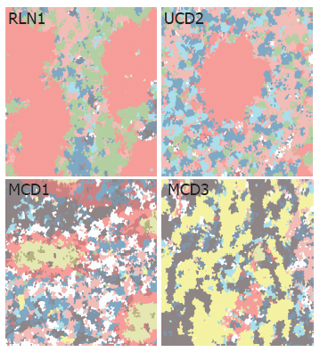
Motif analysis, simple kmeans
Cell type
Constrained by nearest neighbors or radius
Fast
sm.tl.spatial_count > sm.tl.spatial_cluster
k = 5
Motif 1
Motif 2
Cells
Motif 3
Motif 4
Motif 5
Third-party softwares
Spatial functions
Examples

Slide 12
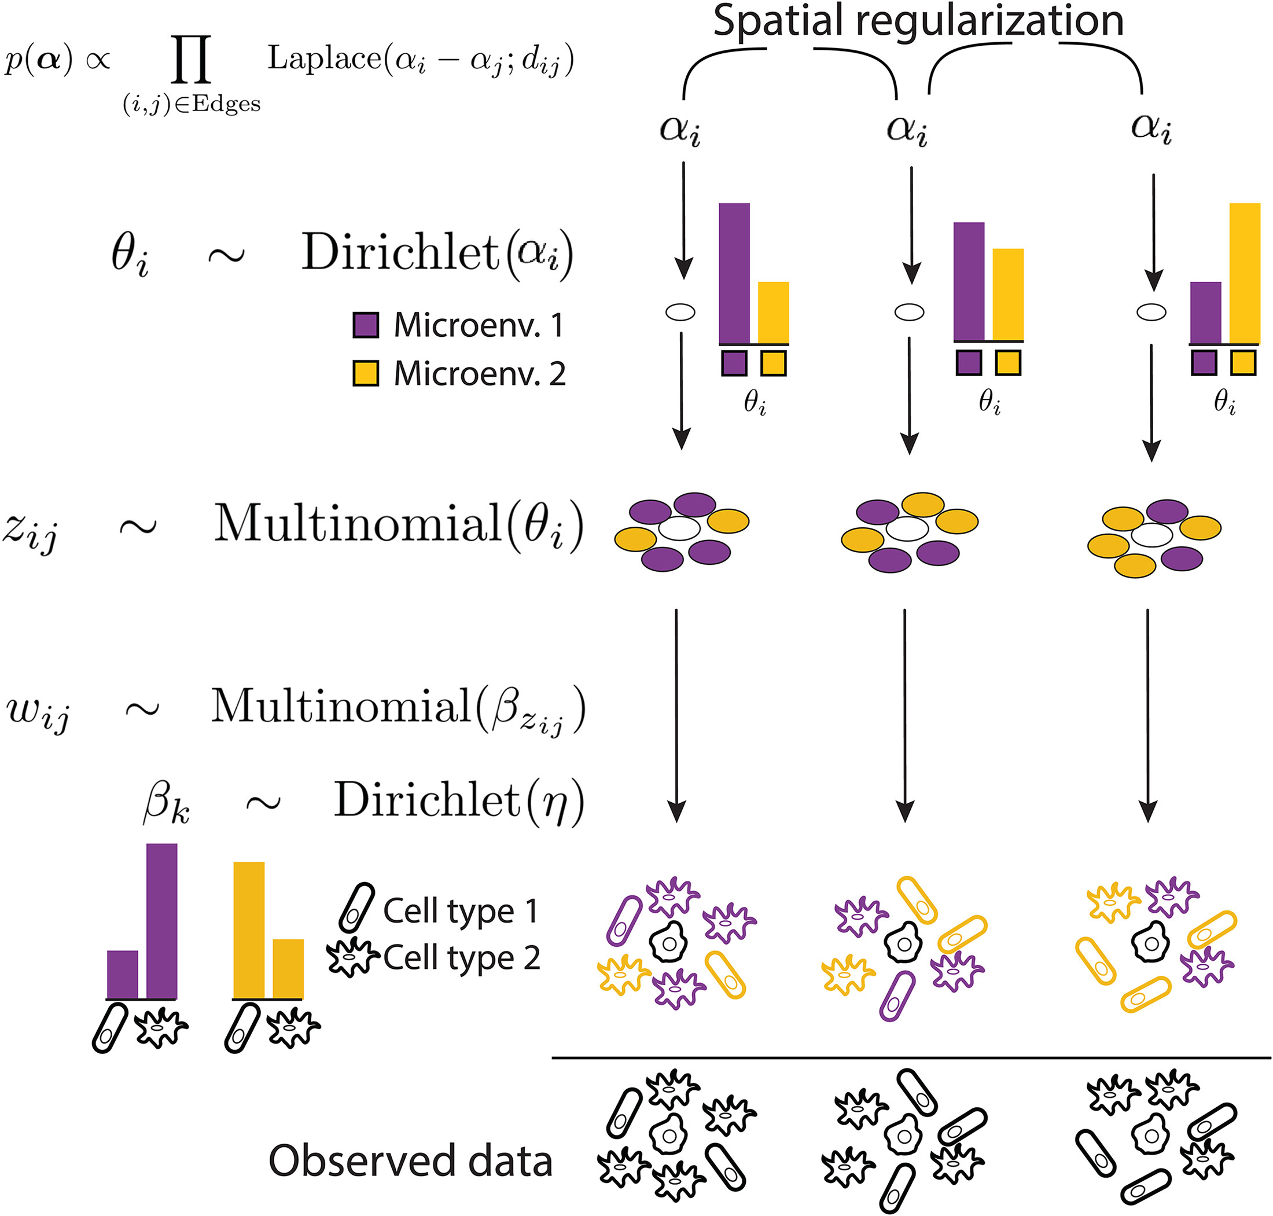
Motif analysis, latent Dirichlet allocation
Microenv.
k = 5
*This is a bad example bc kmeans is still used in the final step, but it’s based on probabilities not cell type distances
sm.tl.spatial_lda()
Motif 1
Motif 5
Motif 2
Cells
Motif 3
Motif 4
Motif 2
Third-party softwares
Spatial functions
Examples

Slide 13
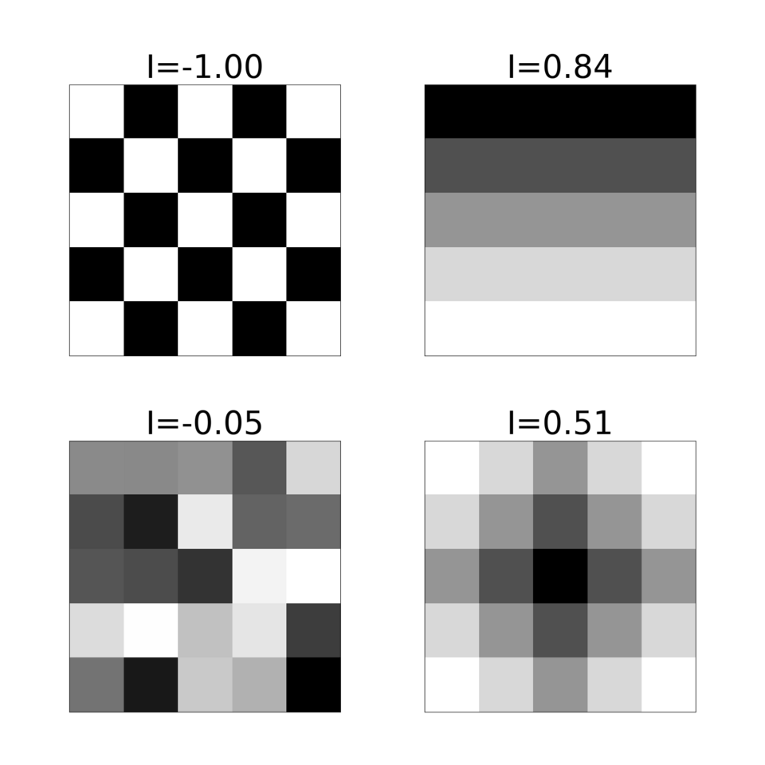

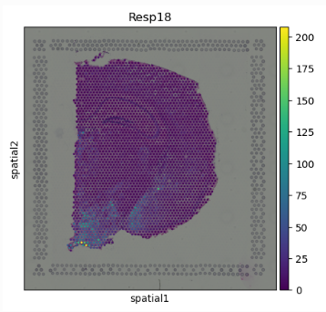
Spatial differential expression, Moran’s I
Third-party softwares
Spatial functions
Examples
Notes:
Measures 2D autocorrelation

Slide 14
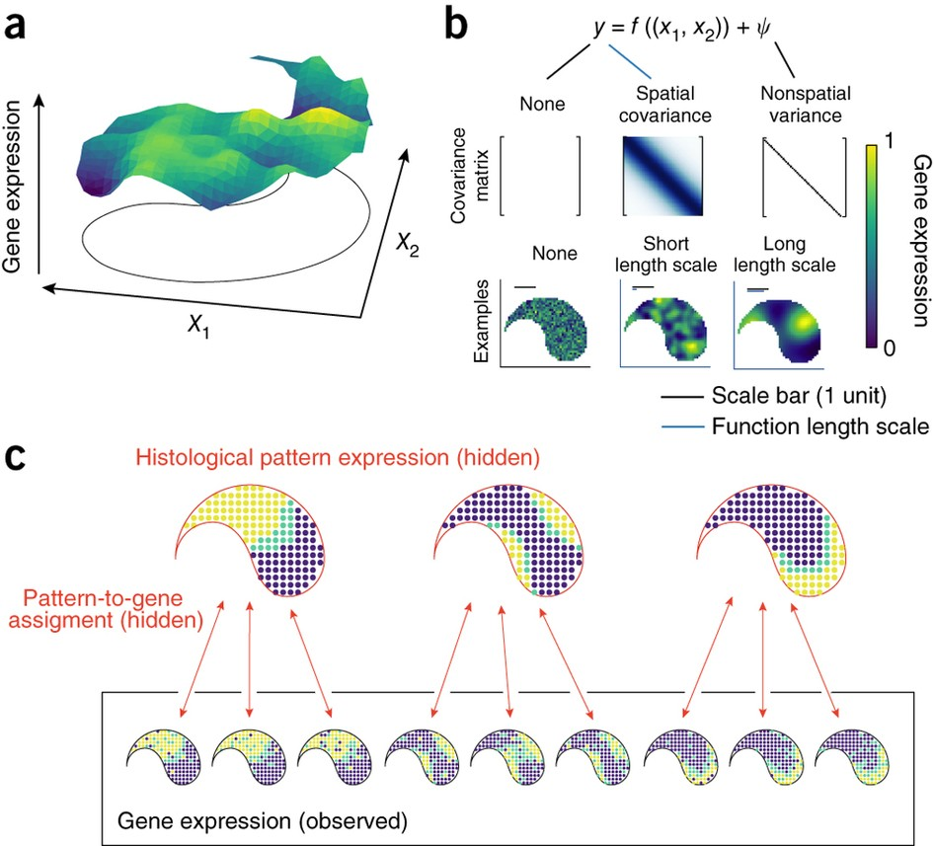
Spatial differential expression, spatialDE
https://github.com/Teichlab/SpatialDE
Model-based
Third-party softwares
Spatial functions
Examples

Slide 15
All the numbers and statistics generated by the preceding slides come from a single context of an experiment. They’re essentially descriptive. What about comparing the numbers across experiment variables?

Slide 16
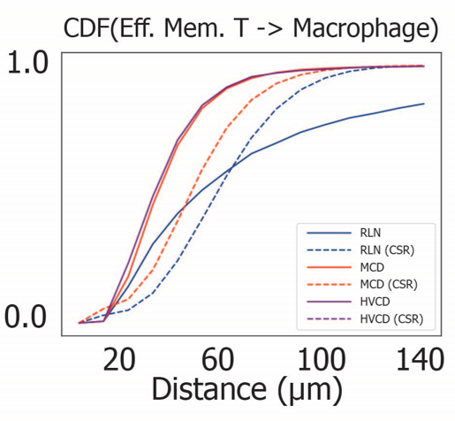
Spatial interaction
Cumulative distribution of distances
Calculate complete spatial randomness (CSR)
Compare with Kullback–Leibler divergence
“scripts/KL_test_and_more.ipynb”
Third-party softwares
Spatial functions
Examples

Slide 17
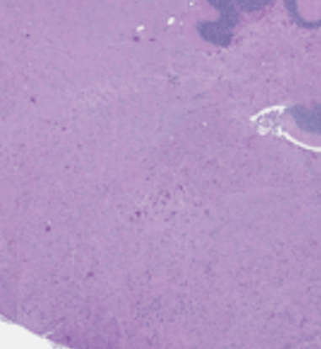
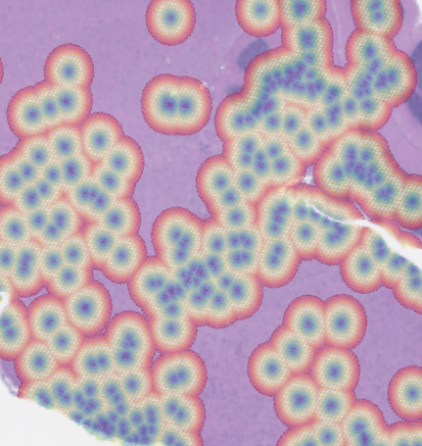
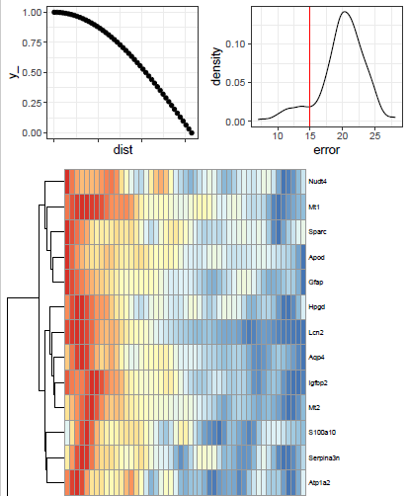
Histology-based pattern expression
“scripts/histology_differential_expression.R”
Third-party softwares
Spatial functions
Examples

Slide 18
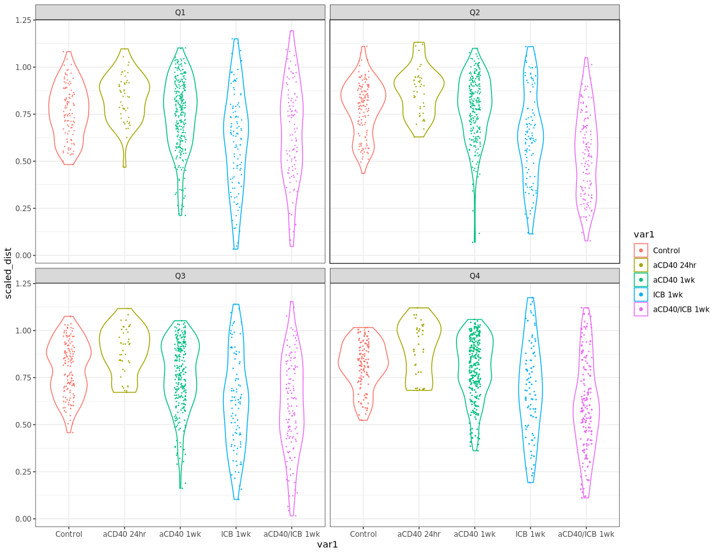
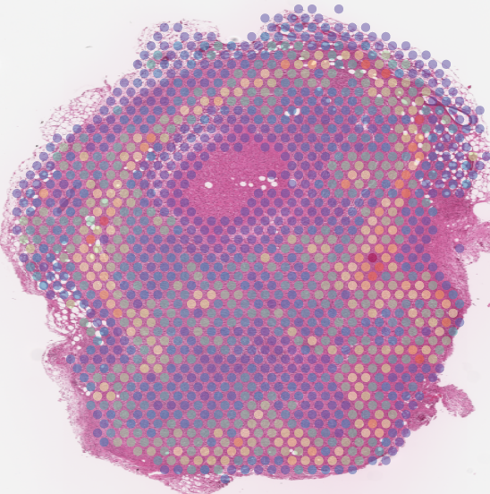
Distance as covariate
IF marker
R: “MAST” / “zinb”, with some tinkering can fit models with continuous covariates
Distance to center
“scripts/sc_covariate_DEG.R”
“scripts/cell_penetration.ipynb”
“scripts/cell_penetration.R”
Third-party softwares
Spatial functions
Examples

Slide 19
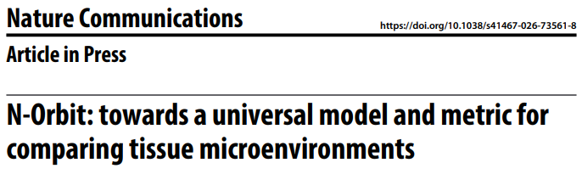
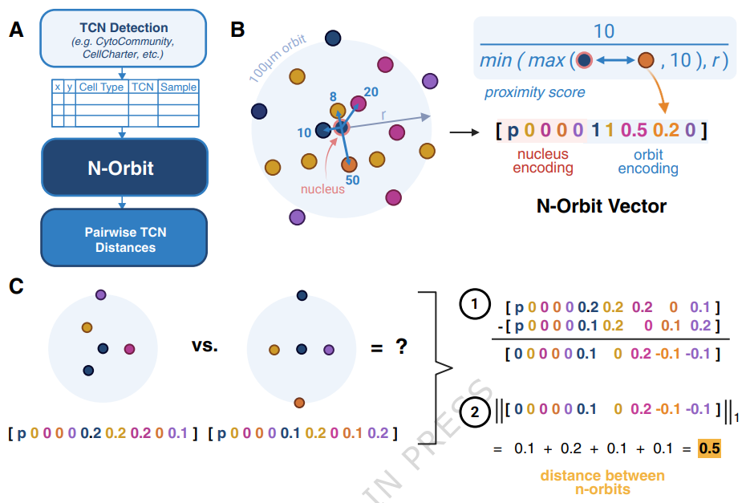
Comparing microenvironments
Compare between tissue cell neighborhoods (TCN)
Compare cells within a TCN across conditions
Third-party softwares
Spatial functions
Examples

Slide 20
Thank You!

Slide 21
Custom tasks
Tile outlier detection?
Contouring analysis?

