Slide 1
Spatial Analysis 1
Data structure fundamentals and other tips to save you time

Slide 2
Overview
Why is this important?
Architecture of SpatialData
Tips and scripts to aid visualization
https://github.com/CSCB-Core/CSCT_resources

Slide 3
R is insufficient
Less development for image analysis and processing
  More community support for Python packages
  Cupy, GPU-accelerated computation
Difficult coordination between modalities
Data storage
  BPcells (R, Python)
  Dask, HDF5, Xarray
Many R single-cell libraries are wrappers for Python packages
Less development for spatial single-cell
Importance SpatialData Tips

Slide 4
Propriety softwares
Loupe, Vizualizer, Xenium Explorer, GeoMx DSP, etc.
Rigid
Can't analyze additional samples
Annoying version control—updates may not support older file types
Importance SpatialData Tips

Slide 5
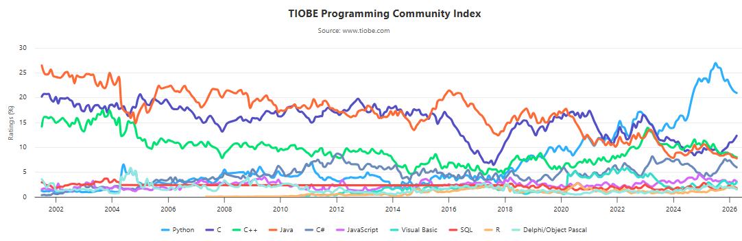
Flexible format for a growing field
Importance SpatialData Tips

Slide 6
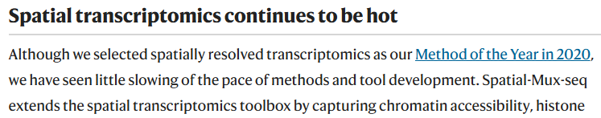
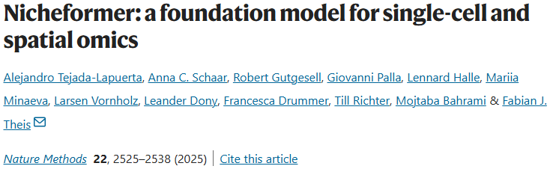
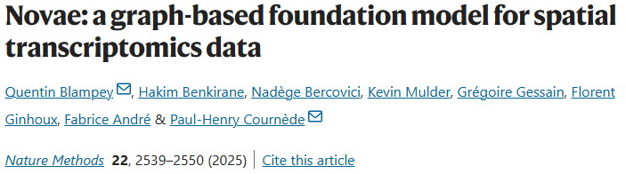
Flexible format for a growing field
Nature Methods, Year in Review 2025
Importance SpatialData Tips

Slide 7
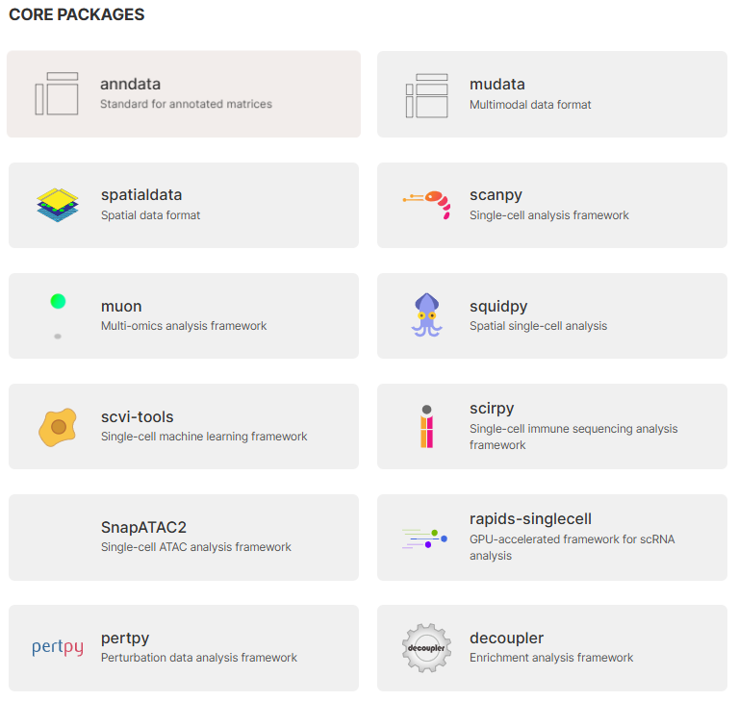
Intro to SpatialData
Importance SpatialData Tips

Slide 8
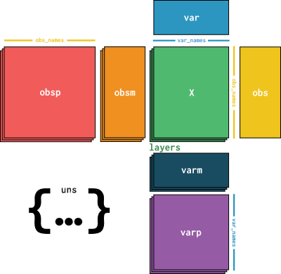
First, the AnnData (`table`) object
Layers/X = Measured values (e.g. expression), transformations, normalizations, splicing, etc
var/obs = metadata on features (e.g. gene conversions, stats) / metadata on observations (e.g. cluster, experiment group)
varm/obsm = result sets that match one dimension of either ‘var’ or ‘obs’ (e.g. UMAP).
obsp/varp = properties
Unstructured = dictionary with results of unique dimension or type (e.g. DEG results)
Importance SpatialData Tips

Slide 9
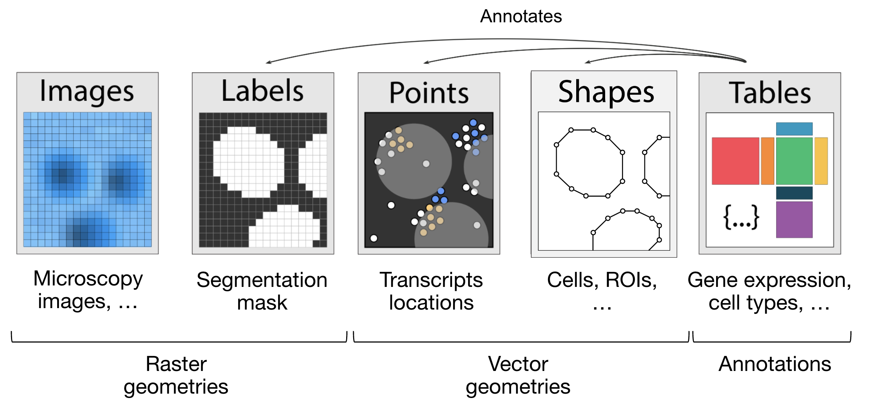
SpatialData Object
There are built-in functions to automatically read the output of most experiment types and generate the spatialdata object.
The formats are compatible with virtually every downstream analysis package
Importance SpatialData Tips

Slide 10
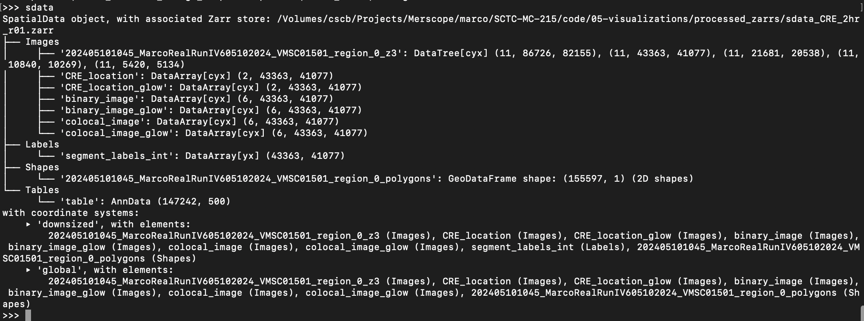
SpatialData Object
Importance SpatialData Tips

Slide 11
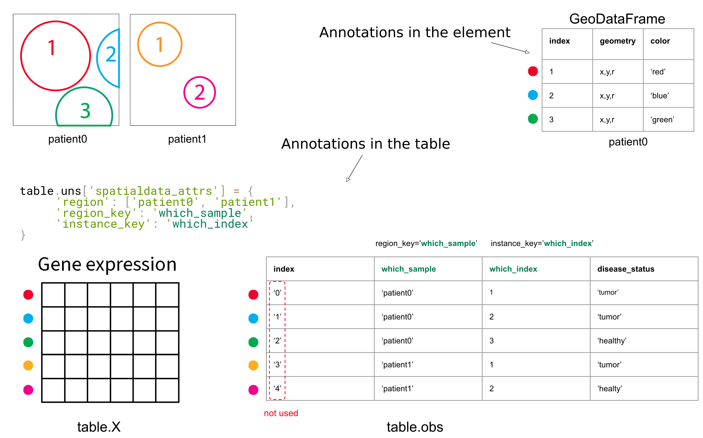
How they're coordinated
Importance SpatialData Tips

Slide 12
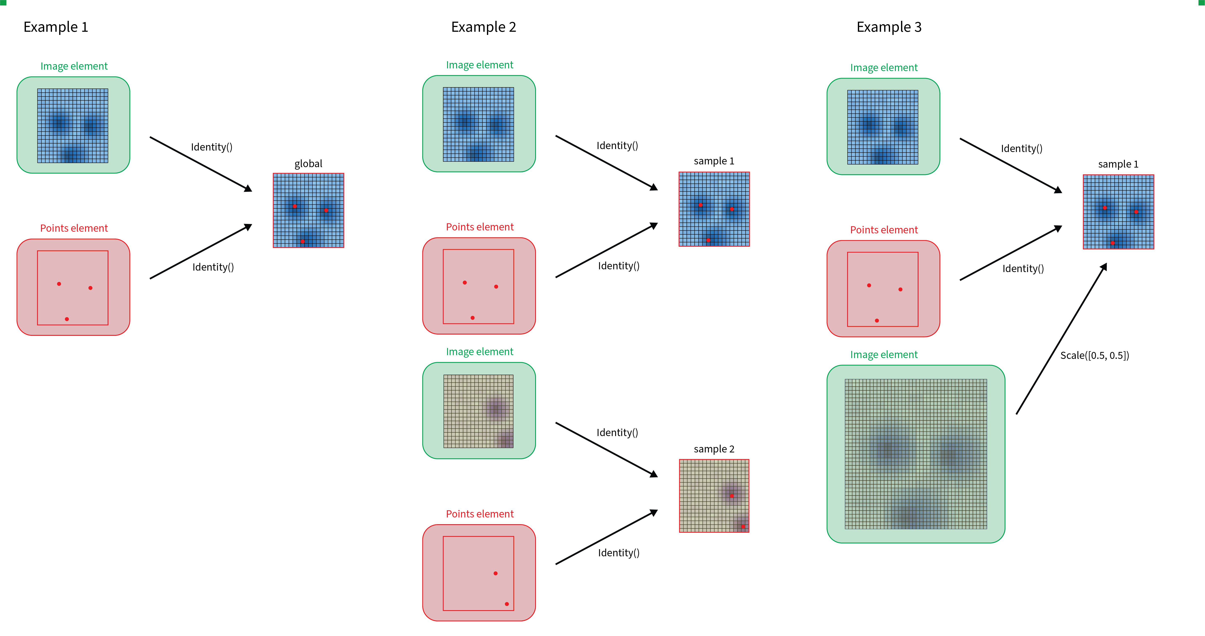
Coordination space
Importance SpatialData Tips

Slide 13
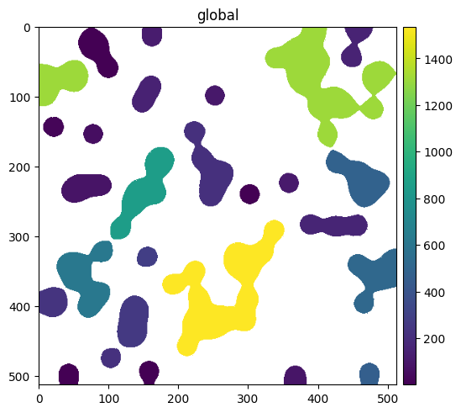
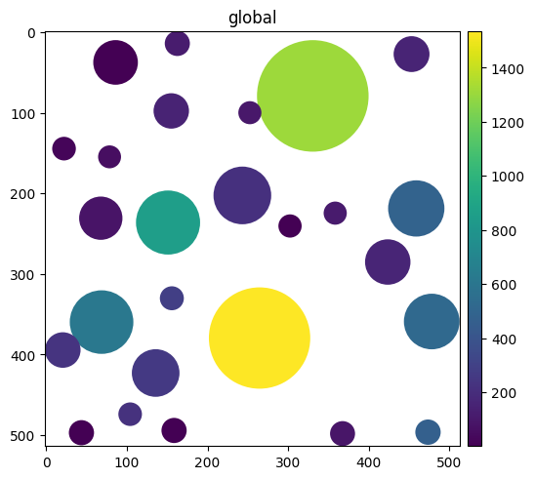
Assigning annotation space
region
region
“labels_as_blob”
“labels_as_blob”
“labels_as_blob”
channel_0_sum
3
30
5
> sdata["table"].obs["region"] = "labels_as_circles"
> sdata.set_table_annotates_spatialelement("table", region="labels_as_circles")
> sdata.pl.render_shapes("labels_as_circles", color="channel_0_sum").pl.show()
Importance SpatialData Tips

Slide 14
Managing disk storage
The zarr format is disk-backed and data is read into memory as needed
  Flexibly handles very large datasets and you don’t have to save the entire object if you make changes.
If you add a new element to your object:
  `sdata.write_element()`
If you modify or update an existing element:
  `sdata.delete_element_from_disk()`
  `sdata.write_element()`
Importance SpatialData Tips

Slide 15
Extensions
SpatialData is transitioning to be the internal format for the scverse ecosystem
Napari
  Interactive visualization
PyTorch
  Deep learning
spatialdata-io
  Converters for common spatial omics technologies
Importance SpatialData Tips

Slide 16
Tips and Scripts
Importance SpatialData Tips

Slide 17
Starting from square 1
Use conda
  https://www.anaconda.com/docs/getting-started/miniconda/main
  Python dependencies are trickier than R. Create environments for specific packages or tasks
`conda create –n your_env_name python=XX`
  This gives you pip()
  pip install vs conda install
  https://spatialdata.scverse.org/en/stable/installation.html
Respublica jupyter notebooks
  https://wiki.chop.edu/spaces/RISUD/pages/261754453/Web+Interface+With+interactive+HPC+components

Slide 18
Seurat to .h5ad
Zellconverter
SeuratDisk
  Make sure assay is Seurat v3 (not Assay5)
Manually
  Assays -> .HDF5
    This allows you to export each individual assay/layer. I think`SeuratDisk`only writes DefaultAssay()…
  Metadata, dim reducs -> .csv
    Convert factors to string
  `AnnData`/`Scanpy`
  N.B. Seurat stores assays as (features x cells), scverse expects assays to be (cells x features)
GH:"seminar_2_SpatialAnalysis1/external_h5_example.ipynb"
  Lots going on here...
Importance SpatialData Tips

Slide 19
Seurat to cloupe
`LoupeR`
Only compatible with v3 assays
Convert factors to string
Spatial experiments often have distinct barcode structures. create_loupe_from_seurat() requires {16bp BC}-NN.
Spatial locations need to be converted to a dim reduc format.
GH:"seminar_2_SpatialAnalysis1/seu_to_h5ad_and_loupe.R"
Importance SpatialData Tips

Slide 20
CellxGene
Open source
Natively reads h5ad
Not as many tools as Loupe. Can do basic differential expression, subsetting, feature plotting
Can visualize continuous variables—Loupe can not
Importance SpatialData Tips

Slide 21
SpatialData in Napari
Open source, designed for image/spatial data
  Can't do analysis (e.g. differential expression)
With Napari extension, easy, interactive visualization of SpatialData objects.
  https://spatialdata.scverse.org/projects/napari/en/latest/notebooks/spatialdata.html
Some special plugins for annotation and plotting
Be mindful of how your table element annotates the spatial element
  Label/legend interface kind of stinks
Be mindful of image sizes. Create new coordinate spaces if needed.
Importance SpatialData Tips

Slide 22
SpatialData from scratch
GH:"seminar_2_SpatialAnalysis1/binned_spatialdata.ipynb"
  Example of constructing and parsing Points, Shapes, Image, Expression, and Table elements
GH:"seminar_2_SpatialAnalysis1/bin2cell_spatialdata.ipynb"
  Build SpatialData from scratch using H&E guided segmentation of Visium HD

Slide 23
Thank you!

