Slide 1
Statistical-based Clone Detection
Final Oral Presentation
He Feng
Department of Physics
fenghe@vt.edu
Liuqing Li
Department of Computer Science
liuqing@vt.edu

Slide 2
Outline
Problem and Solution
Technical Challenges
Experiment Results
Things We Learn

Slide 3
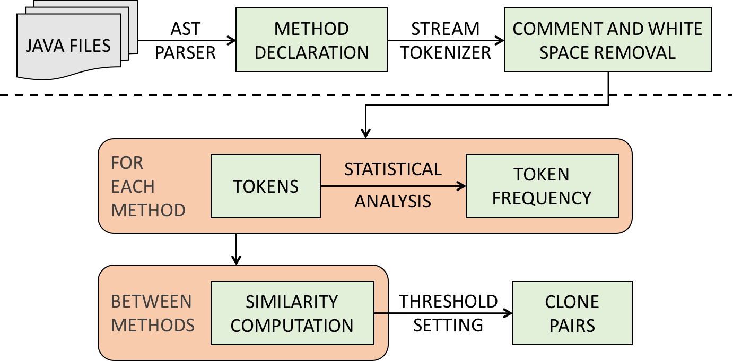
Problem and Solution
Problem and Goal
  Code Clone Detection is important
  To detect code clones between methods based on tokens
Solution: STCD
  Overall Prior Project Diagram

Slide 4
Technical Challenges
Challenges in mid-term presentation
  ASTParser ✗
  Variables Comparison ✗
  Similarity Calculation ✗
  Manual Weights ✗
  Data Collection ✗
  Results Comparison ✗
  UI Development ✗

Slide 5
Technical Challenges
Challenges in mid-term presentation
  ASTParser ✗
  Variables Comparison ✗
  Similarity Calculation ✗
  Manual Weights ✗
  Data Collection ✗
  Results Comparison ✗
  UI Development ✗

Slide 6
Technical Challenges
ASTParser ✗
  Excessive time cost
  Improve the method parsing process
  e.g. Regular expression
  Build-in functions are helpful
Variables Comparison ✓
  e.g. errorLineMessage and messageErrorLine
  Bigram Algorithm has been applied
  Threshold is 0.7

Slide 7
Technical Challenges
Challenges in mid-term presentation
  ASTParser ✗
  Variables Comparison ✓
  Similarity Calculation ✗
  Manual Weights ✗
  Data Collection ✗
  Results Comparison ✗
  UI Development ✗

Slide 8
Technical Challenges
Similarity Calculation
  Old Similarity Algorithm for token Lists
    Sim(List_{x}, List_{y}) = 1 / (1 + Distance(List_{x}, List_{y}))
    Distance (List_{x}, List_{y}): Euclidean Distance
    Not consider the list length
  Example 1
    List_{x}= {<a, 3>, <b, 3>, … , <y, 3>, <z, 1>}
    List_{y}= {<a, 3>, <b, 3>, … , <y, 3>, <z, 10>}
    Sim(List_{x}, List_{y}) = 1 / (1 + 9) = 0.1
  Example 2
    List_{x}= {<a, 3>, <b, 5>, <c, 4>, <d, 1>}
    List_{y}= {<a, 0>, <b, 2>, <c, 1>, <d, 4>}
    Sim(List_{x}, List_{y}) = 1 / (1 + 6) = 0.14
Vector
methodPara
methodType
tokenListNum
tokenListType
tokenListKeyword
tokenListMarker
tokenListOperator
tokenListOther1
tokenListOther2

Slide 9
Technical Challenges
Similarity Calculation ✓
  New Similarity Algorithm for token Lists
    Diff(Elem_{x_a}, Elem_{y_a}) = abs(Freq_{x_a} – Freq_{y_a})
    Sim(List_{x}, List_{y}) = 1 - ∑Diff(Elem_{x_i}, Elem_{y_i}) / (∑Freq_{x_i} + ∑Freq_{y_i})
    Similar to Levenshtein distance
  Example 1
    List_{x}= {<a, 3>, <b, 3>, … , <y, 3>, <z, 1>}
    List_{y}= {<a, 3>, <b, 3>, … , <y, 3>, <z, 10>}
    Sim(List_{x}, List_{y}) = 1 - 9 / (76 + 85) = 0.94
  Example 2
    List_{x}= {<a, 3>, <b, 5>, <c, 4>, <d, 1>}
    List_{y}= {<a, 0>, <b, 2>, <c, 1>, <d, 4>}
    Sim(List_{x}, List_{y}) = 1 - 12 / (13 + 7) = 0.4
Vector
methodPara
methodType
tokenListNum
tokenListType
tokenListKeyword
tokenListMarker
tokenListOperator
tokenListOther1
tokenListOther2

Slide 10
Technical Challenges
Challenges in mid-term presentation
  ASTParser ✗
  Variables Comparison ✓
  Similarity Calculation ✓
  Manual Weights ✗
  Data Collection ✗
  Results Comparison ✗
  UI Development ✗

Slide 11
Technical Challenges
Manual Weights
JAVA FILES
METHOD
DECLARATION
COMMENT AND WHITE SPACE REMOVAL
AST
PARSER
STREAM
TOKENIZER
FOR
EACH
METHOD
TOKENS
TOKEN
FREQUENCY
STATISTICAL
ANALYSIS
BETWEEN
METHODS
SIMILARITY
COMPUTATION
CLONE
PAIRS
THRESHOLD
SETTING

Slide 12
Technical Challenges
Manual Weights
JAVA FILES
METHOD
DECLARATION
COMMENT AND WHITE SPACE REMOVAL
AST
PARSER
STREAM
TOKENIZER
FOR
EACH
METHOD
TOKENS
TOKEN
FREQUENCY
STATISTICAL
ANALYSIS
BETWEEN
METHODS
SIMILARITY
COMPUTATION
CLONE
PAIRS
THRESHOLD
SETTING

Slide 13

Technical Challenges
Manual Weights
  Abstraction
BETWEEN
METHODS
SIMILARITY
COMPUTATION
CLONE
PAIRS
THRESHOLD
SETTING
S1
I1
W1
S2
I2
W2
Out
1 — Pair
0 — Not Pair
W9
Threshold
S9
I9

Slide 14

Technical Challenges
Manual Weights
  Multilayer perceptron (MLP)
Training Process: Feedback
W
H1
Testing Process
S1
I1
H2
W
S2
I2
Out
1 — Pair
H3
0 — Not Pair
Threshold
S9
I9
Hn
Input Layer
Hidden Layer
Output Layer

Slide 15
Technical Challenges
Manual Weights ✓
JAVA FILES
METHOD
DECLARATION
COMMENT AND WHITE SPACE REMOVAL
AST
PARSER
STREAM
TOKENIZER
FOR
EACH
METHOD
TOKENS
STATISTICAL
ANALYSIS
TOKEN
FREQUENCY
BETWEEN
METHODS
MLP
SIMILARITY
COMPUTATION
CLONE
PAIRS
TRAINING
DATA

Slide 16
Technical Challenges
Challenges in mid-term presentation
  ASTParser ✗
  Variables Comparison ✓
  Similarity Calculation ✓
  Manual Weights ✓
  Data Collection ✗
  Results Comparison ✗
  UI Development ✗

Slide 17
Technical Challenges
Data Collection ✓
  See Experiment Results
Results Comparison ✓
  See Experiment Results
UI Development ✓
  From Swing to SWT 4.5 release
  Native elements and native behavior

Slide 18
Technical Challenges
Challenges in mid-term presentation
  ASTParser ✗
  Variables Comparison ✓
  Similarity Calculation ✓
  Manual Weights ✓
  Data Collection ✓
  Results Comparison ✓
  UI Development ✓

Slide 19
Experiment Results
Source: https://github.com/CSCC5704
  ASTParserTool.java
  BiGramSimilarity.java
  CCDTool.java
  MethodList.java
  MethodSimilarity.java
  MethodTokenizerTool.java
  MethodVector.java
  MultiplePerceptronTool.java
  Result.java
  TokenList.java
  TokenVector.java

Slide 20
Experiment Results
Detection of Software Clones
  http://www.bauhaus-stuttgart.de/clones/
  A general repository and information center for Detection of Software Clones
  Accept files with labeled clones for clone detection tool evaluation
  An example of submission file:
Does not meet our requirement so we use manual selection to find ground truth
#1: | foo.c | 12 | 56 | bar.c | 68 | 90 | 1
#2: | wom.c | 34 | 50 | bat.c | 90 | 124 | 2
#3: | wom.c | 69 | 100 | bar.c | 45 | 70 | 1
#4: | wom.c | 69 | 100 | foo.c | 59 | 80 | 1

Slide 21
Experiment Results
Training Data: SWT (# of methods 12~125)
Test Data: SWT(# of methods 38~276)
Combo.txt | Label.txt | Text.txt
DragSource.txt | Printer.txt | WebKit.txt
DropTarget.txt | Program.txt
FormData.txt | Shell.txt
Accessible.java | Menu.java | ToolBar.java
Button.java | Spinner.java | ToolItem.java
Control.java | TabFolder.java | Tracker.java
CoolBar.java | Table.java | Tree.java
Display.java | TableItem.java

Slide 22
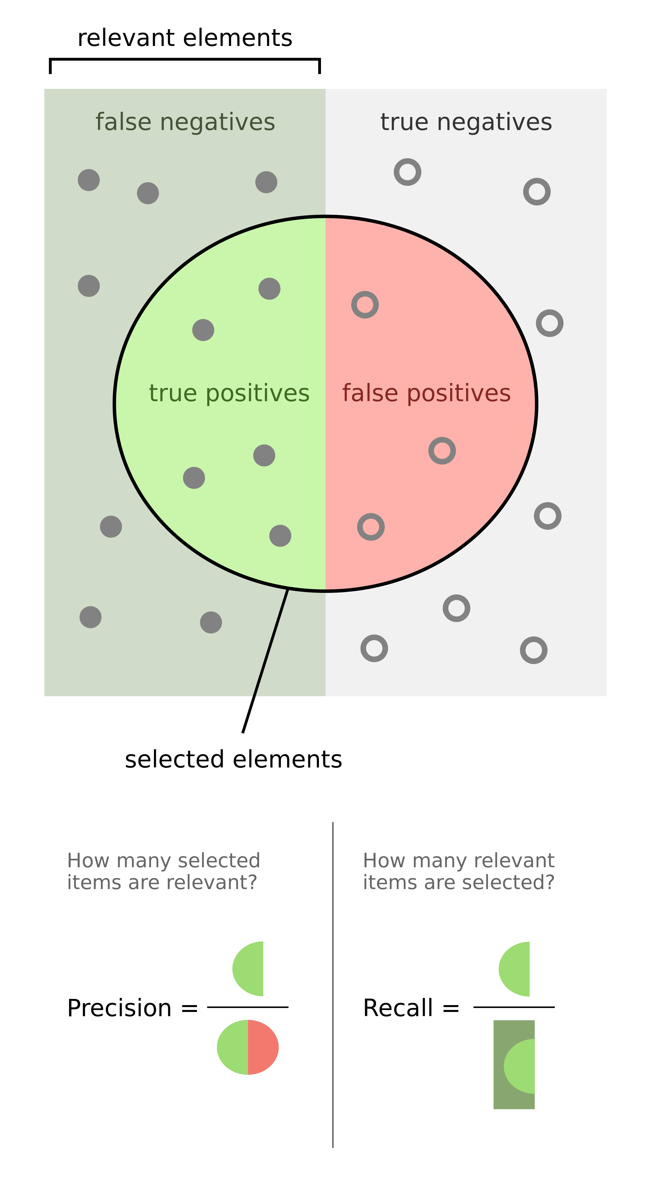
Experiment Results
Evaluation: Precision and Recall

Slide 23
Experiment Results
Experiment 1
Test Files | TP + FN (Actual Clones) | TP + FP (Clones Detected) | TP
Button.java | 0 | 4 | 0
CoolBar.java | 11 | 12 | 10
Menu.java | 1 | 0 | 0
Spinner.java | 2 | 2 | 2
TabFolder.java | 3 | 2 | 2
TableItem.java | 20 | 20 | 18
ToolBar.java | 4 | 4 | 4
ToolItem.java | 3 | 3 | 3
Tracker.java | 1 | 1 | 1
Tree.java | 11 | 13 | 9

Slide 24
Experiment Results
Experiment 1
Test Files | TP + FN (Actual Clones) | TP + FP (Clones Detected) | TP
Button.java | 0 | 4 | 0
CoolBar.java | 11 | 12 | 10
Menu.java | 1 | 0 | 0
Spinner.java | 2 | 2 | 2
TabFolder.java | 3 | 2 | 2
TableItem.java | 20 | 20 | 18
ToolBar.java | 4 | 4 | 4
ToolItem.java | 3 | 3 | 3
Tracker.java | 1 | 1 | 1
Tree.java | 11 | 13 | 9

Slide 25
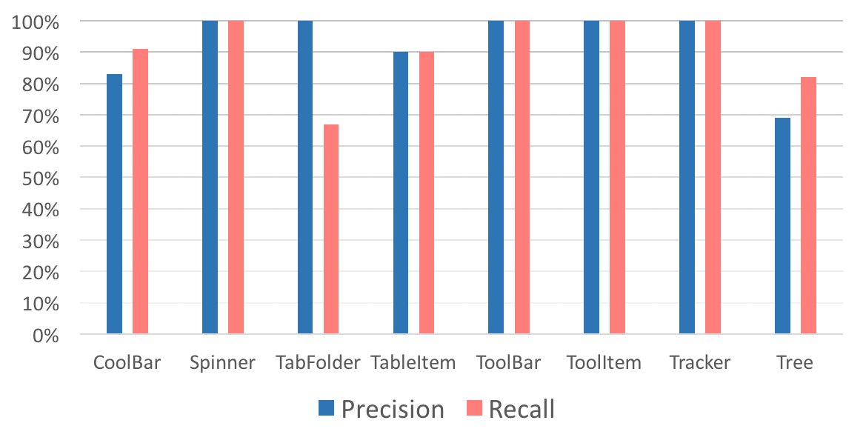
Experiment Results
Experiment 1
  Avg. Precision = 92.75%
  Avg. Recall = 91.25%

Slide 26
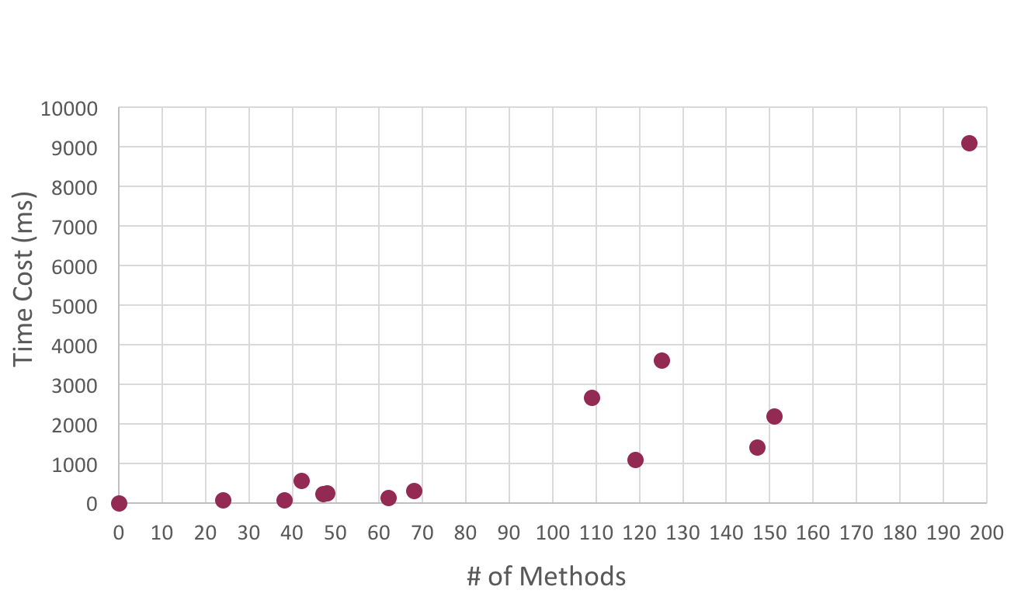
Experiment Results
Experiment 2

Slide 27
Things We Learn
Lectures
  ASTParser Tool
  Bigram Algorithm
  Precision and Recall
Papers
  Similarity Algorithms
  Other Detection Methods
    CMCD, Boreas, AnDarwin, RTF
Others
  First time to use SWT
  Collaboration and discussion

Slide 28
Thank you !
Final Oral Presentation

