Slide 1
Statistical-based Clone Detection
Midpoint Oral Presentation
He Feng
Department of Physics
fenghe@vt.edu
Liuqing Li
Department of Computer Science
liuqing@vt.edu

Slide 2
Outline
Problem Definition
Solution Design
Implementation Status
Technical Challenges
Future Work

Slide 3
Problem Definition
Code Clone
  Code fragment identical or similar to another
Pros
  Improves efficiency
  Increases readability
Cons
  Low maintainability
  Increases code size
Clone Types (Type 1, 2, 3, 4)
Techniques and Tools (Text, Token, Tree, Graph)

Slide 4
Problem Definition
Prerequisites
  Token-based detection tool shows the best performance
  Developers won’t make dramatic changes in code clone
Goal
  Design and implement STCD (Statistical-based Clone Detection) tool to detect the Type 1, 2, 3 code clones between methods based on tokens
Validity
  Ambiguous match

Slide 5
Solution Design
Fragment A and B
  Use a parser to catch all the tokens
  Categorize key tokens into types, variables, identifiers, operators, etc.
  Accumulate the occurrences of each key token
  Transform the fragment into a list of key token and frequency
  Calculate the similarity between two lists
  Set a threshold to the final output

Slide 6
Solution Design
Overall Current Project Diagram
JAVA FILES
METHOD
DECLARATION
COMMENT AND WHITE SPACE REMOVAL
AST
PARSER
STREAM
TOKENIZER
FOR
EACH
METHOD
TOKENS
TOKEN
FREQUENCY
STATISTICAL
ANALYSIS
BETWEEN
METHODS
SIMILARITY
COMPUTATION
CLONE
PAIRS
THRESHOLD
SETTING

Slide 7
Solution Design
Overall Current Project Diagram
JAVA FILES
METHOD
DECLARATION
COMMENT AND WHITE SPACE REMOVAL
AST
PARSER
STREAM
TOKENIZER
FOR
EACH
METHOD
TOKENS
TOKEN
FREQUENCY
STATISTICAL
ANALYSIS
BETWEEN
METHODS
SIMILARITY
COMPUTATION
CLONE
PAIRS
THRESHOLD
SETTING

Slide 8
Solution Design
Method Declaration
  CompilationUnit result
  MethodDeclaration method
Method Info. | Function
startLineNumber | result.getLineNumber(…)
endLineNumber | result.getLineNumber(…)
methodName | method.getName()
methodPara | method.parameters()
methodType | method.getReturnType2()
methodBody | method.getBody()

Slide 9
Solution Design
Overall Current Project Diagram
JAVA FILES
METHOD
DECLARATION
COMMENT AND WHITE SPACE REMOVAL
AST
PARSER
STREAM
TOKENIZER
FOR
EACH
METHOD
TOKENS
TOKEN
FREQUENCY
STATISTICAL
ANALYSIS
BETWEEN
METHODS
SIMILARITY
COMPUTATION
CLONE
PAIRS
THRESHOLD
SETTING

Slide 10
Solution Design
Token & Token Frequency
  StreamTokenizer
Categories | Tokens
Number | 123, 24.5, …
Type | int, char, double, boolean, null, true, false, …
Keyword | static, for, if, else, while, return, this, const, …
Marker | {, }, [, ], (, )
Operator | +, -, *, /, %, ^, <, >, !, …
Other1 | variables, …
Other2 | ?, #, $, …

Slide 11
Solution Design
Token & Token Frequency
  tokenList: store token frequency
  For two categories(e.g. Type and Keywords)
Type | Frequency
int | 8
char | 6
double | 3
boolean | 0
… | …
true | 2
false | 2
Keywords | Frequency
for | 2
if | 1
else | 1
return | 2
… | …
this | 4
static | 3

Slide 12
Solution Design
Overall Current Project Diagram
JAVA FILES
METHOD
DECLARATION
COMMENT AND WHITE SPACE REMOVAL
AST
PARSER
STREAM
TOKENIZER
FOR
EACH
METHOD
TOKENS
TOKEN
FREQUENCY
STATISTICAL
ANALYSIS
BETWEEN
METHODS
SIMILARITY
COMPUTATION
CLONE
PAIRS
THRESHOLD
SETTING

Slide 13
Solution Design
Similarity Computation
  Method Similarity
  9-Dimentional Vetcor
    X = <X1, X2, X3, X4, X5, X6, X7, X8, X9>
    Y = <Y1, Y2, Y3, Y4, Y5, Y6, Y7, Y8, Y9>
    Sim(X1, Y1) = bigram(X1, Y1)
    Sim(X2, Y2) = 1 / 0
    Sim(X_{else}, Y_{else}) = 1 / 1 + Distance(X_{else}, Y_{else})
    Distance (X_{else}, Y_{else}): Euclidean Distance
    Sim(X, Y) = Sum(wi * Sim(Xi, Yi)) (i = 1, 2, …, 9)
Vector
methodPara
methodType
tokenListNum
tokenListType
tokenListKeyword
tokenListMarker,
tokenListOperator
tokenListOther1
tokenListOther2

Slide 14
Solution Design
Overall Current Project Diagram
JAVA FILES
METHOD
DECLARATION
COMMENT AND WHITE SPACE REMOVAL
AST
PARSER
STREAM
TOKENIZER
FOR
EACH
METHOD
TOKENS
TOKEN
FREQUENCY
STATISTICAL
ANALYSIS
BETWEEN
METHODS
SIMILARITY
COMPUTATION
CLONE
PAIRS
THRESHOLD
SETTING

Slide 15
Solution Design
Threshold Setting 1
  For Variables: DrawPointLine vs. PointLineDraw
  tokenThreshold for bigram similarity
  e.g. tokenThreshold > 0.7
Threshold Setting 2
  detectThreshold for method similarity
  e.g. detectThreshold > 0.5
Threshold Setting 3
  lineThreshold for method lines
  e.g. endLineNum - startLineNum > 7

Slide 16
Implementation Status
Source: https://github.com/CSCC5704
  CodeClone.java
    Detect cloned code in java files
  MethodSimilarity.java
    Calculate the similarity of two methods
  BiGramSimilarity.java
    Calculate the similarity of two strings by using bi-gram algorithm
  ASTParserTool.java
    Use JDT ASTParser to parse the java source code into methods
  MethodTokenizerTool.java
    Tokenize method body and get the frequency of tokens
  MethodList.java, MethodVector.java
  TokenList.java, TokenVector.java, …

Slide 17
Implementation Status
TokenList.java
Token | Category | Freq
int | Type | 1
for | Keyword | 1
i | Other1 | 8
System | Other1 | 3
out | Other1 | 3
println | Other1 | 3
toBinary | Other1 | 1
Integer | Other1 | 1
toBinaryString | Other1 | 1
( | Marker | 6
Token | Category | Freq
) | Marker | 6
} | Marker | 2
{ | Marker | 1
+ | Operator | 6
= | Operator | 1
- | Operator | 1
< | Operator | 1
: | Other2 | 2
5.0 | Num | 1
33.0 | Num | 1

Slide 18
Implementation Status
Java Source Files from GitHub with LOC 200~3000
Find out pairs of clone code
  Output Format
  Clone Group # --> Similarity: #
  Method Name 1 Start Line # End Line #
  Method Name 2 Start Line # End Line #
Matches well with manual examination

Slide 19
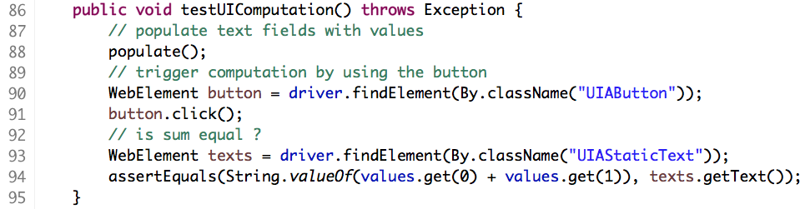
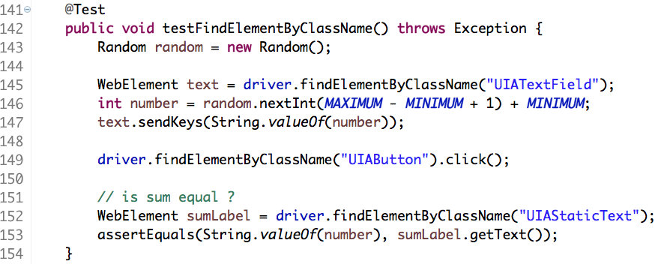
Implementation Status
Source: https://github.com/appium/sample-code
Clone Group 3 --> Similarity: 0.5102

Slide 20
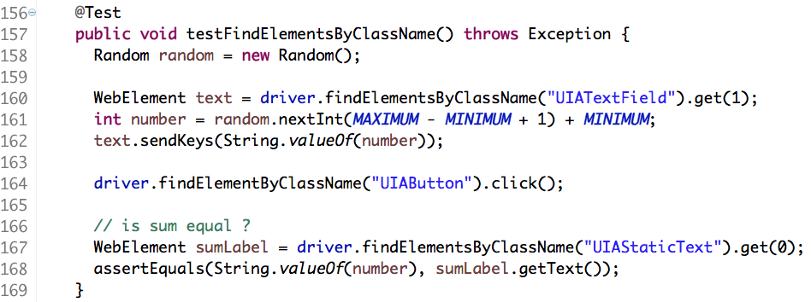
Implementation Status
Source: https://github.com/appium/sample-code
Clone Group 5 --> Similarity: 0.6676

Slide 21
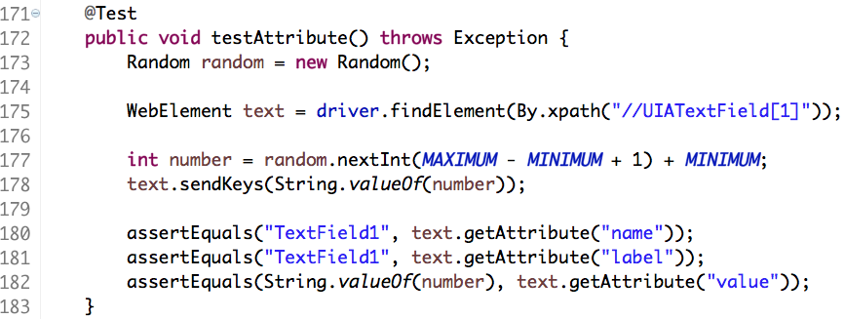
Implementation Status
Source: https://github.com/appium/sample-code
Clone Group 6 --> Similarity: 0.6190

Slide 22
Implementation Status
Apache Commons
  http://commons.apache.org
Two Files
  FileUtils.java
    Total methods: 106
    Cloned methods: 11 pairs (no clusters)
    Ratio: 20.8%
  IOUtils.java
    Total methods: 105
    Cloned methods: 4 pairs (no clusters)
    Ratio: 7.62%

Slide 23
Technical Challenges
ASTParser
  Excessive time cost
  Improve the method parsing process
  e.g. regular expression
Manual weights and threshold
  9-Dimentional (w1, …, w9)
  Machine Learning Techniques (Training Data)
  e.g. Multilayer perceptron (MLP)

Slide 24
Future Work
Variables Comparison
  Bigram Algorithm
Data Collection
  Training Data for Machine Learning
  Test Data for results comparison
Results Comparison
  Precision & Recall
UI Development
  Java WindowBuilder

Slide 25
Thank you !
Midpoint Oral Presentation

