Slide 1
Statistical-based Clone Detection
(STCD)
Mid-point Presentation
He Feng
Department of Physics
fenghe@vt.edu
Liuqing Li
Department of Computer Science
liuqing@vt.edu

Slide 2
Outline
Problem Definition
Solution Design
Implementation Status
Technical Challenges
Future Work

Slide 3
Problem Definition
Code Clone:
  Code fragment identical or similar to another
Pros:
  Improves efficiency, increases readability
Cons
  Low maintainability, increases code size
Clone Types:
  Type 1 – Type 4
Techniques and Tools
  Text-based, token-based, tree-based, graph-based

Slide 4
Our Proposed Solution
Prerequisites
  Token-based detection tool shows the best performance
  Developers won’t make dramatic changes in code clone
Goal
  Design and implement a Statistical-based Clone Detection(STCD) tool to detect the Type 1, 2, 3 code clones between code methods based on tokens
Validity
  Ambiguous match

Slide 5
Our Proposed Solution
Fragment A and B
  Use a parser to catch all the tokens
  Categorize key tokens into types, variables, identifiers, operators, etc.
  Accumulate the occurrences of each key token
  Transform the fragment into a list of key token and frequency
  Calculate the similarity between two lists
  Set a threshold to the final output

Slide 6
Structure of Designed Program
Overall Current Project Diagram
JAVA FILES
METHOD
DECLARATION
COMMENT AND WHITE SPACE REMOVAL
AST
PARSER
STREAM
TOKENIZER
FOR
EACH
METHOD
TOKENS
TOKEN
FREQUENCY
STATISTICAL
ANALYSIS
BETWEEN
METHODS
SIMILARITY
COMPUTATION
CLONE
PAIRS
THRESHOLD
SETTING

Slide 7
Structure of Designed Program
Overall Current Project Diagram
JAVA FILES
METHOD
DECLARATION
COMMENT AND WHITE SPACE REMOVAL
AST
PARSER
STREAM
TOKENIZER
FOR
EACH
METHOD
TOKENS
TOKEN
FREQUENCY
STATISTICAL
ANALYSIS
BETWEEN
METHODS
SIMILARITY
COMPUTATION
CLONE
PAIRS
THRESHOLD
SETTING

Slide 8
Structure of Designed Program
Method Declaration
  CompilationUnit result
  MethodDeclaration method
Method Info. | Function
startLineNumber | result.getLineNumber(…)
endLineNumber | result.getLineNumber(…)
methodName | method.getName()
methodPara | method.parameters()
methodType | method.getReturnType2()
methodBody | method.getBody()

Slide 9
Structure of Designed Program
Overall Current Project Diagram
JAVA FILES
METHOD
DECLARATION
COMMENT AND WHITE SPACE REMOVAL
AST
PARSER
STREAM
TOKENIZER
FOR
EACH
METHOD
TOKENS
TOKEN
FREQUENCY
STATISTICAL
ANALYSIS
BETWEEN
METHODS
SIMILARITY
COMPUTATION
CLONE
PAIRS
THRESHOLD
SETTING

Slide 10
Structure of Designed Program
Token & Token Frequency
  StreamTokenizer
Categories | Tokens
Number | 123, 24.5, …
Type | int, char, double, boolean, null, true, false, …
Keyword | static, for, if, else, while, return, this, const, …
Marker | {, }, [, ], (, )
Operator | +, -, *, /, %, ^, <, >, !, …
Other1 | variables, …
Other2 | ?, #, $, …

Slide 11
Structure of Designed Program
Token & Token Frequency
  tokenList: store token frequency
  For two categories(e.g. Type and Keywords)
Type | Frequency
int | 8
char | 6
double | 3
boolean | 0
… | …
true | 2
false | 2
Keywords | Frequency
for | 2
if | 1
else | 1
return | 2
… | …
this | 4
static | 3

Slide 12
Structure of Designed Program
Overall Current Project Diagram
JAVA FILES
METHOD
DECLARATION
COMMENT AND WHITE SPACE REMOVAL
AST
PARSER
STREAM
TOKENIZER
FOR
EACH
METHOD
TOKENS
TOKEN
FREQUENCY
STATISTICAL
ANALYSIS
BETWEEN
METHODS
SIMILARITY
COMPUTATION
CLONE
PAIRS
THRESHOLD
SETTING

Slide 13
Structure of Designed Program
Similarity Computation
  Method Similarity
  9-Dimentional Vetcor
    X = <X1, X2, X3, X4, X5, X6, X7, X8, X9>
    Y = <Y1, Y2, Y3, Y4, Y5, Y6, Y7, Y8, Y9>
    Sim(X1, Y1) = bigram(X1, Y1)
    Sim(X2, Y2) = 1 / 0
    Sim(X_{else}, Y_{else}) =
    Sim(X, Y) = Sum(wi * Sim(Xi, Yi)) (i = 1, 2, …, 9)
Vector
methodPara
methodType
tokenListNum
tokenListType
tokenListKeyword
tokenListMarker,
tokenListOperator
tokenListOther1
tokenListOther2

Slide 14
Structure of Designed Program
Overall Current Project Diagram
JAVA FILES
METHOD
DECLARATION
COMMENT AND WHITE SPACE REMOVAL
AST
PARSER
STREAM
TOKENIZER
FOR
EACH
METHOD
TOKENS
TOKEN
FREQUENCY
STATISTICAL
ANALYSIS
BETWEEN
METHODS
SIMILARITY
COMPUTATION
CLONE
PAIRS
THRESHOLD
SETTING

Slide 15
Structure of Designed Program
Threshold Setting
  tokenListOther1 (Variables)
    Problem: DrawPointLine vs. PointLineDraw
    Threshold 1: bigram similarity
    e.g. tokenThreshold > 0.7
  Method
    Threshold 2: method similarity
    e.g. detectThreshold > 0.5
    Threshold 3: method lines
    e.g. endLineNum - startLineNum > 7

Slide 16
Implementation Status
Source code: https://github.com/CSCC5704
CodeClone.java - the main function to detect cloned code in java files
ASTParserTool.java - use JDT ASTParser to parse the jave source code into methods
MethodTokenizerTool.java - tokenize the method body and get the frequency of selected tokens
BiGramSimilarity.java - calculate the similarity of two strings by using the bi-gram algorithm
MethodSimilarity.java - calculate the similarities of two methods (e.g. methodPara, methodType)
MethodList.java - a list of MethodVector and some local functions
MethodVector.java - build the structure of each method, including startLineNumber, endLineNumber, methodName, methodPara, methodType and methodBody
TokenList.java - a list of TokenVector and some local functions
TokenVector.java - build the structure of each token, including tokenName, tokenType and tokenCount

Slide 17
int | Type | 1
for | Keyword | 1
i | Other1 | 8
System | Other1 | 3
out | Other1 | 3
println | Other1 | 3
toBinary | Other1 | 1
Integer | Other1 | 1
toBinaryString | Other1 | 1
( | Marker | 6
) | Marker | 6
} | Marker | 2
{ | Marker | 1
+ | Operator | 6
= | Operator | 1
- | Operator | 1
< | Operator | 1
. | Other2 | 7
: | Other2 | 2
5.0 | Num | 1
33.0 | Num | 1

Slide 18
Test Result
Java source files from GitHub with LOC 200~3000
Find out clone fragments
  Output format:
    Clone Group # → Similarity: #
    Method Name 1 Start Line # End Line #
    Method Name 2 Start Line # End Line #
Matches well with manual examination

Slide 19
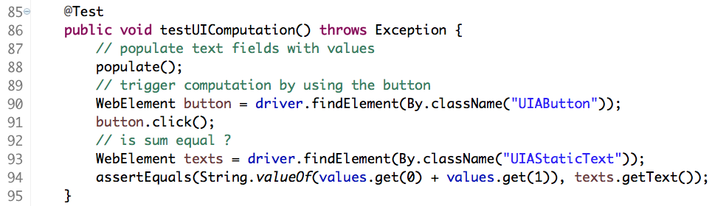
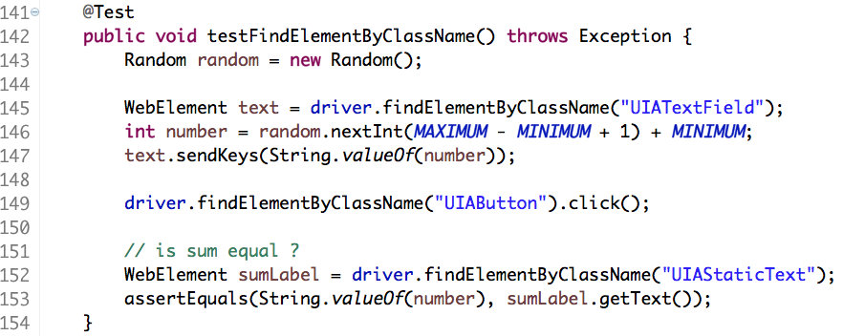
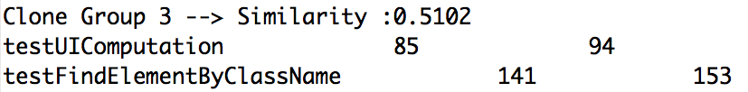
Test Result Example 1
Source: https://github.com/appium/sample-code

Slide 20
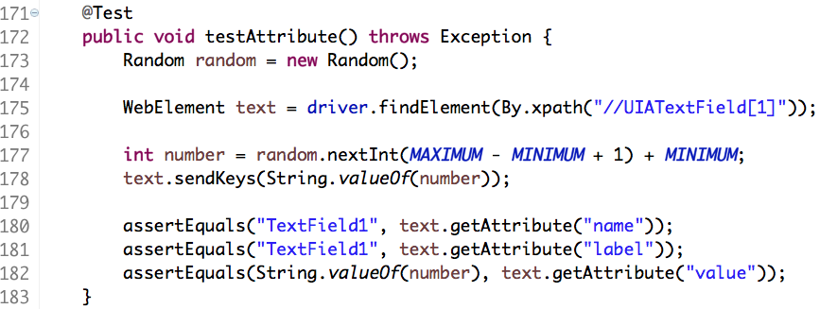
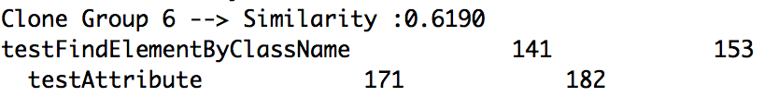
Test Result Example 2
Source: https://github.com/appium/sample-code

Slide 21
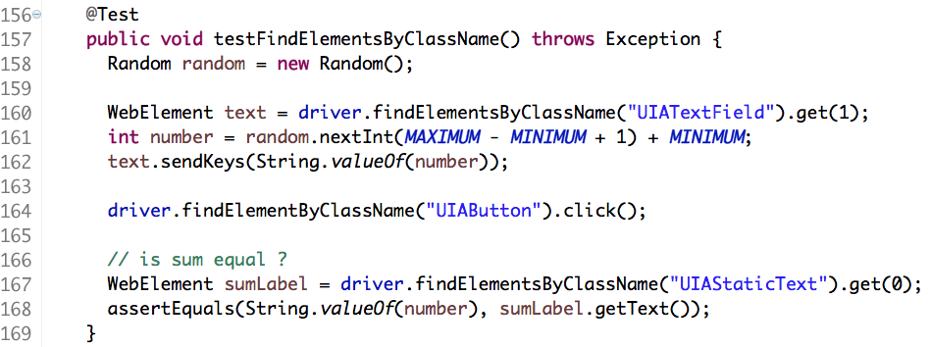
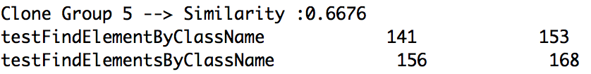
Test Result Example 3
Source: https://github.com/appium/sample-code

Slide 22
Apache Commons
http://commons.apache.org
FileUtils.java total methods: 106 11 pairs of clones ratio: 20.8%
IOUtils.java 105 4 pairs ratio: 7.62%

Slide 23
Challenges
Use ASTParser tool to catch the tokens, excessive time cost
  Improve the tokenize process, reduce time cost
  e.g regular expression
Manually set weight and threshold, need to be improved
  Use machine learning to set weights
  e.g Multilayer perceptrons (MLP)

Slide 24
Future Work
Variables comparison
Data collection
Results comparison
UI development

Slide 25
Thank you !
Mid-point Presentation

