Slide 1
Deep Learning Project
Harold Gamarro
Joe Brian Malubay
Said Mejia
Juan Pablo Montoya

Slide 2
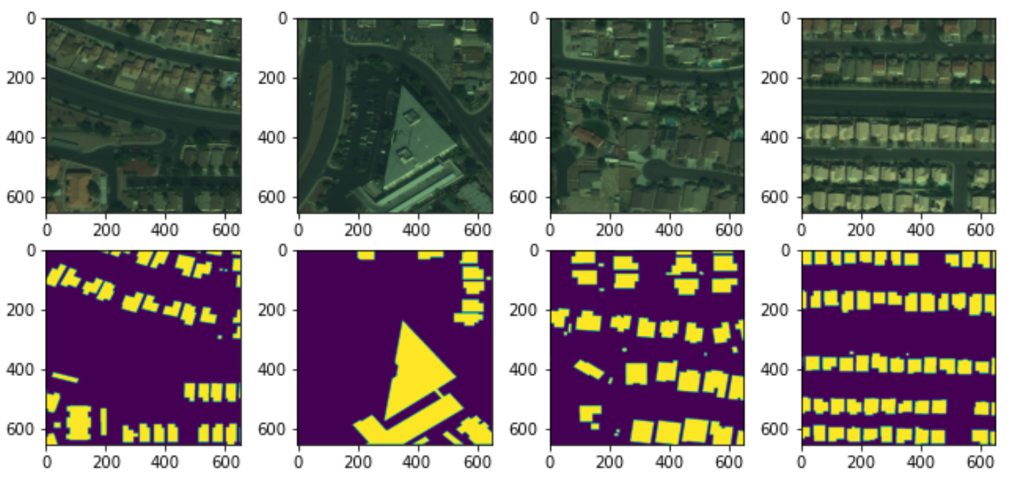
Spacenet Data processing for building detection
Input Image:
3 band geotiff
650 x 650 x 3
~ 3000 images
Input mask:
Geojson
650 x 650 x 3
Output data:
Processed NumPy arrays in batches of 32 images
Normalized data
Rescaled to 512 x 512
91 files of 32x512x512x3 for images
91 files of 32x512x512x1 for imagmaskses
Image and mask generator

Slide 3
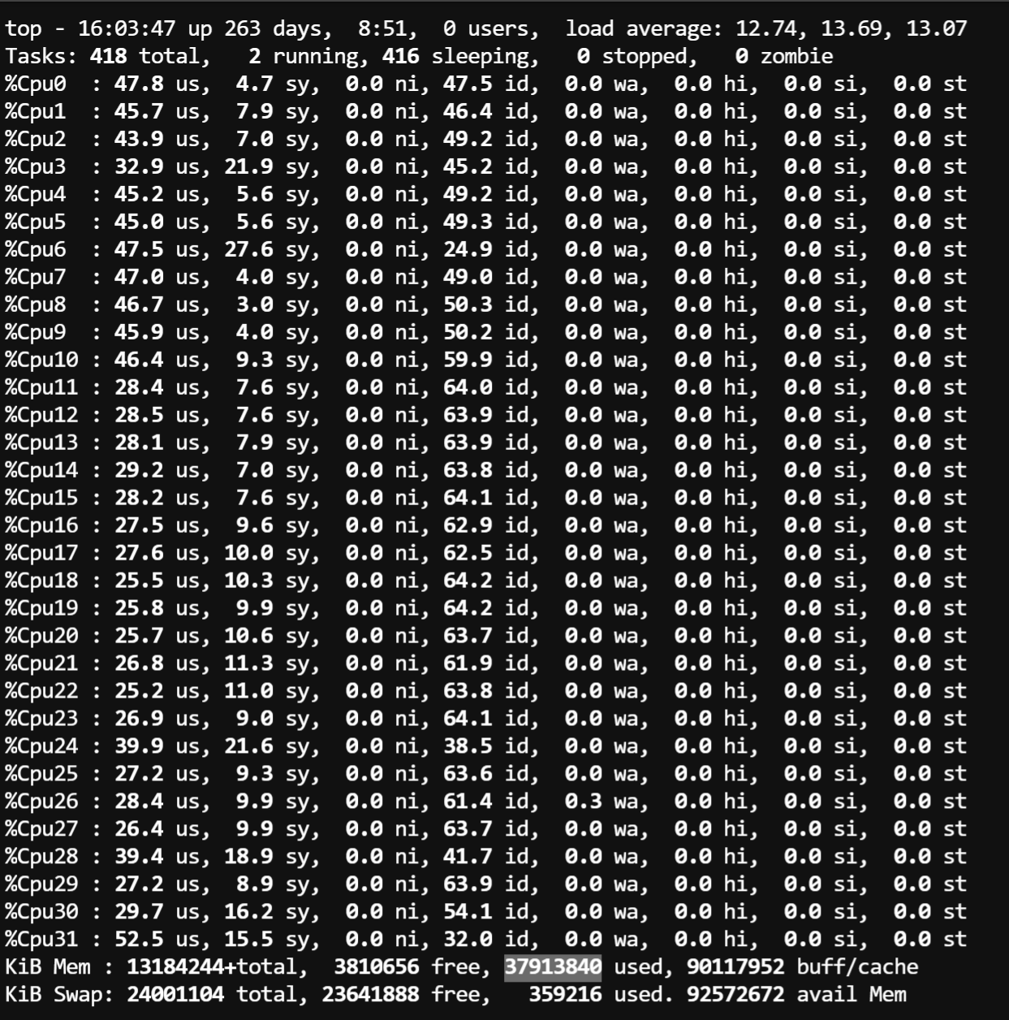
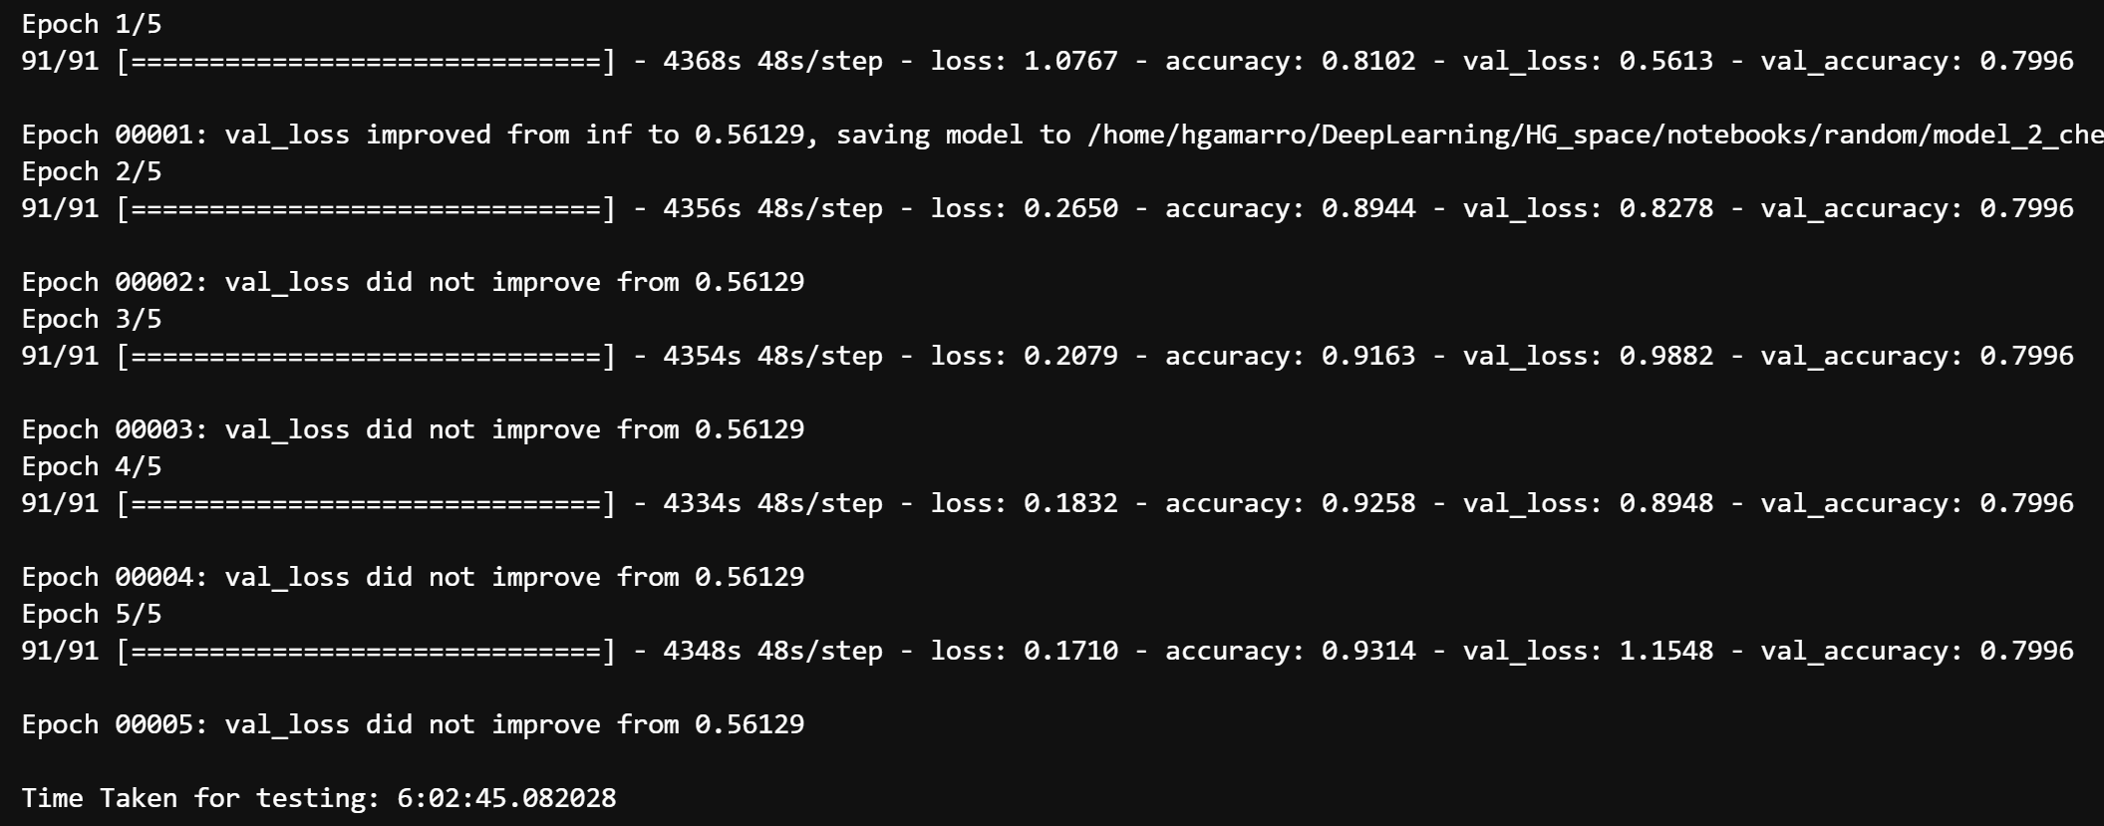
Spacenet Data processing for building detection
Current Progress:
Finished source code to convert images to jpegs for model input
Tested out the framework to load image and mask into a Unet model that successfully trained model over 5 epochs
Computation served as a big challenge resulting in OOM errors
Figured out how to use research compute cluster to handle the training
32 cores with about 60 GB of memory
Can submit jobs and test various models
Each Epoch takes about 1 hour 20 min
Uses all 32 cores
Memory peaks 40 GB in above

