Slide 1
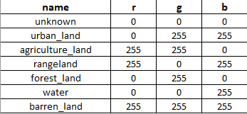
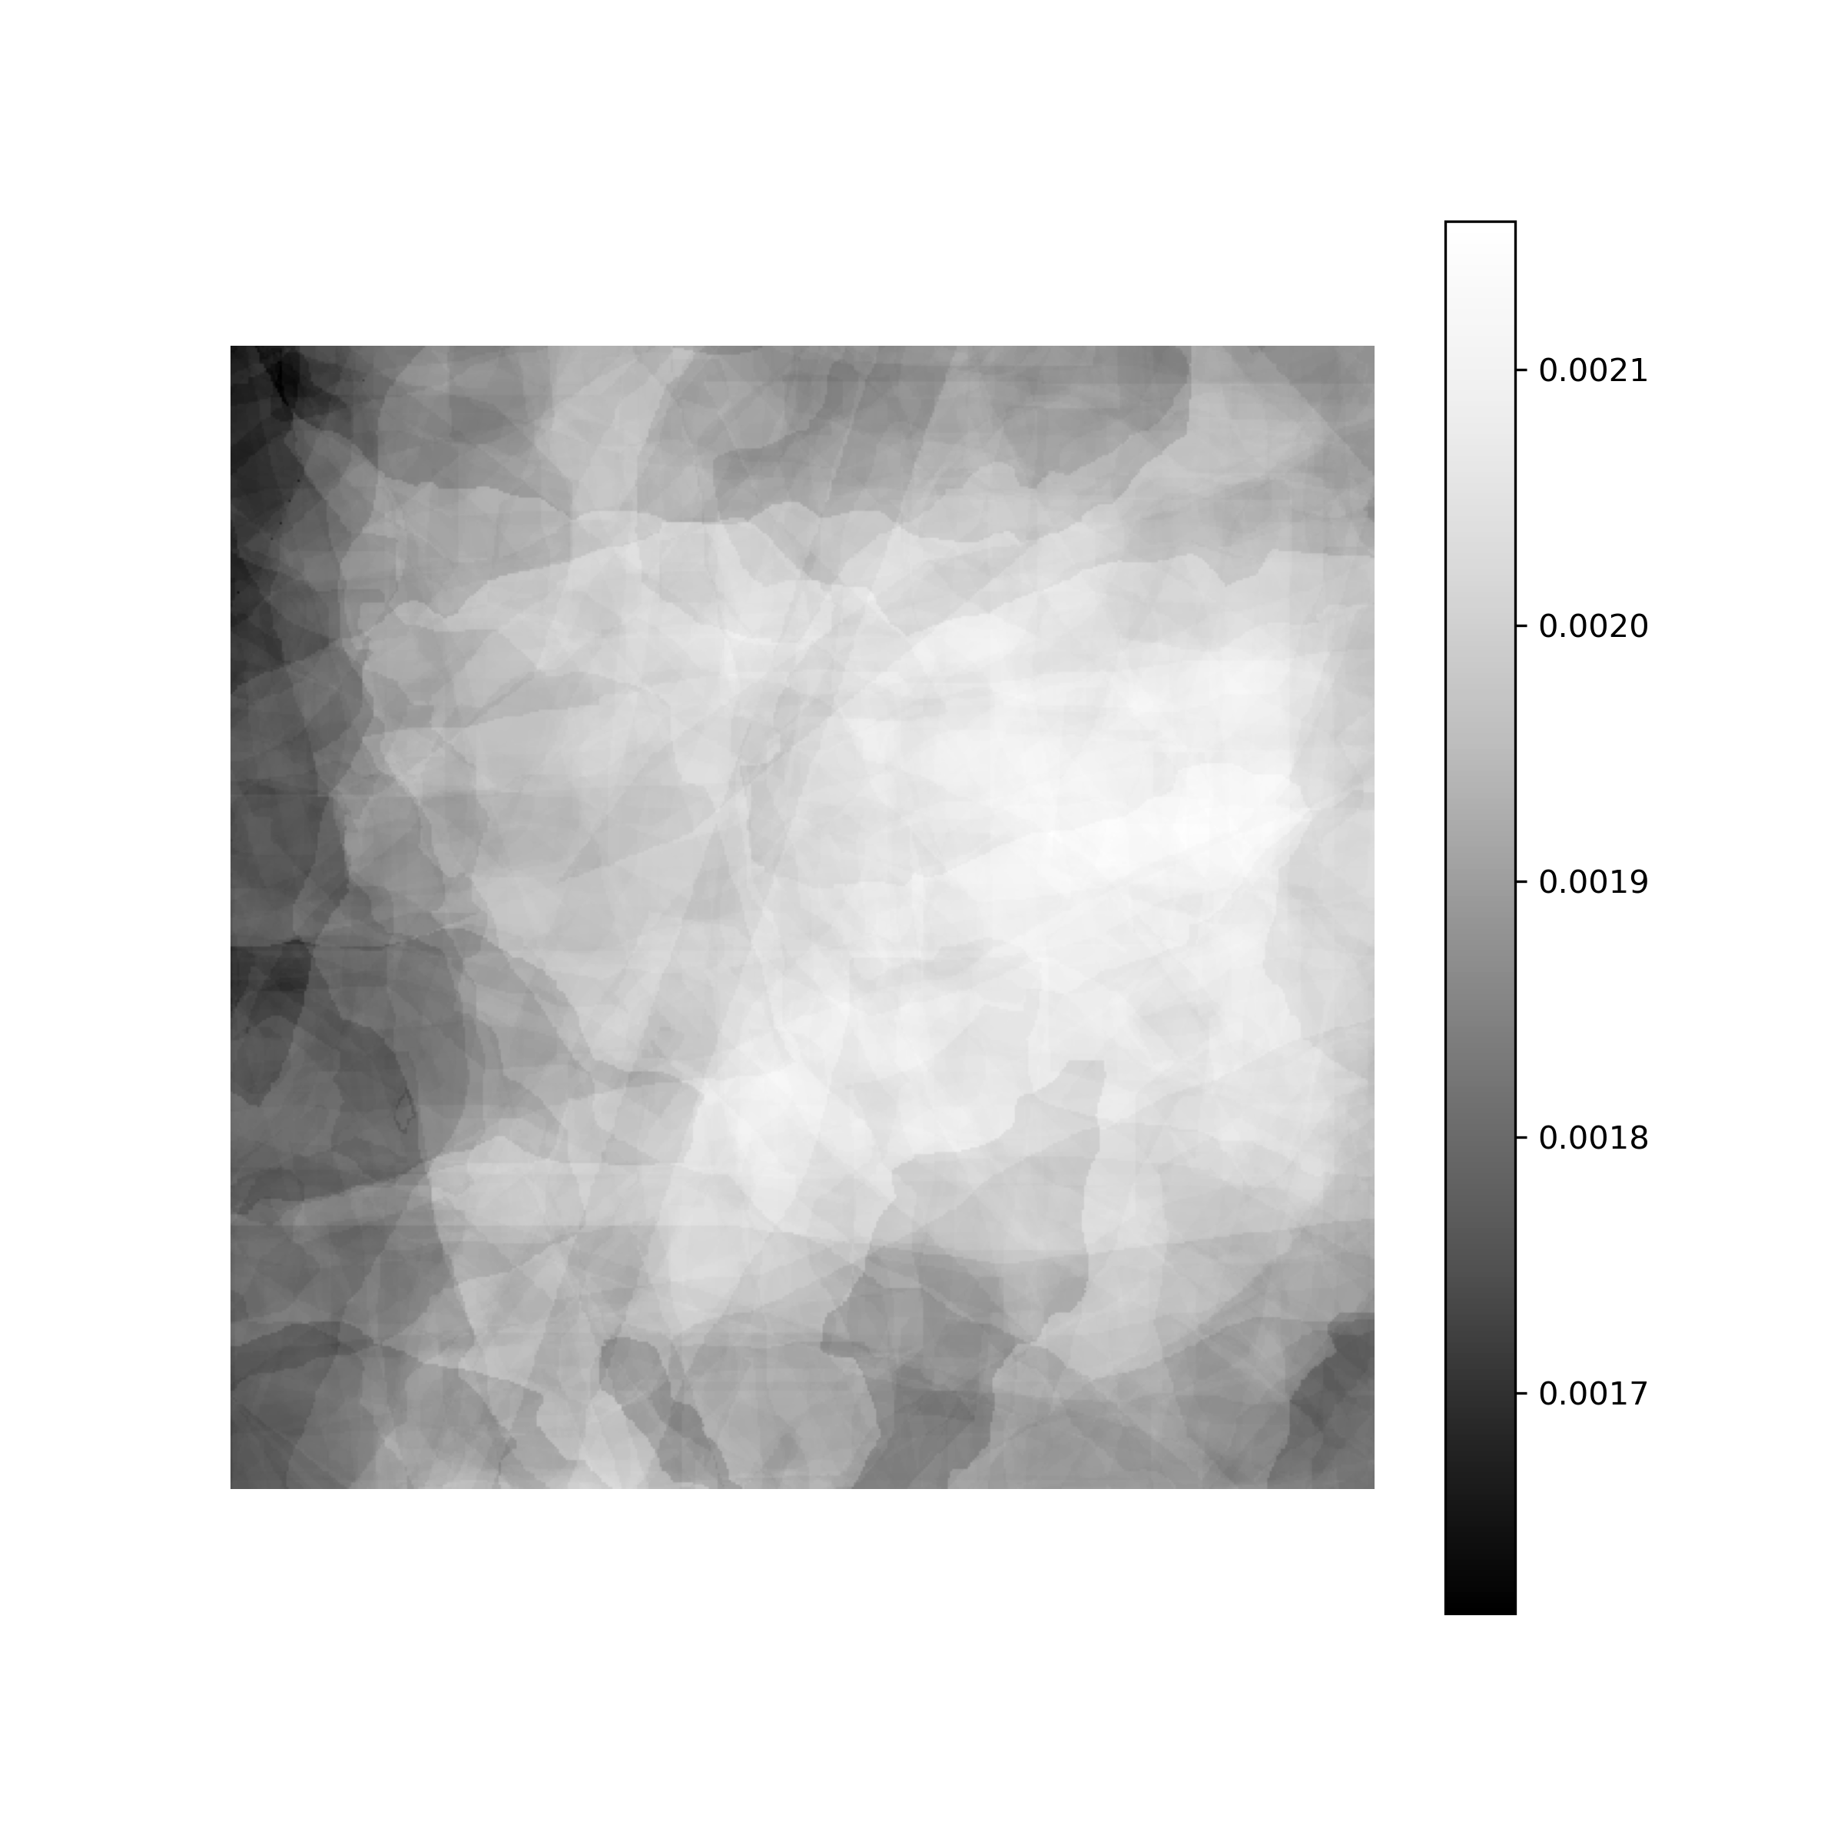
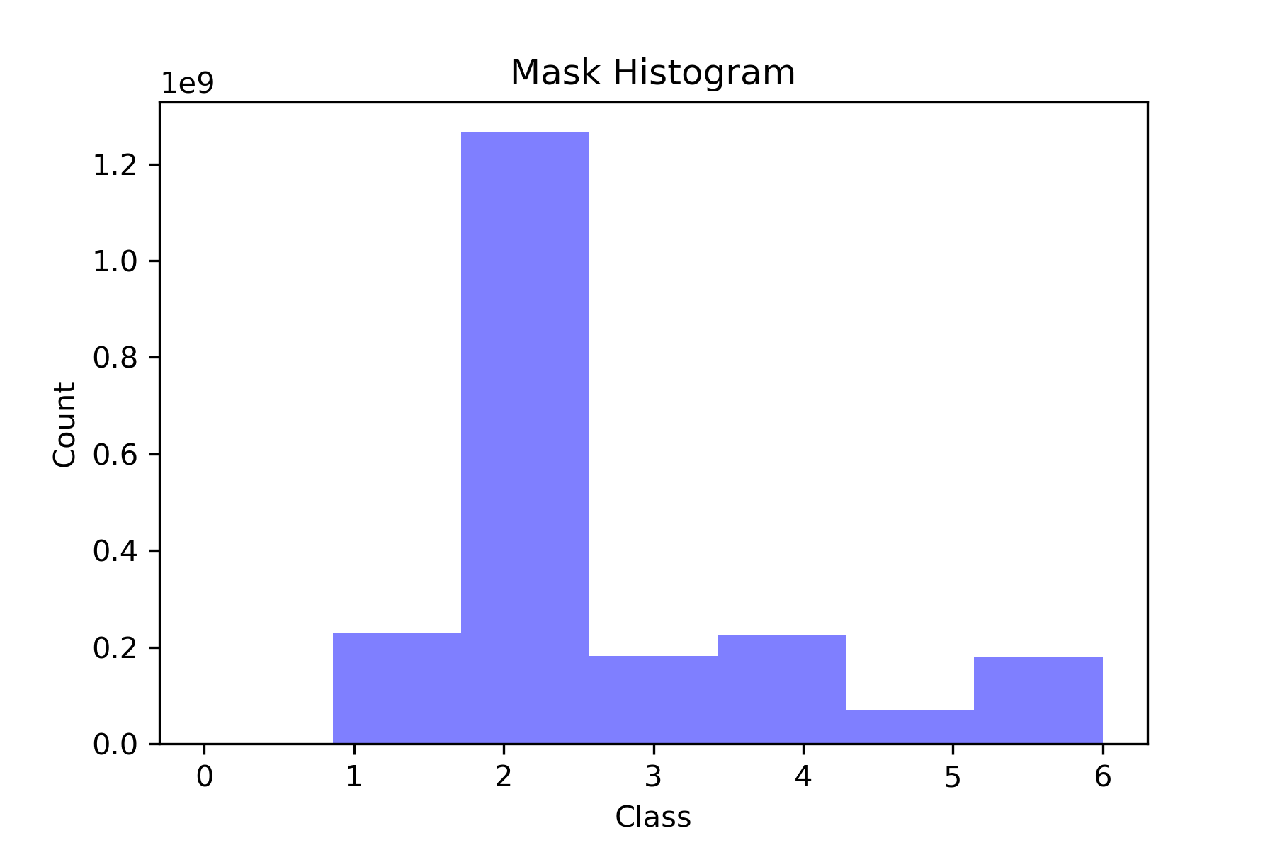
DeepGlobe Dataset
 | Train | Val | Test
Images | 8221 | 2056 | 2570
Mask | 8221 | 2056 | 2570
Mask PCA

Slide 2
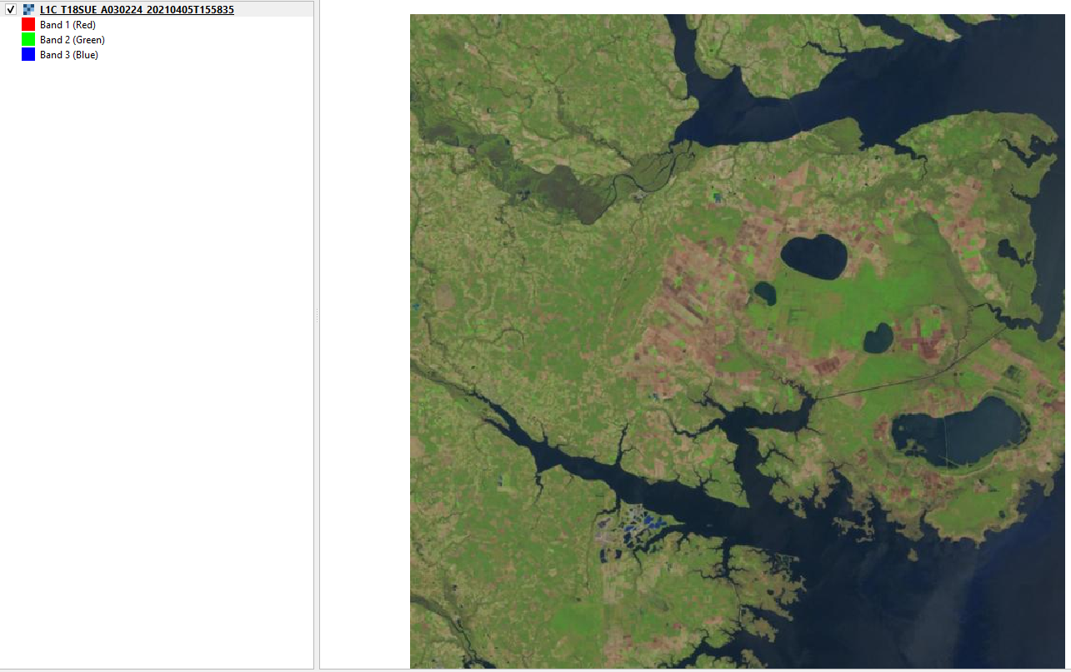
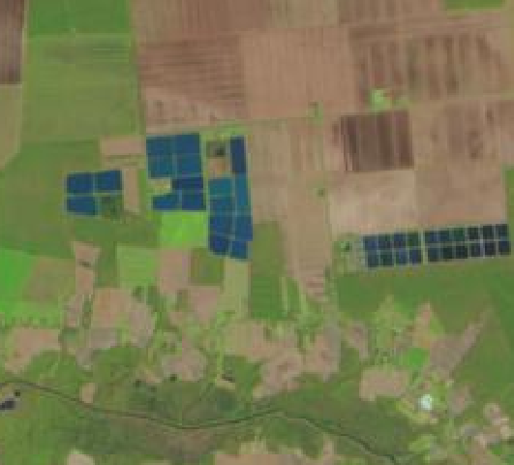
Sentinel 2

Slide 3
Models
VGG16_UNET
RESNET50_UNET (In progress)
VGG16_SEGNET (In progress)
RESNET50_SEGNET (In progress)
VGG16_PSPNET (In progress)
RESNET50_PSPNET (In progress)

Slide 4
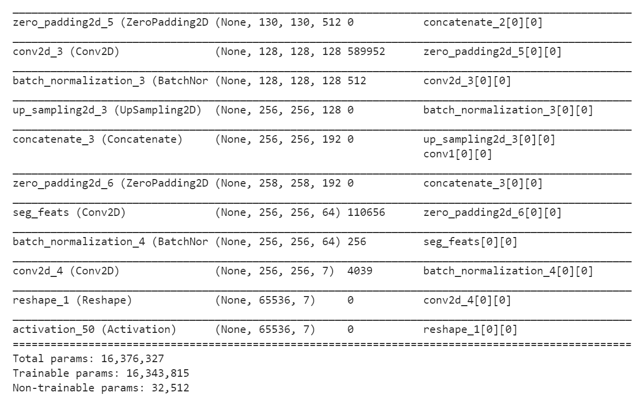
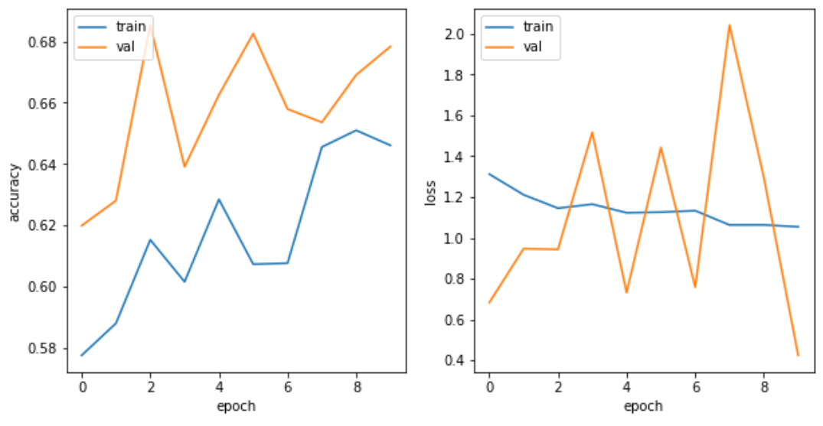
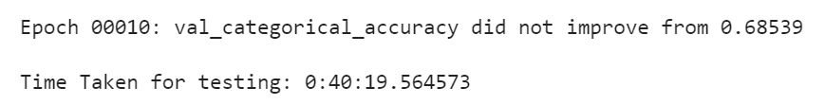
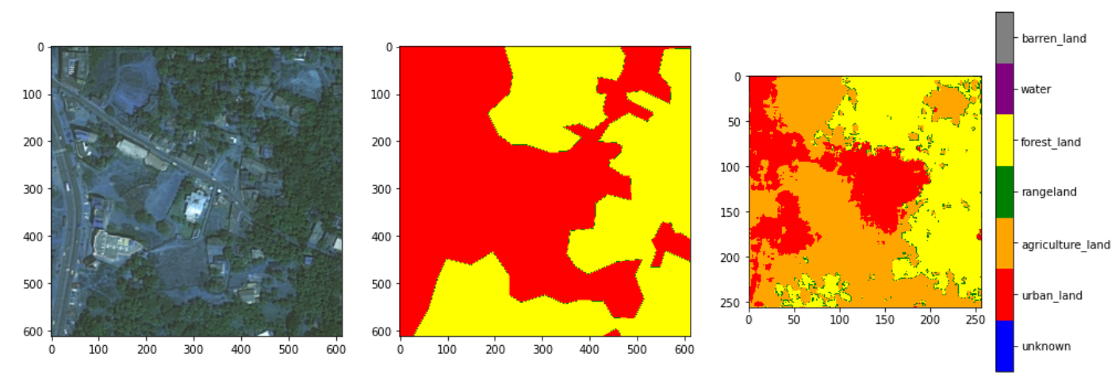
VGG_UNET

Slide 5
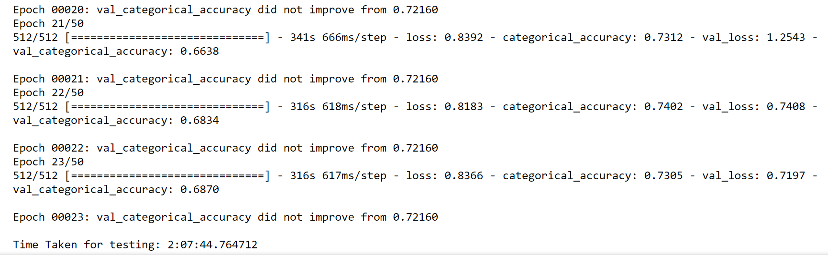
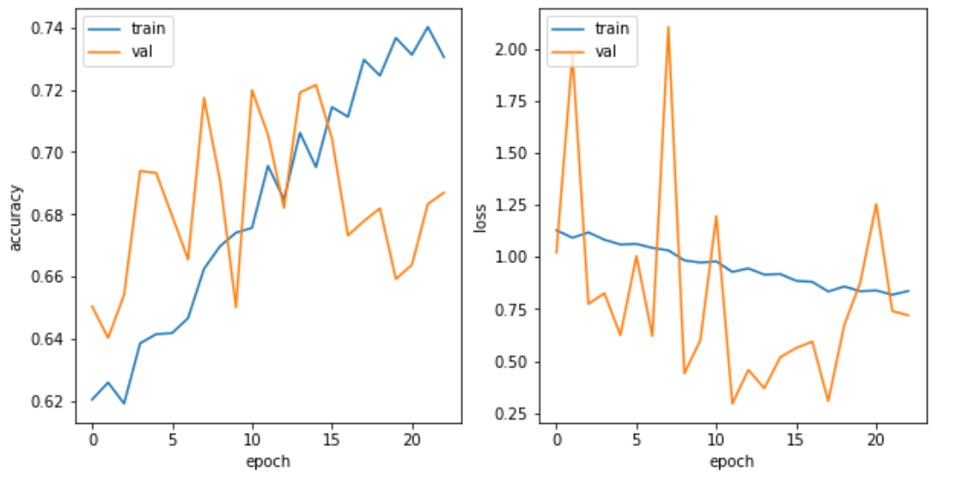
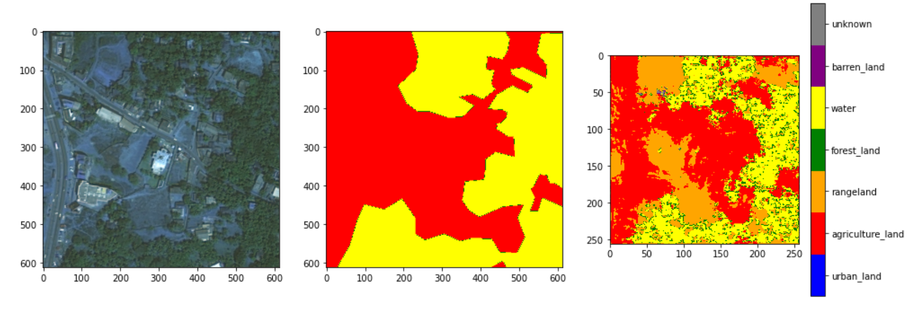
VGG_UNET

