Slide 1
Deep Learning Project
Harold Gamarro
Joe Brian Malubay
Said Mejia
Juan Pablo Montoya

Slide 2
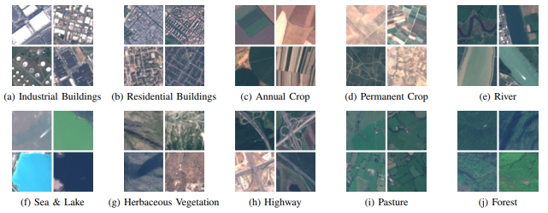
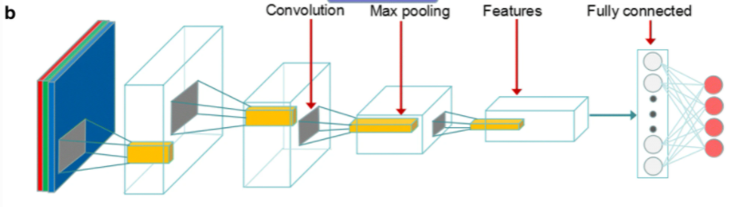
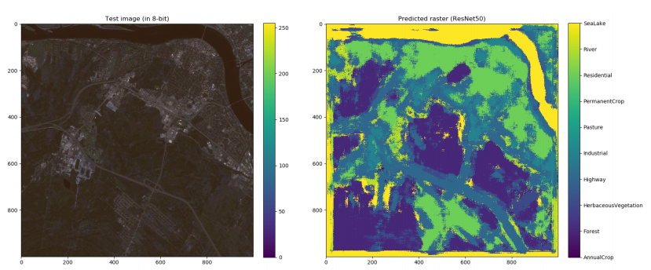
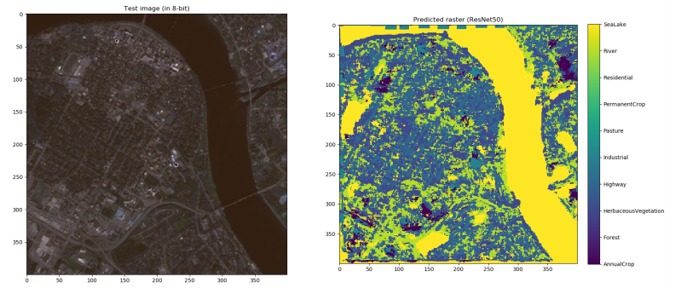
First Approach
It uses REsNet50 and they test it using an experimental image
REsNet50 architecture
Source: EuroSAT: A Novel Dataset and Deep Learning Benchmark for Land Use and Land Cover Classification
Source: LandUse / LandCover Classification using ResNet50

Slide 3
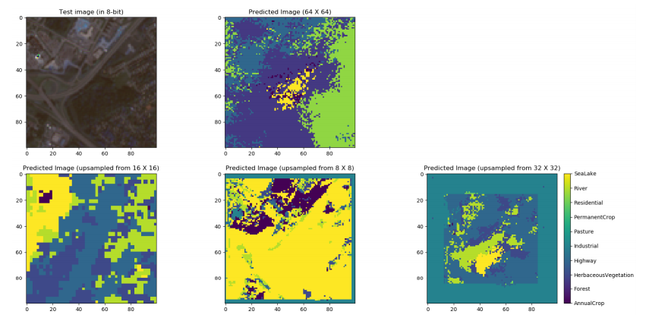
Problems

Slide 4
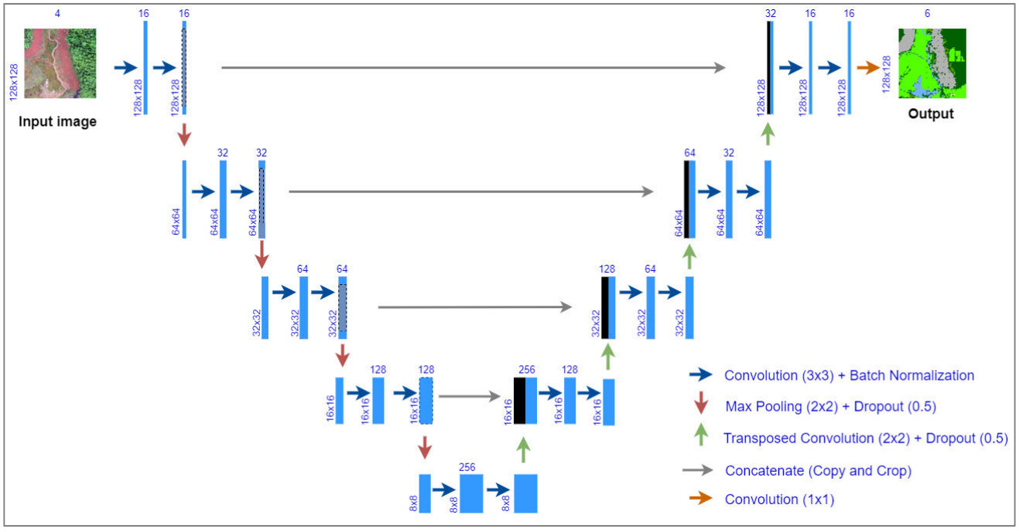
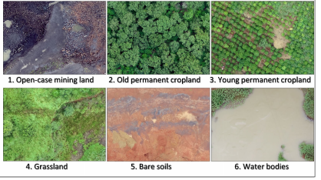
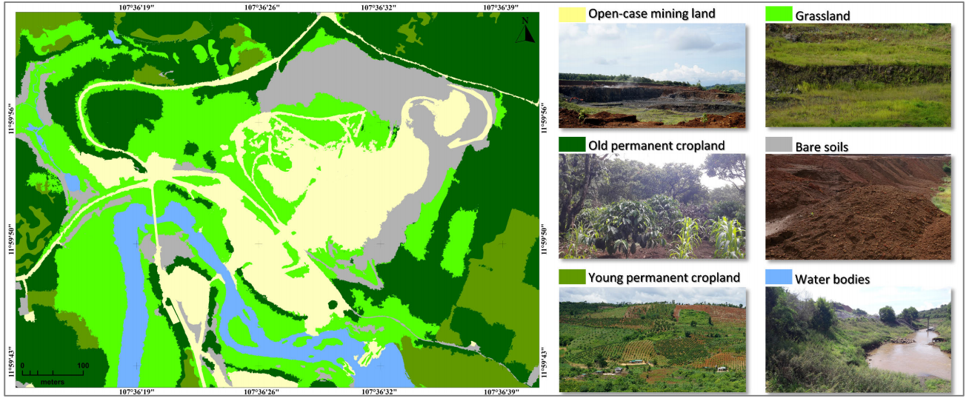
Second Approach U-Net
Image shape: 128x128x4
Source: U-Net Convolutional Networks for Mining Land Cover Classification Based on High-Resolution UAV Imagery

Slide 5
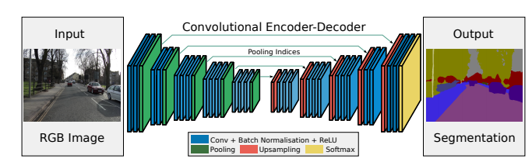
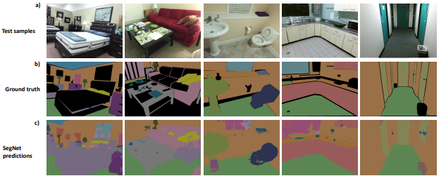
Third Approach SegNet
Source: SegNet: A Deep Convolutional Encoder-Decoder Architecture for Image Segmentation

Slide 6
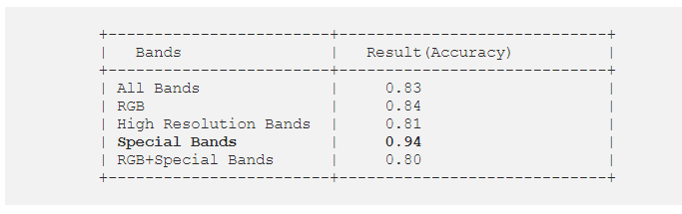
Comments
Develop the REsNet50 function and make some changes
Use second approach using the first dataset from EuroSAT with 12 bands and make some modifications to the number of layers

Slide 7
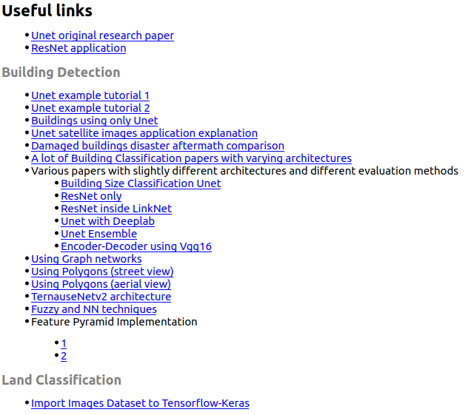
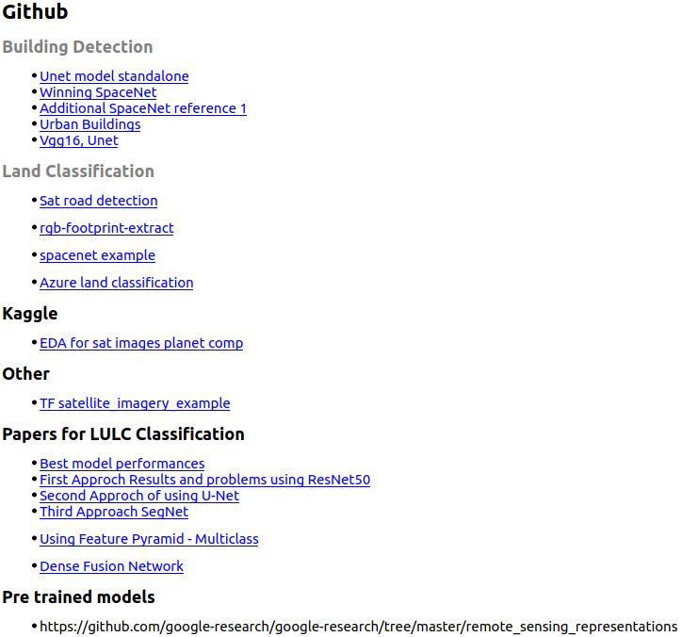

Slide 8
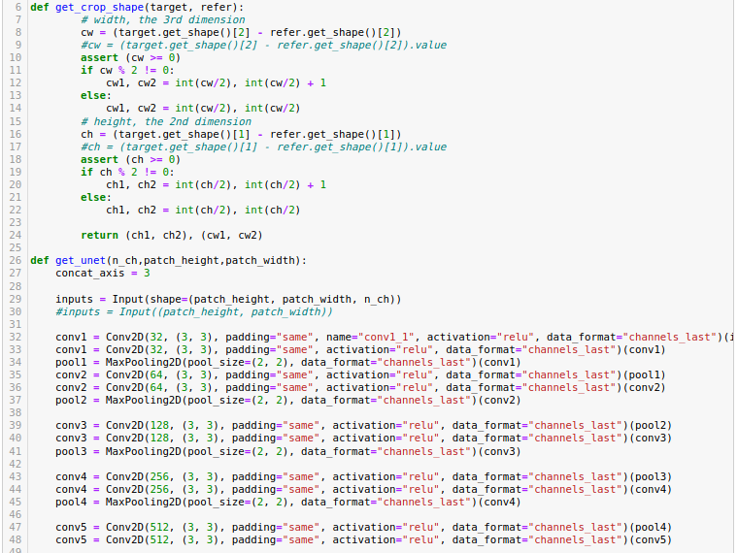
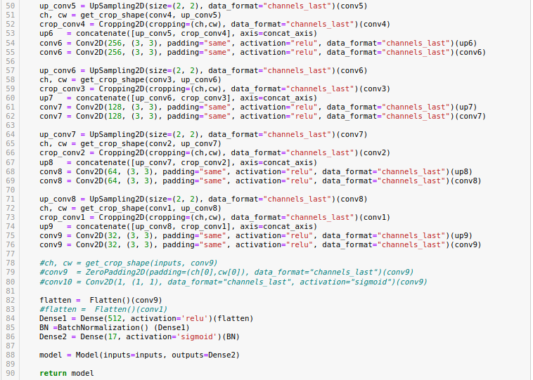

Slide 9
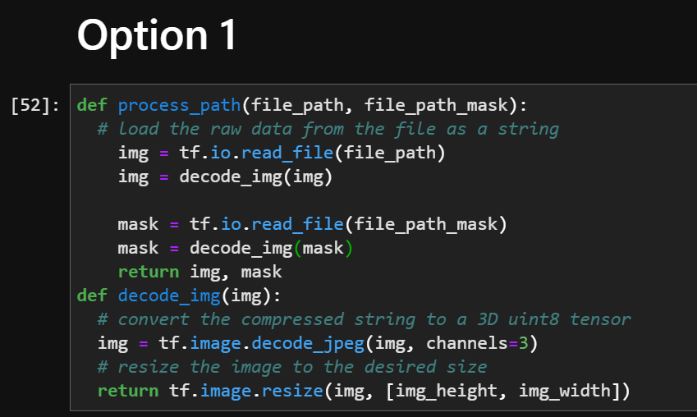
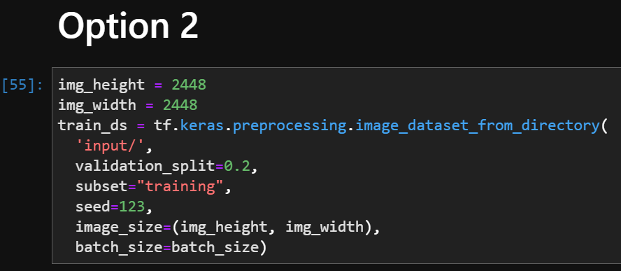
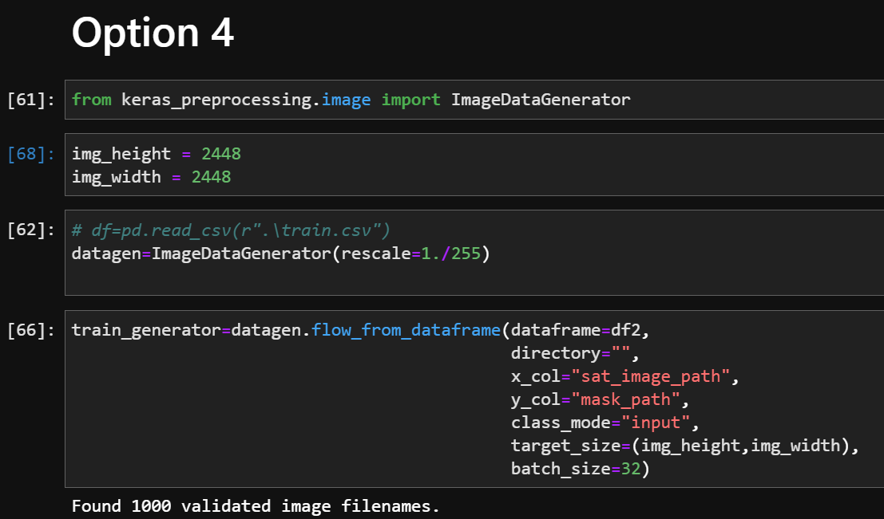
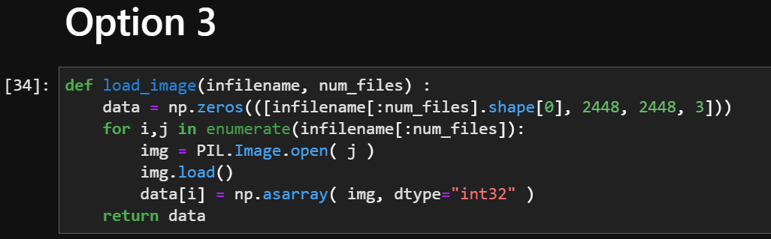
Import Image Segmentation Dataset

