Slide 1
PA2: Your Own Linux Shell
Tanzir Ahmed CSCE 313 Spring 2021

Slide 2
Programming Assignment # 2
Main Challenges (after fork + exec)
I/O Redirection
Piping
To solve these challenges, we need the topics:
File I/O basics
Inter Process Communication using pipes

Slide 3
Main Idea in Pseudocode
A shell’s main logic is as follows:
However, the we know that exec() function (i.e., system call to execute a command) does not return
Overwrite the main process
Therefore, we need to fork() a child process and then exec()
Note that, the parent (i.e., the shell) must wait() for the child
For instance, “sleep 5” should block the shell for 5 seconds
while (!endofinput){
1. get the next command from user
2. execute the command fully
}

Slide 4
Skeleton Code
int main (){
while (true){
cout << "My Shell$ "; //print a prompt
string inputline;
getline (cin, inputline); //get a line from standard input
if (inputline == string("exit")){
cout << "Bye!! End of shell" << endl;
break;
}
int pid = fork ();
if (pid == 0){ //child process
// preparing the input command for execution
char* args [] = {(char *) inputline.c_str(), NULL};
execvp (args [0], args);
}else{
waitpid (pid, 0, 0); //parent waits for child process
}
}
}

Slide 5
Issues With Skeleton Code
The skeleton is almost a fully functional shell
Can find commands in the PATH and current directory and execute them properly
However, the following features are missing:
Cannot handle arguments to the program: “ls –l”
I/O redirection (e.g., “ls –l > a.txt”, “grep pattern < a.txt”)
Piping (e.g., “ls – l | grep pattern1|grep pattern2|less -5”)
Directory handling commands (e.g., “cd /path/to/dir”)
Handling background processes (e.g., “sleep 5 &”)
Handling commands with arguments (e.g., “ls –l –a”)
…

Slide 6
File I/O – File Descriptors
int main ()
{
int fd; // file descriptor
char* buf [] = “file content”;
fd = open (“foobar.txt”, O_CRAEATE|O_WRONLY);
write (fd, buf, strlen (buf)); close (fd);
fd = open(“foobar.txt”, O_RDONLY, 0);
read(fd, &c, 1);
printf(“c=%c\n”, c);
close (fd);
return 0;
}
Every process has a file descriptor table, where there are 3 default entries to begin with:
Standard input, output, and error
Descriptor table
[one table per process]
stdin
fd 0
stdout
fd 1
stderr
fd 2
fd 3
fd

Slide 7
I/O Redirection
Question: How does a shell implement I/O redirection?
unix> ls > foo.txt
Answer: By calling the dup2(source, destination) function
Copies (per-process) descriptor table entry source to entry destination
Descriptor table
before dup2(3,1)
Descriptor table
after dup2(3,1)
fd 0
fd 0
fd 1
a
fd 1
b
fd 2
fd 2
fd 3
b
fd 3
b

Slide 8
Implementing “ls –l –a -w> foo.txt”
#include <stdio.h>
#include <unistd.h>
#include <sys/stat.h>
#include <fcntl.h>
int main ()
{
int fd = open ("foo.txt", O_CREAT|O_WRONLY|O_TRUNC,
S_IRUSR | S_IWUSR | S_IRGRP | S_IROTH);
dup2 (fd, 1); // overwriting stdout with the new file
execlp ("ls", "ls", "-l", "-a", "-w", NULL); // execute
return 0;
}

Slide 9


IPC Pipe
BEFORE pipe
AFTER pipe
0 1 2
0 1 2 3 4
Process has some usual files open
Kernel creates a pipe and sets file descriptors

Slide 10
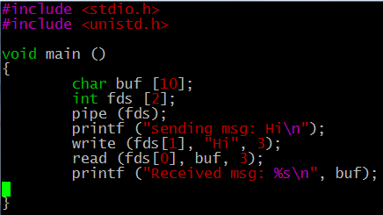

IPC Pipe - Method
Is this of any use at all ???
Connects the two fds as pipe

Slide 11
Pipe Between Two Processes
int main ()
{
int fds [2];
pipe (fds); // connect the pipe
if (!fork()){ // on the child side
char * msg = "a test message";
printf ("CHILD: Sent %s\n", msg);
write (fds[1],msg,strlen(msg)+1);
}else{
char buf [100];
read (fds [0], buf, 100);
printf ("PARENT:Recv %s\n", buf);
}
return 0;
}
child
parent

Slide 12
Shell Piping Example: “ls –l | grep soda”
Meaning of the command:
Find all files that has the string “soda” in the filename and show detailed properties of those files
How many processes do we have to run (in addition to our shell process)?
Process # 1: To run “ls –l”
Process # 2: To run “grep soda”
What else do we need so that the process #1 sends its output to process #2
Idea: If we can connect stdout of p1 to stdin of p2, we are done!!
Step 1: Redirect stdout of p1 to a file descriptor fd1
Step 2: Redirect stdin of p2 to a another file descriptor fd2
Step 3: Now, pipe fd1 and fd2 together so that fd1 is the “write side” and fd2 is the “read side”

Slide 13
Shell Piping: “ls –l | grep soda”
void main ()
{
int fds [2];
pipe (fds); // connect the pipe
if (!fork()){ // on the child side
dup2 (fds[1], 1); // redirect stdout to pipeout execlp ("ls", "ls", "-l", NULL);
}else{
dup2 (fds[0], 0); // redirect stdin to pipe in
execlp (“grep", “grep", “soda", NULL);
}
}
Step 3
Step 1
Step 2

Slide 14
Visual Representation
1. Pipe() + fork()
0 1 2 3 4
Parent Process for grep soda
Child Process for ls -l
0 1 2 3 4

Slide 15
Visual Representation
1. Pipe() + fork()
2. dup2(4, 1) on child side
0 1 2 3 4
Parent Process for grep soda
Child Process for ls -l
0 1 2 3 4

Slide 16
Visual Representation
1. Pipe() + fork()
2. dup2(4, 1) on child side
3. dup2(3,0) on parent side
0 1 2 3 4
Parent Process for grep soda
Child Process for ls -l
0 1 2 3 4

Slide 17
Running “ls –l | grep soda”
We fork()-ed only once
Child ran “ls –l” and parent ran “grep soda”
But exec(“grep”..) wipes out parent, preventing any further action
We need to go further for the shell
We need to keep the parent process intact
Must fork() for 1 more time for exec(“grep…”)
We need the following diagram
0 1 2 3 4
Parent Process for Shell itself
Fork()
0 1 2 3 4
Child Process for grep soda
Child Process for ls -l
0 1 2 3 4

Slide 18
How about more than 2 levels of pipe?
The previous code does not scale to more than 2 levels of “|” symbol
For instance, how about:
We need a loop-structure that goes beyond the previously described hard-coded structure
We really want the above processes connected like the following:
Also, we need a skeletal structure for PA4
ls -la | grep Jul | grep . | grep .cpp
grep .cpp
STDIN
STDIN
ls -l
grep Jul
grep .
STDIN
Pipe stream
Pipe stream
Pipe stream
STDOUT
STDOUT
STDOUT

Slide 19
Plan of Action
Say the input line is: “c₁ | c₂ | … | c_{n}”
Shell
Pipe 1
Pipe 2
Child c₁
Pipe 1
Child c₂
Pipe 2
Child c₃

Slide 20
Shell Skeleton
while (true){// continue until the user enters a blank like
string line = read a line from the user;
// now split the line by | symbol that gives us separate commands
// You NEED to write this function
// for instance: ls -la | grep Jul | grep . | grep .cpp
vector<string> c = split (line, "|");
//after the above, levels.size() == 4, because there are
// 3 pipe symbols making 4 pipe levels
for (int i=0; i< c.size(); i++){
// set up the pipe
int fd [2];
pipe (fd);
int pid = fork();
if (!pid){ // in the child process
// 1. redirect the output to the next level
// 2. execute the command at this level
}else{ // in the parent process
waitpid (pid); /*1. wait for the child process running
the current level command */
//2. redirect input from the child process
}
}
}

Slide 21
Each Iteration of the For Loop
int cid = fork();
if (!cid){// child process
/* redirect output to the next level
unless this is the last level */
if (i < levels.size() - 1){
dup2 (fd[1], 1); // redirect STDOUT to fd[1], so that it can write to the other side
be closed
}
//execute function that can split the command by spaces to
// find out all the arguments, see the definition
execute (levels [i]); // this is where you execute the command, you NEED to write this function
} else{
if (i == levels.size() - 1) // wait only for the last child waitpid (cid);
dup2 (fd [0], 0); // now redirect the input for the next loop iteration
close (fd [1]); // fd [1] MUST be closed, otherwise the next level will wait
}

Slide 22
Why close fd[1]?
Because with pipe() and redirection, we obtain a picture like the following:
If we do not close fd[1], the next level process grep thinks that there is more data coming and thus keeps waiting
Therefore, closing the fd[1] side finally provides the EOF (end of file) symbol to the input to grep, which then finishes
ls -l
shell
STDIN
STDOUT
Pipe stream
Fd[1]

Slide 23
Zombie Processes
Idea
When process terminates, still consumes system resources
Various tables maintained by OS (to store exit status)
Called a “zombie”
Living corpse, half alive and half dead
Reaping
Performed by parent on terminated child by calling wait() function
Parent is given exit status (i.e., wait (&status))
Kernel discards process

Slide 24
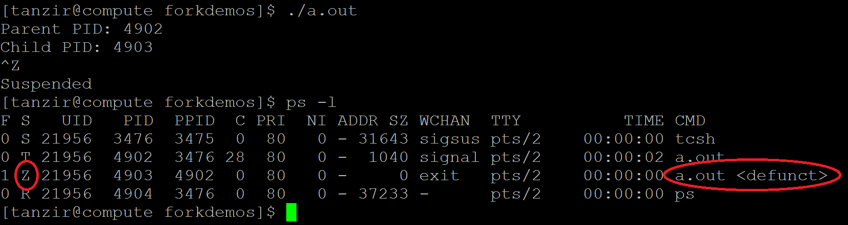
Zombie Example
ps shows child process as “defunct”
Terminated child continue to take resources in Zombie state
This state is over when
Parent is killed, or
Parent performs wait ()
Killing parent allows child to be reaped
There is no Zombie processes in WSL (aka. Ubuntu Subsystem under Windows)
So, WSL is not supported for this PA
void main ()
{
if (fork() == 0){ // child process
// exiting the child process right away
printf ("Child PID: %d\n", getpid ());
}
else{// parent process
printf ("Parent PID: %d\n", getpid ());
// do nothing
while (1);
}
}

Slide 25
Handling Background Processes
First things is, we cannot issue wait()
That will get your shell stuck on the bg process
Example: “sleep 5” should take 5 seconds to run and give shell back
On the other hand, “sleep 5 &” should take just 0 seconds, because it is running in the bg
However, not using wait() would lead to Zombie processes
How to get around this problem?
Solution:
Collect the pid of each background process in a list
Periodically (e.g., before each command) call waitpid () function in a non-blocking manner on each pid in the above
Blocking waitpid() will get the shell process stuck
Remove the pids that are done from the list

