Slide 1
Programming Assignment # 4
Tanzir Ahmed, SPRING 2021

Slide 2
Goal
To do the same things as in PA2, but much faster using threads
For instance, the following command asks you to download first 10K data points each for the first 10 patients (note, there are 15 patients each with 15K points):
This will require 100K messages back-and-forth with the server
Will take a long time
In addition, you have to put the collected data in 15 separate histograms for proper visualization
Of course, you cannot just print them all in the screen
Like parallelizing anything other problem, the main technique is to:
Divide the workload (i.e., of getting all these data messages) into smaller portions
Dedicate each portion to a thread. Start all threads simultaneously. Also, make sure the threads access anything shared in a thread-safe manner (i.e., w/o race conditions)
Wait for all threads to finish and then optionally, combine the results computed by the threads to a final result
$./client –n 10000 –p 10

Slide 3
Dividing the Work
Let us work with the given example: downloading 100K data points
We can simply create w threads (let us call them workers), and let each thread work on 100K/w points
The questions are:
Will this work?
Will this give us w-fold speedup?
Answer to both questions is NO:
The channel is not thread-safe (multiple threads cannot write to it concurrently)
Even if it worked, the channel would be the main “bottleneck” making everything slow
Solution: Create ONE channel per ONE worker
Create w new channels, 1 for each worker
Client
Worker 1
Server
channel
Worker 2
…
Worker w

Slide 4
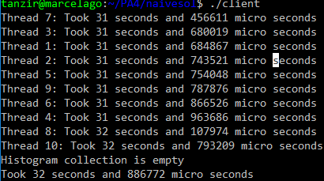
Dividing the Work – One channel/worker
Will this achieve w-fold speed up?
Ideally, yes
But, in practice, NO
The problem is in how the server responds to each request
Remember, there is random sleep in each request
As a result, some threads may take much longer than others
This is a general problem beyond just this PA
Some threads finish much later than others
Such threads are called “stragglers”
Client
Server
Worker 1
Channel 1
Channel 2
Worker 2
…
Worker w=p
Channel w

Slide 5
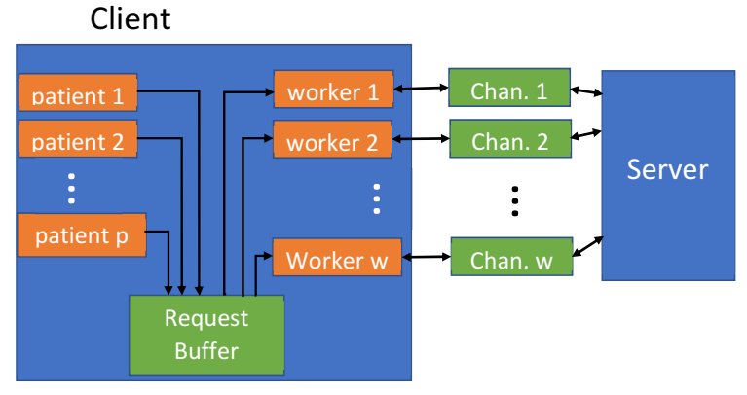
Avoiding Stragglers Problem
Instead we will use something called “Work Stealing”
The idea is to generating the work requests and push them in a buffer
The worker threads then pops those requests 1 at a time, download the request, and then repeat as long as the buffer is not completely depleted
The effect is that all threads then finish at about the same time
By that time, some threads may have done more downloads than the others
That is fine, because then the workers do not stay idle by “stealing” work from the buffer

Slide 6
Eliminating Race Condition
Implementing “Work Stealing” requires a “BoundedBuffer” which needs to be:
Thread-safe or Race condition free. Note that queue::push()/pop() are not thread-safe
Bounded to a maximum size so that too many push()es to do not make it infinite in size
If the buffer is full, the push()es will have to wait
Protected against underflow so that too many pop()s do not deplete it below size 0
If the buffer is empty, more pop()s will wait
Since each worker now access all p Histograms simultaneously, there is a race condition there as well, which must be eliminated

