Slide 1

L3Harris Capstone
Quantum Cryptography Project Planning
Members:
Aidan Heffron
Blake Lun
Grant Shields
Shifan Hirani
Josef Munduchirakal
TA:
Brady Testa
Instructor:
Pauline Wade

Slide 2
Agenda
Team Appreciative Agreement
Preliminary Timeline
Project Plan
Related Work / Existing Systems

Slide 3
Team Appreciative Agreement

Slide 4
The Highlights
Expectations
There should be constant communication between the group and sponsors
Members should be on time to all meetings
All work should be completed with competence and heed all requirements/guidelines
Communication
The group will communicate with L3Harris via email whenever appropriate
Project Planning
Action items should be tracked in the team’s Jira
Weekly Meetings
Thursday’s, 3:45 - 5:00 (may not always take the full time)
Members can ask sponsors any pertinent questions
Sponsors may review / question any recent code changes, merges, etc.
Discussion about upcoming deadlines, actionable tasks, etc.

Slide 5
Preliminary Timeline

Slide 6
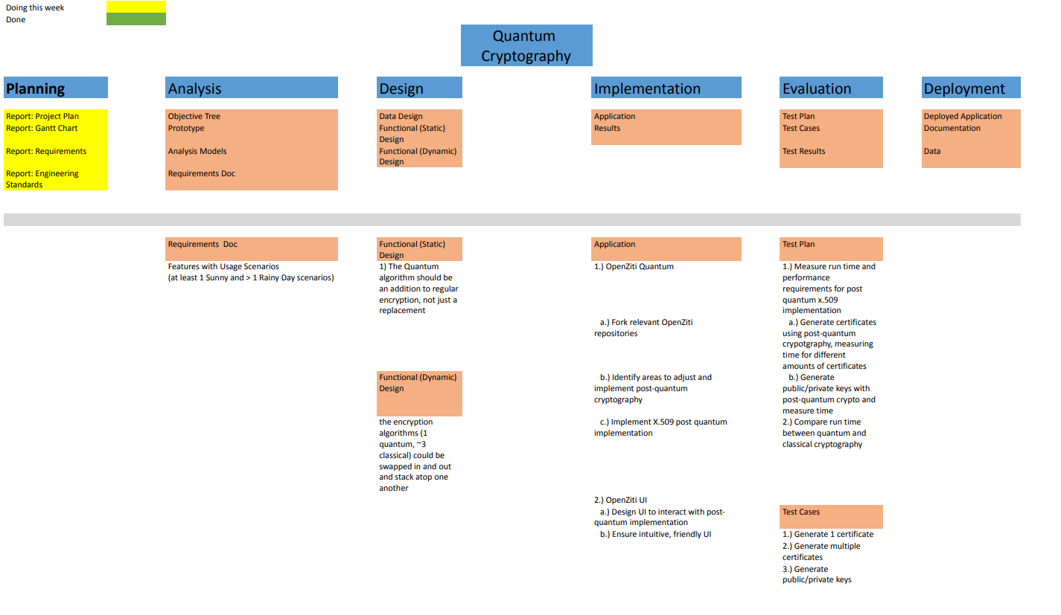
Work Breakdown Structure

Slide 7
Upcoming Due Dates (based on class schedule)
Feb. 13 – Project Plan & Gantt Chart Due
Feb. 20 – Requirements & Engineering Standards Due
Feb. 27 – Project Design Due
Feb. 29 – Code Submission 1
Mar. 5 – Evaluation Plan Due
Mar. 10 - Mar. 15 – Spring Break (out of school)
Mar. 21 – Code Submission 2
Mar. 21 – User Acceptance Test Due
Mar. 21 – Final Report v1 Due
Mar. 28 – Final Implementation Due
Mar. 28 – Internal Test Cases Due

Slide 8
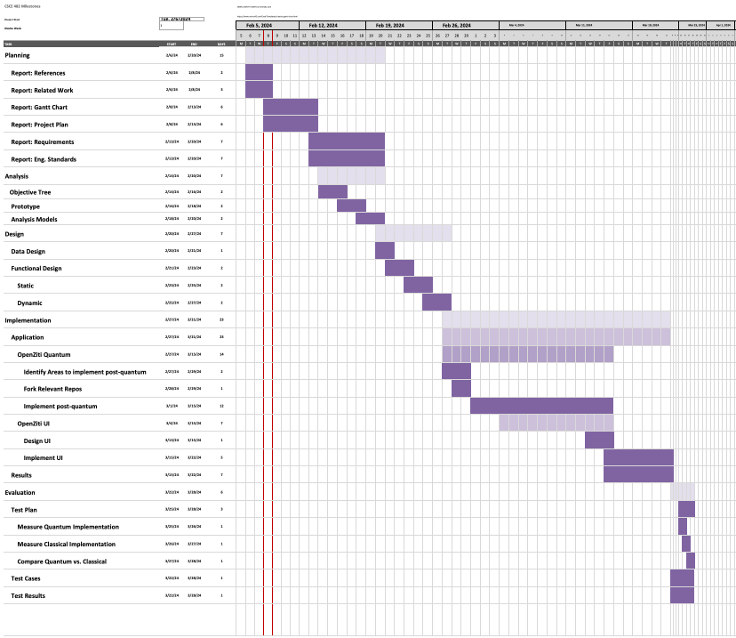
Preliminary GANTT Chart
Date Breakdown
Planning
Feb. 8 - Feb. 20
Analysis
Feb. 13 - Feb. 20
Design
Feb. 20 - Feb. 27
Implementation
Feb. 27 - Mar. 21
Evaluation
Mar. 22 - Mar. 28

Slide 9
The Project Plan

Slide 10
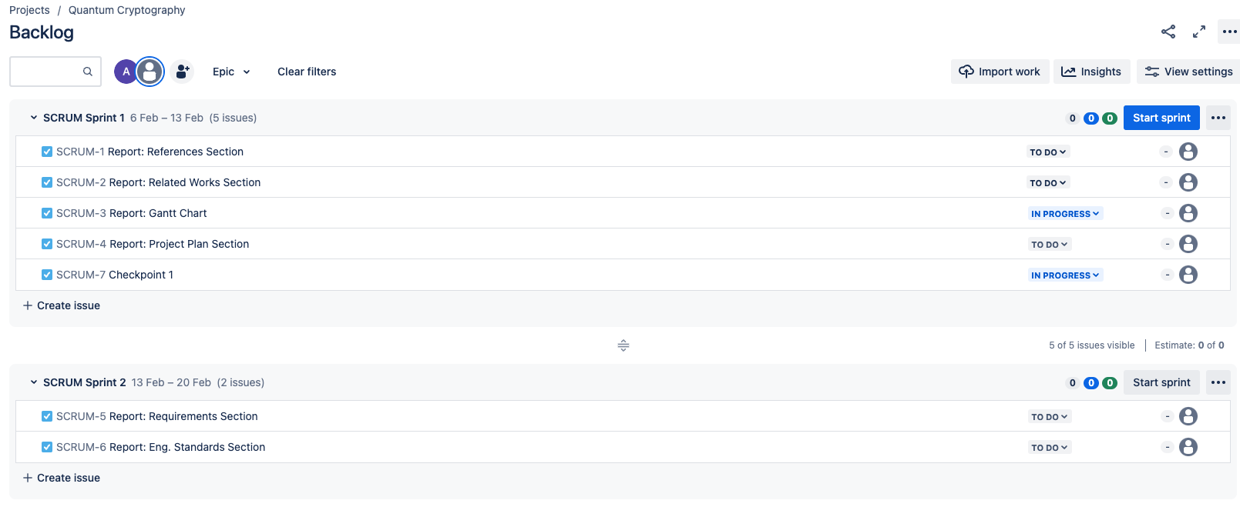
Our Process Model – Agile
Weekly Sprints, beginning today
Organized SCRUM Boards on Jira
Story Points assigned to members weekly
Managed Backlog for current and future stories, known bugs, actionable tasks

Slide 11
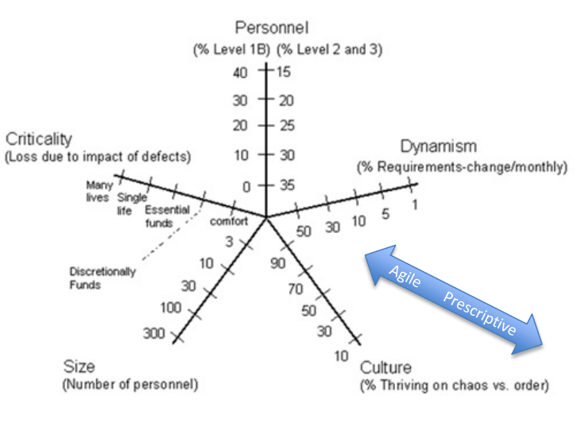
Why Go Agile?
Requirements for this project may be subject to change throughout its lifetime
We are a relatively small team
This project is a POC, so impact of defects is relatively low
We are operating out of OpenZiti, a public repo that makes frequent updates/commits

Slide 12
Related Work / Existing Systems

Slide 13

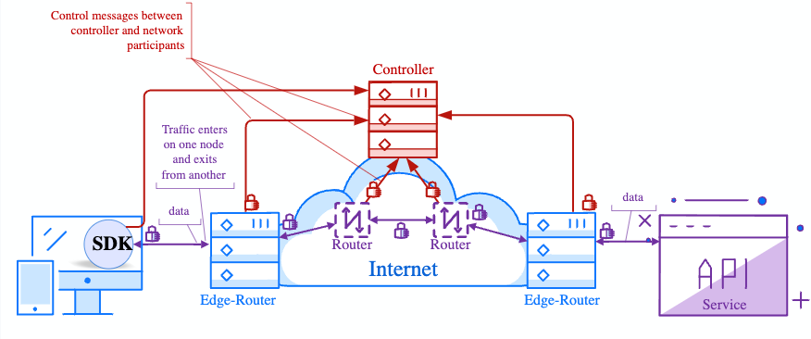
OpenZiti – Existing System
Overview:
Provides a platform for implementing Zero Trust architecture through an open-source approach
Features include overlay mesh networks, tunneling, end-to-end encryption, SDKs for application integration, and more
The System:
The OpenZiti Controller is responsible for authentication and authorization for every connection in the OpenZiti Network
The OpenZiti Router in combination with the Ziti Controller is responsible for authenticating and authorizing OpenZiti Edge Clients.
This is where we first plan on implementing quantum safe X509

Slide 14

Advancements and Resources in PQC
NIST's involvement in developing standards for PQC to safeguard against quantum threats
Development of libraries such as LibOQS by Open Quantum Safe, aiming to facilitate the integration of PQC into existing systems
Efforts to create PQC variants of widely used cryptographic libraries like OpenSSL and standards like X.509

Slide 15
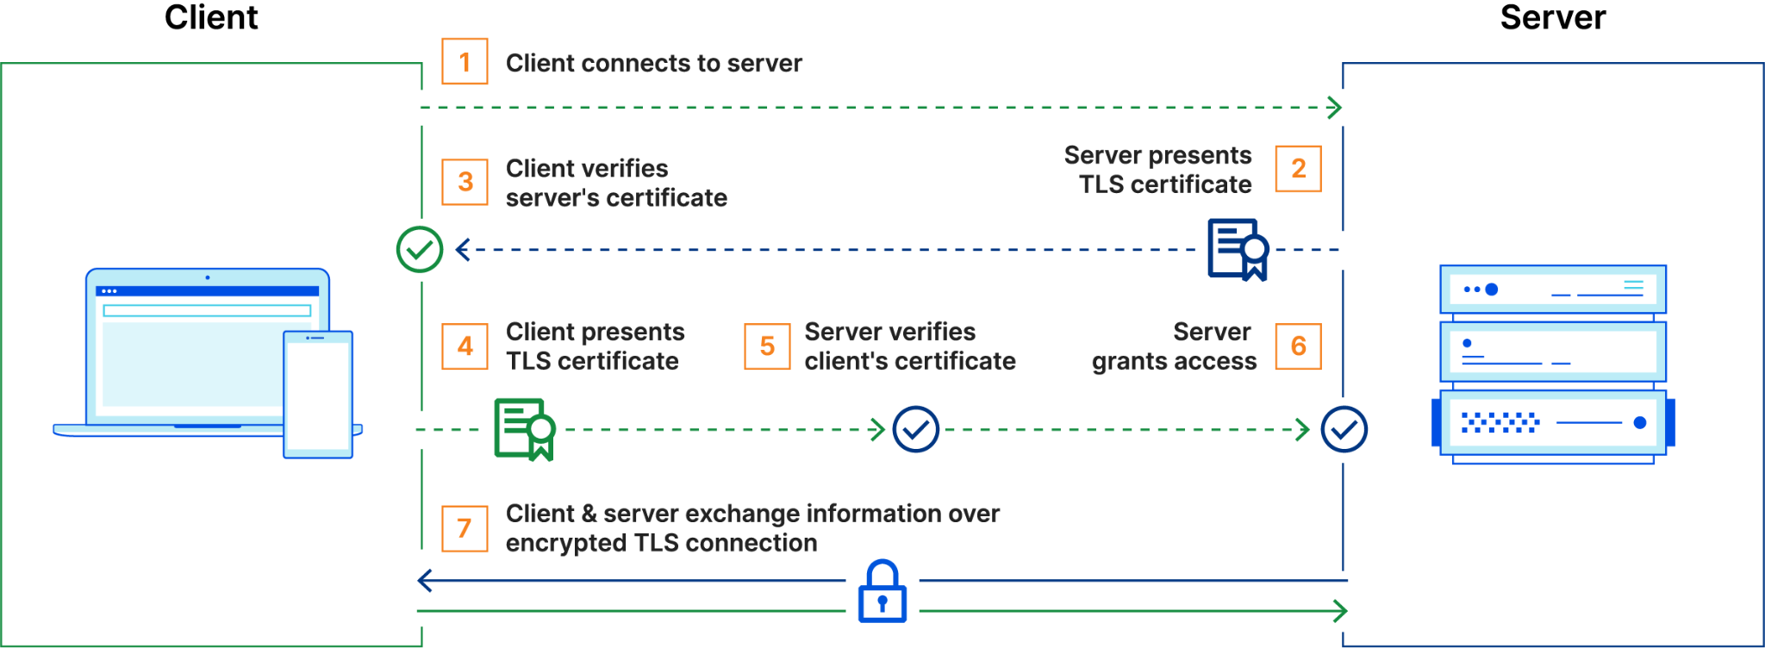
How MTLS Works

Slide 16
PQ X.509 Implementation
Incorporating new quantum-resistant algorithms into the X.509 certificate structure without breaking compatibility with existing systems
Implementing PQC algorithms in X.509 certificates might introduce performance overheads due to their typically larger key sizes and computational requirements
Traditional enrollment protocols for issuing X.509 certificates, such as Simple Certificate Enrollment Protocol (SCEP) or Certificate Management Protocol (CMP), may need adaptations to support the nuances of PQC algorithms
Lifecycle management must be agile enough to adapt to new or updated PQC algorithms as the post-quantum landscape evolves. This might involve issuing new certificates or updating existing ones with new PQC algorithms without causing disruptions.

Slide 17
Questions?

