Slide 1



Checkpoint 2:
Requirements & Eng. Standards
Group Members:
Aidan Heffron
Blake Lun
Grant Shields
Josef Munduchirakal
Shifan Hirani
TA:
Brady Testa
Professor:
Pauline Wade

Slide 2
Table of contents
01
Requirements Overview
02
User Stories
03
Prototypes
04
Engineering Standards
What do we need to be able to do.
What do consumers want to be able to do.
Potential solution designs
Ethical concerns regarding our project

Slide 3
01
Requirements Overview
What we need for a Minimum Viable Product

Slide 4
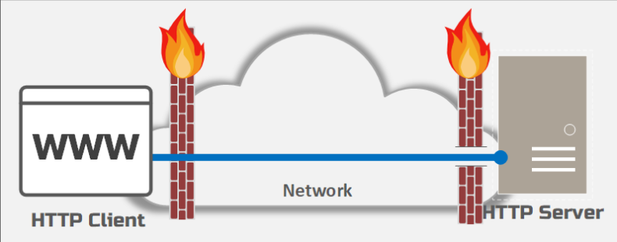
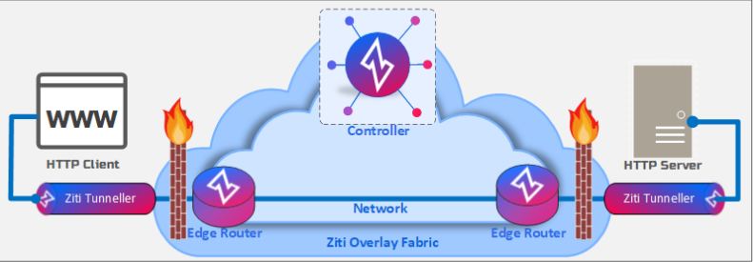
Where we are focused:
Authentication and enrollment between routers

Slide 5
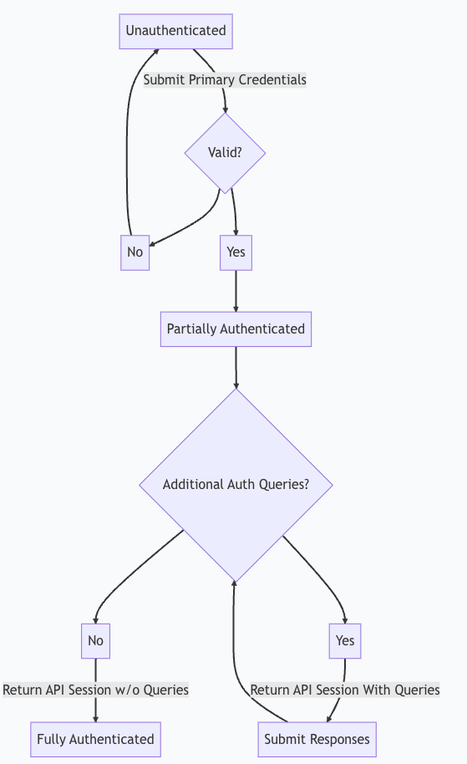
Our Project
The Enrollment Process:
Clients enroll in a service by Creating an identity and receiving a Certificate from Ziti or a 3rd Party CA
Our requirement is to enable PQ certificates generation and distribution in this process
The Authentication Process:
Clients enrolled in a service are authenticated and allowed to use the service
Our requirement is to enable verification of PQ certificates during this process
The Experience:
Clients and Services need to be able to perform all actions easily
Our requirement is to ensure proper documentation and help for all commands
Ideally there is no deviation from current process of enrollment and authentication.

Slide 6
02
User Stories
What do consumers want to be able to do.

Slide 7
Client Side State Machine
No service found,
search again
Idle
Create Identity on ziti network
Looking for Service
Use Service
Found service, enrolled in service, authenticated from service
Found service,
Not enrolled
Gain access from service
Enroll in Service (use Ziti to generate Keys/certs)
Access Edge Routers
Granted Access to Edge Routers

Slide 8
As a User:
I want to be able to create an Identity
I want to be able to Search for Available Services
I want to be able to enroll into a service
I want to be able to access edge routers in Ziti
I want to be able to Dial a service I’m authenticated to
I want to be able to navigate ziti commands easily
I want access to helpful documentation
As an Application Owner:
I want to be able to create a service for my application
I want to be able to let clients enroll in my service
I want to be able to generate Quantum-safe certificates
I want to be able to send Quantum-safe certificates
I want to be able to authenticate clients enrolled in my service
I want to be able to verify Quantum-safe certificates
I want to be able to manage client policies
I want to provide services for authenticated clients

Slide 9
03
Prototype
Potential Solution Design

Slide 10
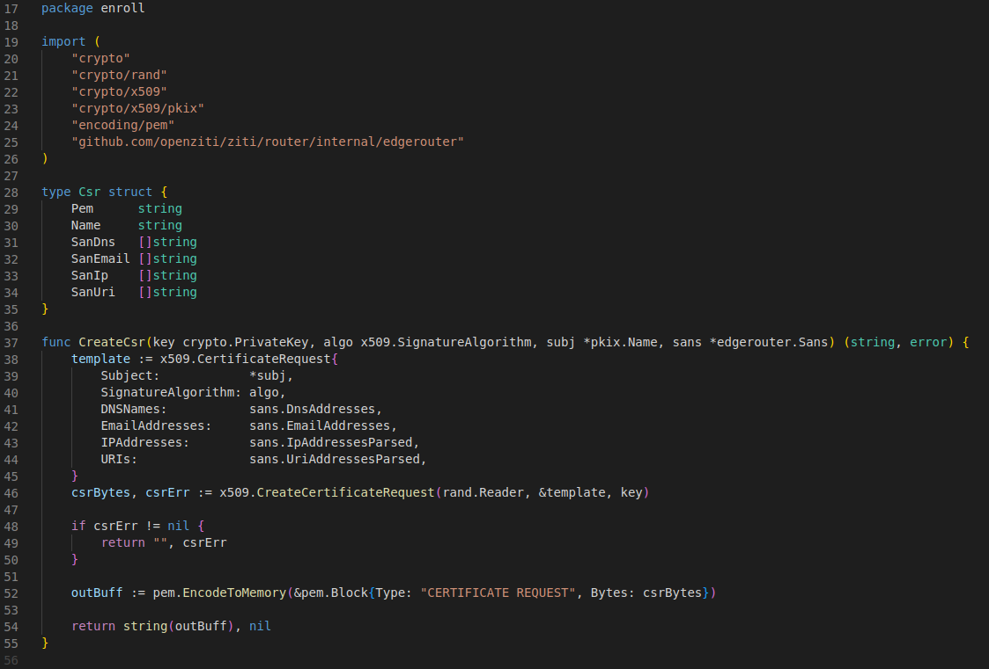
Current Certificate Generation in Ziti

Slide 11
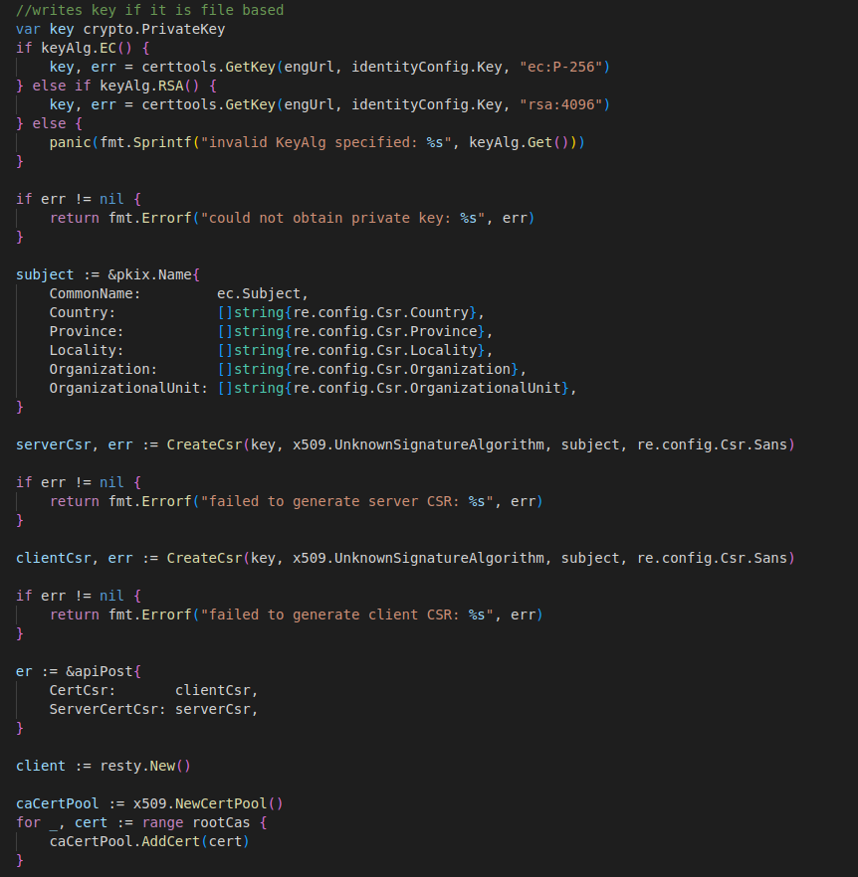
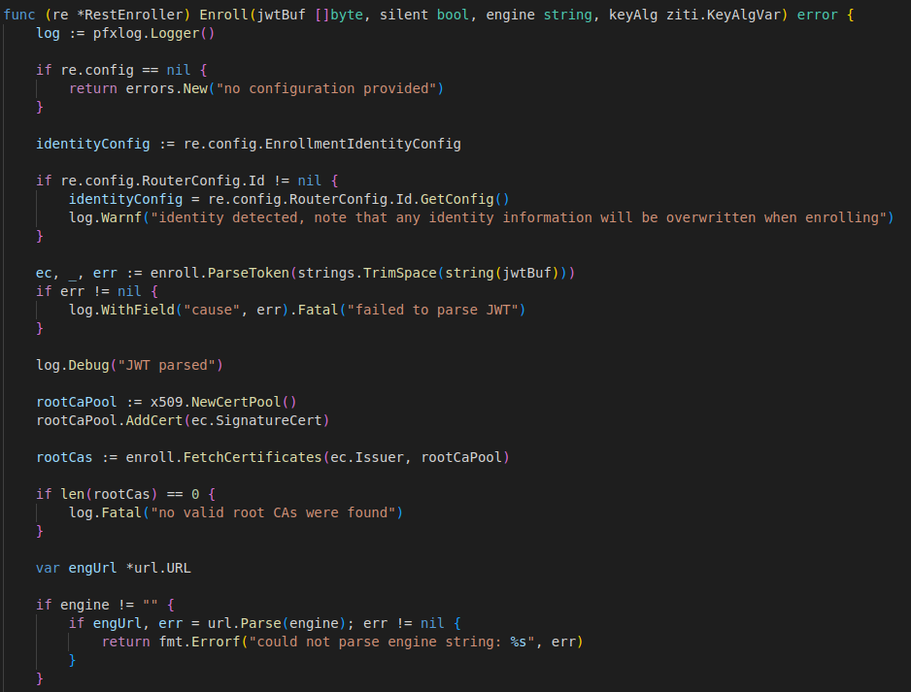
Current Enroll in Ziti

Slide 12
Proposed Component Diagram
OpenZiti Platform
Overlay Mesh Network
End-to-End Encryption SDKS
Private Authenticated SDKS
PQC Module
Quantum-Resistant Algorithm
Hybrid PQC mechanisms
PQC Key Management
Injection of the PQC Module will specifically target the enrollment and authentication functions of the OpenZiti source code
Zero Trust Components
ZTNA (Network Access)
ZTHA (Hosted Applications
ZTAA (Access Architecture)
Performance Module
Benchmarking Tools
Performance Metrics
Classical vs PQC Comparison
User Experience Module
UX Optimization Techniques
User Feedback Integration
Performance Impact Minimization

Slide 13
04
Engineering Standards
Ethical concerns regarding our project

Slide 14



Types of Licenses
MIT
Most popular
Requires users to include original copyright license notice in project
Apache
Contains a patent grant
Used by OpenZiti
Unlicense
Least restrictive scenario
GNU General Public License
Suitable for commercial, patent, and private use

Slide 15
Environmental and Health/Safety Concerns
Environmental Impact
May include energy consumption by servers and computer systems
Healthy/Safety Concerns
Quantum Cryptography poses a threat to the healthcare industry due to its capability of breaking encryption used for sensitive data
Introduces a safety concern to all encryption methods in general

Slide 16
Social, Political, and Ethical Concerns
Social Concerns
The project’s impact on the community revolves around enhancing data security
The project supports social well-being by ensuring the integrity and confidentiality of communications in a post-quantum world, thus maintaining trust in digital interactions
Political Concerns
By strengthening cybersecurity, the project could influence power dynamics, particularly in areas where information security is crucial for political stability
Important to make sure the technology is not disproportionately empowering certain groups at the expense of others
Ethical Concerns
The project must adhere to ethical standards, especially in the development and deployment of advanced cryptographic solutions
Includes transparency and respect for user privacy

Slide 17
Manufacturability, Sustainability, and Economics
Manufacturing
The project's focus on open-source software ensures that the solutions developed are easily replicable and adaptable, enhancing manufacturability
Use of widely available technologies can facilitate the deployment and scaling of solution
Sustainability
Creating long-lasting solutions that remain effective against evolving threats without requiring frequent, resource-intensive updates
Use of PQC aims to future-proof cybersecurity measures against emerging quantum computing threats
Economics
Utilizing open source software proves to be less costly than proprietary software allowing an enterprise’s budget to be used elsewhere
Open-source models can reduce costs and barriers to entry

Slide 18
Questions?

