Slide 1

Checkpoint 4: Evaluation
Group Members:
Aidan Heffron
Blake Lun
Shifan Hirani
Grant Shields
Josef Munduchikaral
TA:
Brady Testa
Professor:
Pauline Wade

Slide 2
Agenda
Quality Plan
Internal Evaluation Plan
User Acceptance Plan

Slide 3
01
Quality Plan

Slide 4
Quality Goal and Policies
Create an architecture where 100% of users interacting with our server are authenticated with a Post-Quantum Key by April
Use existing, expert-approved post-quantum implementations
Unauthenticated users are denied access to a service
Provide alternate key exchange algorithms in case of failure
Implement UI/UX elements that are navigated intuitively by at least 95% of stakeholders by April
Any changes should be reviewed and approved by at least two other group members
Structure new commands in a way similar to existing OpenZiti commands
Provide documentation for any new features or commands added
Capture relevant performance metrics for 100% of the authentication/authorization journey to be compared against existing metrics by April
Implement timers before and after generation procedures
Operate on a Virtual Machine
Notes:
Overarching idea: External users should all be authenticated before entry and the ability to authenticate should be intuitive to use.

Slide 5
Quality Processes and Artifacts
Ensure unit test performance remains similar before and after implementation
Utilize Github to submit PRs for peer review by at least two members to ensure code quality is in line with coding standards
Create Unit Tests for
failed authentication scenarios
ensuring data integrity when dealing with unrecognized users
multiple PQC implementations
Ensure code meets implementation expectations through code reviews with L3Harris
Notes:
We want to be able to understand each piece of the process and to achieve this, we create unit tests. The goal of a unit test is accuracy of *our* result and ensuring this is L3 Harris’ desired result as well

Slide 6
02
Internal Evaluation Plan

Slide 7
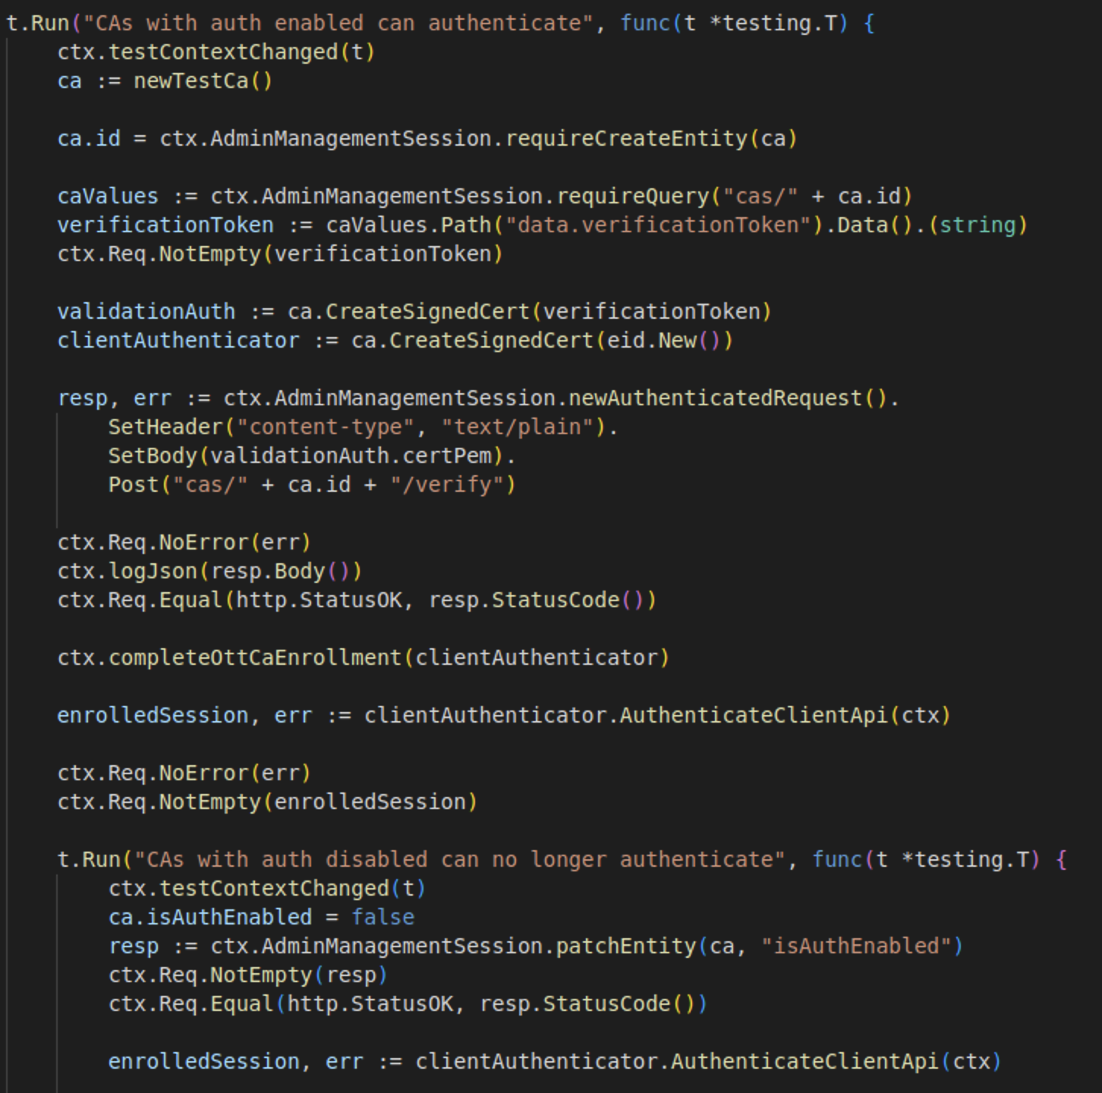
Unit Testing
Public/Private Key generation with OQS Provider
Router Enrollment
Authenticate Certificate

Slide 8
Integration Testing
Combined Component Testing - verify that individual components or modules work together as expected
Interface Testing - ensuring that connections between interacting components like APIs and data exchanges work correctly with PQC introduction
End-to-End Testing - testing entire workflow to ensure that the entire process from authentication to data handling and cryptographic operations works seamlessly
Scenario-Based Testing - testing based on real-world scenarios, particularly focusing on the authentication process within a zero-trust framework
Performance Testing - ensuring that the integration of PQC does not significantly degrade system performance
Compliance Testing - testing would need to ensure that the integration complies with relevant industry and security standards

Slide 9
03
User Acceptance Plan

Slide 10
The Process
We will send our fork of OpenZiti to the L3 Harris group along with basic instructions on how to deploy and connect to a simple service
L3 Harris group tries to deploy and establish a Quantum-Safe connection by following the instructions
Any errors or frustrations encountered should be documented
Measure how long it takes to establish a secure connection
Discuss Acceptance in an virtual meeting over Zoom
Notes:
This can be done outside of our regular meeting hours as we would like to let the instructions be the only guide. If our service is unusable without developer intervention, that implies it is simply unusable.

Slide 11
Recruitment of Users
Our capstone’s default number of test users is 20
Is this a reasonable number for L3 Harris? Is it too high/low?
For user testing, we have two scenarios for interaction.
Creating a Ziti service (primarily admins)
Using/Enrolling in a Ziti service (primarily general public/general user)
At a minimum, everyone should be able to to use and enroll. UX/UI usability standards are higher for this group than creation.
Notes:
Creating a ziti service is far less common than using one, so it does not *need* to be as user friendly

Slide 12
User Response
Ease of Basic Use
(very confusing) 0 to 5 (very easy)
Ease of Intermediate Use
(very confusing) 0 to 5 (very easy)
Overall comfort with tools
(very confusing) 0 to 5 (very easy)
Open response
Textbox for detailed response
Notes:
Following the user tests, we present a brief response survey to tackle three objectives. At a minimum, how well is a user able to login and enroll (basic). Intermediate use would be defined as changing encryption scheme, or creating a ziti service, and finally an overall comfort/confidence and open response for more detailed feedback

Slide 13
Questions?

