Slide 1

Checkpoint 5: Implementation
Group Members: Aidan Heffron
Josef Munduchikaral
Grant Shields
Shifan Hirani
Blake Lun
TA:
Brady Testa
Professor:
Pauline Wade

Slide 2
Table of contents
01
02
03
04
Overview
qs509
Client/Server Tunnel
Mininet and Wireshark

Slide 3
Overview

Slide 4
3 Parts to Implement
qs509 Go Library
A Go wrapper library for OQS X.509
Also includes benchmarking code for timing
Client/Server Tunnel Application
Executables to test our library and performance metrics
Mininet Simulation Suite
Multiple network topography files that simulate different delays, configurations, etc.

Slide 5
qs509 Library

Slide 6
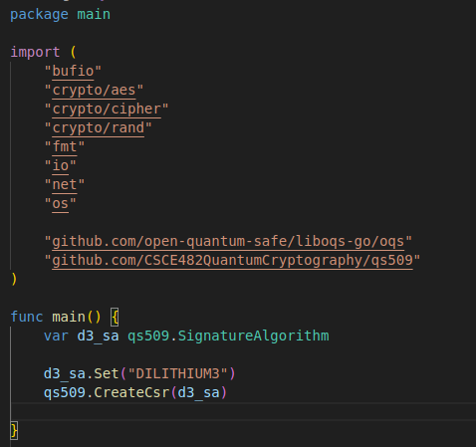

Creating a Go Library
Go libraries can be easily initialized and exported by defining a Go module for a package
go mod init "github.com/CSCE482QuantumCryptography/qs509"
This creates a module that can then be imported by any other Go package
Functions can then be called statically within whatever package imports the library

Slide 7
What Our Library Offers
Our library requires: LibOQS, OpenSSL 3.3, oqs-provider
Generate Key
Can generate any supported KEM or Signature Key
Generate Certificate
Can create a certificate that is signed with any supported Signature Key
Certificate Signing Request
Submits a signing request for a certificate to our local CA
Verify Certificate
Verifies a certificate against our local CA
Also checks certificate format, expiration, etc.
Performance Metrics
Different functions that can be called to track the time it takes to use QS functions

Slide 8
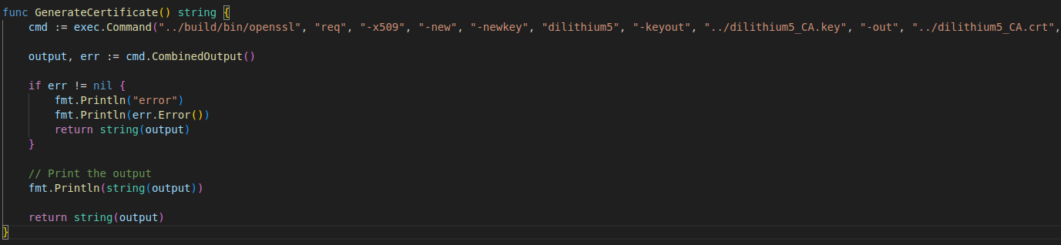
Implementing Our Library
Our library will be making use of the Standard Go import, “os/exec”
We define variable types for the various supported Signature and KEM algorithms
We create different Go functions for each command we need to support
These functions execute OQS commands and return in a format friendly to Go
The benefit of this library is that now we have a Go-friendly way to call OQS commands in other packages, by simply calling a function rather than having to dispatch to a terminal ourselves

Slide 9
Client/Server Tunnel

Slide 10
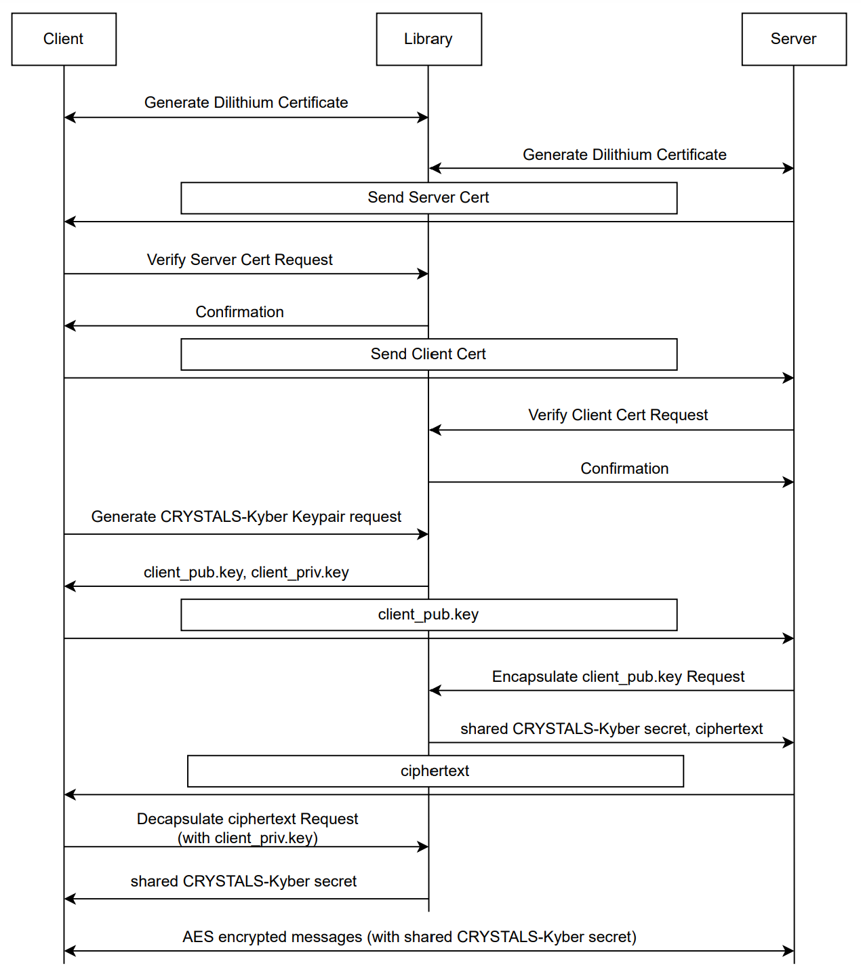
Client-Server Interaction
There are 3 different components of the Client/Server architecture:
Certificate Authentication
PQ KEM
AES256 Encryption
Our qs509 Library makes certificate authentication much easier in Go

Slide 11
Certificate Authentication
Clients and Servers will follow the following sequence:
Call qs509 library to generate a dilithium certificate and key
Call qs509 library to have their certificate signed by our CA
Send certificate information across the network
Call qs509 library to verify the received certificate
Because we are just testing locally, we are using a locally created CA. However, in other implementations, the Certificate Signing Request can be dispatched to any well-known CA the server or client is authorized to use.

Slide 12
PQ KEM
Once Certificates are verified, the client and server need to agree on a 32-byte, shared Kyber Key.
Clients make a call to liboqs-go to create a Kyber Key Pair
Clients send this key across the network (in plain text) to the server
The server makes a call to liboqs-go to Encapsulate the public key and generate a shared secret key
The server sends the shared secret as a cipher back to the client
The client makes a call to liboqs-go to decrypt the cipher (with the client private key) and get the shared secret

Slide 13
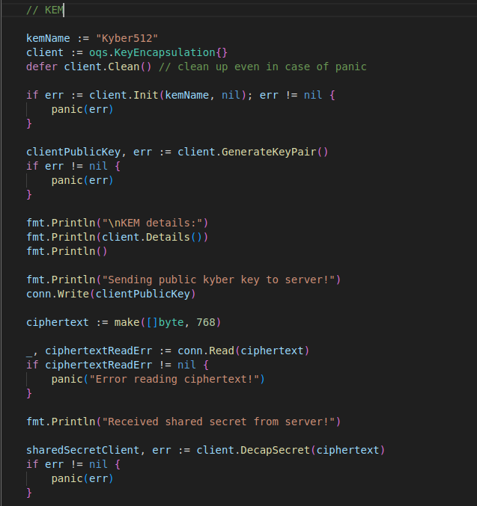
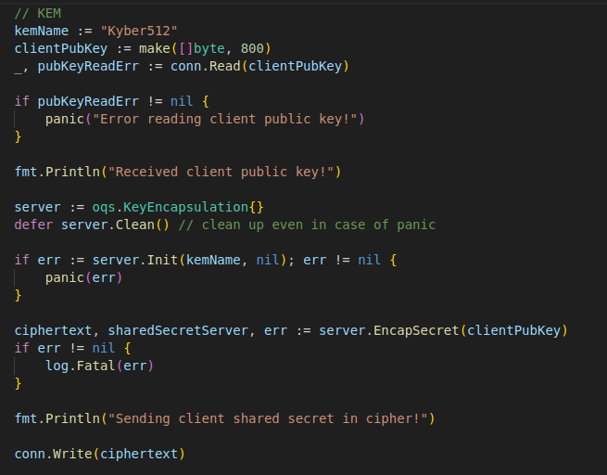
Server
Client

Slide 14
AES256 Encryption
Now that both client and server have a shared Kyber key, they can use AES256 to encrypt all messages and stream across the network
Both the client and server use “crypto/aes” to create a new cipher with the shared secret
The client uses a random number generator to create an Initialization Vector
Client writes the IV over to the server
Clients and Servers can now use “crypto/cipher” to create CFBEncrypters and CFBdecrypters that can translate cipher to plain text and vice versa
Clients and Servers send messages using this new encryption

Slide 15
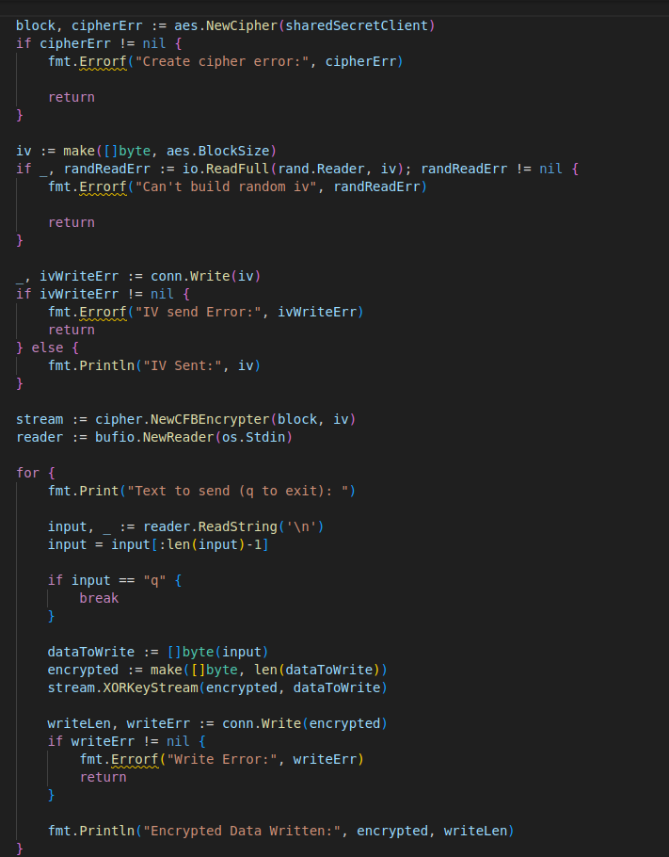
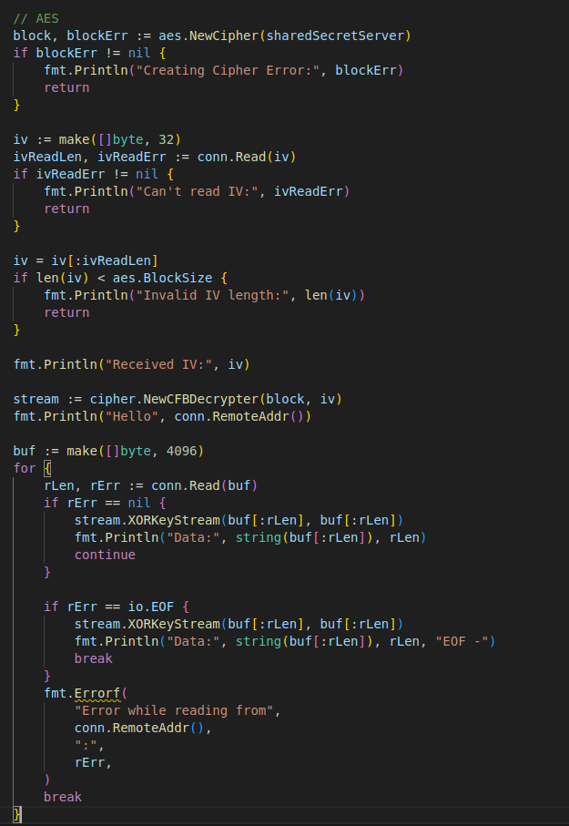
Client
Server

Slide 16
Mininet
and
Wireshark

Slide 17
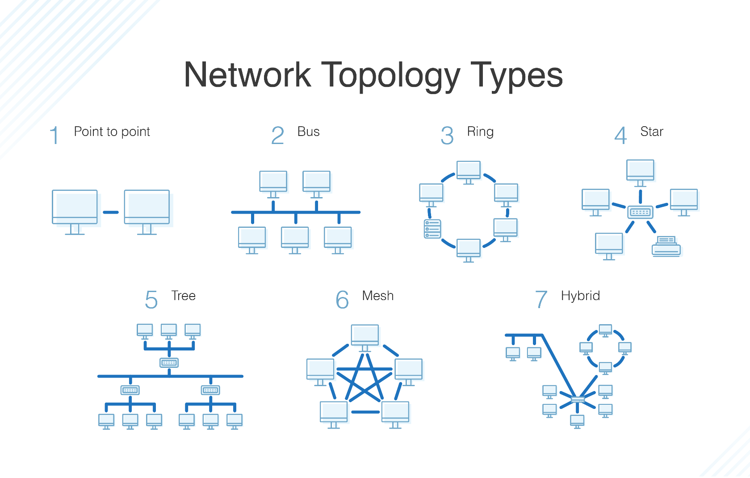
Different Network Topologies
In Mininet, we can simulate an infinite number of different network configurations
Mininet allows us to set up many different host devices and switches, each of which can be configured with different bandwidths, latencies, etc.
Configuring common topologies will allow us to see exactly how Post-Quantum cryptography will affect services and their clients
https://www.dnsstuff.com/what-is-network-topology

Slide 18
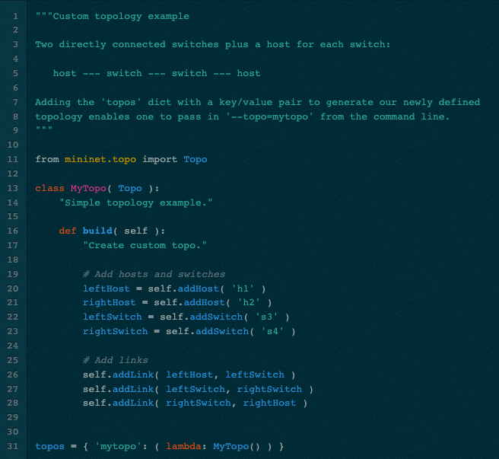
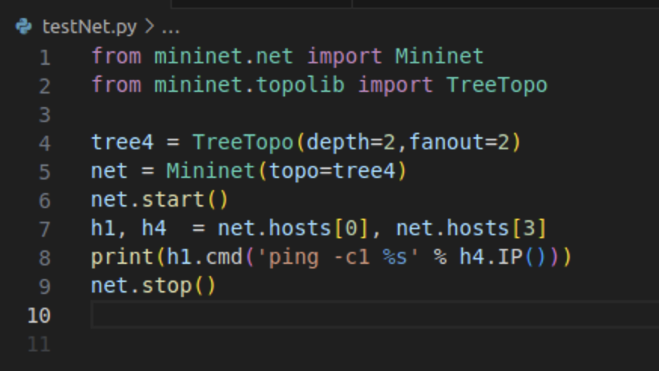
Creating Topologies
Mininet works with python to create complex topologies with many different hosts
Every host is configured with its own IP address
We will create various topologies to test the following situations:
1 client communicating to a host
5 clients simultaneously communicate with the same host
1 client communicating with a host across the nation
5 clients simultaneously communicating with the same host from different areas

Slide 19
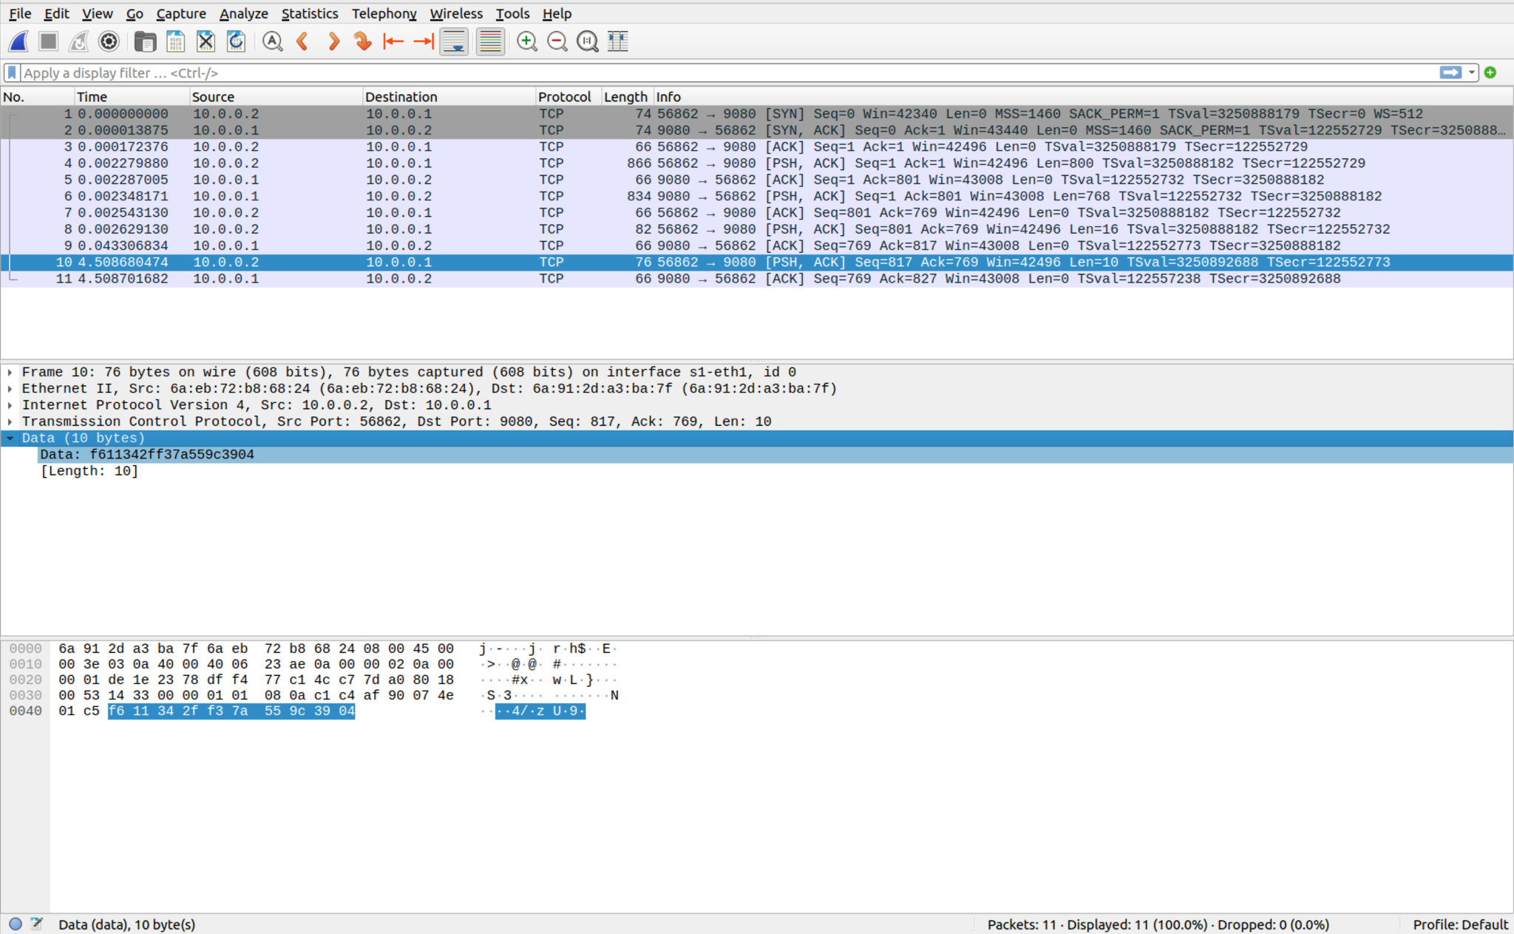
Wireshark Captures
The entire point of creating these different mininet topologies is to test how post-quantum cryptography affects the time and size of communication between a server and its clients
We are conducting extensive tests to gather as much information on (for both PQ and classical cryptography):
Packet size
Number of packets
Time spent sending packets through different bandwidths
The effect of latency on sending packets
Compiling all of this data will allow us to directly compare the trade-off between performance and security

Slide 20
Questions?

