Slide 1
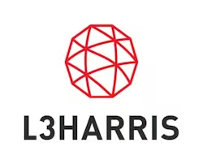

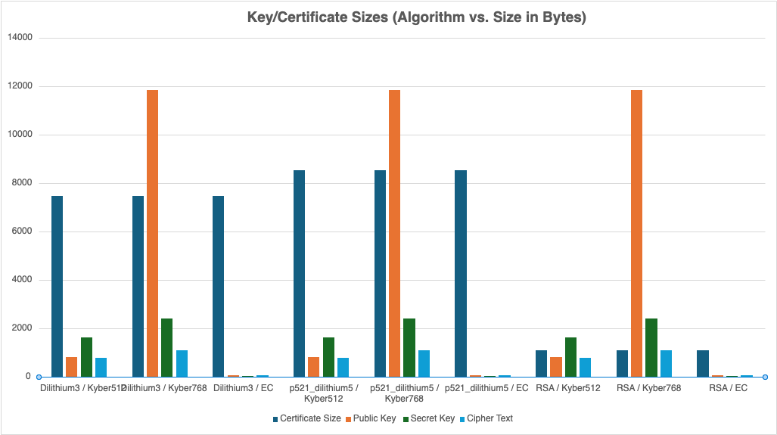
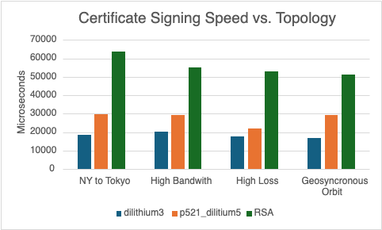
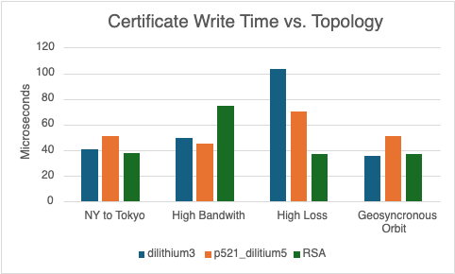
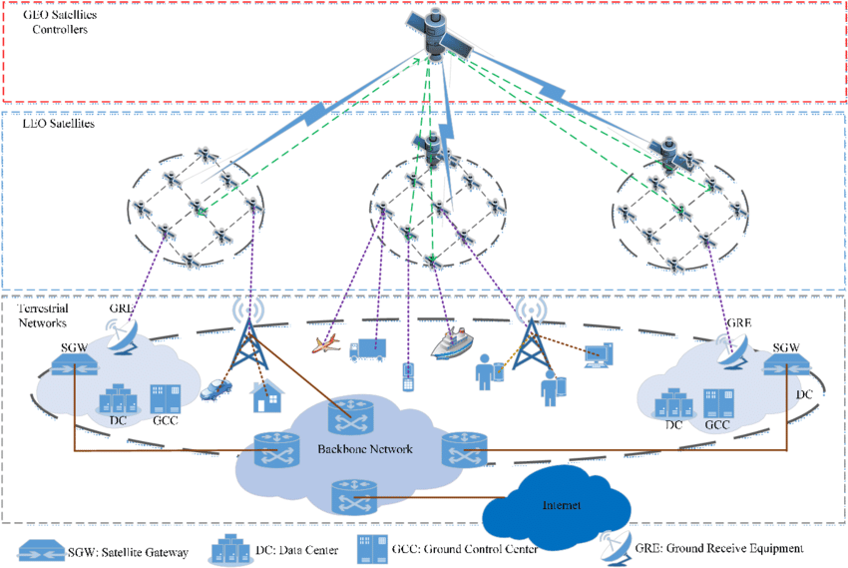
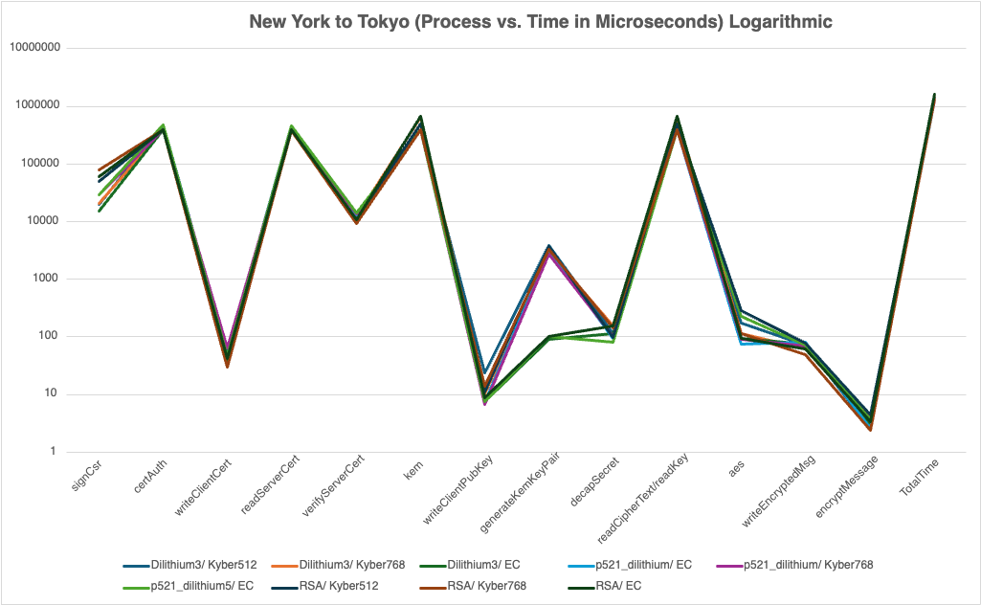
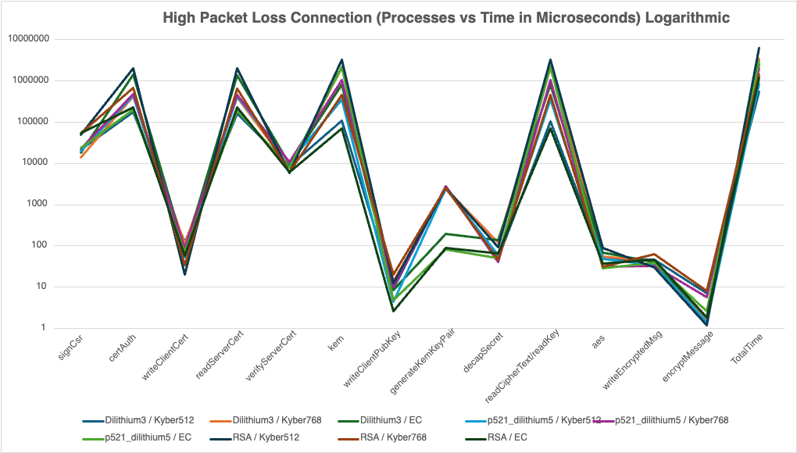
Booth 449
Post-Quantum Cryptography
Aidan Heffron, Shifan Hirani, Blake Lun, Josef Munduchirakal, Grant Shields
Dr. Pauline Wade
Background/Motivation
Data sent over a network is only as secure as its encryption. When quantum computers become more widespread, the common encryption methods such as RSA will be cracked in a matter of minutes. Networks need encryption for a post-quantum world.
Quantitative Results
End Results
Our project shows that incorporating post-quantum cryptography into a system is very viable. However, it does lead to increased cost in data size and timing, depending on the specific algorithms used.
Proposed Solution
Implement a Go library that provides functionality for quantum-safe certificate generation and verification
Test our library in a client/server application
Host our client/server application on various real-world network topologies
Provide performance metrics to compare post-quantum and classical cryptography
Impact
Ease of Generation and Verification: Developers will be able to create, sign and verify certificates through a simple Go import and function call.
Performance Analysis: Our library offers metrics for exactly how long it takes to produce different certificates and keys.
Network Analysis: We provide exhaustive analysis of how post-quantum cryptography works with various different network configurations. This can be referred to by network admins when deciding to implement post-quantum algorithms.
Using Our Tunnel: If a private entity wishes to add post-quantum cryptography on top of their solution, they can use our tunnel as an additional layer of security for their application.
Figure 2. Cryptographic Component Size vs. Algorithm
System Design
Our project consists of three different major components:
Go library for OQS X.509
Client/Server Tunneling Application
Mininet Simulation
We leverage Go, Python, and Bash for our working solution
Figure 3. Time Spent Creating a Certificate
Figure 4. Time Spent Sending a Certificate
References
Aikata, Aikata, et al. “A Crystal for Post-Quantum Security Using Kyber and Dilithium.” Research Gate, Jan. 2022, www.researchgate.net/publication/365332761_A_Crystal_for_Post-Quantum_Security_Using_Kyber_and_Dilithium
An, Hyeongcheol, et al. “Performance Evaluation of Liboqs in Open Quantum Safe Project.” The Institute of Electronics, Information and Communication Engineers, 23 Jan. 2018, caislab.kaist.ac.kr/publication/paper_files/2018/SCIS’18_HC_SCA.pdf
Bilogrevic, Igor. Satellite Communications: Internet Challenges and Low-latency Applications. (2008). In I. Bilogrevic (Ed.), Infoscience. https://infoscience.epfl.ch/record/147212
Bos, J., Ducas, L., & Kiltz, E. (n.d.). Crystals - Kyber: A CCA-secure module-lattice-based Kem | IEEE ... https://ieeexplore.ieee.org/abstract/document/8406610
Jena, B. K. (2023, February 9). What is AES encryption and how does it work?. Simplilearn.com. https://www.simplilearn.com/tutorials/cryptography-tutorial/aes-encryption
Acknowledgements
Thank you to L3Harris, Professor Pauline Wade, and Brady Testa for supporting us through this project!
Figure 1. Tested Mininet Network Topologies
Figure 5. Application Process vs. Time to Complete (New York to Tokyo)
Figure 6. Application Process vs. Time to Complete (High Packet Loss)

