Slide 1
CHELSIE’S / RYAN’S DIGITAL CITIZENSHIP AUDIT
Example (exported to PDF)
CSCI 1100, Spring 2026

Slide 2

Contents
1. Information Literacy
2. Data Literacy
3. Web Literacy
4. AI Literacy
5. Cybersecurity Literacy
6. Microsoft Office Skills

Slide 3
Information Literacy
Information literacy is the cornerstone of responsible engagement in today’s online world. It equips individuals with the ability to critically evaluate digital content, navigate platforms effectively, and address challenges such as misinformation with ethical awareness.
In this section, I showcase my information literacy skills by fact-checking a social media post using the SIFT method. This example demonstrates my ability to critically assess online information, conduct thorough research, and promote responsible digital practices in an age in which misinformation spreads rapidly.

Slide 4
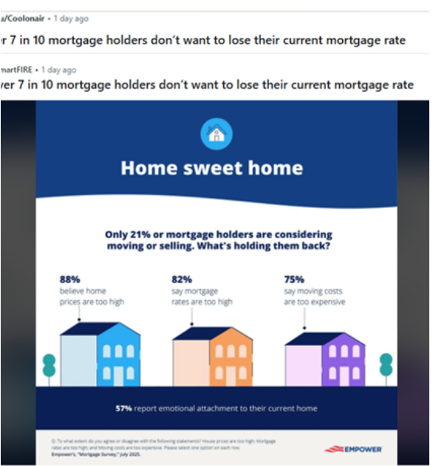
Analyzing A Redditor’s Claim in Infographic Post
Step 1: Gather the Claim
I visited r/Infographics on Reddit to browse for a post that made a key claim based on an infographic.
I selected a post from Reddit User "Coolonair".
The post suggests that more than 7 in 10 mortgage holders [in the United States] want to keep their current mortgage rate.
📎View post here [Ctrl-click]

Slide 5
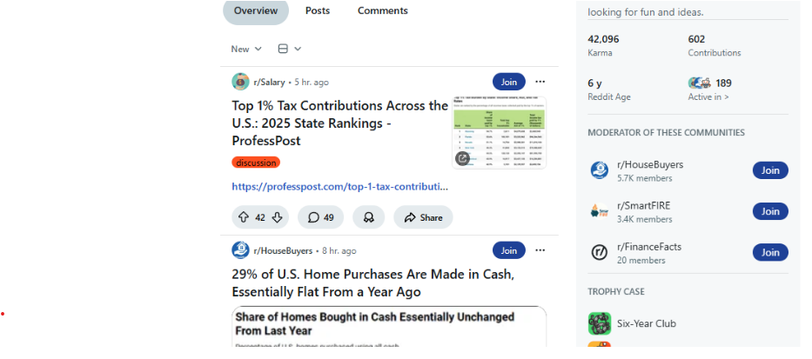
Analyzing A Redditor’s Claim in Infographic Post: SIFT Time
Step 2: Apply the SIFT Method
i. STOP
My Initial reaction: Neutral – seems plausible
My potential biases: I am biased to believe the reporting because this claim is consistent with my pre-existing beliefs about homeowner/homebuyer sentiment.
ii. INVESTIGATE
Author/account info: The user’s bio simply reads “looking for fun and ideas.” The author has been on Reddit for about 6 years, and their account largely seems to consist of re-posting infographics related to economic measures in the U.S. shared on a subreddit called r/SmartFIRE.

Slide 6
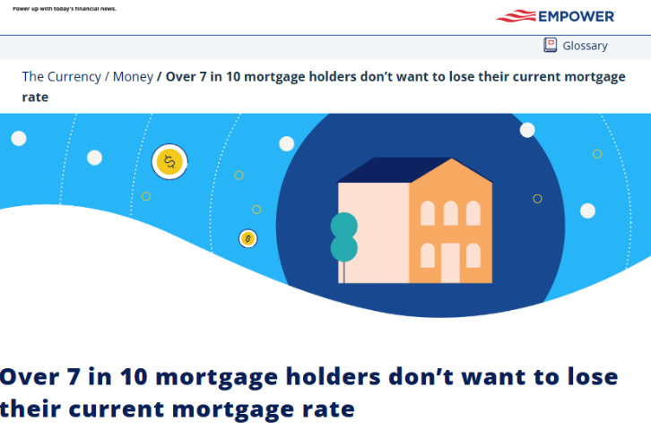
Analyzing A Redditor’s Claim in Infographic Post: SIFT cont’d
Step 2: Apply the SIFT Method
iii. FIND
iv. TRACE
Original source: Empower. Nov 18, 2025
Proper context: Yes (see discussion below)
Missing information: Of course, there is additional context about this survey, however, because the original infographic the Reddit author posted from Empower includes the question that was asked to survey respondents, no key information is missing from the infographic or seems to be misrepresented based on the supporting sources.
📎Source 1. New York Times [Ctrl-click]
📎Source 2. Yahoo Finance [Ctrl-click]
Above: The original source corroborates the core claim in its headline and provides the full context of the survey, including the original infographic that was shared in the Reddit post.

Slide 7

Analyzing A Redditor’s Claim: Final Assessment
Final Assessment & Discussion
Final assessment: 4.5/5 reliability
The New York Times source from 2024 explains the “mortgage rate lock-in effect” where many homeowners secured fixed-rate mortgages at rates below the market rate and were therefore reluctant to sell. This older article increases the plausibility of the Empower survey’s finding.
Empower’s survey findings were cited in the Yahoo Finance article, which lends some credibility to Empower because of Yahoo Finance’s reputation as a trusted source for financial reporting.
Furthermore, because the core claim and the infographic posted were traced directly back to Empower, the claim appears to be credible and free of significant bias. I chose to rank this rating just shy of 5/5, because in this cursory analysis, I did not look to see if other surveys reported a similar (>70 percent) figure.

Slide 8
Information Literacy Reflection
💪🏻 Strengths
Chocolate cotton candy danish cotton candy soufflé cake ice cream muffin. Sugar plum gummi bears marshmallow jelly beans powder lollipop bonbon. Jelly beans toffee soufflé soufflé candy wafer toffee.
🫤 Growth areas
Danish muffin jelly-o dragée toffee. Candy brownie macaroon danish chocolate bear claw sweet roll. Chupa chups topping chupa chups oat cake pie. Toffee gummi bears soufflé fruitcake liquorice.
🎯Goals
Shortbread candy soufflé wafer cheesecake muffin.
Chocolate cake jujubes lollipop jelly icing candy canes chocolate caramels biscuit. Cake fruitcake pie candy canes donut.

Slide 9
Data Literacy
Data literacy is the ability to collect, analyze, interpret, and communicate data effectively to make informed decisions. It goes beyond understanding numbers, requiring critical thinking to ensure data is used ethically, accurately, and responsibly. This skill is essential for navigating complex information and making evidence-based, data-driven decisions.
In this section, I demonstrate my proficiency in data literacy by analyzing a dataset and presenting key insights through a visual representation. This example highlights my ability to use tools like Excel to process, visualize, and interpret data in ways that are both clear and impactful.

Slide 10

Data Literacy: Spotify Most Streamed Songs
The Dataset & Tools Used
Key Insights
I analyzed a Kaggle dataset of 953 records covering the most streamed Spotify songs, enriched with data from Apple Music, Deezer, and Shazam (Kaggle).
Playlist releases by month: January and September are peak months for playlist adds; December is the lowest
Tempo vs. danceability: A scatter plot revealed little to no correlation between BPM and danceability
Musical keys: C# dominates at 13.99%, followed by G# at 11.19% and F# at 10.61%
Tools used: Microsoft Excel for data processing and chart creation

Slide 11
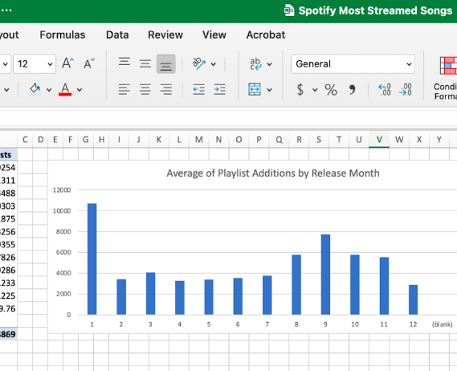
Songs Most Added to Playlist by Month
The chart shows that songs released in January and September receive the most additions to Spotify playlists, while December sees the fewest, likely due to holiday-focused content and fewer new releases.
These patterns suggest artists should time new releases in early spring and late summer to maximize playlist visibility.

Slide 12
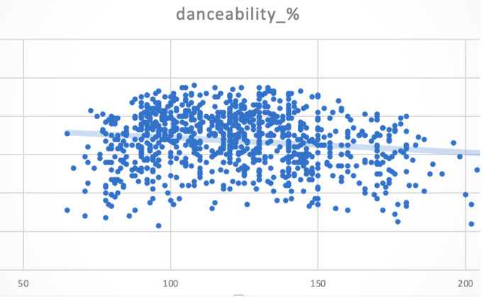
Most Streamed Songs: Danceability / BPM Connection?: Not really…
The scatter plot shows a dense cluster of songs around mid-range BPM and danceability, yet the overall correlation between the two variables is weak.
The slight downward trendline indicates that BPM alone has little influence on a song’s danceability, suggesting other factors play a more significant role.

Slide 13
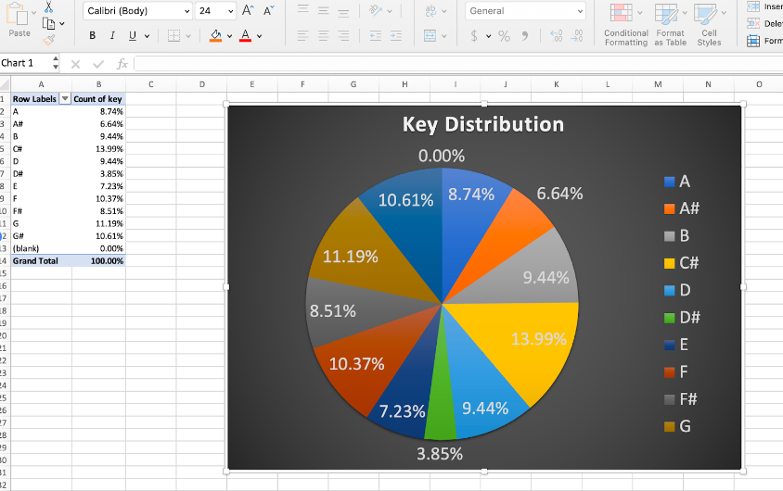
Most Streamed Songs Key Distribution
Low key, not surprising
The pie chart shows that the most streamed songs on Spotify favor sharp keys, with C# leading at 13.99%, followed by G# (11.19%) and F# (10.61%).
Keys like D# and A# are less common, suggesting that certain tonalities may resonate more with listeners and align with popular musical trends.

Slide 14
Data Literacy Reflection
💪🏻 Strengths
Chocolate cotton candy danish cotton candy soufflé cake ice cream muffin. Sugar plum gummi bears marshmallow jelly beans powder lollipop bonbon. Jelly beans toffee soufflé soufflé candy wafer toffee.
🫤 Growth areas
Danish muffin jelly-o dragée toffee. Candy brownie macaroon danish chocolate bear claw sweet roll. Chupa chups topping chupa chups oat cake pie. Toffee gummi bears soufflé fruitcake liquorice.
🎯Goals
Shortbread candy soufflé wafer cheesecake muffin.
Chocolate cake jujubes lollipop jelly icing candy canes chocolate caramels biscuit. Cake fruitcake pie candy canes donut.

Slide 15
Web Literacy
Web literacy is the ability to critically evaluate and effectively engage with online information, ensuring that content is credible, relevant, and reliable. It also involves understanding how websites function, navigating the vast amounts of information available online, and understanding what makes for well-structured, accessible web content.
To demonstrate my competence in web literacy, I have conducted an analysis of the National Center for Education Statistics (NCES) website, hosted at nces.ed.gov. Using the free Google Chrome extension, WAVE Evaluation Tool, I evaluate the website for three key accessibility features: contrast, alternative text, and well-structured headings.

Slide 16
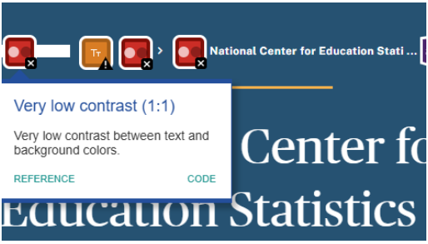
Accessibility Audit of NCES: Contrast
Using the browser's "Inspect" tool, I found the background color being used was #215374.
I pasted this hex value in for the background color in WebAIM's Contrast Checker, set the foreground color to white.
The Contrast Checker revealed that the resulting contrast ratio is 8.22:1 which passes all the WCAG guidelines.
Above – When WAVE lies: The WAVE extension flagged elements of the breadcrumb navigation in the hero section as having "Very low contrast", however, they were still white text on the same blue background, so the tool is mistaken.

Slide 17
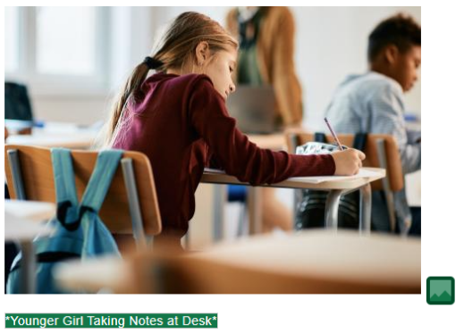
Accessibility Audit of NCES: Alt Text
The NCES generally features sufficiently descriptive alt text on their images.
However, the image at the top of the page with students at their desks raising their hands is missing alt text. If it is decorative, it should have empty quotes (alt=“”).
This will need to be corrected so a screen reader can identify the content of the image.
Above – Good Use of Alt Text: The description “Younger girl taking notes at desk” is vivid enough to provide a mental picture without being too verbose.

Slide 18
Accessibility Audit of NCES: Use of Headings, Structure
The NCES has an overall well-defined, navigable structure that is broken up by heading levels
However, in some cases the hierarchy in which the headings are used is counterintuitive. E.g., the top title—"National Center for Education Statistics (NCES)"—uses a level-1 heading and the gallery immediately after uses level-3 headings, skipping a second level.
While this is not an accessibility error, it is best practice to not skip heading levels from top to bottom.

Slide 19
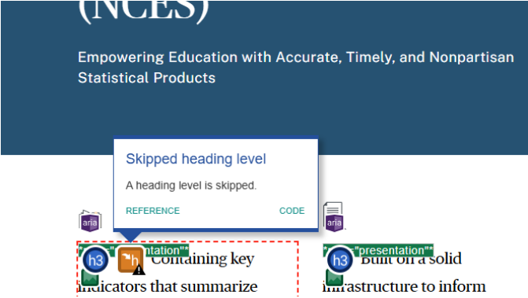
Accessibility Audit of NCES: Use of Headings, Structure, cont’d
Skipping headings – reduces screen reader navigability
Scrolling down the page, for example, the next section features a level-2 heading—"Explore NCES"—which could make it a bit confusing to navigate the site with a screen reader since level-3 headings precede it.
Visually, however, it is still quite organized and easy to differentiate sections of the webpage.

Slide 20
Accessibility Audit Conclusion: Good overall, room for improvement
Judging by the homepage, the NCES website is overall a very accessible site. Its only error is a missing alt text description.
No (valid) contrast errors, so those with lower vision should find it readable, and the site uses heading levels strategically to make the site navigable.
A notable limitation of the site's navigability is, of course, that the h2 level was skipped toward the top of the page, which could make navigating different sections of the homepage less intuitive for visitors using screen readers.
Overall: the NCES seems to be doing quite well with accessible design, but fixing the identified issues would help make their site even more accessible.

Slide 21
Web Literacy Reflection
💪🏻 Strengths
Chocolate cotton candy danish cotton candy soufflé cake ice cream muffin. Sugar plum gummi bears marshmallow jelly beans powder lollipop bonbon. Jelly beans toffee soufflé soufflé candy wafer toffee.
🫤 Growth areas
Danish muffin jelly-o dragée toffee. Candy brownie macaroon danish chocolate bear claw sweet roll. Chupa chups topping chupa chups oat cake pie. Toffee gummi bears soufflé fruitcake liquorice.
🎯Goals
Shortbread candy soufflé wafer cheesecake muffin.
Chocolate cake jujubes lollipop jelly icing candy canes chocolate caramels biscuit. Cake fruitcake pie candy canes donut.

Slide 22
AI Literacy
AI literacy is the ability to understand, evaluate, and use artificial intelligence tools effectively, while critically reflecting on their limitations, ethical implications, and potential impact on society. In today’s rapidly evolving technological landscape, AI literacy is essential for navigating tools like chatbots, recommendation systems, and machine learning platforms. This involves using AI effectively and critically comparing their outputs, identifying biases, and assessing their reliability and relevance in different contexts.
To demonstrate my competence in AI literacy, I have compared the outputs of two AI models: ChatGPT and Gemini. This work highlights my ability to analyze and evaluate the differences in their responses, critically assess the quality and accuracy of the content generated and reflect on the implications of these differences for practical applications. By engaging in this exercise, I showcase my understanding of how to leverage AI tools responsibly and effectively.

Slide 23
ChatGPT vs Gemini: Prompt 1 – Testing w/ well-known literary work
Prompt: Explain Beowulf
Output:
Beowulf is one of the oldest surviving works of English literature, a heroic epic poem written in Old English around 700-1000 AD. Although its exact authorship is unknown, the poem is a cornerstone of Anglo-Saxon literature, blending pagan traditions with emerging Christian themes. It recounts the adventures of its titular hero, Beowulf, and explores themes of bravery, loyalty, honor, and the inevitable decline of heroes.
Plot Summary
The poem can be divided into three main sections:
… [ response continues ]
Prompt: Explain Beowulf
Output:
Beowulf is an epic poem, considered one of the most important works of Old English literature. It tells the story of Beowulf, a heroic warrior who comes to the aid of King Hrothgar of the Danes, whose mead hall (Heorot) is being terrorized by a monstrous creature called Grendel.
The Story in Three Parts
The poem is often divided into three main parts:
Grendel: Beowulf travels to Heorot and defeats Grendel in a fierce battle, ripping off the monster's arm.
Grendel's Mother: Grendel's mother, seeking revenge, attacks Heorot. Beowulf follows her to … [ response continues ]

Slide 24
ChatGPT vs Gemini: Prompt 1 Analysis
Both: ChatGPT and Gemini provide comprehensive overviews of the Beowulf epic, covering similar core elements such as the poem's three-part narrative structure, key themes, and literary significance.
The ChatGPT output offers a more detailed and nuanced exploration, with richer descriptions of themes like fate (wyrd) and more elaborate explanations of the cultural context.
It also provides more specific literary analysis, such as discussing the use of kennings.
The Gemini output, while equally informative, has a slightly more straightforward and concise presentation, with additional practical suggestions for further reading.
Both outputs highlight the poem's blend of Christian and pagan elements, its significance in Anglo-Saxon literature, and Beowulf's heroic journey, demonstrating a consistent scholarly understanding of this important literary work.

Slide 25
ChatGPT vs Gemini: Prompt 2 – Same literary work, more CLEAR
Prompt: Explain Beowulf’s illustration of cultural values & to what extent they manifest in the story as well as within documented culture.
Output:
Beowulf is a rich artifact of Anglo-Saxon culture, and it vividly illustrates the values and principles of that society. The poem not only tells a story but also serves as a lens through which we can examine the cultural norms, beliefs, and expectations of the time. These values manifest both explicitly within the plot and implicitly in the documented culture of the Anglo-Saxons.
Key Cultural Values in Beowulf and Their Manifestation
… [ response continues ]
Prompt: Explain Beowulf’s illustration of cultural values & to what extent they manifest in the story as well as within documented culture.
Output:
Beowulf provides a fascinating window into the cultural values of the Anglo-Saxons, the Germanic people who inhabited England from the 5th century onwards. Here's how these values are woven into the story and how they connect to historical Anglo-Saxon culture:
Key Values Illustrated in Beowulf
Strength and Courage: Beowulf is the epitome of physical prowess. He boasts of his strength, battles monsters with his bare hands, and faces the dragon despite … [ response continues ]

Slide 26
ChatGPT vs Gemini: Prompt 2 Analysis
Both: provide in-depth explorations of Anglo-Saxon cultural values through the lens of Beowulf, but with distinct stylistic and structural approaches.
The ChatGPT output offers a more scholarly and systematically organized analysis, breaking down six key cultural values with detailed explanations of their manifestation in both the story and historical context.
It provides more extensive archaeological & historical evidence to support its claims.
The Gemini output, while equally insightful, takes a slightly more narrative approach, presenting the cultural values in a more conversational tone and with fewer specific historical references.

Slide 27
ChatGPT vs Gemini: Prompt 2 Analysis, cont’d
Both: highlight similar core values – heroism, loyalty, strength, reputation, and the interplay between pagan and Christian beliefs.
The ChatGPT version goes into greater depth, providing more nuanced analysis, while the Gemini output offers a more accessible, broadly sweeping interpretation of the epic's cultural significance.
Both: Notably, both outputs emphasize Beowulf's role as a cultural artifact that provides insight into Anglo-Saxon societal norms and values beyond simply being a narrative.
CLEAR-style prompting saw greater results in drilling into the cultural values expressed in the book and their relation to culture with ChatGPT, whereas Gemini’s answers continued to be more generic.

Slide 28
AI Literacy Reflection
💪🏻 Strengths
Chocolate cotton candy danish cotton candy soufflé cake ice cream muffin. Sugar plum gummi bears marshmallow jelly beans powder lollipop bonbon. Jelly beans toffee soufflé soufflé candy wafer toffee.
🫤 Growth areas
Danish muffin jelly-o dragée toffee. Candy brownie macaroon danish chocolate bear claw sweet roll. Chupa chups topping chupa chups oat cake pie. Toffee gummi bears soufflé fruitcake liquorice.
🎯Goals
Shortbread candy soufflé wafer cheesecake muffin.
Chocolate cake jujubes lollipop jelly icing candy canes chocolate caramels biscuit. Cake fruitcake pie candy canes donut.

Slide 29
Cybersecurity Literacy
Cybersecurity literacy encompasses the knowledge and practices required to protect devices, data, and online identities from digital threats. This includes understanding key principles like strong passwords, data encryption, phishing awareness, and safe browsing habits to promote responsible and secure online behavior.
To demonstrate my competence in cybersecurity literacy, I will identify three practices or tools that I can use to improve my personal cybersecurity across three vectors: Accounts, Devices, and Identity.

Slide 30
Cybersecurity Literacy: My plan after auditing my personal cybersecurity
Accounts: Expand use of two-factor authentication beyond banking and school accounts to online shopping
2
Identity: Replace my real phone number on accounts with a virtual number to reduce my digital footprint
3
Devices: Enable Windows BitLocker to encrypt my filesystem against physical theft or loss
1

Slide 31
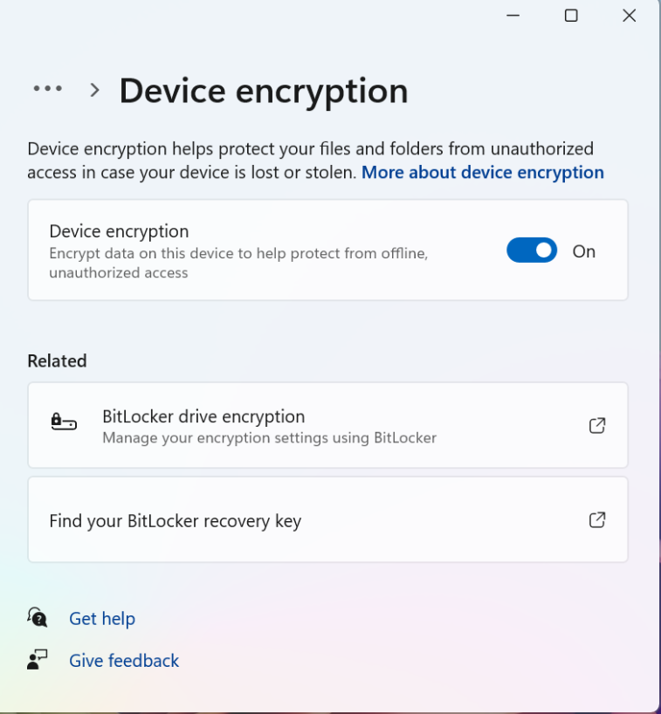
1. Devices: Using Bitlocker
In the event that my devices fall into the wrong hands, having an encrypted file system could be the difference between someone having access to all the personal files and data on my laptop or not.
I can follow these instructions to set up Windows Filesystem Encryption (Bitlocker) to encrypt my filesystem:
Means that when laptop first powered on, the data on my permanent storage is scrambled and cannot be unscrambled until I provide the master key (the password I set).
This gives me peace of mind that if I do lose my laptop for good, at least I am confident that someone will not access sensitive or personally identifiable data, like family photos or my downloaded paystubs.

Slide 32
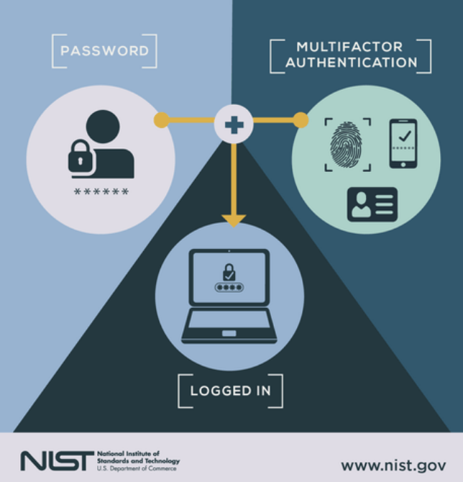
2. Accounts: Using 2FA
I already employ some solid account management practices & tooling: I use a trustworthy password manager to help me centralize my account passwords.
One practice, however, that I can use to harden my accounts' security is to use two-factor or multifactor authentication more widely.
I already use 2FA/MFA on many of my most important accounts, such as my ETSU & bank account, but some services I use (e.g., online shopping) do not have 2FA turned on.
The solution here is pretty simple!: I’ll shore up accounts without 2FA by adding it + set the practice of saving recovery codes, phrases, and answers to a safe place (my password manager).

Slide 33
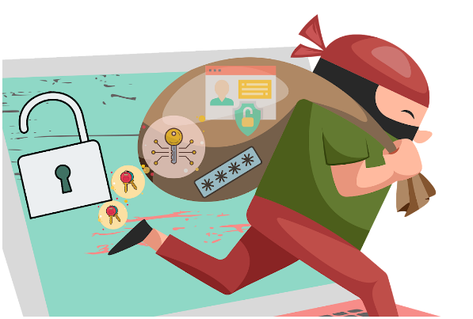
3. Identity: Reducing my footprint
Reducing my digital footprint can make it more difficult for scammers and hackers to try to put together identifiable breadcrumbs across the Internet that give a bad actor a detailed picture of my personal life.
While I already subscribe to a service that issues takedown requests to data broker websites and search engines that feature my personal info, I can further reduce my footprint by changing the contact phone number on my accounts to a virtual number.
Phone # less available online → harder to find → less fraudulent calls
More importantly, phone number reveals carrier and the general geographic area indicated by area code, so making it less available makes my private info less available.

Slide 34
Cybersecurity Literacy Reflection
💪🏻 Strengths
Chocolate cotton candy danish cotton candy soufflé cake ice cream muffin. Sugar plum gummi bears marshmallow jelly beans powder lollipop bonbon. Jelly beans toffee soufflé soufflé candy wafer toffee.
🫤 Growth areas
Danish muffin jelly-o dragée toffee. Candy brownie macaroon danish chocolate bear claw sweet roll. Chupa chups topping chupa chups oat cake pie. Toffee gummi bears soufflé fruitcake liquorice.
🎯Goals
Shortbread candy soufflé wafer cheesecake muffin.
Chocolate cake jujubes lollipop jelly icing candy canes chocolate caramels biscuit. Cake fruitcake pie candy canes donut.

Slide 35
Microsoft Office Skills
Proficiency in Microsoft Office tools, such as Word, Excel, and PowerPoint, is essential for creating, analyzing, and presenting information in both academic and professional settings. These tools provide useful functionalities for drafting detailed documents, managing and analyzing data, and delivering impactful presentations.
To showcase my skills, I have linked two examples: my dissertation proposal formatted in Word and my dissertation defense slide deck in PowerPoint, which features data visualizations, animations, and high-resolution images. These examples highlight my ability to leverage Microsoft Office tools to communicate effectively and efficiently.

Slide 36
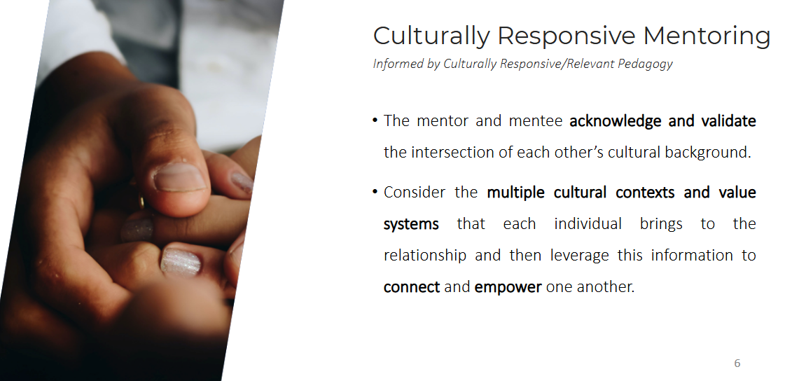
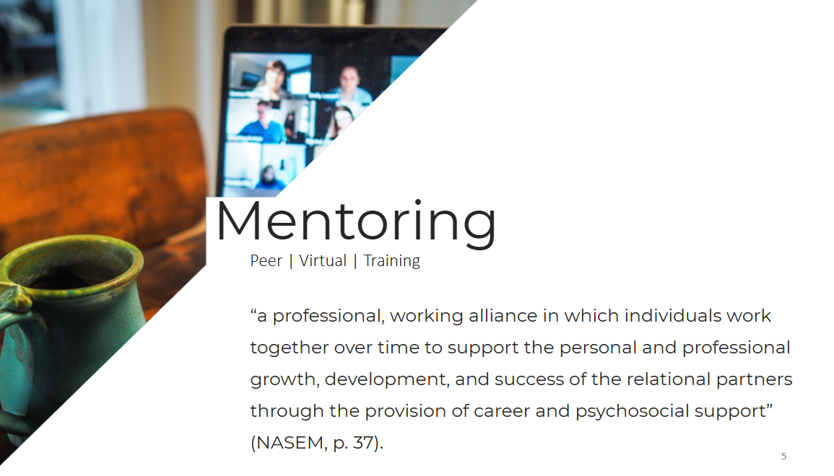
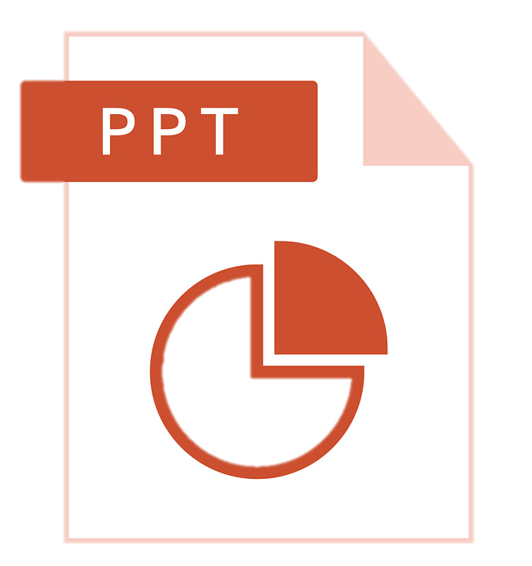
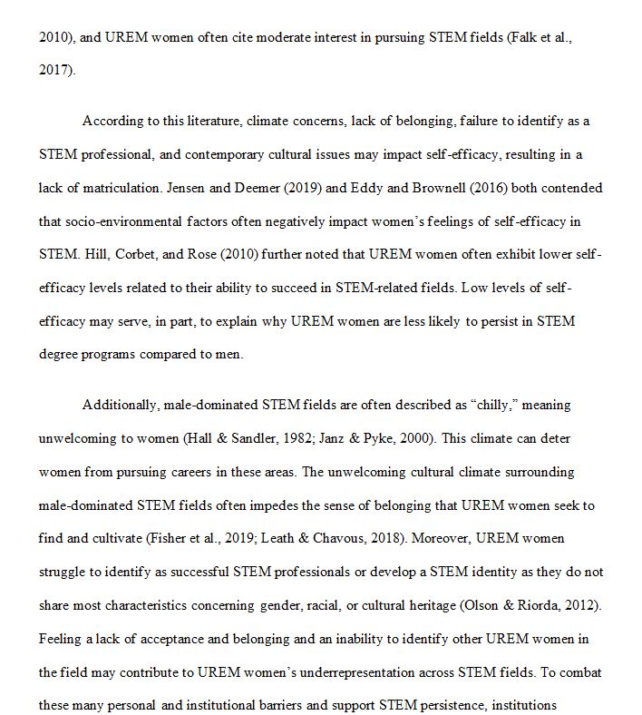
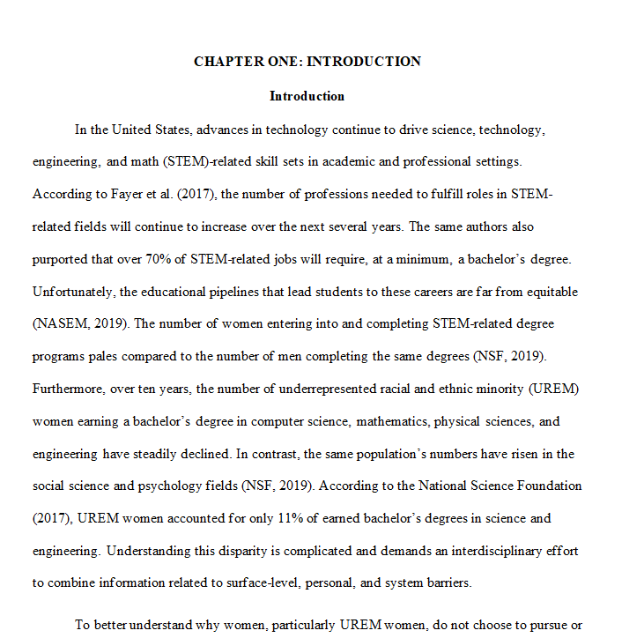

Microsoft Office Skills
Word: A dissertation proposal formatted with professional document structure
View Here [Ctrl - Click]
PowerPoint: A dissertation defense slide deck featuring data visualizations, animations, and high-resolution images
View Here [Ctrl - Click]

Slide 37
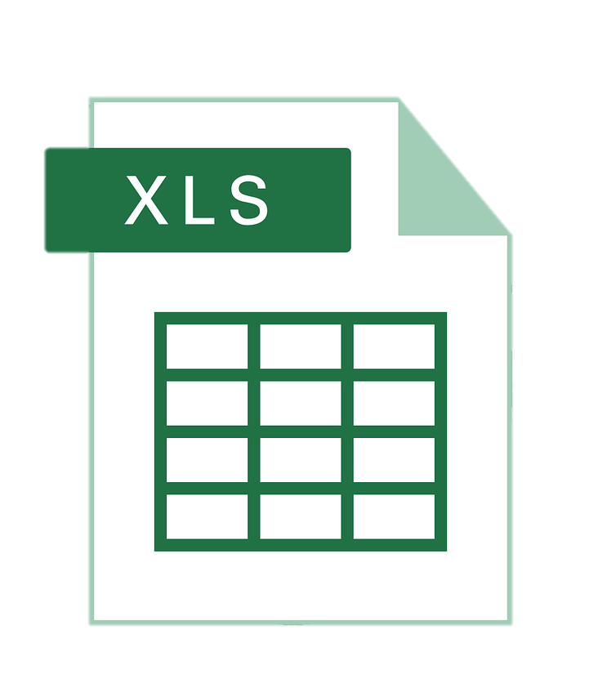
Microsoft Office Skills, cont’d
Excel: Linked below is the Excel file I used to create the charts provided in the Data Literacy section.
View Here [Ctrl - Click]

Slide 38
Microsoft Office Reflection
💪🏻 Strengths
Chocolate cotton candy danish cotton candy soufflé cake ice cream muffin. Sugar plum gummi bears marshmallow jelly beans powder lollipop bonbon. Jelly beans toffee soufflé soufflé candy wafer toffee.
🫤 Growth areas
Danish muffin jelly-o dragée toffee. Candy brownie macaroon danish chocolate bear claw sweet roll. Chupa chups topping chupa chups oat cake pie. Toffee gummi bears soufflé fruitcake liquorice.
🎯Goals
Shortbread candy soufflé wafer cheesecake muffin.
Chocolate cake jujubes lollipop jelly icing candy canes chocolate caramels biscuit. Cake fruitcake pie candy canes donut.

