Slide 1
Information Literacy
Effective Strategies for Evaluating & Finding Information
Professor Ryan Haas

Slide 2
1. TMI (Too Much Information)

Slide 3
The Modern Information Challenge
We Live in an Information-Rich World
More information is produced daily than previous generations saw in a lifetime
Social media and digital platforms amplify both accurate and inaccurate information
Anyone can publish content that looks professional and authoritative
Emotional content spreads faster than factual content
The Challenge: How do we distinguish reliable information from misinformation in seconds or minutes rather than hours?
Traditional approaches (like lengthy checklists) are too slow for the modern web.

Slide 4
2. SIFT for your sanity

Slide 5
The SIFT Method
A Strategy Used by Professional Fact-Checkers
S STOP
Pause and check your emotional response. Are you reacting strongly to this information?
I INVESTIGATE
Research the source. Who created this? What's their track record and motivation?
F FIND
Look for better coverage. What do other reputable sources say about this claim?
T TRACE
Follow information back to its original source and context.

Slide 6
S STOP: Check your emotions
Content that produces strong emotions spreads fastest on social media
We're more likely to share information that confirms our beliefs Emotional reactions can override critical thinking
Misinformation often targets our emotions deliberately
Before you read, react, or share, ask yourself:
What is my immediate emotional response to this?
What do I already know about this topic?
Do I want this information to be true or false?
Could my biases be influencing my reaction?
Key Principle: The stronger your emotional reaction, the more important it is to fact-check before sharing.

Slide 7
I INVESTIGATE: Research the source
Who posted the claim?
✍️ The Author
👤 Scrutinize the Author's Profile
Who posted the information?
What can you find out about the account/author?
What might be their motivation for sharing the claim?
Links in the bio + post history can clue us in as to their affiliations, biases
Some authors are not even people! They're bots!

Slide 8
F FIND: Look for better coverage
Don't Stop at One Source!
🔎 Effective Search Strategies
🚩 Red Flags to Watch For
Fact-checking sites: Search Snopes, FactCheck.org, PolitiFact
News search: Use Google News to find recent coverage
Multiple perspectives: Look for coverage across different types of sources
Expert sources: Find subject matter experts who have weighed in
Only one source is reporting this "breaking" news
Reputable news sources aren't covering a major claim The story significantly contradicts established facts
Sources are all from the same political or ideological perspective

Slide 9
F FIND: Look for better coverage, cont’d
Leave the page to learn about the page…
❌ Vertical Reading
✅ Lateral Reading
Stay on the same website
Look for "About Us" pages
Trust the site's self-description
Can be easily fooled
Open new tabs immediately
Search for the source name
Check Wikipedia for background
See what other sources say
Quick Investigation Checklist:
Open a new tab and search: [source name] + "Wikipedia"
Look for the source in news articles
Check if fact-checkers have evaluated this source
Note any conflicts of interest or bias

Slide 10
T TRACE: Follow information to its source
✅ What to Trace
🤔 Common Problems with Second- Hand Reporting
Research studies: Find the original paper, not just the press release
Quotes: Verify the full context, not just the excerpt
Statistics: Find the original data source
Images and videos: Use reverse image search to find origins
Important context gets lost in retellings
Headlines may misrepresent the actual findings
Preliminary research gets presented as definitive
Correlation gets reported as causation
Tracing Techniques
Look for links to original sources in articles
Search for study titles in academic databases
Use Google's reverse image search for photos
Check if quotes are taken out of context

Slide 11
SIFT In Action
✏ Let's work through the SIFT method with a current social media post!
Step-by-Step Process:
STOP: Notice our emotional reaction to the claim
INVESTIGATE: Research the source making the claim
FIND: Look for coverage by reputable news sources
TRACE: Follow the claim back to its original source
Key Insight: This entire process should take a minute or two for most claims. If it's taking longer, you might be going down a rabbit hole—circle back and try a different approach.

Slide 12
Beyond Google: Finding Scholarly Sources

Slide 13



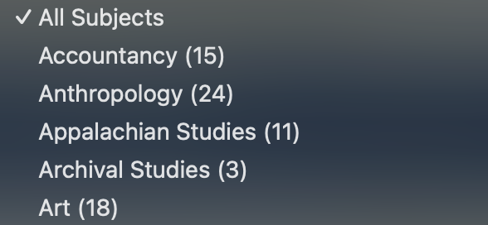
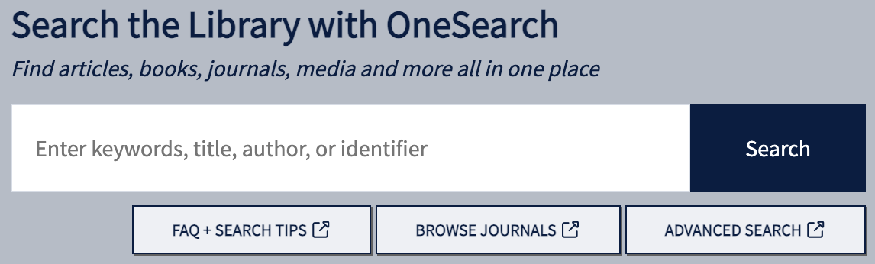
Finding Scholarly Sources: ETSU Databases
OneSearch ↗
Subject Databases ↗
Research Assistance ↗
Search across multiple databases simultaneously.
A quick way to get started on libraries.etsu.edu
Specialized collections for your field of study.
I found filtering by Subject most useful as a student.
Librarian support for complex research questions.
While you can schedule an appointment, you can also just casually start a chat!
I’m sure your tuition helps pay for it, so you might as well use it!

Slide 14
Academic Databases: Why not just… Google?
Why use Academic Databases?
💯 Hot Tip:
Peer-reviewed content: Experts have evaluated the research
Credible sources: Authors are identified with their credentials
Current information: Recent publications in your field
Full-text access: Complete articles, not just abstracts
Even before using Google Scholar, Log into libraries.etsu.edu with your ETSU username (everything before “@etsu.edu”) and password to access full-text articles and avoid paywalls!

Slide 15
Effective Database Searches: Why not just… Google?
√
Using Boolean Operators
Advanced Search Features
√
AND: climate change AND agriculture (both terms must appear)
OR: teenagers OR adolescents (either term can appear)
NOT: apple NOT fruit (exclude the second term)
Quotes: "machine learning" (exact phrase)
Field searching: Search specific parts (title, author, subject)
Date filters: Limit to recent publications
Source type filters: Academic journals, books, conference papers
Subject filters: Narrow by discipline or topic area

Slide 16
Evaluating Academic Sources
Not all sources are equal!
❌ Weaker Academic Sources
✅ Strong Academic Sources
Predatory journals
Self-published works
Outdated research (field-dependent) Sources with clear conflicts of interest
Non-peer-reviewed preprints
Peer-reviewed journals
University press publications
Government research reports
Established research institutions
Recent publications in your field
Quick Quality Checklist:
Is the journal indexed in major databases?
Do the authors have relevant credentials?
Are there proper citations and references?
Has the work been cited by other researchers?

Slide 17
Wikipedia: A Powerful Research Starting Point
Moving beyond “Wikipedia is unreliable”
👓 How Professional Fact-Checkers Use Wikipedia
Background research: Quickly understand topics and controversies
Source mining: Use Wikipedia's references as a launching pad
Verifying credentials: Check author and organization backgrounds
Finding experts: Identify key researchers in a field
❌ Wikipedia’s Weaknesses
✅ Wikipedia’s Strengths
Wikipedia’s open editing invites bias, vandalism, and variable accuracy.
Anonymous authorship, reliance on potentially flawed sources, and lack of formal review raise credibility concerns.
Comprehensive coverage of topics
Extensive citations to reliable sources
Recent updates and edit history
Multiple language versions for international perspectives

Slide 18
Recognizing Misinformation

Slide 19
Recognizing Misinformation Tactics
√
🦹🏼‍♂️ Sophisticated Misinformation Techniques
🚩Red Flags
√
Emotional language: Excessive use of words like "shocking," "devastating," "miraculous"
Lack of sources: Claims without links to original research or data
Anonymous authors: No clear indication of who wrote the content
Misleading headlines: Headlines that don't match the actual content
Cherry-picked data: Selective use of statistics or quotes
Professional design: Websites that look like legitimate news sources
Partial truths: Mixing accurate information with false claims
False attribution: Fake quotes from real experts
Manipulated images: Doctored photos or images from different contexts
Conversational AI is capable of partial truths false attribution, and other manipulation! [1]
1. Scheming reasoning evaluations. Apollo Research, 2024.

Slide 20
5. Applying & Integrating Digital Literacy

Slide 21
Building Lasting Information Habits
Daily Practices for Better Information Consumption
Questions to Ask Regularly
Tools at Your Disposal
Diversify your sources: Read across the political and ideological spectrum
Check before you share: Use SIFT on content that triggers strong emotions
Update your understanding: Be willing to change your mind with new evidence
Who benefits if I believe this information?
What might I be missing in this story?
How does this fit with what I already know?
What would convince me this is wrong)?
Lateral reading for staying informed day-to-day
ETSU library databases and Google Scholar for academic research
Wikipedia for quick background research

Slide 22
Integrating Digital Literacy
Current Events
Research Projects & Professional Development
Use lateral reading to understand complex news stories with a fuller picture.
Apply SIFT to evaluate sources for academic papers, verify industry information or trends. Distinguish hype from sober reality.
Cybersecurity & Privacy
Your Personal Life
Identify phishing attempts and scam websites.
Make informed choices about health, finance, and lifestyle.

Slide 23
Sources
Primary Sources:
Brodsky, J. E., Brooks, P. J., Scimeca, D., Todorova, R., et al. (2021). Improving college students' fact-checking strategies through lateral reading instruction. Cognitive Research: Principles and Implications, 6(23). https://cognitiveresearchjournal.springeropen.com/articles/10.1186/s41235-021-00291-4
Caulfield, M. (2017). Web Literacy for Student Fact-Checkers. Washington State University Vancouver. https://pressbooks.pub/webliteracy/
University of Chicago Library. (2022). The SIFT Method. https://guides.lib.uchicago.edu/c.php?g=1241077&p=9082322
ETSU Resources:
ETSU Sherrod Library. Database guides and research assistance materials. libraries.etsu.edu

