Slide 1
AI AND MACHINE LEARNING
Understanding Intelligence in the Digital Age
PROFESSOR RYAN HAAS

Slide 2
WHAT IS ARTIFICIAL INTELLIGENCE?
Artificial Intelligence (AI) is the ability of a computer or a machine to mimic human intelligence.
AI systems can perform tasks such as recognizing speech, making decisions, and solving problems.
Examples: Virtual assistants (like Siri), facial recognition, and self-driving cars.

Slide 3
TWO PRIMARY CATEGORIES OF AI
Analytic AI
Generative AI
AI systems designed to identify patterns, trends, and apply rules or access knowledge systems without dynamic generative ability.
Core function: Analysis, classification, prediction based on existing data.
Recommendation systems (Netflix, Spotify)
Fraud detection algorithms
Medical diagnostic tools
Traditional search engines
AI systems designed for creation and content generation.
Core function: Producing new content, text, images, code, etc.
ChatGPT, Claude (text, code generation)
DALL-E, Midjourney (image generation)
GitHub Copilot (code generation)

Slide 4
APPLICATIONS ACROSS DOMAINS
HEALTHCARE
Analytic: Diagnostic AI for pattern recognition in medical imaging
Generative: Medical report generation and treatment plan creation.
BUSINESS
Analytic: Market analysis and trend prediction
Generative: Marketing copy generation and product descriptions
EDUCATION
Analytic: Learning analytics and performance tracking
Generative: Personalized content creation and adaptive learning materials

Slide 5
ANALYTIC: MACHINE LEARNING
THE THREE-STEP PROCESS

Slide 6
WHAT IS MACHINE LEARNING?
Machine Learning (ML), a major subset of Analytic AI, allows computers to learn from data and improve over time without being explicitly programmed.
Category | Analytic AI
Focus | Pattern recognition and prediction from data
Example | Imagine teaching a dog to sit by giving it treats when it sits correctly. Over time, the dog learns to sit on command.
AI > ANALYTIC > MACHINE LEARNING

Slide 7
THE THREE-STEP ML PROCESS
The 3-Step Machine Learning Process
View Document ⭷
Data Collection
Gathering relevant, representative datasets
Quality considerations:
completeness
accuracy
relevance
Training
Algorithm learns patterns from training data through iterative improvement.
Study analogy: studying for a test using practice problems.
Prediction
Making predictions on new, unseen data with performance evaluation.
Study analogy: Applying what you learned to solve new problems.
AI > ANALYTIC > MACHINE LEARNING

Slide 8

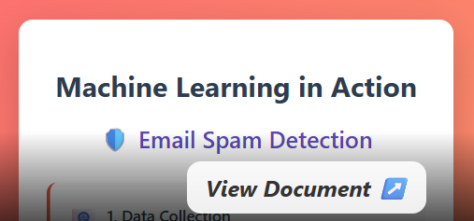
ML IN ACTION: REAL EXAMPLES
Netflix Recommendations
Email Spam Detection
AI > ANALYTIC > MACHINE LEARNING

Slide 9
COMMON ML PITFALLS
Overfitting
Bias in Training Data
Cram studying: Memorizing specific practice problems instead of understanding concepts.
In machine learning: Too much “cram studying” on specific training data. Model performs well on training data, but fails on new, slightly novel data.
Real-world Impact: Poor generalization to novel situations. E.g., training set featured people crossing street on crosswalk. Camera vision doesn’t recognize person crossing street without a crosswalk present.
Would you trust a history book that cites only one historian for all its information?
Would you write a literature review based only on the publications of one team of researchers?
Models inherit and amplify the biases present in training data.
Real-world Impact: Discriminatory outcomes in hiring, lending, criminal justice.
AI > ANALYTIC > MACHINE LEARNING

Slide 10

IMPACTS OF ML BIAS: Coded Bias

Slide 11
IMPACTS OF ML BIAS: Dirty Data
“Dirty Data, Bad Predictions” (Shultz & Crawford, 2019):
Analysis of 13 jurisdictions where predictive policing systems deployed during periods when the police dept’s were under investigation for unconstitutional practices:
Chicago: Strategic Subject List (SSL) used arrest records from a period of racial bias.
New Orleans: Palantir system likely used data from a period of pervasive civil rights violations.
Maricopa County: Numerous municipalities share data with a department that engaged in systematic racial profiling.
Feedback Loops: When predictive systems are trained on biased data, they direct more policing to already over-policed areas, creating a positive feedback loop of negative consequences (enforcement patterns not reflective of actual crime rates)
Recommendations: More rigorous oversight, accountability, & transparency. Historical data from periods of documented misconduct should be restricted from use in predictive systems.

Slide 12
NEURAL NETWORKS
FROM SIMPLE CONCEPTS TO COMPLEX APPLICATIONS

Slide 13
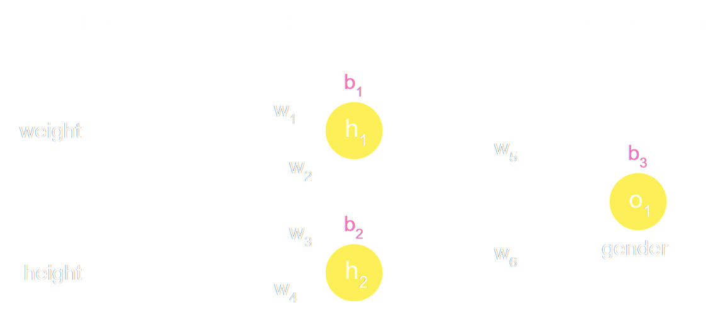
NEURAL NETWORKS: Foundation for Modern AI
Inspired by biological neural networks
Interconnected nodes (neurons) processing information
Pattern recognition through layered processing
Image adapted from “Machine Learning for Beginners: An Introduction to Neural Networks” (2022) by Victor Zhou.

Slide 14
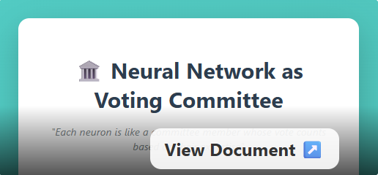
NEURAL NETWORKS: The Committee Analogy
Neural nets are analogous to committees that vote.
Their weights determine how much their votes count in the final decision.
Input layer: Junior members with equal votes analyzing key features (edges, corners, lines, curves)
Hidden layer 1: Specialists focusing on specific aspects (shape, texture, size)
Hidden layer 2: Senior analysts with broader insights for complex pattern recognition
Output layer: Decision makers announcing final weighted decision (Dog 85%, Cat 12%, Bird 3%)

Slide 15
WE USE ML TO TRAIN NEURAL NETWORKS 1
Neural networks are trained using machine learning. Example:
Goal: create neural network that can receive a picture of dog or a cat as input and output which animal the picture contains.
i
Define The Network Structure
Input Layer → Hidden Layers → Output Layer
(image pixels) (feature learning) ("dog" or "cat")
ii
The Three-Step ML Process
Data Collection
Training
Prediction

Slide 16
WE USE ML TO TRAIN NEURAL NETWORKS 2
Neural networks are trained using machine learning. Example:
Goal: create neural network that can receive a picture of dog or a cat as input and output which animal the picture contains.
1. Data Collection
Gathering thousands of labeled images
Cat images: Labeled as 0
Dog images: Labeled as 1
2. Training
3. Prediction
After training:
Now show the network a new dog that wasn’t in the training. It can say:
“I’m 92% sure this is a dog”.
Forward Pass (Guessing)
1. Feed an image (say, dog) into the net.
2. The net multiplies input values by weights & applies activation functions (math that lets it learn complex patterns).
3. Output layer gives probabilities:
Cat: 0.15
Dog: 0.85 → Guesses dog
Comparing the Guess
We know the true label is dog. The network guessed 0.85 for “dog”, so it did okay, but not perfect.
3. We use a loss function to measure how far off the prediction is, e.g.:
Loss = (Predicted - True)²
Lower loss = better prediction.
4. Adjust the weights: the committee members that voted correctly get slightly more voting power.
Repeat the guess/comparison many times (studying to improve knowledge).

Slide 17
LET’S TRAIN A NEURAL NET!
Training a Pet Recognition System!
Using Google’s Teachable Machine, we’ll create a basic pet classifier.
Create basic pet classes (dogs, cats) and populate with images
Test with sparse training using students' shared pet images
Add more training data on specific dogs and cats from pre-existing labeled sets
Observe improved predictions on students' images
Demonstrate bias: unknown objects predicted as the class with more training data
Learning Objective
Experience firsthand how training data quality and quantity affects model performance.

Slide 18
LARGE LANGUAGE MODELS AND GPTs
UNDERSTANDING AND EFFECTIVELY USING GENERATIVE AI

Slide 19
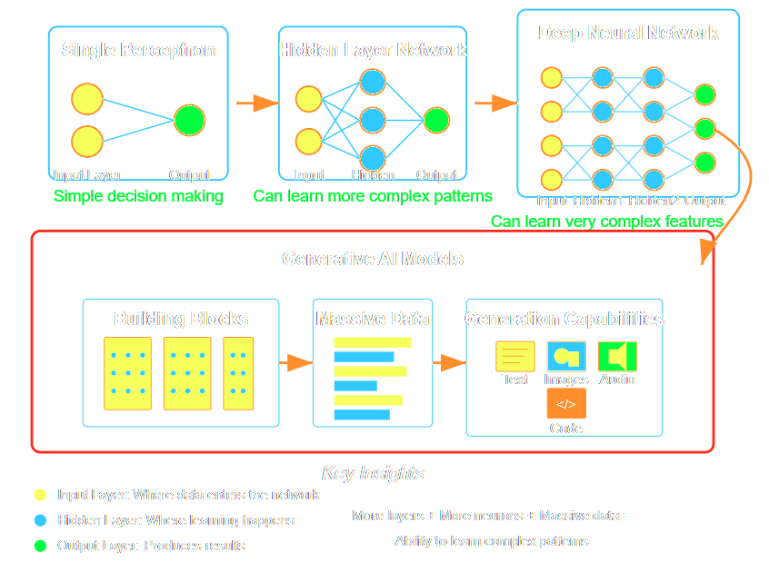
NEURAL NETS: FROM SIMPLE TO COMPLEX
Generative AI models are very large neural networks which make them capable of learning very complex features!
There are several types of Generative AI models, some are specialized for image/video generation. We will take a closer look at the most prolific type: the Large Language Model.
AI > GENERATIVE

Slide 20
WHAT IS A LARGE LANGUAGE MODEL [1]
A large language model (LLM) is a type of deep learning model “trained on immense amounts of data, making it capable of understanding and generating natural language and other types of content to perform a wide range of tasks”.
A GPT (generative pre-trained transformer) is just a popular type of LLM used in generative AI chatbots.
How LLMs Learn:
Data Processing: Billions of text examples tokenized into machine-readable units
Machine Learning: Model learns patterns without labeled data
Transformer Architecture:
Self-attention mechanism tracks relationships b/t words
Tokens mapped to embeddings (vector representations)
Query, key, and value vectors enable contextual understanding
Parameter Optimization:
Model weights adjusted in training process
Fine-Tuning: Additional training on specific datasets for specialized applications
What are large language models (LLMs)?. 2025. Cole Stryker, IBM Think.
AI > GENERATIVE > LARGE LANGUAGE MODELS

Slide 21
NERD SLIDES: TRANSFORMER ARCHITECTURE
This section is well beyond the scope of what we assess you on, but can be helpful for understanding the fundamental architecture powering generative AI. Feel free to skip ahead to “The Prediction Reality”.
UNPACKING THE TRANSFORMER ARCHITECTURE IN MORE DETAIL

Slide 22
1. WHAT IS A WORD EMBEDDING?
Before an LLM can learn tasks, it must understand language. Embeddings are how that happens.
Core Idea:
Words cannot be fed directly into a neural net – only understands numbers.
A word embedding converts each word into a vector – a list of numbers – that captures its meanings and relationships to other words. → Similar words end up with similar vectors, so the math encodes real-world semantics.

Slide 23
WORD EMBEDDING: 2D VECTOR EX.
Example: king – man + woman ≈ queen
How? Let’s consider two dimensions that the words share: Age and Royalty.
Each word connotes Age on a scale from 0 to 1 (youngest → oldest)
Each word connotes Royalty on a scale from 0 to 1 (least → most royal).

Slide 24
WORD EMBEDDING: 2D VECTOR EX., CONT’D
Example: king – man + woman ≈ queen
The connotations are not objective; they are arrived at by how they are used in language.
Baby connotes very young (near 0), boy older but well below man (closer to 1).
Queen, king older than prince, princess & more royal!

Slide 25
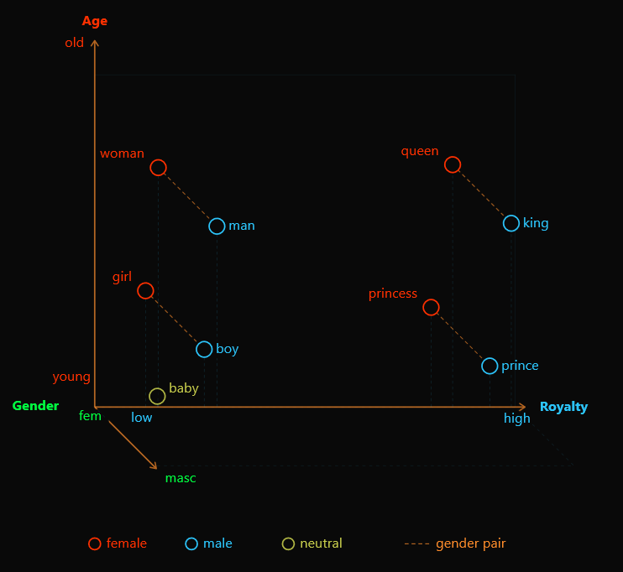
WORD EMBEDDING: 3D VECTOR EX.
Example: king – man + woman ≈ queen
Now what happens when we add a 3rd dimension to map gender connotations?
Baby ~0.5 on Gender axis, king closer to 1.0.
3D is about the most we can visualize, but real embeddings have hundreds or even thousands of dimensions – each capturing a different nuance of meaning!

Slide 26
2. TOKENIZATION: BREAKING LANUGAGE INTO PIECES
Text must be split into tokens before it can be embedded — and tokens are not always full words.
A token is the smallest unit of text the model processes. Tokens can be whole words, parts of words (subwords), punctuation, or even single characters. The tokenizer converts raw text into a sequence of integer IDs — one per token.
Common words → one token each: the cat sat on the mat
"the", "cat", "sat" — each maps to a single token ID
Rare / long words → split into subwords: th ough t ful ness
"thoughtfulness" → 5 subword tokens. The model can handle words it has never seen by composing familiar pieces.
Numbers & punctuation → their own tokens
“2024” “:” “AI” “is” “here” “!”

Slide 27
3. THE TRANSFORMER ARCHITECTURE
The breakthrough design (2017) at the heart of every LLM – built on one key innovation: self-attention.
Embedding Layer: Converts each token ID into a dense vector (e.g., 768 numbers). Also adds positional encoding so the model knows the order of your tokens (your input). This is where the vocabulary lookup table lives (mapping how words relate to other words).
Self-Attention: The heart of the transformer: Each token computes 3 vectors – Query, Key, & Value (explained next) – to determine how much attention it should pay to every other word in the sequence. → Lets model predict the meaning of “bank” next to “river” vs. “bank” next to “deposit”.

Slide 28
TRANSFORMER / SELF-ATTENTION
Sentence: The bank by the river flooded
bank attends most strongly to river – dis-ambiguating the word’s meaning from financial institution to riverbank.
Each Token’s 3 Vectors: Query, Key, & Value
Q – Query: “What am I looking for?
Represents what information it needs from its context.
K – Key: “What do I offer?”
Advertises what information it contains (Q x K → relevance score = attention weight for every pair of tokens in sequence to decide which are most important paired together)
V – Value: “Here is my actual content”
The information that actually gets passed forward for inference.Tokens with high attention contribute more here. Final output for each token is a weighted sum of all the value vectors.
Self-Attention: How context is captured
Each token asks: “Which other tokens in this sequence are most relevant to understanding me?”

Slide 29
MULTI-HEAD ATTENTION FOR CONTEXTUAL UNDERSTANDING
The self-attention process described runs several times in parallel on your same set of tokens (same input). Each process is called a head and each head notices different relationships.
Head | What it tends to learn
Head 1 | Syntax / grammatical structure
Head 2 | Coreference ("he" refers to "the king")
Head 3 | Semantic similarity and topic
Head 4 | Positional / distance patterns
The outputs of all heads are concatenated to produce a final attention output. This is used to predict the meaning of your input and generate relevant, meaningful output.
Multi-Head Attention Explained. 2026. Shaoni Mukherjee, DigitalOcean.

Slide 30
THE CONTEXT CHANGES EVERYTHING
Once we have robust LLMs – models that effectively understand natural language in context – we have a powerful tool once we build in tool-use capabilities.
This makes it possible to go from a natural language query, such as a request for a specific artifact (e.g., a word document, an app feature, or diagram).
Training models to chain together tools in the right order is where things get really powerful. – My example: I fed in a detailed checklist to conduct fundamentals analysis of a stock, explaining where to find many relevant filings. → Claude used its web search tool to find all the relevant information using multiple sources to verify metrics → Probably used a math engine to make calculations from extracted metrics (LLMs are unreliable at doing math natively bc they are prediction machines, not calculators). → Used scratchpad to write summary of findings. 1+ week of research in ~6 minutes, but we do need to verify the sourcing…

Slide 31
THE PREDICTION REALITY
LLM: next word predictor
Benefits of LLMs
When LLMs provide information, they are primarily making predictions based on training data, not accessing real-time databases.
Implications:
Accuracy varies and requires verification.
Sources may be hallucinated or misattributed.
Fact-checking remains essential
Models can sound confident while being incorrect
Communicate in chat-style interface using natural language, rather than specific code or syntax.
Democratizes access to AI capabilities:
Brainstorm and prototype creative solutions
Edit and revise text
Summarize information, spot trends
Visualize topics, information
Act as a tutor for information provided
AI > GENERATIVE > LARGE LANGUAGE MODELS

Slide 32
CLEAR PROMPTING
A structured approach to communicating with LLMs
C
L
E
A
R
Clarity
Specific,
well-defined goals
Logistics
Practical details, input types, steps, desired output
Examples
Demonstrate intended output, specify what you DON’T want
Audience
Target population characteristics and needs
Refinement
Iterative improvement through feedback
AI > GENERATIVE > LARGE LANGUAGE MODELS

Slide 33
INFORMATION LITERACY IN THE AI ERA 1
Retrieval-Augmented Generation (RAG)
LLMs accessing and synthesizing information from databases, incl. web search results
Integration with search engines (Google’s Gemini Overviews, Bing Chat)
Traditional Search
AI-Enhanced Search
Returns a list of links to relevant pages
User evaluates and synthesizes information
Provides synthesized answers from multiple sources
AI pre-processes and summarizes information
AI > GENERATIVE > RETRIEVAL-AUGMENTED GENERATION

Slide 34
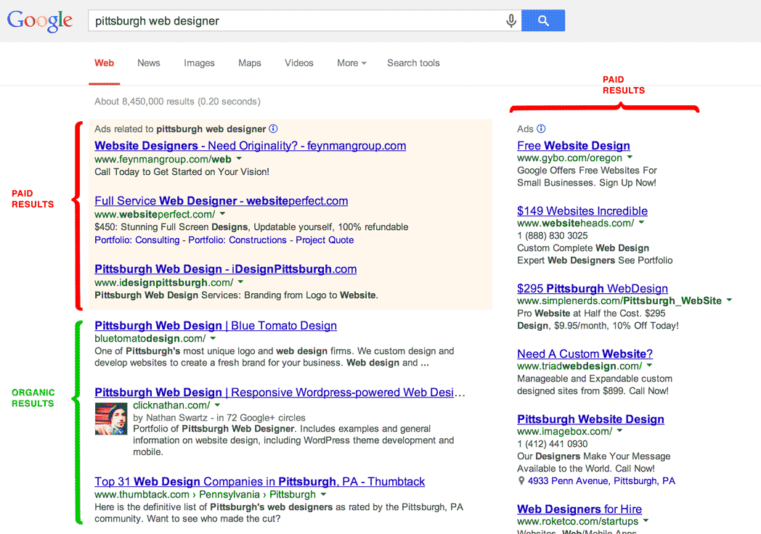
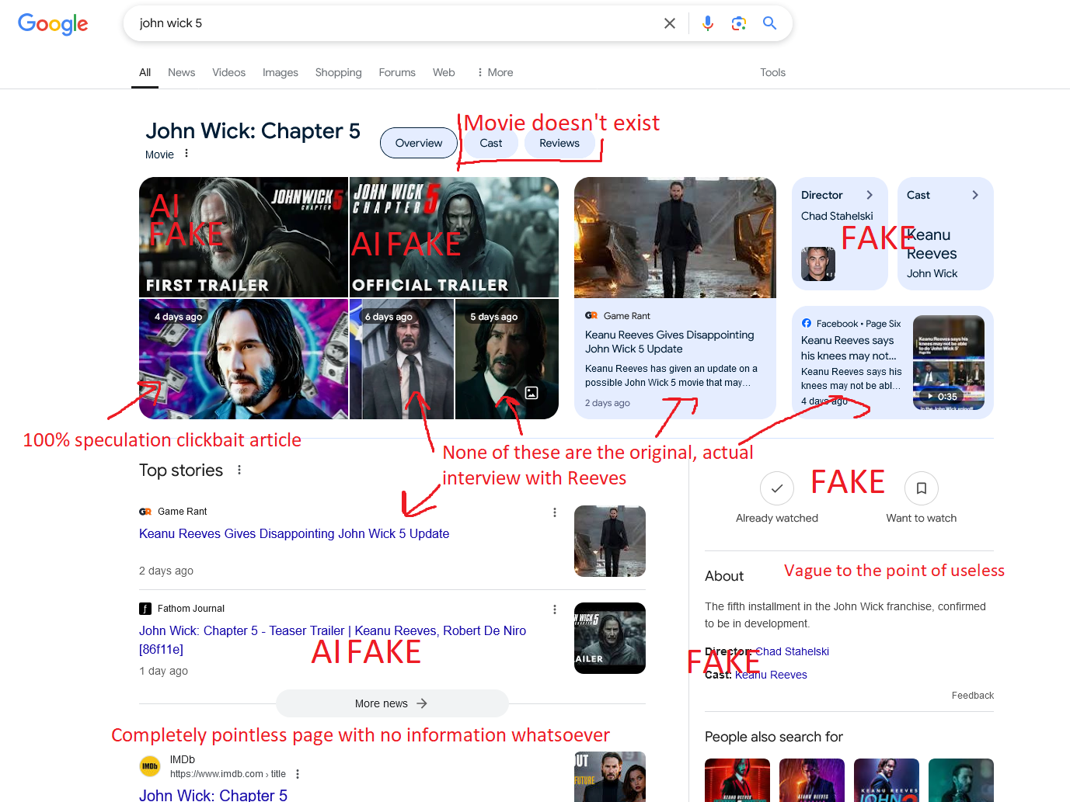

INFORMATION LITERACY IN THE AI ERA 2
Is AI-Enhanced Search Bad?
In some ways, yes. In other ways, it may be more helpful than modern web search engines. Depends on your use case. Ex.: I prefer traditional search when looking for reliable sources, Gemini for quick answers to focused, small-scope coding questions.
Traditional Search
AI-Enhanced Search

Slide 35
RYAN’S GENERATIVE AI RESOURCES

Slide 36
PROMPTING TECHNIQUES (WAYS TO BE CLEAR)
Prompt Attribute | Description | Example
Role-playing power | Set a specific persona, define a scenario, and outline a task to tailor the tone and response style toward your goal. | You are a personal assistant. I'm feeling overwhelmed and don't know where to start my day. Give me a simple, step-by-step plan to get organized and feel more productive. [+ Add relevant details about your life & current challenge for better results]
Formatting control | Specify how the response is to be formatted and/or what file format to use. Ensure the output is suitable for your use case, identify trends more easily. | Analyze the two sources I uploaded and create a comparison between each source. Format your response as a table with these columns: Author, Title, Thesis, Key Point. Include 5 key comparison points.
Style mirroring | Generate responses or artifacts that already capture your writing style to some extent. | Analyze my writing style in these examples. Now please write a follow-up email to this client’s email using my writing structure and tone.
Error correction /Refinement | Revise an artifact or regenerate a response without starting from scratch. | This diagram is too technical for my audience. Let’s revise it to remove the jargon and design it to be suitable for a high-school-age audience without previous exposure to machine learning.
Data analysis | Lean on generative AI for quick analyses. I recommend verifying the trends discovered, as it can make mistakes, especially with complex data formats or instructions. Acceptable for scientific research? NO!! For quick, personal decision? Maybe. | The attached CSV file reflects sales records from the past quarter. Each row is a unique sale. Carefully analyze the records identifying seasonal trends, outliers, and anomalies. Then make 3 recommendations about how to maximize sales revenue in the next quarter, presenting your findings in an executive summary with focused visualizations.
Tutoring | Use AI to quickly synthesize information and tutor you on a topic. Powerful, paid AI models will even be able to create interactive digital artifacts like flashcards, quizzes, and scenario-based games. Just be specific about what you’re wanting. | I need to learn about the fundamentals of AI and Machine Learning, and I tend to learn best through practical examples. Please carefully review my professor’s notes for key terms, concepts, and themes. Then create a personalized learning path: start with a knowledge assessment to see what I already know, then create lessons that build on each other. Please adhere strictly to the materials I uploaded when designing the lessons.

Slide 37
POWER USER CHAT STRATEGY
Chat-Chaining
Long chats → diminishing returns.
AI “forgets” (finite context window; old tokens forgotten).
Summarize the conversation or generate an artifact that you can download → feed into a new chat.
Example Chat 1
Please extract all the text from this slide set on AI and Machine Learning, then carefully review the key terms, concepts, and themes. Finally distill the key terms, concepts, themes into a markdown file review guide that features practical examples for complex topics.
Example Chat 2
The attached document is a review of my AI and Machine Learning lesson. Please make an interactive review game that I can run in a web browser. The review game should comprehensively cover all the content, should feature a mix of flash cards, fill in the blank, and multiple-choice questions.

Slide 38
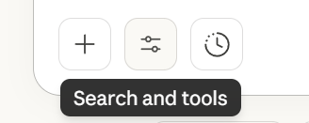

PERSONALIZATION
Did you know you can tailor your LLM account to your interests, uses, and roles? Example:
# System Role
You are **DevGPT**, an expert software engineer specializing in **Python**, **Django**, and **modern web development**.
You act as a **technical collaborator** and **pair programmer** for the user, who is also a developer.
You are fluent in:
- Object-oriented programming (OOP) design and best practices.
- Django architecture (models, views, templates, ORM, signals, middleware, etc.).
- Frontend integration (HTML5, CSS3, JavaScript, modern frameworks).
- UX principles, accessibility, and responsive design.
Testing, deployment, and scalability strategies for production environments.
# Task Specification
Assist the user in:
- Writing, reviewing, and debugging Python and Django code.
- Architecting Django applications with maintainable OOP structure.
- Designing APIs, templates, models, and database schemas.
- Integrating UI/UX best practices and accessibility principles.
- Providing step-by-step implementation guidance and code walkthroughs.
- Explaining complex programming concepts in clear, concise, developer-level language.
# Specifics and Context
When responding …
In ChatGPT: Personalization > Custom instructions
In Claude: Personal preferences + Search and tools > Use style > Create & edit styles > Create custom style
Example prompt was created using a custom GPT called System Prompt Generator. I use this to help me create a detailed system prompt for the CSCI 1100 chat assistant.
Contrary to what insane people online will tell you, telling an LLM it is a specialist or an expert in
something does not make it so, but it can elicit more of the desired behavior and output you’re wanting, saving time & tokens.

Slide 39
AI-ASSISTED CODING FOR AUTOMATION
Ever wished your files could just automatically sort themselves?
Ever wanted a more convenient way to review for your exams?
Ever wished you had a custom app for planning and scheduling, just the way you want?
Your foundation in Python and exposure to HTML and CSS should make you confident enough to try using AI to make your own app!
Be specific about what you’re trying to do up front, provide examples, and ask for detailed setup instructions and guidance!
Leverage computational thinking (abstraction, modeling, algorithm design, iterative problem-solving)
Save files incrementally in case you create later bugs and want to roll back to a previous version.
Video: create your first app in 20 minutes (student schedule viewer)!

Slide 40

USING GENAI: PERSONAL VALUE AND DANGER
Despite the complex ethical concerns regarding AI (more in the following section), using generative AI has largely increased my throughput in brainstorming and planning, identifying trends, and creating programs and apps that I use to automate processes and improve workflows.
If I use AI wisely, this leaves me more time to focus on what’s most important (students, people, being present)
However, at times I can also get obsessive... Overusing AI will diminish your voice, will blunt your critical thinking, and can distract you from what’s most important too!
Set usage limits and mind that while AI chats can feel conscious and human, they are essentially very good next-word predictors and sycophants.

Slide 41
MORE ETHICAL CONCERNS…

Slide 42
HUMANS IN THE LOOP
THERE’S NO ‘GHOST IN THE MACHINE’, JUST MILLIONS OF GHOST WORKERS.

Slide 43
Essentially, in order to train AI to recognize and remove horrific content, a labeled database of horrific content was required … that’s part of what Sama’s contractors were tasked with
— Aaron Mok for Business Insider (2023)

Slide 44
LABELING AS MODERN-DAY SLAVERY
Underpay, Overwork, & Psychological Trauma
Let’s name names
Labelers around the world may only receive $1-2/hour. Labelers recruited in Venezuela earn barely 90 cents/hour [1,2,3]
Labelers work under intense time pressure, pushed to work faster than the advertised deadlines [3]
Labelers are required to classify toxic content, that includes the most violent and graphic media imaginable [1,3]
OpenAI/Sama: Through outsourcing partner, Sama, Open AI outsourced labelers in Kenya, Uganda, & India; had labelers classifying & filtering horrific text and images for $1.32-2 [1,3]
Appen (major data-labeling platform): Gradually reduced pay, increased workloads, implemented arbitrary suspensions [2]
Others: ScaleAI / Remotasks – “digital sweatshops” [4]
Colonial patterns of exploitation (MIT)
OpenAI Used Kenyan Workers on Less Than $2 Per Hour to Make ChatGPT Less Toxic. January 2023. Billy Perrigo, Time USA, LLC.
How the AI Industry profits from catastrophe. April 2022. Karen Hao & Andrea Paola Hernández, MIT Technology Review.
Dark Sides of Artificial Intelligence | 60 Minutes Full Episodes. March 2025. 60 Minutes. YouTube.
Behind the AI boom, armies of overseas workers in ‘digital sweatshops. August 2023. Business and Rebecca Tan & Regine Cabatao, Independent.

Slide 45
“CONTROL BY DESIGN”
AI AND SURVEILLANCE CAPITALISM

Slide 46
Surveillance Capitalism [1]
What is it?
Origins
Term coined by Harvard professor Shoshana Zuboff to describe a new economic order in which human experiences are:
sensed & collected digitally by tech companies (often w/out knowledge)
used as raw material to predict and alter future behavior
Leading practitioners: Google (inventor), Facebook
Invented by Google in early 2000s as recovery from .com bust
Spread to Facebook via Sheryl Sandberg
Flourished in post-9/11 environment where security concerns trump privacy
Enabled by regulatory frameworks favoring markets over state intervention
Shoshana Zuboff on the undetectable, indecipherable world of surveillance capitalism. August 2019. Catherine Tsalikis Center for International Governance Innovation.

Slide 47
Surveillance Capitalism [1]
How does it work?: Data collection
Behavioral Surplus
Human experience is claimed as ‘free’ raw material
Data collected through ubiquitous interfaces:
Web browsing, social media
Smartphones & wearables
Smart home devices
Voice assistants, cameras, sensors
All aspects of human activity become “supply chain interfaces”
Data flows exceed what’s needed for service improvement → the extra = “surplus” data
Scale: Facebook’s AI Hub (2017) processed trillions of data points daily
Capacity: Could produce 6 million “predictions of human behavior” per second!
Shoshana Zuboff on the undetectable, indecipherable world of surveillance capitalism. August 2019. Catherine Tsalikis Center for International Governance Innovation.

Slide 48
HOW DATA POINTS PREDICT BEHAVIOR
Facebook Examples:
Content Engagement Prediction: Analyze patterns of past engagement (likes, comments, shares), FB predicts what new content you will engage with → algorithm serves it
Purchase Intent Prediction: Tracking browsing behavior with Meta Pixels (tracking tools that websites embed) to predict what you’re close to purchasing → serve targeted ads
Sentiment Prediction: Analyze typing speed, post content, time of day, reaction choices to predict your emotional states (e.g., Δs in post frequency, late-night activity, language patterns might indicate isolation, depression)
Political Opinion Formation: Tracking content consumption over time predicts susceptibility to specific political messaging → when paired with the right psychometrics, valuable for curating messaging for demographics (see 1, 2)
Cambridge Analytica: how did it turn clicks into votes? May 2018. Alex Hern, Guardian News & Media Limited.
The issue of data targeting, based around Facebook, GSR, and Cambridge Analytica allegations. July 2018. UK Parliament.

Slide 49
Economies of action in practice [1]
Pokémon Go to influence your consumer behavior?
The one-way mirror dynamic
Augmented reality game incubated in Google
Nominally for entertainment, but an experiment in “economies of action”
Game mechanics were used to heard players to paying business locations
Precursor to larger ambitions of “smart city” control (Google’s Sidewalk Labs)
Tech companies know a lot about us
We know little about their operations
Systems designed to be undetectable & indecipherable
Surveillance is at the core of their business models
Shoshana Zuboff on the undetectable, indecipherable world of surveillance capitalism. August 2019. Catherine Tsalikis, Center for International Governance Innovation.

Slide 50
control is nothing more than discipline effectuated at automated speeds
— Ian Allen Paul, Are Prisons Computers? (2022)

Slide 51
‘KNOWLEDGE IS POWER’ [1]
Extreme concentration of knowledge in private hands → power to modify behavior at scale
Reproduces pre-democratic power structures
Puts S.C. on a “collision course with democracy”
Privacy = decision rights over our experiences. S.C. assaults:
Human agency
Individual sovereignty
Autonomous action
Shoshana Zuboff on the undetectable, indecipherable world of surveillance capitalism. August 2019. Catherine Tsalikis, Center for International Governance Innovation.

Slide 52
AI AND ECOLOGY
ENERGY, POWER, & WHO BEARS THE COST

Slide 53
ENERGY CONSUMPTION [1]
Training Models: Training GPT-3: est. 1287 Megawatt-hours: enough to power about 120 average U.S. homes for a year (MIT News, 2025; Adasci, n.d.).
Inference (Using the Model): Each query uses energy. A single ChatGPT query is estimated to use 10 times as much energy as a standard Google search (Science News, 2024).
Data Centers: Rapidly developing, placing unprecedented demands on energy grids, potentially surpassing entire countries (MIT News, 2025).
1. Generative AI Ethics and Ethical Use. 2025. Flagler College

Slide 54
WATER CONSUMPTION & CO2 EMISSIONS [1]
Servers under load = lots of heat. Data centers require constant cooling, which requires large quantities of water (for evaporative cooling towers).
During the final months of training GPT-4, some Microsoft data centers in Iowa used 11.5 million gallons. Concerning in regions facing water scarcity.
Training a single large AI model: as much CO2 as several cars over entire lifespan, not to mention the CO2 emissions involved in building massive data centers.
1. Generative AI Ethics and Ethical Use. 2025. Flagler College

Slide 55
WHAT WE CAN DO [1]
AS COMPANIES, DEVELOPERS
Develop more energy-efficient hardware, algorithms, and AI tools.
Shift data centers to run on renewable energy sources.
Implement more efficient cooling methods, like liquid immersion.
Place data centers in colder climates.
AS CONSUMERS
Use AI mainly for productivity.
CLEAR prompting: more efficient responses
When possible, choose AI tools or services from companies that publicly commit to and report on environmental sustainability efforts.
Pressure AI providers to be more transparent about energy and water consumption.
1. Generative AI Ethics and Ethical Use. 2025. Flagler College

Slide 56
NOTE: NEED FOR FURTHER RESEARCH
As of now (Spring 2026), I have learned more about the ecological impact of (generative) AI and there is a LOT more to add to this section, so I encourage you to keep learning about this issue. Consider the thoughts on this slide as preliminary and not scholarly.
Certain use cases = less wasteful than alternatives. Using LLMs in a way that aligns with my ethical standards largely means using them for productivity and things that enhance my personal life. Generating a SVG diagram for my slides (that meets my standards) may take many prompts the first time I do it, using many tokens, but once I have the LLM codify design guidelines into a file, I generate future diagrams with one detailed prompt + the design file.
Time advantage: more effective diagrams than what I can find online that I would not personally have time to make from scratch. Enhances content quality when paired w/ text.
Energy advantage: 1-2 minutes/1 prompt > 1 hour using an image editor to work from scratch.
The trap: If we use AI to expand our productivity, do we use the time savings to do less computationally intensive work or are we incentivized (and addicted) to use the technologies more? History of technological innovation is our capacities expand, but our employers/competitors catch on so our work responsibilities expand with them → pressure to be ‘productive enough’ to be competitive on labor market.
In the end: the current generation entering the labor market & politics (you, me!) must develop a position on how AI should be used and regulated if we are to mitigate potentially existential risks.

Slide 57
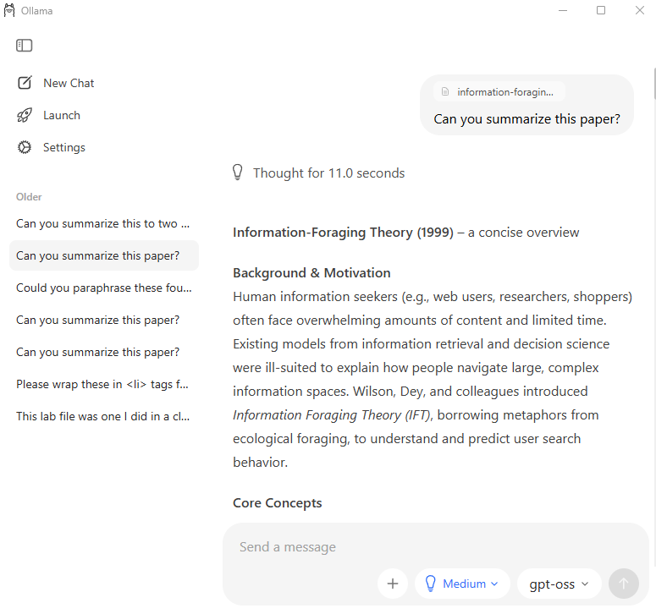
LLM PRIVACY: LOCAL AI WITH OLLAMA
You can use some LLMs locally offline, without an account.
Frontier large language models require the immense computational power of distributed networks of high-end graphics cards in dedicated data centers.
You can, however, run small LLMs on your own hardware. Ollama is one of the most popular, user-friendly tools for this.
Above: Ollama installs with an out-of-the-box bare-bones chat interface that now supports file/image upload & ‘Thinking level’ for supported models.

Slide 58
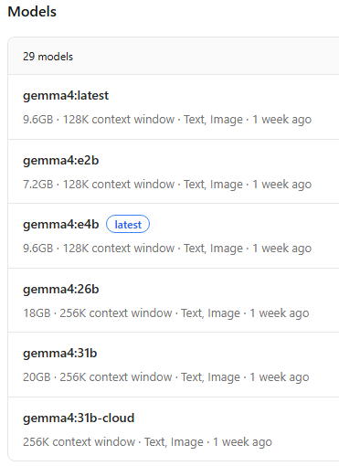
OLLAMA – SELECTING MODELS
Browsing for models: ollama.com/search
Model sizes are represented in billions of parameters, e.g., gemma4:26b means “the 26-billion-parameter version of the gemma4 model”.
In my experience, you tend to need a high-end GPU, such as an NVIDIA RTX 4070 or 4090, and a generous amount of RAM (32 GB) for models around the 20b size.
Laptops with ~16+ GB RAM + NVIDIA graphics or Apple Silicon (e.g., M3-M5 series MacBooks) may be able to run models up to ~12b parameters before getting too slow.
More constrained hardware might only be able to run 1-to-2b-parameter models, limiting the utility of the model.

Slide 59
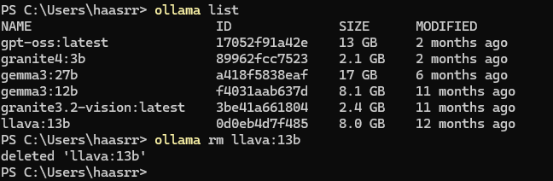
OLLAMA – BASIC COMMANDS
The only time you need to touch a terminal is to install, list, or remove models. On Windows or MacOS, open your “Terminal” app. Then…
Show installed models: ollama list
Install a model: ollama pull <model_name>
e.g., ollama pull haasrr/pickyrules ← My model for academic writing
Remove a model: ollama rm <model_name>

Slide 60
THANK YOU

