Slide 1
TODO-Team-Name
Members: Ryan Lile, Curtis Motes, Paige Peck
Project: Jython Music

Slide 2
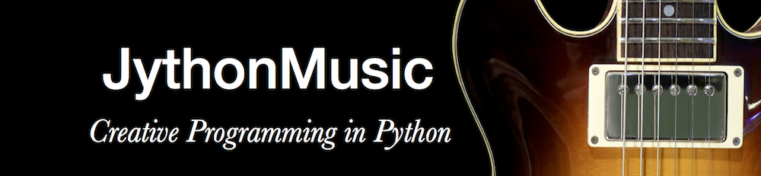
What is JythonMusic?
A free open source environment that allows users to create music through python programming
An extension of the jMusic library, which provides composition and audio tools to programmers in Java
Written in Python

Slide 3
JythonMusic Structure
JEM.jar executable file used to run JythonMusic environment
Library Folder containing core python files:
Music library
GUI and Image library
Timer library
MIDI library
OSC(Open Sound Control) library

Slide 4
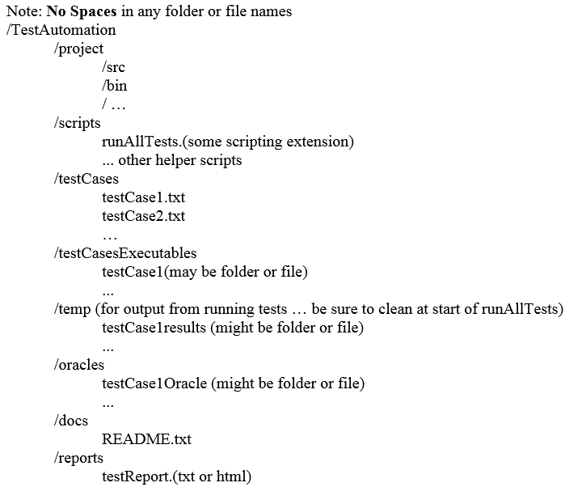
Automated Testing Framework
Invoked by bash script ‘RunAllTests.sh’ at top-level directory
Clears any existing test ouput
Accesses testCases folder within TestAutomation directory
Uses .txt files within testCases to populate array for entry into HTML table
Uses .txt files to supply inputs to python tests
Runs JEM, executes test, pipes output to HTML table
Compares oracle to actual output to determine Pass/Fail

Slide 5
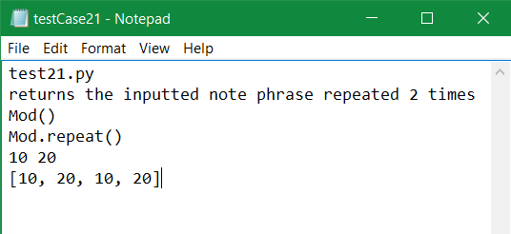
Test Case Format
Test Cases are formatted in the following way, which each property on a new line within the text file:
Test number
Requirement being tested
Component being tested
Method being tested
Test Input(s)
Expected output (Oracle)

Slide 6
Components/Methods Being Tested
In music.py
Note:
getPitch()
setPitch()
Phrase:
addNote()
getNoteList()
empty()
copy()
Mod:
repeat(phrase)
palindrome(phrase)
In timer.py
Timer2:
isRunning()
setRepeat()
start()
stop()
getDelay()

Slide 7
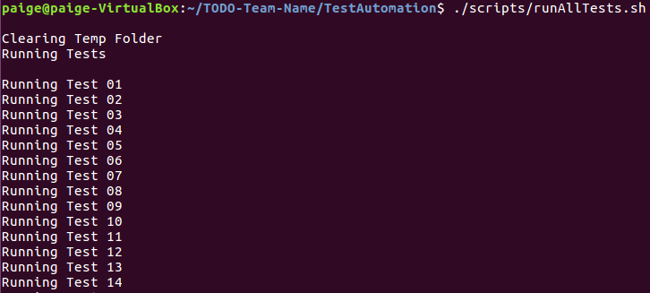
Running the Framework
The testing framework is invoked by using the command ./scripts/runAllTests.sh from within the TestAutomation directory. Here is how it looks while executing:

Slide 8
Testing Report
Once tests are finished running, the testing framework produces an HTML report with CSS styling displaying test case information and pass/fail result of test.
Report opens in a new browser window using the default browser.
Pass/Fail is generated by comparing piped output from test.py files to oracle in txt file.

Slide 9
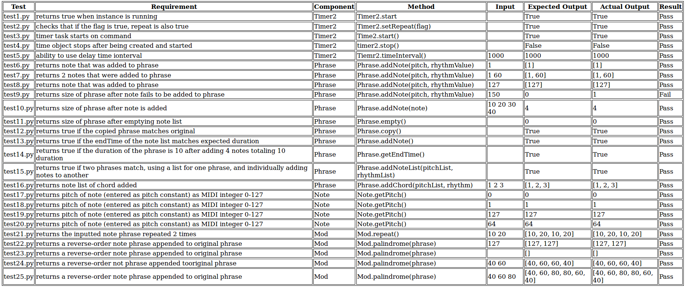
Passing Tests

Slide 10
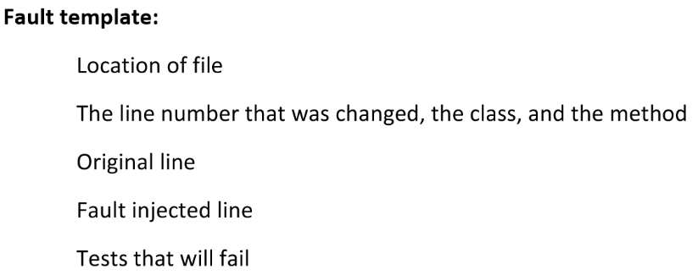
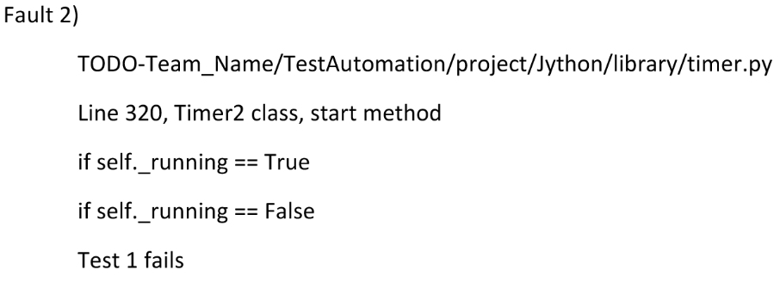
Fault-Injection
Fault-injection is the process of intentionally altering logic within the source code of tested files to check whether tests are properly testing requirements of individual methods.
We injected 5 faults into our source code at different locations within each component being tested.
Fault Injection Template: Example:

Slide 11
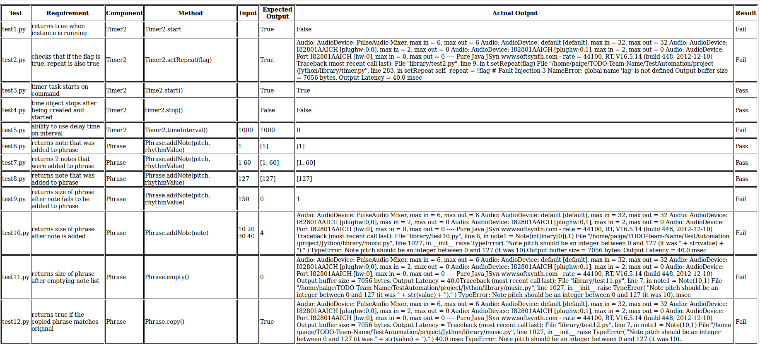
Fault-Injection Results

Slide 12
Overview/Works Cited
GitHub: https://github.com/CSCI-362-01-2016/TODO-Team-Name
JythonMusic: https://jythonmusic.me/
Beginner Bash: http://www.tldp.org/LDP/Bash-Beginners-Guide/html/

