Slide 1
Matplotlib Testing Framework
Jan-Michael Carrington
Vincent Nguyen
Phillip Wilson

Slide 2

Building Amara
Our first choice from the H/FOSS projects
Video subtitle editor run by volunteers
Python based
Requires numerous dependencies
Eventually got to run its built in test suite
Was unable to view testing data

Slide 3
Testing Amara
Attempted to manually test methods
Major obstacles due to multiple dependencies also requiring multiple dependencies
Switched projects

Slide 4

PixiJS
“HTML5 creation engine”
Javascript based
Had trouble creating a test suite that could export testing data
Once again switched projects

Slide 5
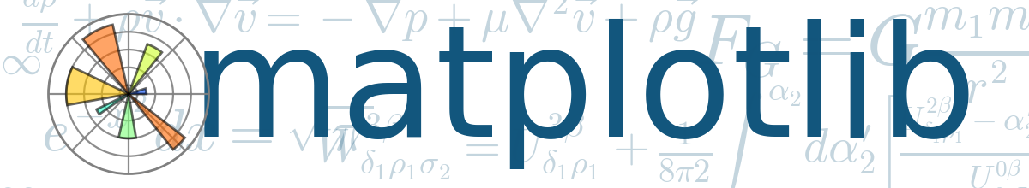
matplotlib
2D plotting library
generates plots, histograms, power spectras, bar charts, error charts, scattterplots, etc
Python based
Fewer dependencies than the two previous projects

Slide 6
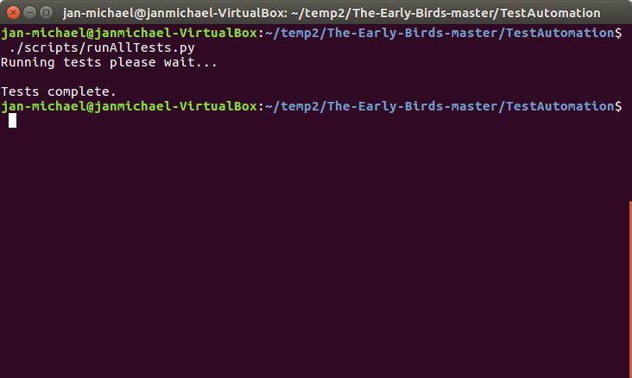
Testing Suite
Main script is runAllTests.py
Invoked from the TestAutomation folder
Goes through each test case file testing methods
Exports data to an html file and a text file

Slide 7
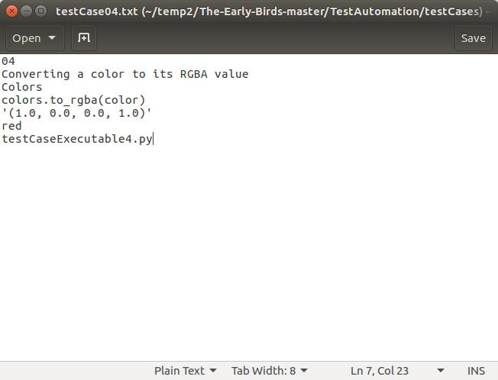
Test Case Specifications Template
test case number
requirement being tested
component being tested
method being tested
test inputs
expected outputs
test case executable file

Slide 8
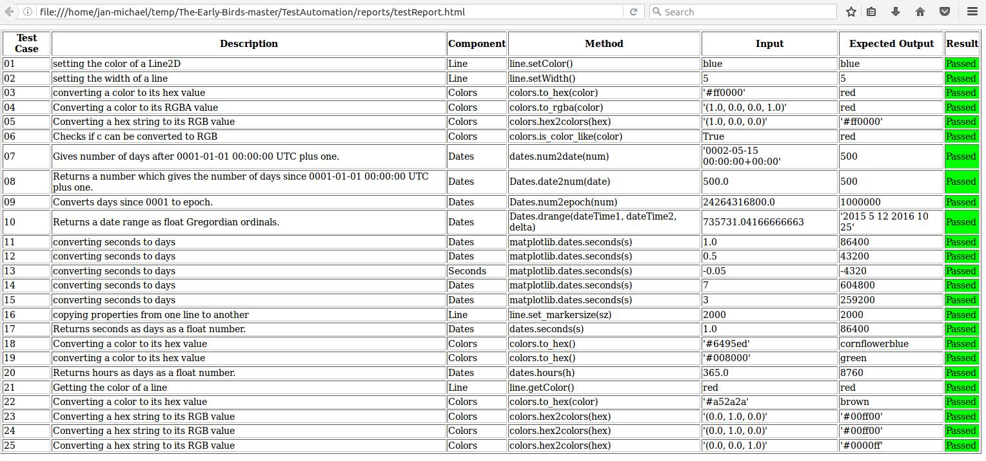

Slide 9
Fault Injection
Had to figure out where exactly the source code was
Changed the source code of matplotlib in:
colors.py
dates.py

Slide 10
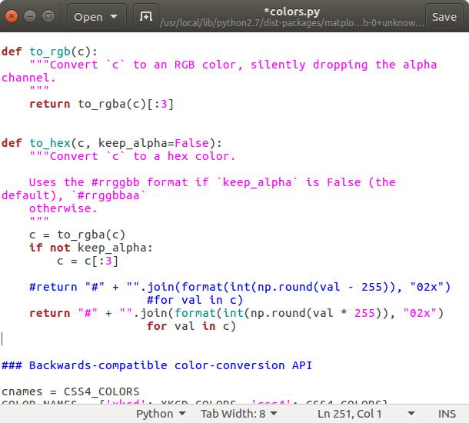

Slide 11
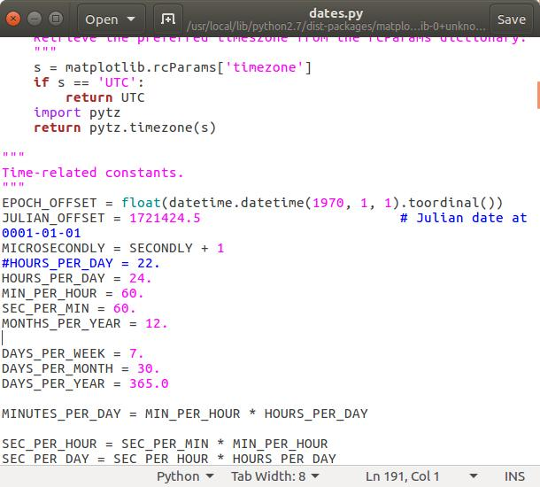

Slide 12
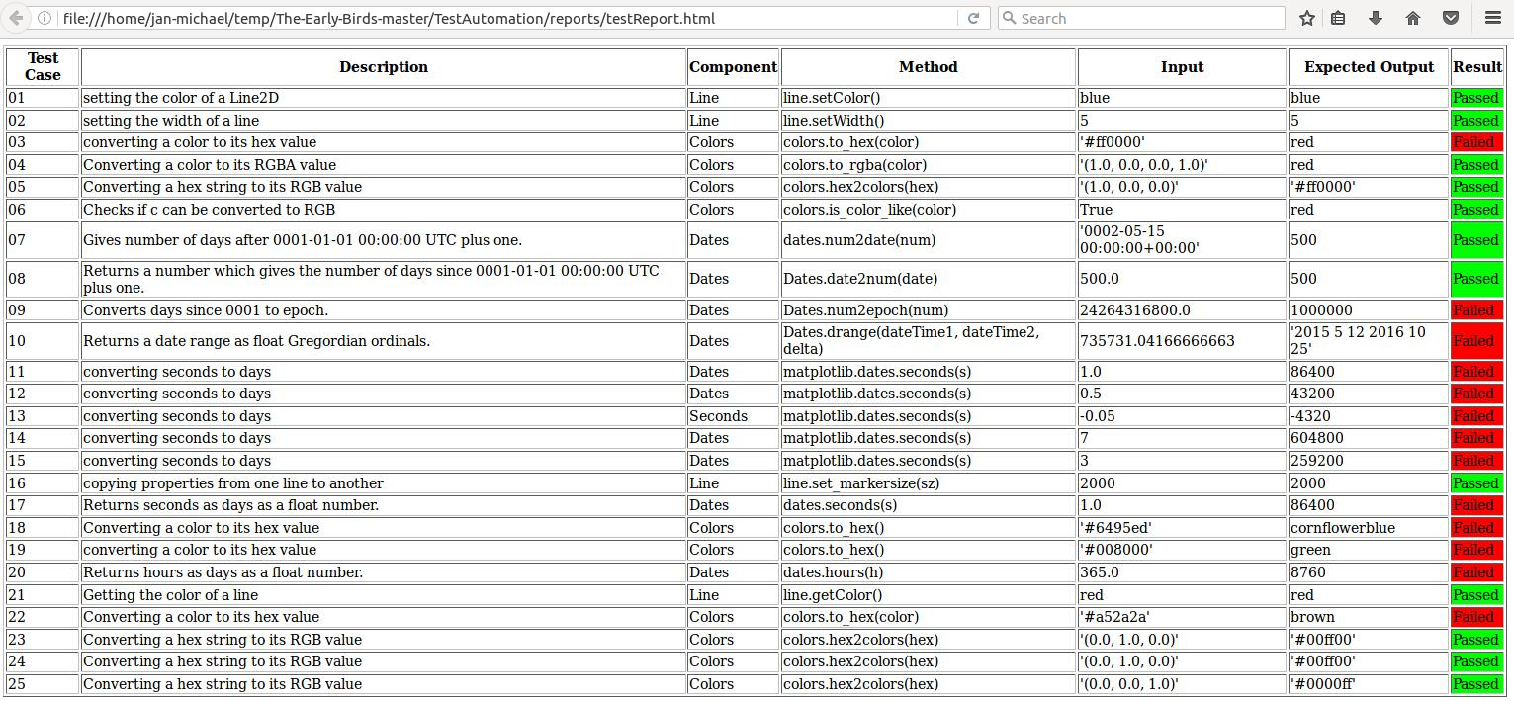

Slide 13
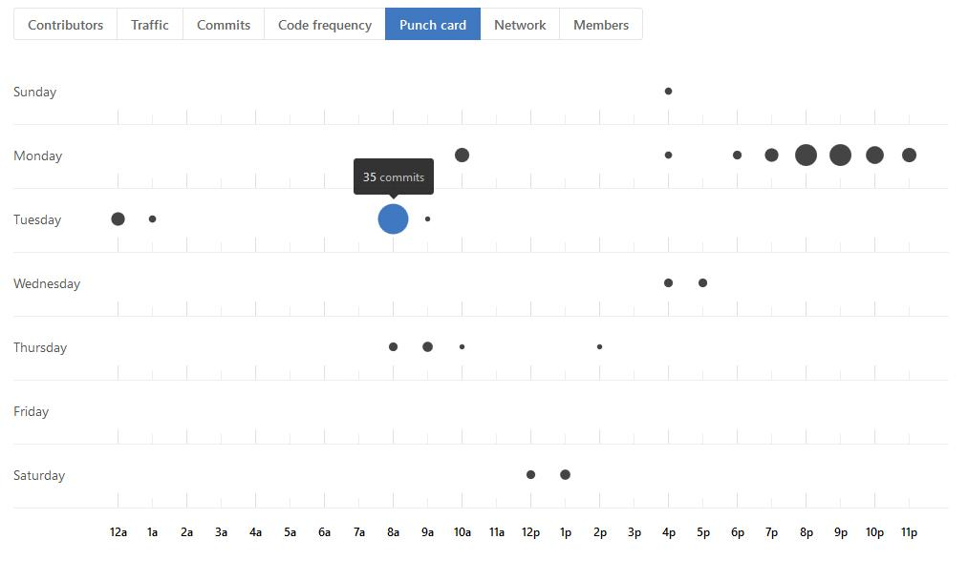
Take Aways
Multiple dependencies
Communication
Documentation
GitHub
Time Management

