Slide 1
Youtube-dl
Matt Adamson | Matt Bell | Colton Williams

Slide 2
Introduction of Project
What is Youtube-dl?
How does the software work?
What are we testing?
Injecting faults into tests
Lessons learned

Slide 3
About Youtube-dl
Youtube-DL is a terminal based software for downloading videos.
The project is available for many operating systems and can download from hundreds of sites.
Unlike online alternatives, Youtube-DL does not have to rely on a remote server, and also has no risk of downloading malware from “fake” downloading sites.

Slide 4

How Youtube-dl works (terminal command)
Youtube-DL can be downloaded and executed with a simple terminal command.
The software only requires that Python 2.7 or later is installed.
Suppose we want to download this video:
https://www.youtube.com/watch?v=KCYEDj69IRg
We would type: “youtube-dl KCYEDj69IRg”

Slide 5
The Testing Framework
parseTextFile()
Parses test cases from text file into a string list
executeTestCase(testInputList)
Executes each method with test input and writes the result to a list and returns it
textToHtml(outputList)
Writes the output list from executeTestCase() to an html table inside an html file.
loadOutputInBrowser()
Opens the generated html file in users default browser.

Slide 6
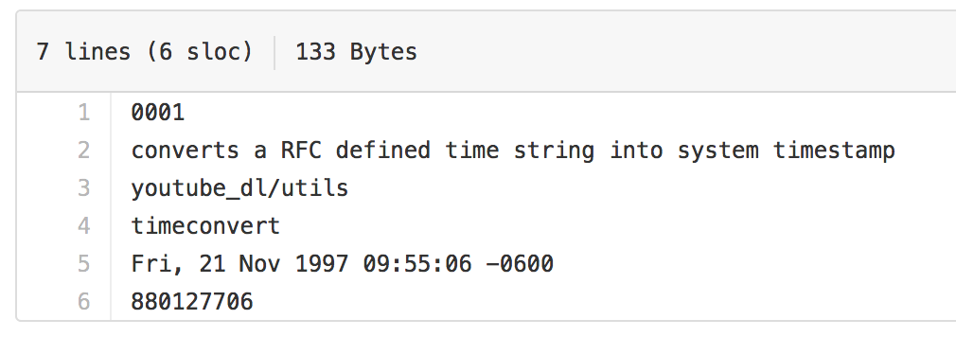
Test case input (the .txt files)
Test Number
Requirement being tested
Component being tested
Method being tested
Test input
Expected outcomes

Slide 7
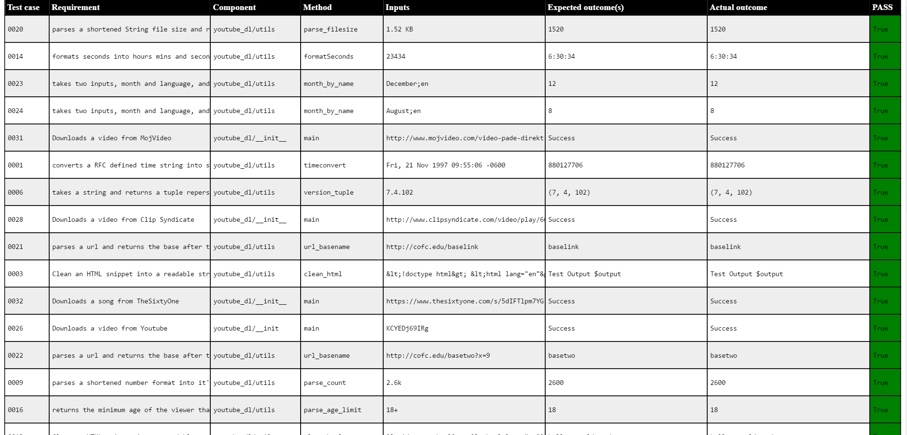
Outputting the results to HTML

Slide 8
Video Downloading Tests
Some of our tests involved running the main Python program, which downloads a video given a Url code.
Unlike the other tests, which are methods called from utility methods, the Main program must be compiled and run from the terminal.
This means the test framework automatically executes the terminal command and then verifies that the video was downloaded properly.

Slide 9
Introduction of Fault injection
Tried to pick methods that worked on a string or integer and returned data based off of it
Easy comparison to check if the test passed or failed
Easier to inject faults
Sometimes the faults injected didn’t result in failed test cases
Important to thoroughly test your fault injections and understand why they’re working as they do in order to make corrections
Lesson learned is sometimes your code can look like it’s working as intended with passing test cases, even if it’s broken.

Slide 10
Fault Example
timeConvert()
Original line of code:
if timetuple is not None:
New line of code:
if timetuple is None:
Flipped the statements meaning, output was returned as None.

Slide 11
Fault Example
formatSeconds()
Original line of code:
if secs > 3600:
New line of code:
if secs < 3600:
Caused anything over an hour to be formatted incorrectly.

Slide 12
Lessons learned
Our biggest technical challenges were the get-attribute function of converting Strings from the input files into actual method names.
Another challenge was executing command line methods from inside the Python framework.
We also learned that working together in person was more effective than by text messages.

Slide 13
Conclusion
We learned about creating Testing frameworks in Python, as well as working with an Open Source project
Our testing framework is more convenient that the existing test execution system.
The Framework includes 33 test cases, a method of executing tests, as well as an outputted HTML table of the tests.

