Slide 1
Fat Mike’s Unit Testing Shell (FMUTS)
By Chandler Deloach, Ethan Hendrix, and Jayse White

Slide 2
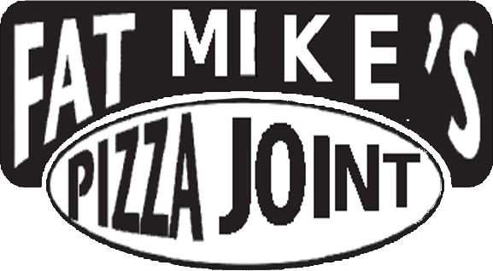
GOOD MORNING!
We are Fat Mike’s Pizza Joint
We are here to explain the in’s and out’s of our all new automated python testing software, FOR FREE

Slide 3
Our Experiences
Chose 3 H/FOSS projects
Test plan with 5 cases
Implemented all test cases
Importance of mock instances
Fault Injection
Notes:
So, before we got into what we’ve actually built, we were going to talk about our experiences throughout this assignment a little bit first. Our project probably changed more than any of us could have anticipated it to, because instead of testing an open source project like everyone else, we went on to test our own actual testing framework.
But, in the beginning, like everyone, we chose our first three projects: Martus, Cadasta, and Insight Segmentation and Registration Toolkit or ITK. Unfortunately, these would all be busts. Martus we couldn’t even get to build on our machine, because the project was so dead that many dependencies were out-of-date or not even available for download. Then, Cadasta rellied so heavily on Django that we couldn’t handle the imports with our testing framework. Thankfully, we’d built a generic enough testing framework that we could just make it the focus of our project. So, we actually went on to test the testing framework itself with the testing framework.
So, this changed our test plan, of course, because the one we had written for the other open source projects were no longer valid. So, we changed our test plan to reflect what we were currently working on.
The most interesting experience about testing our own framework, in truth, was handling our own code. This is something we’ve talked a little about before, but we had to create mock classes to be able to continue execution when we wrote test cases that would cause a failure or throw an error.
After that, we injected faults into our program, which we were able to successfully do with some ease. We were able to get 6 of 8 test cases to fail for one class, so we were able to successfully achieve our goal.

Slide 4
1.
Basic
Operation
Let’s start with a basic use overview

Slide 5
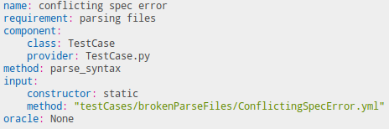
Basic Instructions
Input Guidelines:
Name: name of the test case
Requirement: High level goal of component being tested
Component:
Class: Class being tested
Provider: Where test can be found
Method: method testing
Input:
Constructor: inputs needed to constructor
Method: file location
Oracle: expected output

Slide 6
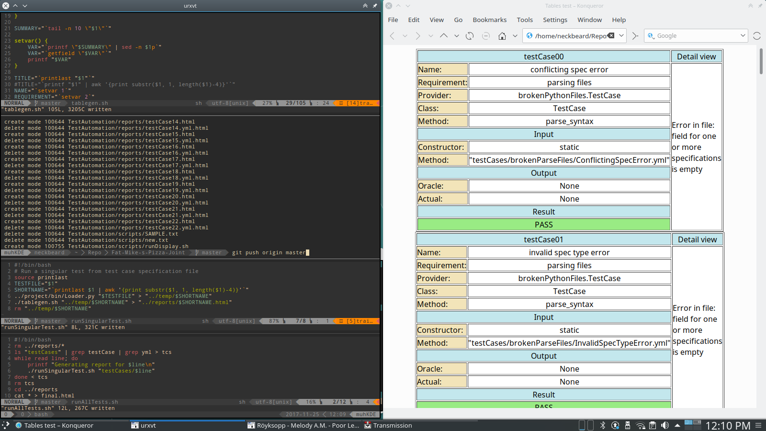
Basic Instructions
Output Expectations:
Test case number
Repeat of test case information
Input
Input specifications for method
Output
Oracle vs actual
Result
Pass/Fail

Slide 7
Fault Injection Safety
Allows encapsulated analysis of code with developer induced faults

Slide 8
2.
How It Works
Overview of script and code level operations

Slide 9
TestCase
Built from validation of user-created text file
Forms blueprint for creation of a Driver
Middle man between input through text file and executable Driver

Slide 10
Driver
The executable whose behavior is defined by the individual test case being run
Can be nested within other drivers
Allows you to test the Driver class itself

Slide 11
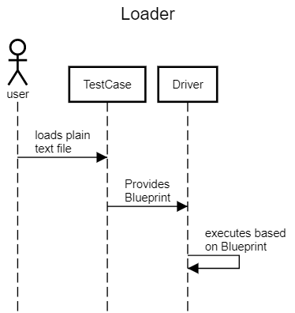
Loader
Loads raw text file to generate TestCase object

Slide 12
Scripting
With FMUTS, the user never directly executes a Python program manually
All executions are handled via a set of bash scripts
Different bash scripts are used to achieve different usage goals

Slide 13
Scripting
./runAllTests.sh
Execute all “clean” tests from test case files
Display compound report in web browser
./runSingularTest.sh
Execute individual test and generate report
./runDisplaySingularTest.sh
Same as above, but display the output report in browser

Slide 14
Fault Encapsulation
Our software allows for containment of fault injection in software project files to be tested
Reports can be generated for fault injected files while the originals are left unmodified

Slide 15
Scripting
./createInfectedTests.sh
Generate test case files which point to “infected” directory for encapsulated fault injection
./runInfectedTests.sh
Run all tests from test case files generated by above script
Display compound report in web browser

Slide 16
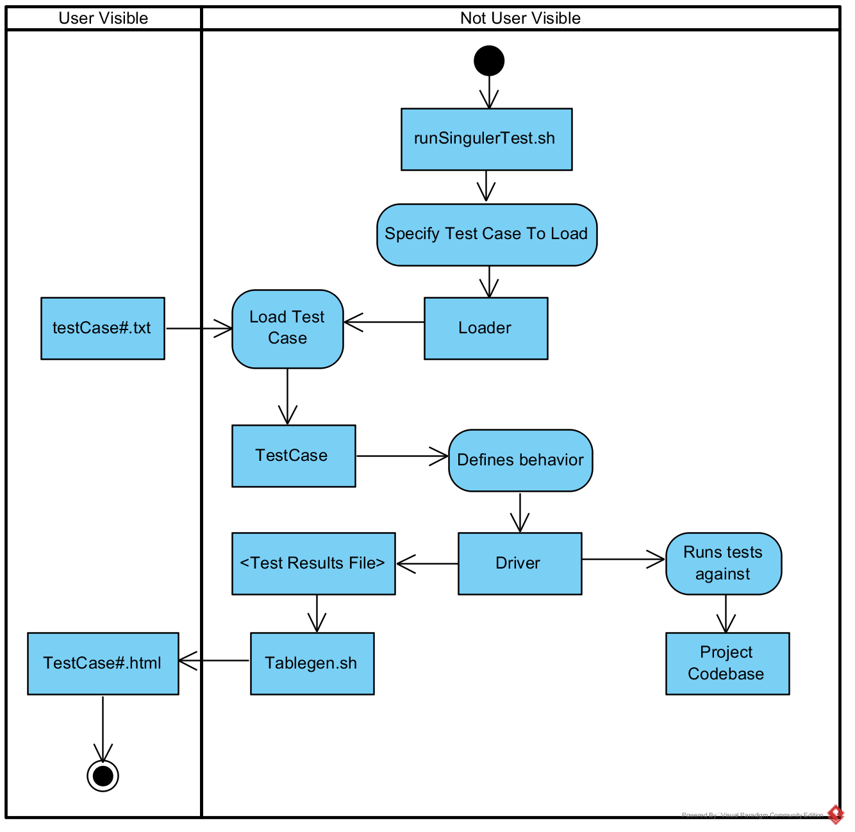
Core Sequence

Slide 17
3.
Test Cases
Why we expanded Test Case Input
Notes:
So, throughout the project, we decided we wanted to write more-robust test cases that are still dynamic. This is the heart of the syntax that we’ve mentioned earlier in our presentation. The two by-products of this are: lower user error and additional flexibility.

Slide 18
Lower User Error
Syntax strictly enforced
Full Execution every time
Verified twice while parsing
Notes:
So, one of the goals of expanding test case input is to drive down the possibility of user-error. We want to be able to handle user errors in a way that allows our testing framework to execute fully every time. Because of this, we’ve developed a syntax of sorts for our test cases. This syntax is a little more complicated than comma separated values, as you’ve seen already in the earlier slides. By moving away from a more-basic form of a test case, we’ve been able to ensure that all of the fields are properly filled.
The first way we do this is by strictly enforcing that syntax. Strictly enforcing the syntax allows for the testing framework to ensure that all test cases will always create a valid test case object. This is checked, and improper syntax notifies the user that their test case is incorrectly written, so they can rewrite the test case according to the template we’ve provided.
Secondly, this allows us to know that we have valid test cases every time. This allows us to ensure that the testing framework will always fully execute. As long as your test cases are correctly written, you’ll get some results. They may pass or fail depending on whether you correctly anticipated your oracle, but you’ll get the results.
And, finally, we do this through verifying the integrity twice. When parsing a test case, it’s verified twice, once in the initial parsing of the entire file, but then again it is re-verified when the single line is parsed. This double verification allows us to ensure that only 100% correct test cases are used in the testing software.
All of these pieces work together to make sure that, so long as the user writes the test cases correctly as we’ve specified, the framework will work for them.

Slide 19
Additional Flexibility
Generic testing
Specific but non-constraining syntax
Notes:
Test cases are written to get right down to the granular level, so that we can validate on a component level that your code base is working.
Also, in the previous slide, I talked about how strictly the syntax is enforced, and while that might seem like a drawback at first, ut in truth it isn’t. Once you start conforming to the syntax as you’re supposed to, you’ll start to realize how flexible the test cases can be. For example, some of the special flags that were mentioned earlier in the presentation, such as the null and static flags allow the user to easily test more methods and classes by allowing for a greater variety of method type.
These two things have really allowed us to create more a more-dynamic and flexible testing framework that really starts at the test cases themselves. What we’ve really done is just take good input verification its greatest extent that we could. And, doing so allowed us to make sure that whatever we built on top of these test cases was more robust.

Slide 20
Evaluation
Worthwhile experience
Experience with automated testing
Familiarity with test-driven development
scripting
Notes:
So, for an evaluation of this project, we’d say overall it was a pretty worthwhile experience.
Even though we might not have developed a tool that would be as robust as an entire testing library, we thought that it was good to experience automated testing and what that would be like to create automated testing.
Additionally, we got to learn a lot about test-driven development. We might not have used it as often as we should have in this development process, but we can see the benefit of it. It’s kind of difficult in our case, because we’re writing the automated testing framework, and we have to write the test cases for it to pass. But for it to even pass the test case in the first place, we had to have a working code base.
And, finally, scripting was a worthwhile experience, because, as you can probably tell, we relied heavily on scripting in this project to make this project possible. So, without knowledge of scripting or the willingness to learn, we would have never be able to accomplish this.

Slide 21
THANKS!
Any questions?

