Slide 1
Sigmah Testing Framework
By Noah Griffin, Brian Steele, and Andrew Miller

Slide 2

HFOSS Project: Sigmah
In running projects, international aid organizations have to manage large quantities of computerized data that they continually share internally or with their partners, and often in the heat of a crisis response. A lot of time and data is lost during these exchanges. The idea of “infoxication” is used here because we are “intoxicated” by the amount of information and documents that circulate. Without speaking of the different drafts and versions of a document that get mixed up, the different tools for monitoring indicators that are used from one project to another, etc.

Slide 3
Testing Framework → NumberUtils.java
Methods tested in NumberUtils.java:
truncate (Number n) – this method truncates a double value to two decimals.
truncate (Number n, int decimals) – this method truncates
ratioAsString (Number n, Number in)
ratio (Number n, Number in)
truncateDouble (final Double value)

Slide 4

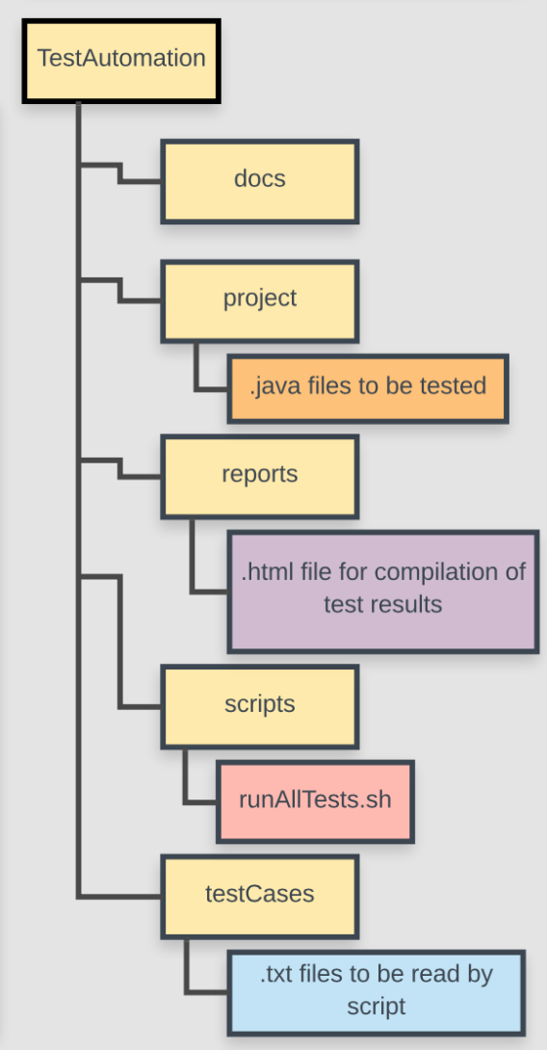
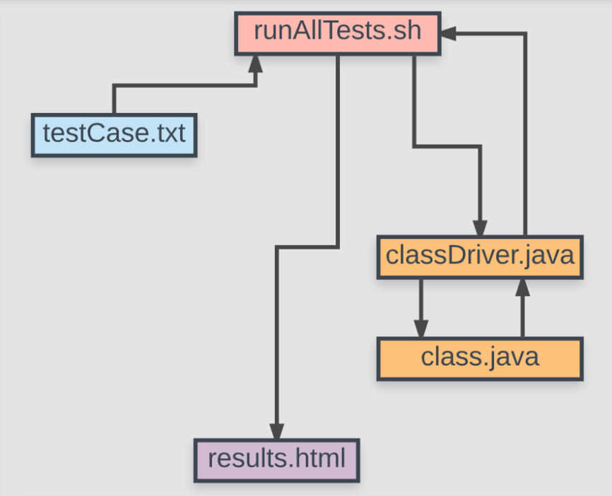
TESTING FRAMEWORK MODEL AND STRUCTURE

Slide 5
Test Cases
Format:
1. test number or ID
2. requirement being tested
3. component being tested
4. method being tested
5. test input(s) including command-line argument(s)
6. expected outcome(s)
Example:
Test #000
Mathematical functions must be accurate.
NumberUtils.java
truncate(Number n)
3.883
3.88

Slide 6
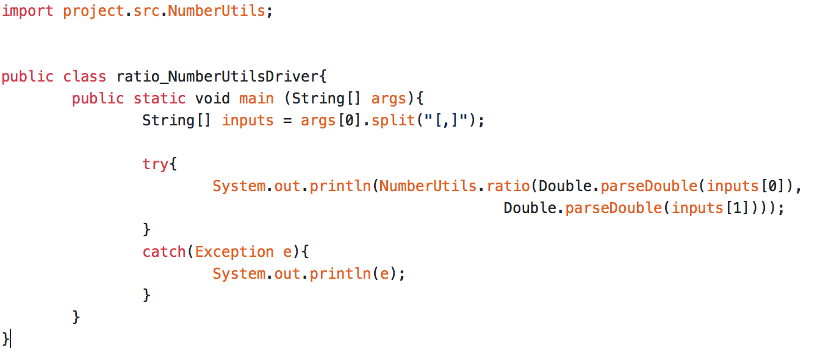
Drivers
Our drivers are simply put, the drivers. We pass our testCase file’s input into the driver, which then call’s the destined function with the given input, then saves the output for comparison.

Slide 7
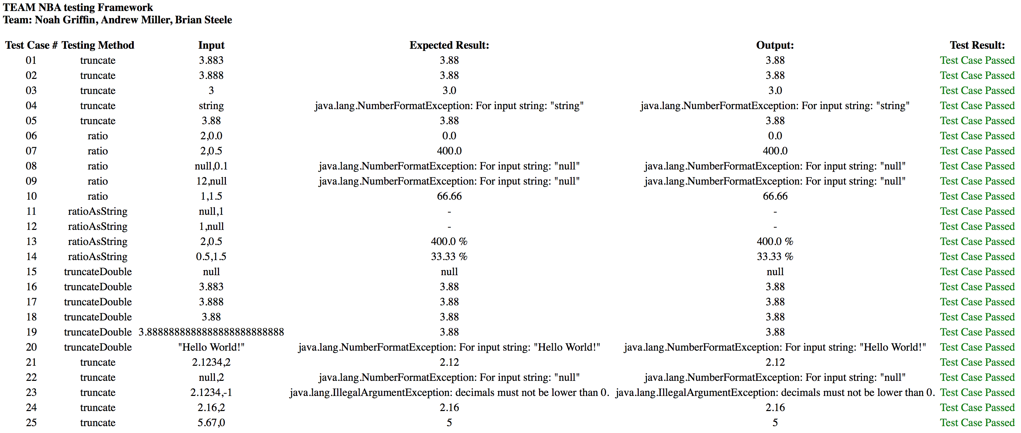
Output Format → HTML File with Table

Slide 8
Injected Faults
NumberUtils.java -> truncate (Number n)
Tests #001-005
Line 49, Source code: return truncate (n, 2);
Line 50, Fault injection code: return truncate (n, 3);
Expects a double truncated to 2 decimal places.
Tests #1, #2, #3, #5: FAIL
Test #4: PASS
NumberUtils.java -> truncateDouble (final Double value)
Tests #015-020
Line 62, Source code: if (value == null)
Line 63, Fault injection code: if (value != null)
Looks for a null input parameter. Now truncates null, and returns null on valid input.
Tests #16, #17, #18, #19: FAIL
Tests #15, #20: PASS
NumberUtils.java -> truncate (Number n, int decimals)
Tests #021-025
Line 100, Source code: if (index == -1)
Line 101, Fault injection code: if (index == 1)
If the double has a -1 index value, then returns a truncated double as a string. The fault causes this to occur when the index value is 1.
Tests #21, #23, #24, #25: FAIL
Test #22: PASS
NumberUtils.java -> truncate (Number n, int decimals)
Tests #021-025
Line 112, Source code: final int last = index + 1 + decimals;
Line 113, Fault injection code: final int last = index + 2 + decimals;
Changes output to be off by 1 decimal value.
Tests #21, #23, #24, #25: FAIL
Test #22: PASS
NumberUtils.java -> truncate (Number n, int decimals)
Tests #021-025
Line 85, Source code: if (decimals < 0)
Line 86, Fault injection code: if (decimals > 0)
Expects to throw error if decimal value is negative, and proceed if positive. This fault flips that and now throws error for positive and proceeds if negative.
Tests #21, #23, #24, #25: FAIL
Test #22: PASS

Slide 9
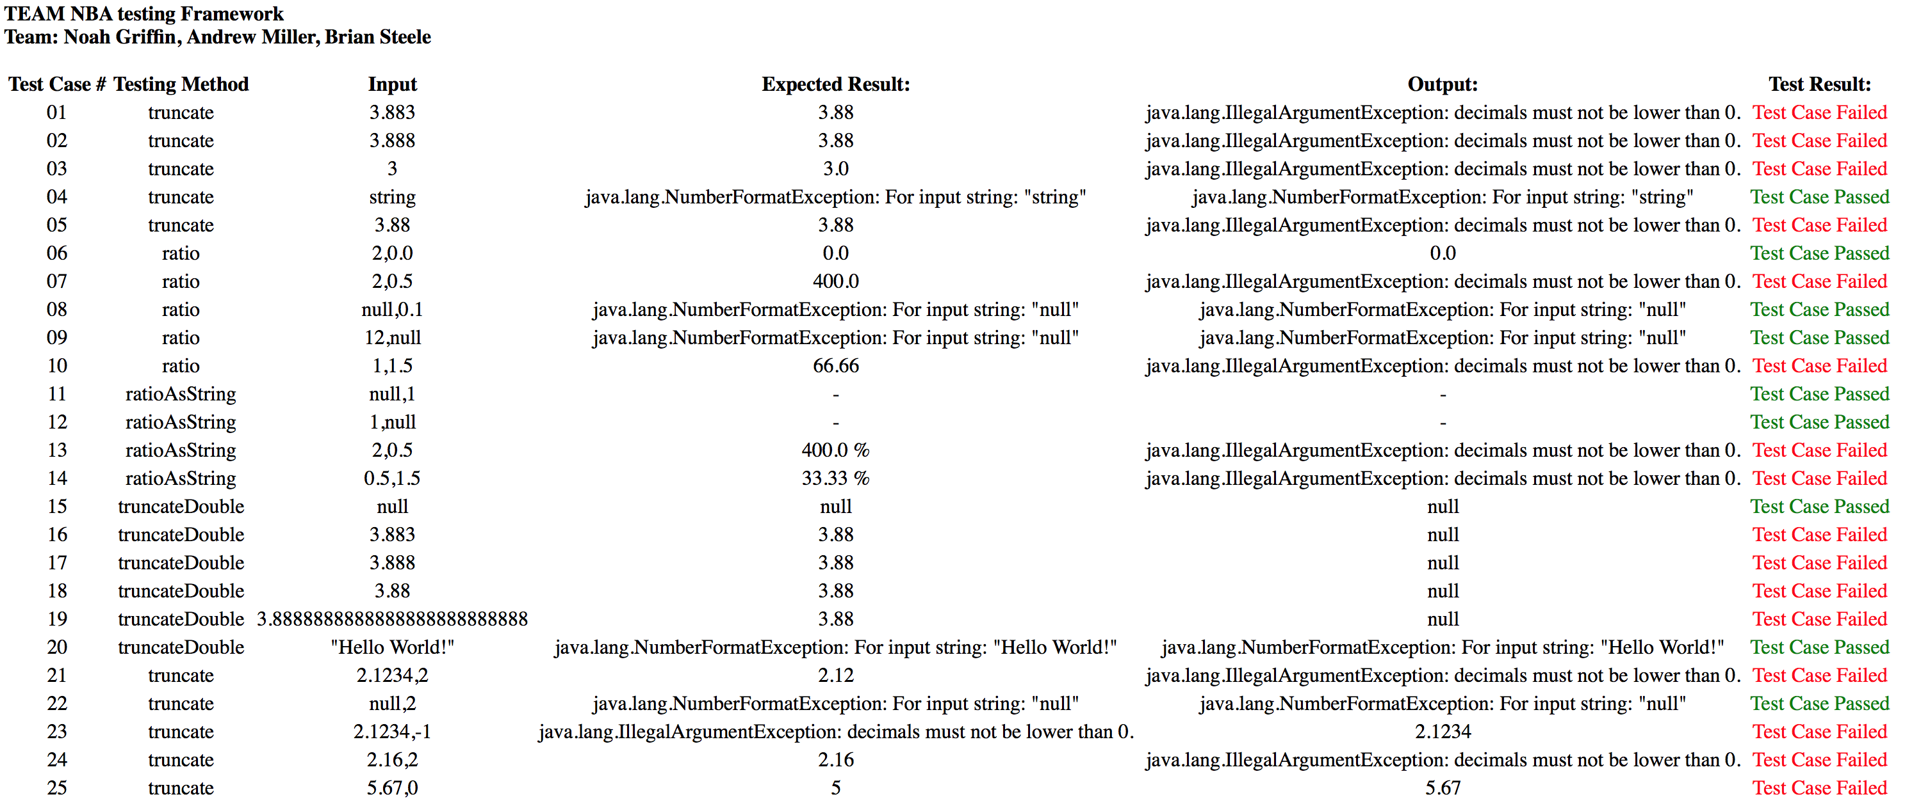
Injected Faults Results

Slide 10
Suggestions Moving Forward
When building and compiling the Sigmah project we faced a bit of misunderstanding with their three different instruction sets. We would recommend a better format for these guides to keep from deterring potential users.
It also seemed as if the use of dependencies was overused. We understand that Sigmah is OSS but with the sheer amount of dependencies it just seemed as if some of them were unnecessary.

Slide 11
Questions?

