Slide 1
Team TBD
Jake Marotta
Baylee Sims
Tyler Montgomery

Slide 2

Testing framework from TBD is based on Glucosio for Android.

Slide 3
What is Glucosio-Android?
Glucosio is an open-source project which develops and maintains Android and IOS apps for tracking blood-glucose levels. The software is meant to be used by people who are interested in tracking their blood-glucose levels and is useful for getting feedback.
Glucosio is research-driven, so users are able to opt in to share anonymized [sic] information to share with researchers.

Slide 4
Lessons Learned
Bash scripting with relative paths
Working with GitHub to manage versions in a team-based environment.
Learning to set environment variables such as JAVA_HOME and ANDROID_HOME.
Developing from within an Ubuntu virtual machine.
Building projects which use Gradle wrappers.
Unit testing of existing methods.

Slide 5
Tools Used
Ubuntu
Bash
Android Studio
gedit
Gradle

Slide 6
Requirements
Java Development Kit (JDK 8 or greater) w/ JAVA_HOME variable path set
Android Development Kit (ADK 3 or greater) w/ ANDROID_HOME variable path set
Linux or VirtualBox w/ Linux installed
Team’s GitHub repository
Default browser set for the system, to open report generated from framework

Slide 7
Framework Structure
Bash script reads test cases (.txt files)
Uses driver and input/output information to run a Java driver
Driver sets up and runs the method, returns output
Script compares expected output with actual, determines pass/fail
Script adds information to an .html file, which is automatically displayed in the system default browser when all tests have been run.

Slide 8
Framework Structure (con’d)
TBD
docs
drivers
project
reports
scripts
temp
testCases
Deliverables, documentation, etc.
.java
Glucosio project files
.html
.sh
Temporary files (cleared when script is finished)
.txt
.java
.txt
.java
.txt
...
...

Slide 9
Test Case Template
TestID - An identifier for the test.
Requirement - A description of the method being tested, as well as the condition being tested.
Component - A class within the application being tested.
Method - A method within the component being tested.
Specified Driver - The name of the Java driver required to run the test (no file extension).
Test Input - This will include the parameters necessary to test the specified requirement.
Expected Outcome - This will specify the output which would be returned if the method executed as expected.

Slide 10
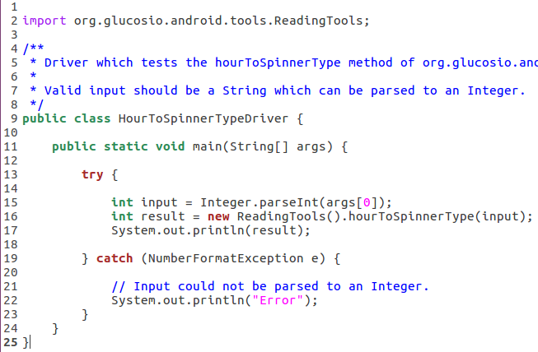
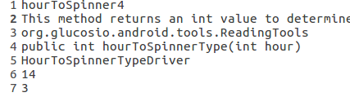
Test Case Example 1

Slide 11
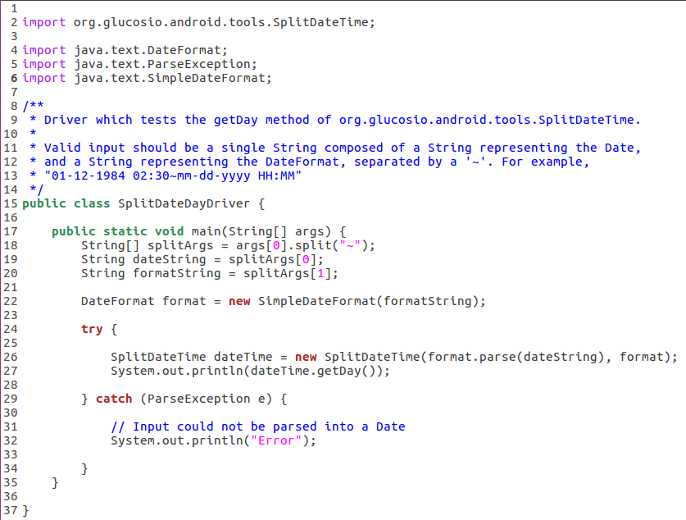
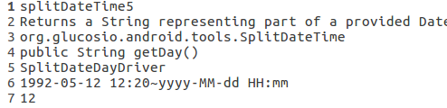
Test Case Example 2

Slide 12
Compilation
At the beginning of the Bash script, Glucosio’s Gradle wrapper is called to assemble the project files.
When the drivers are compiled, the classpath is altered to include the Gradle wrapper’s build directory.
Driver .class files are placed in the “temp” directory so they don’t have to be compiled each time.
The classpath is again altered to include the build directory when each driver is executed.

Slide 13
Demonstration

Slide 14
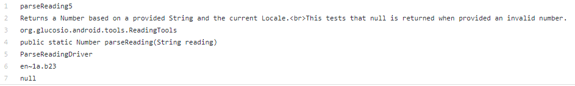
Failing Tests
Two test cases we wrote fail, both for the same method, for the same reason.
The default Number.parse() truncates the String value passed to it before the first invalid character, so while “1a.b23” is an invalid number, the method still returns “1.0”.

Slide 15
Reflections (Strengths)
Choosing a project which already used Gradle worked in our favor.
No need to worry about individual dependencies
Simple build process
Separation of responsibilities proved efficient.
During each meeting, tasks which could be done individually were distributed among group members

Slide 16
Reflections (Obstacles)
Inability to test classes which used the Android SDK
Could not compile Android classes using javac
Incompatibility of schedules/Spread out locations
One team member lives downtown, one in West Ashley, and one in Summerville
Meeting in person could be difficult, and progress slowed
Misunderstanding directions
Spent a good amount of pre-Deliverable3 fashioning a driver that didn’t meet the project requirements.

Slide 17
Questions?

