Slide 1

Open MRS
Team InsertNameHere

Slide 2
What is OpenMRS?
“The global OpenMRS community works together to build the world's leading open source enterprise electronic medical record system platform”
An Electronic Medical Record is the digital collection of patient health data and covers a patient’s medical history.
OpenMRS is a system which facilitates the creation, update, and retrieval of Electronic Medical Records.

Slide 3
OpenMRS
OpenMRS began in 2004 in an effort to aid developing nations who found creating digital medical records systems cost-prohibitive to produce and paper records insufficient for their needs.
They are led in part by the Partners in Health organization located in Boston, Massachussetts.
OpenMRS is in use in many locations around the world, including several countries in Africa, Haiti, China, and the Philippines.

Slide 4
OpenMRS
In their words, “The mission of OpenMRS is to improve healthcare delivery in resource-constrained environments by coordinating a global community that creates a robust, scalable, user-driven, open source medical record system platform.”
To realize that goal, they base themselves on the following ideals:
Design decisions are driven by real, not perceived needs
We believe the best ideas come from people with different backgrounds and talents, and we build a community where these people can come together and innovate.
We believe in harnessing the wisdom of our software development community by creating a safe place to raise concerns, discuss failures, improve existing ideas, and solve problems.

Slide 5
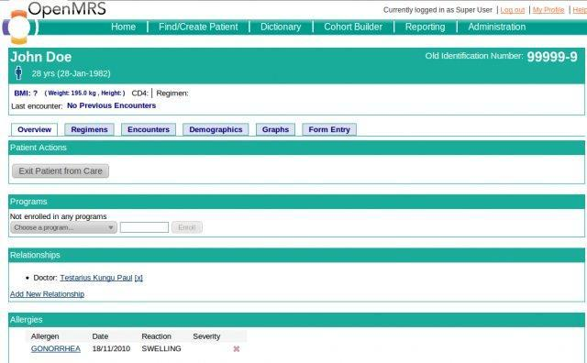
What Does OpenMRS Look Like?

Slide 6
How does OpenMRS work?
OpenMRS is in essence an application for streamlining/automating the creation and manipulation of medical records as well as patient management and classification.
Features:
Central concept dictionary • Patient repository • Multiple identifiers/ patient
Modular architecture • Patient workflows • Cohort management
Patient merging • Localization

Slide 7
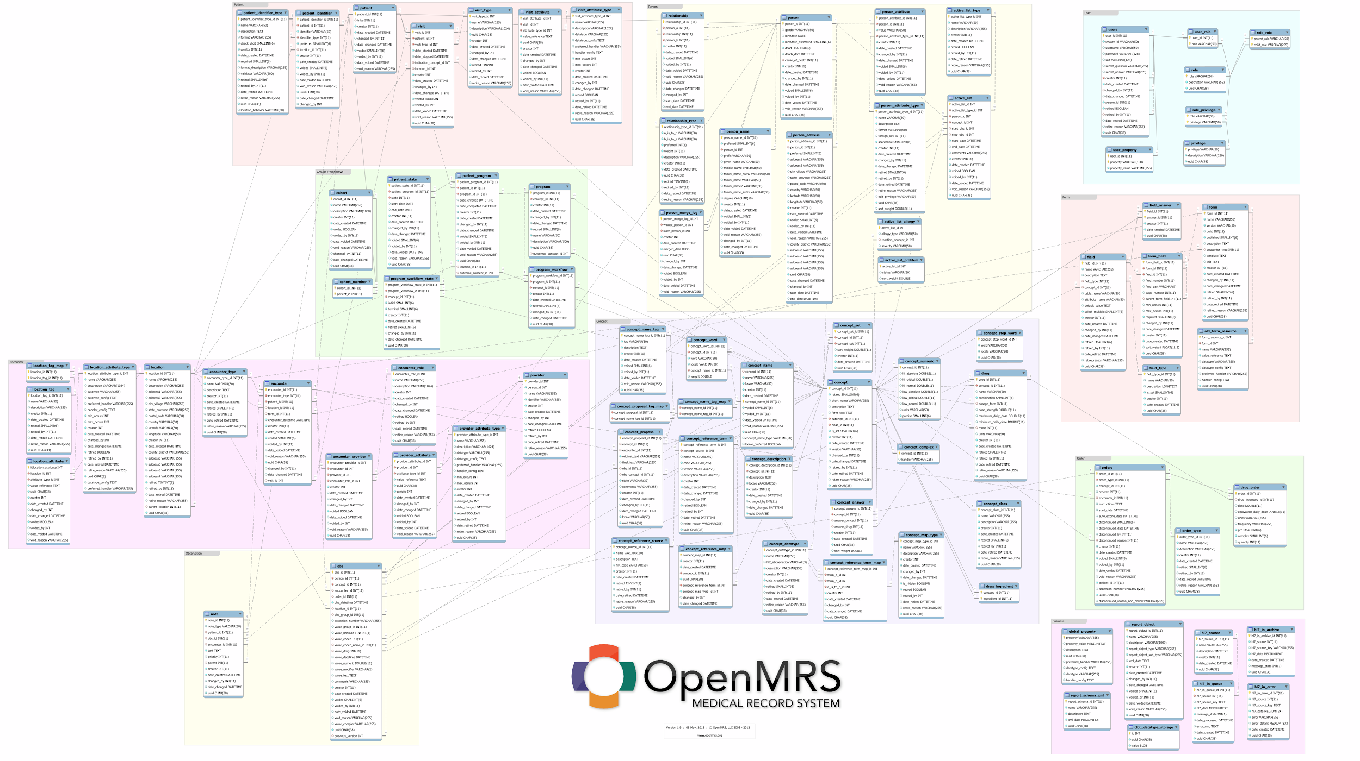
Data Model

Slide 8
Testing Framework
Project
Test Cases
Test Case Executables
Scripts
Reports

Slide 9
The Cohort Class
A Cohort is a group of patients.
Our framework extensively tests the methods that manipulate cohorts through set operations, namely the Intersection, Subtraction, and Union functions.

Slide 10
Cohort Class Core Methods
Intersection | Union | Subtraction
Intersect(Cohort A, Cohort B) Creates a Cohort composed of only items found in both Cohort A AND Cohort B | Union(Cohort A, Cohort B) Creates a Cohort composed of all items in either Cohort A OR Cohort B. | Subtract(Cohort A, Cohort B) Creates a Cohort composed of all items in Cohort A that are not in Cohort B

Slide 11
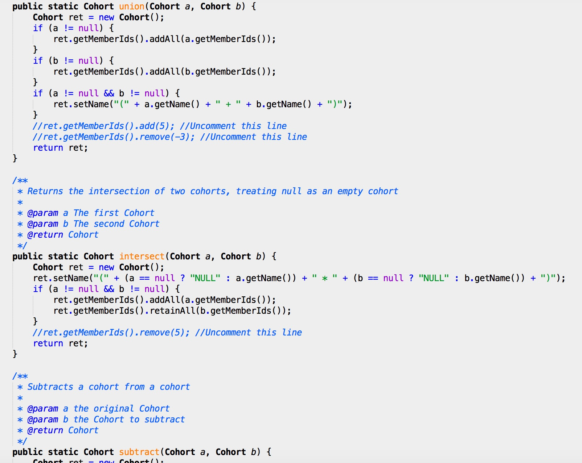

Slide 12
Our Test Cases
Test ID: 1
Requirement: The union of two Cohorts has no repeated values
Component: Cohort
Method: public static Cohort union(Cohort a, Cohort b)
Inputs: [1,2,3,4,5] [3,4,5]
Expected: [1,2,3,4,5]
Driver: CohortUnionDriver
Notes:

Slide 13
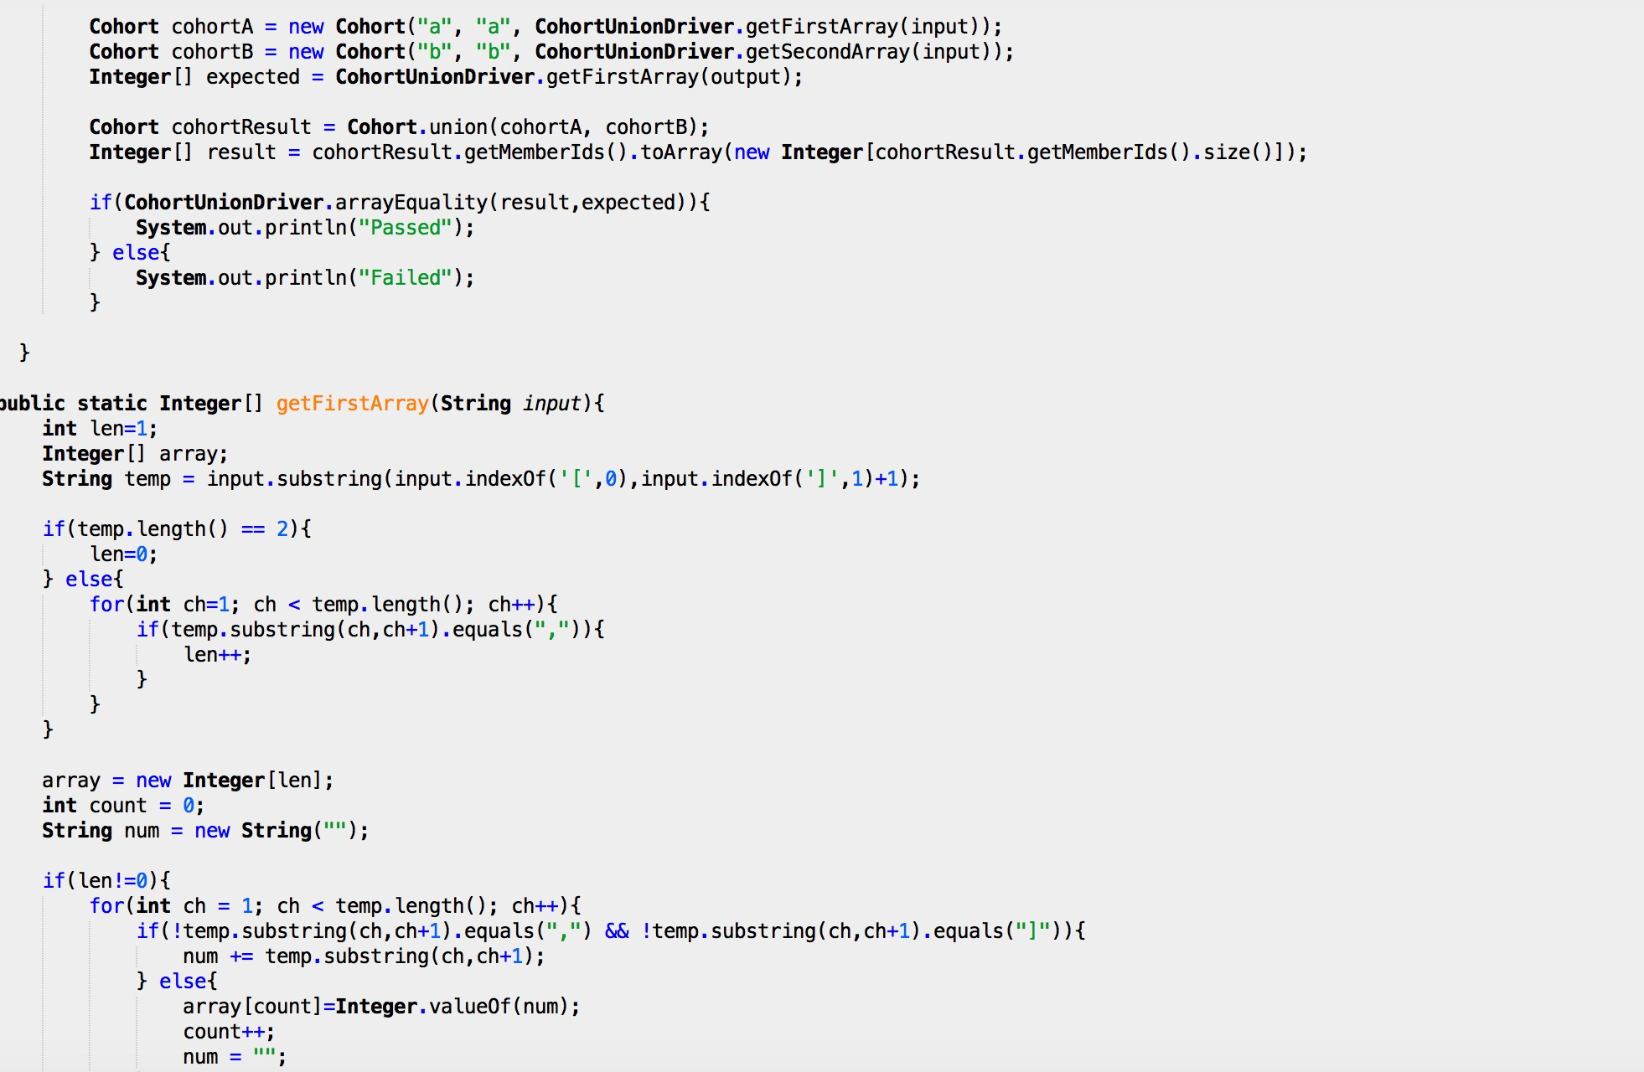

Slide 14
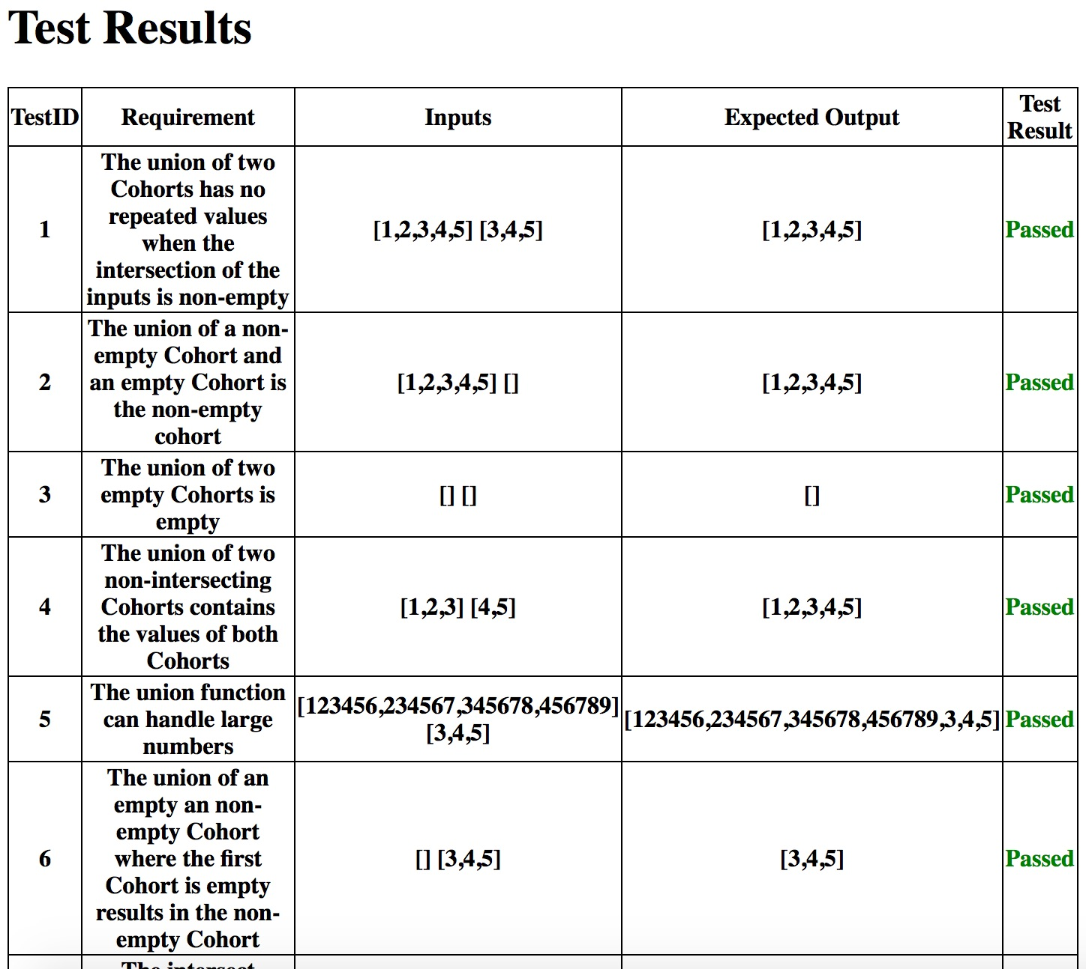
Results

Slide 15
Faults
To test our testing framework, the following errors were inserted into the source code:
In the union method, just before the return statement, we added the line:
ret.getMemberIds().add(5);
This would add the number 5 to the returned cohort, and thus, any result that was not supposed to contain a 5, would fail. Thus, test case 3 failed.

Slide 16
Faults, Part 2
Another error we injected was putting the line:
ret.getMemberIds().remove(4);
in the subtract method. This caused any test with a 4 in the result to fail.
Hence, test 15 failed.

Slide 17
What We Learned
Communication is an important part of being in a team.
The ability to effectively understand and approach a project as a group starts with an effective understanding of each team member’s skills and weaknesses, as well as the ability to understand what each member needs help with.
Delegation & Division is necessary in for an efficient team
Knowing how to distribute the tasks based on the skills possessed by each team member in such a way that work is completed in a timely manner, and that progress can constantly be being made.

Slide 18
What We Learned (continued)
Regular meetings help to focus and better inform team members
A consistent meeting time and place can very positively affect the progress of a team. Even though we might have felt like we had nothing to discuss at times, this was a cornerstone to keeping everyone in the loop at all times. More often than not problems tended to arise when we failed to meet.

