Slide 1
Testing MathJax’s LaTeX to MathML Capabilities
TeamTwo4Now’s Semester Experience with Testing Frameworks

Slide 2



The Team
Charles Thiry
‘Hemingway’
James Keels
‘Chronos’
Hassam Solano
‘SpinDr.’

Slide 3
“Ushahidi, which translates to “testimony” in Swahili, was developed to map reports of violence in Kenya after the post-election violence in 2008. Since then, thousands have used our crowdsourcing tools to raise their voice. We’re a technology leader in Africa, headquartered in Nairobi, with a global team.”
- https://www.ushahidi.com/about

Slide 4

“The MathJax Consortium is a joint venture of the American Mathematical Society (AMS) and the Society for Industrial and Applied Mathematics (SIAM) to advance mathematical and scientific content on the web. The core of the MathJax project is the development of its state-of-the-art, open source, JavaScript platform for display of mathematics.”
-https://www.mathjax.org/#about

Slide 5
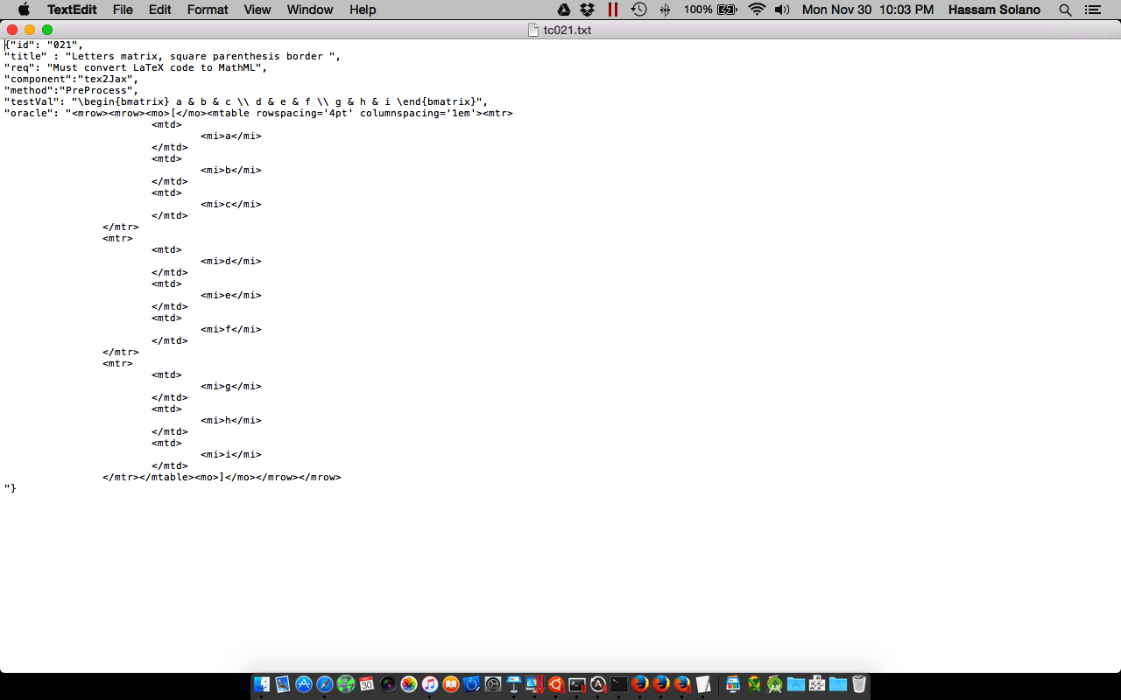
Test Cases
Constant
req
component
method
Variable
id
testVal
oracle
title

Slide 6
The Framework
Test case file JSON is parsed
Values are passed into MathJax tester
Converted MathML is captured
Captured MathML String is compared to oracle
HTML file collects results of tests and displays in Firefox window

Slide 7
Tools/Dependencies
Selenium
Python
Firefox

Slide 8
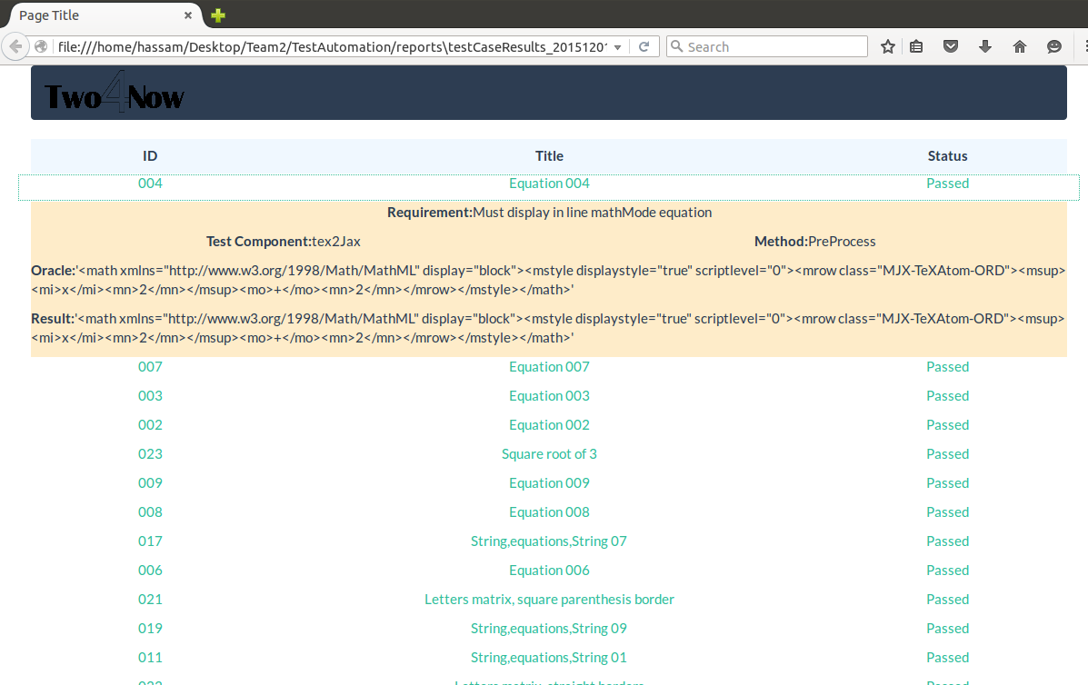
Passing Tests

Slide 9
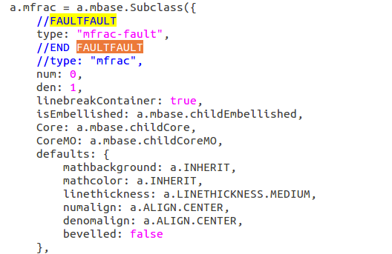
Fault-Injection
File: TeX-AMS-MML_HTMLorMML.js
Search “FAULTFAULT"
”Uncomment
Comment
2
3

Slide 10
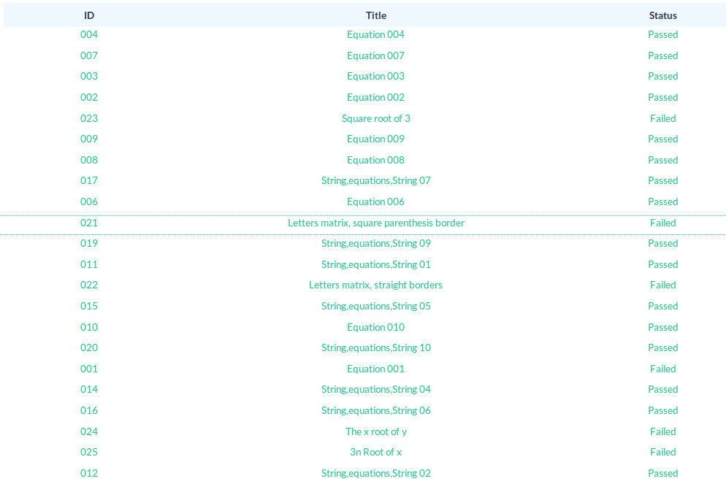
Fault-Injection

Slide 11
Lessons Learned
Scheduling is key!
Fully research a project before getting involved
Proper testing requires fundamental understanding of the software being tested

