Slide 1
Phaser
Winslow DiBona

Slide 2
Phaser
https://github.com/photonstorm/phaser
HTML/JS game framework
Browser based web & mobile

Slide 3
Project Specifications
Node.js Testing Framework
npm - Node Package Manager
HTML Report

Slide 4
General Overview
Main folders
project/src/phaser/build/Phaser.js
scripts
reports
testCases
testCasesExecutables

Slide 5
Scripts
runAllTests.js
reads in JSON
passes to testCase executables
report.html

Slide 6
Scripts
function readFileToJson(testCase){
var path = '../testCases/' + testCase; var obj = JSON.parse(fs.readFileSync(path, 'utf8')); return obj }
function createHTMLResultTable(number, requirement, component, method, inputs, expectedOutcome, actualOutcome){ var result = ""; if(expectedOutcome === actualOutcome){ result = "<font color='green'> Passed </font>"; } else{ result = "<font color='red'> Failed </font>"; } var string = "<tr> <td>" + number + "</td> <td>" + result + "</td> <td>" + requirement + "</td> <td>" + component + "</td> <td>" + method + "</td> <td>" + inputs + "</td> <td>" + expectedOutcome + "</td> <td>" + actualOutcome + "</td> </tr>"; return string; }

Slide 7
Scripts
function runTestCase(object){ var path = '../testCasesExecutables/' + object.filename; var testCase = require(path); var result = testCase.test(object.inputs); resultsObject[object.number] = createHTMLResultTable(object.number, object.requirement, object.component, object.method, object.inputs, object.outcomes, result) if(Object.keys(resultsObject).length === 25){ writeToHTMLFile(); } }

Slide 8
Test Cases
Specification Format
filename
number
requirement
component
method
inputs - Array
outcomes - Value, Array, or JSON object

Slide 9
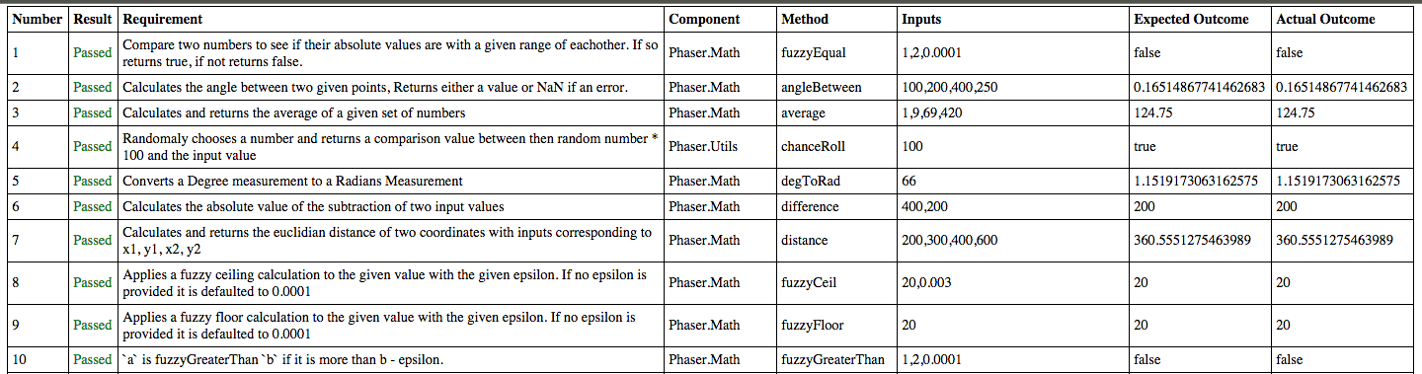
Testing Results
> node runAllTests.js

Slide 10
Fault Injections
5 fault injections
Phaser.Math
Phaser.ArrayUtils
Phaser.Utils

Slide 11
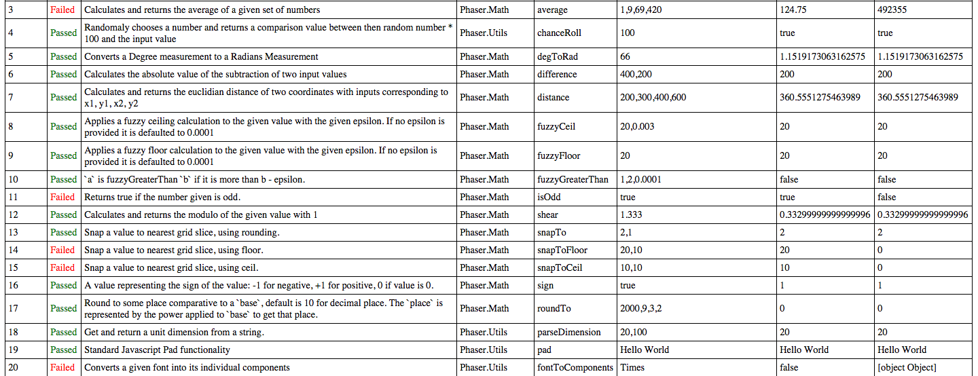
Fault Injection Results
> node runAllTests.js

Slide 12
Lessons Learned
Package Managers = Awesome
Version Control + Package Managers = Potential Headache
Testing frameworks are (more) fun (than expected)

Slide 13
Questions?

