Slide 1
The Darkness
Team Members:
Chance Leaird
Juan Carlos
Wyatt Morris

Slide 2
FuzzyWuzzy
Software that is used to compare two strings and return different types of ratios, depending on the ratio type the user is chosen

Slide 3
Reason for the choice
After try to figure out about another softwares we got this application that fits perfectly on the project. It is a pretty simple software in which we could gain a great amount of experience dealing with.

Slide 4
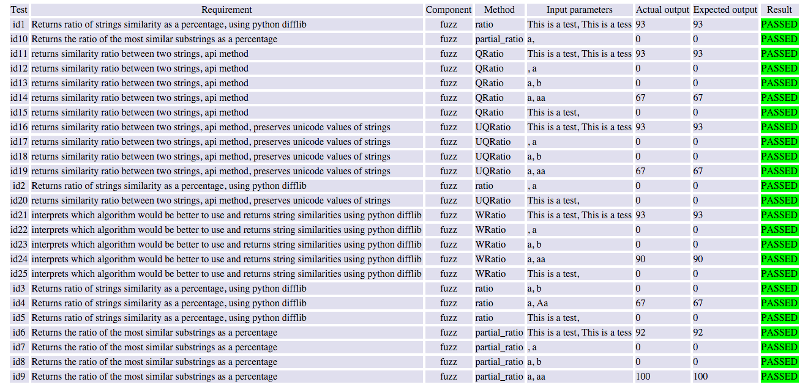
Test Passing

Slide 5
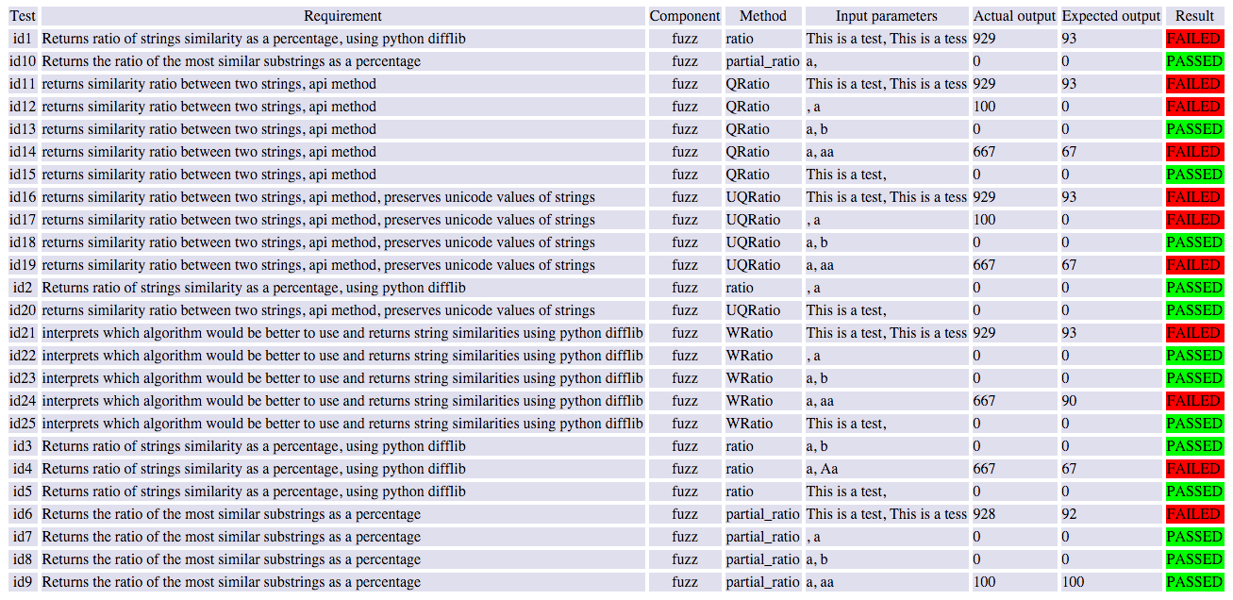
Test Failing

