Slide 1

Team HABA
Hugo Felkel, Arthur Hilgendorf, Brett Perrine, Angel Rodriguez

Slide 2
What is Martus?
Martus is a free, open source, secure information collection and management tool that empowers human rights activists to be stronger in their fight against injustice and abuse. Individuals and groups who protect human rights and civil liberties work in environments where resources are scarce and adversaries often have the upper hand. Martus is a way for them to safely report incidents with minimal risk.
Where is Martus?
Martus is being currently maintained through it’s parent company Benetech, while it has continued to stay with its open source roots by actively maintaining their source code distributed through the Github platform.
Why Martus?
We choose the Martus platform due to its simplicity being written entirely in Java, and there was good documentation of the overall project. The main deciding factor in choosing this platform came down to the support provided by Martus’ parent company, Benetech. While the documentation on their website was dense, the over documentation in their source code was sparse at best.

Slide 3
Framework
Language
The framework of our system is based around the runAllTests.sh bash file. Using this method was sufficient, although we believe that the program could have accomplished perhaps better and with more capabilities using a python shell file. Almost everything can be done simpler and more efficiently through shell, but at the time of development we decided to create runAllTests as a bash file instead.
Approach
The approach taken to develop our framework was based around the agile development process, in which we created deliverables every few weeks where we met specific deadlines in order to accomplish the task at hand. We broke a large problem down into smaller pieces, which help us significantly tackle and understand the problem when being an automated framework.
Adjustments
The adjustments made on the overall framework involved how the test cases were handled, as well as how the project was compiled and stored.
Notes:
Builds the html file with appropriate headers. Compile the appropriate driver files for the methods specified within the program. From there it will run the necessary driver for each test case and display those results within the table.
Hurdles: The javac and java commands not working correctly with the adjustments made to the scripts file. We intial built a super driver that would handle all the input test cases, but this approach was wrong. The script was not supposed to “know” anything about the methods it was calling. We split the work onto multiple drivers which only handled one method per driver. The final hurdle that we had to overcome dealt with how java compilation was storing the compiled class files.
Grabbing the information from the file came from a line by line basis using the bash command sed, which would extract the entire file. The template for the test cases was provided at the top of each file to provide clarity without interfering with the sed command

Slide 4
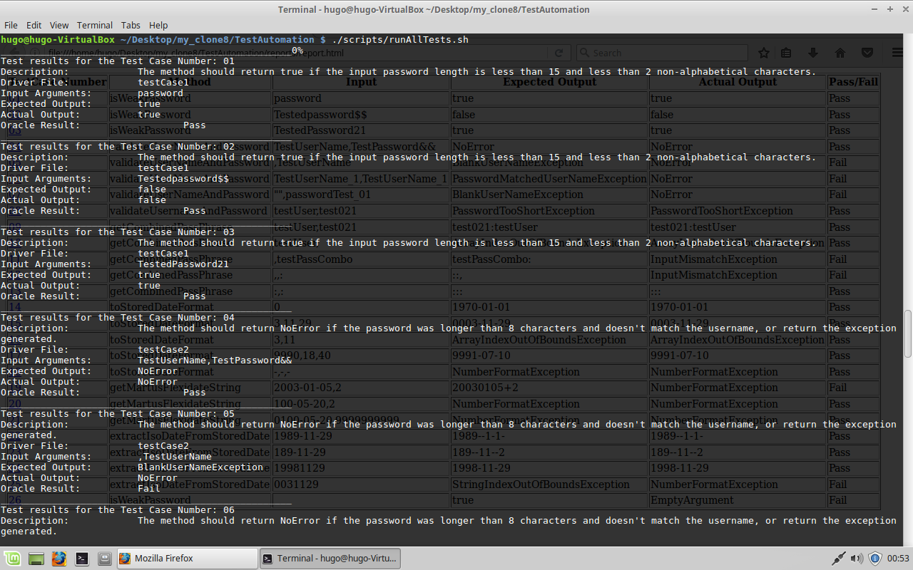

Slide 5
Test Cases: MartusUserNameAndPassword
isWeakPassword
Test Case 01: Password < 15 chars => true
Test Case 02: Strong password => false
Test Case 03: Password < 2 non-alphabetic chars => true
validateMartusUserNameAndPassword
Test Case 04: valid Username and Password => NoError
Test Case 05: Username blank => BlankUserNameException
Test Case 06: Username matches password => PasswordMatchedUserNameException
Test Case 07: Empty Username String => BlankUserNameException
Test Case 08: Password too short => PasswordTooShortException
Notes:
PRESENTATION NOTES *add testcase format explanation* #Test case number #Requirement being tested #Class name #method name #test input #expected output #driver used we constructed 25 tests cases for the martus software. Our Test cases came from 3 classes MartusUserNameAndPassword, PasswordHelper and the MartusFlexidate class we chose these classes because they were integral to the system and because the methods within the classes were straightforward on what was needed for an input and what to expect for an output. we derived 8 test cases from MartusUserNameAndPassword from the MartusUserNameAndPassword class we looked at the boolean method isWeakPassword. This method takes in a char array and checks the password contains at least 15 characters or greater and checks if the char[] contains at least two non alphanumeric characters. If the password meets the requirements false is returned as to say "the the password is not weak, "and returns true if it does not meet the requirements “ the password is weak" Similar methods are prevalent in programs that require the user to create a password. (Much like the mycofc login has special requirements:length between 8-12, 1 letter,1 digit and one special character from a specific list.) Although in martus these requirement are not strict they are more of recommendation you have the option to ignore these rules for the password. our test cases consisted of inputs that were below the strong password length, input that met the length requirement but did not meet the 2 non alphanumeric characters requirement, and an input that met both these requirements The second method we grabbed from this class was the validateMarthusUserNameAndPassword this method take in a String for the username and a char[] for the password. for testing input we tried to throw each of the exceptions within the method which are BlankUserNameExceptoion, PasswordMatchedUserNameException and the PasswordTooShortException which are pretty self explanatory.(continues to explain them anyways) if there is a blank username BlankUserNameException is thrown if the username is blank, PasswordMatchedUserNameException is thrown if the username and password are the same and the PasswordTooShortException is thrown if the password is too short (< 8). We picked inputs that would invoke each of these exceptions. PasswordHelper class we tested the getCombinedPassPhase method. The method takes a String for the username and a char[] for the password as parameter. This returns a char[] which is a combination of the username with a + a colon + the password. This method is later on for parsing the colon is used as a delimiter which is used when transferring from database. from this method we were able to generate 5 additional test cases. for the testing inputs we chose to use a comma as the username or as the password this causes the method to throw an exception since the comma is used a delimiter within the method to combine the username and password. 12 test cases came from the MatusFlexidateClass toStoredDateFormat takes a MultiCalendar which is essentially a string which is separated by commas year,month,day and converts the date into the YYYY- MM-DD format. this would be used to store to the databases getMarthusFlexidateString takes MultiCalendar and an int for the range. this method uses the int to show how many days have elapsed. It will return an integer followed by a + and an int which will be the time elapsed. We chose inputs that were correctly formatted and some inputs that were incorrectly formatted or that were formatted incorrectly (not seperated by commas correctly). extarctIsoDateFromStoreDate this method is used to convert the input which is a String into the correct date format this would be used fir converting database string into the correct date format. for this one we chose inputs that were not correctly formatted again.

Slide 6
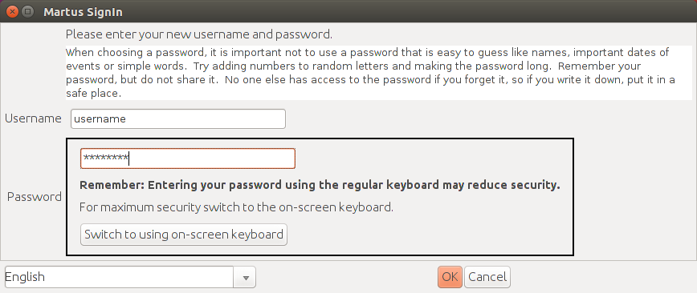
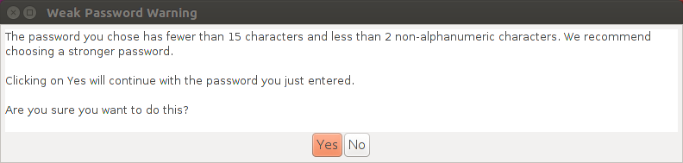

Slide 7
Test Case: PasswordHelper
getCombinedPassPhrase
Test Case 09: valid Password phrase => Delimited result
Test Case 10: second part of password phrase missing => ArrayOutOfBoudsException
Test Case 11: first part of password phrase missing => Delimited result
Test Case 12: password phrase is only a comma and delimited value => Delimited result
Test Case 13: password phrase is only two delimiter values => Delimited result

Slide 8
Test Case: MartusFlexidate
toStoredDateFormat
Test Case 14: simple integer value => Correct date based on starting point
Test Case 15: valid calendar date => Delimited result
Test Case 16: Invalid format => ArrayOutOfBoundsException
Test Case 17: invalid calendar data but correct format => Delimited result
Test Case 18: Invalid characters entered => NumberFormatException
getMartusFlexidateString
Test Case 19: valid date and input => Delimited result
Test Case 20: invalid date => NumberFormatException
Test Case 21: invalid addition input => NumberFormatException

Slide 9
Test Case: MartusFlexidate(cont)
extractIsoDateFromStoreDate
Test Case 22: valid date but delimited => Wrong delimited result
Test Case 23: invalid date but delimited => Wrong delimited result
Test Case 24: valid date => Delimited result
Test Case 25: invalid date => StringIndexOutOfBoundsException

Slide 10
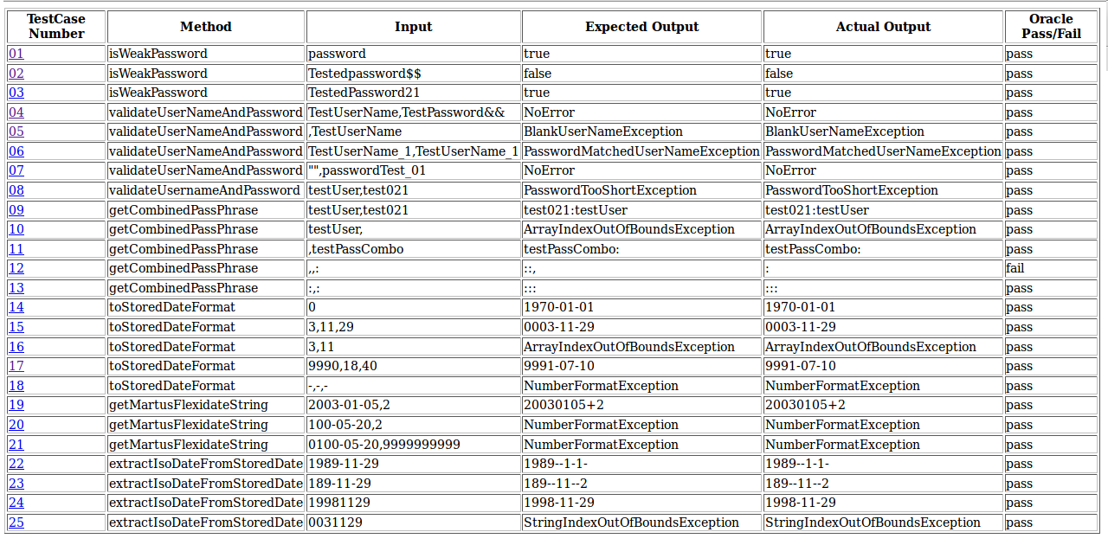

Slide 11
Fault Injections
Fault Injection 1: Removed the catch BlankUserNameException from the method validateUserNameAndPassword inside MartusUserNameAndPassword.
Causes Test Case #5 and #7 to change the error generated from BlankUserNameException to NoError
Fault Injection 2: Removed the catch PasswordMatchedUserNameException from the method validateUserNameAndPassword inside MartusUserNameAndPassword.
Causes Test Case #6 to change the error generated from PasswordMatchedUserNameException to NoError
Fault Injection 3: Add the catch cause InputMismatchException if the String variable was empty from the method getCombinedPasswordPhrase inside PasswordHelper.
Causes Test Case #11 and #12 to change the error generated from ArrayIndexOutOfBounds to InputMismatchException
Fault Injection 4: Changed the methods getMartusFlexidateString and toFlexidateFormat to return integers instead of Strings inside MartusFlexidate.
Causes Test Case #19 to change the result generated from 20030105+2 to the error NumberFormatException
Fault Injection 5: Add the catch cause NumberFormatException if the String variable was less than 7 characters in length from the method extractIsoDateFromStoredDate inside MartusFlexidate.
Causes Test Case #25 to change the error generated from StringIndexOutOfBoundsException to NumberFormatException

Slide 12
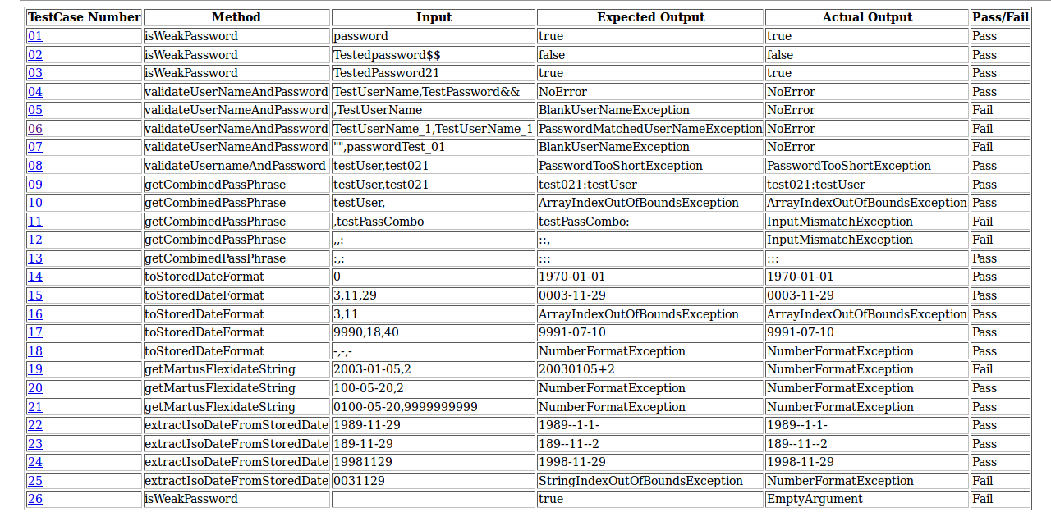

Slide 13
Experiences
Meetings
Meetings became a serious challenge with our group due to different work schedule, as well a people not living in a centralized location. Skype provided a useful tool, but communicating over Skype less beneficial when compared to face to face discussion.
Hurdles
We faced many hurdles during this project due to clarify issues between all members involved. We initially developed a super driver to handle all of our test cases, as well as programming the overall oracle structure of the program wrong. The largest hurdle came in the form of compiling and running the java within the command line.
Accomplishments

