Slide 1

Automated Testing Framework
CSCI 362: Software Engineering
Team-3
Brielen Beamon
Logan Smith
Scott White

Slide 2
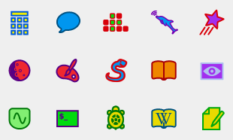
Introduction to Sugar Labs
Sugar Labs is a free and open source software project that focuses on allowing people around the world to learn more about the world around them for free.
Sugar Labs is a spin off of One Laptop Per Child, constituting a simple Linux-based operating system.
It is used to give disadvantaged populations an opportunity to interact with a simple computer system.

Slide 3
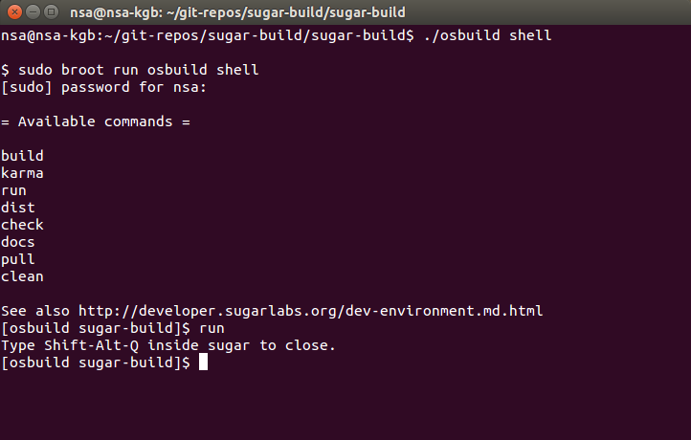
Building the Project
Documentation made it easy to build and run Sugar Labs
Our only problem was a small bug in the software that made a component, the Web browser, fail to compile
To fix this, we edited a configuration file
Once we did this, it ran smoothly

Slide 4
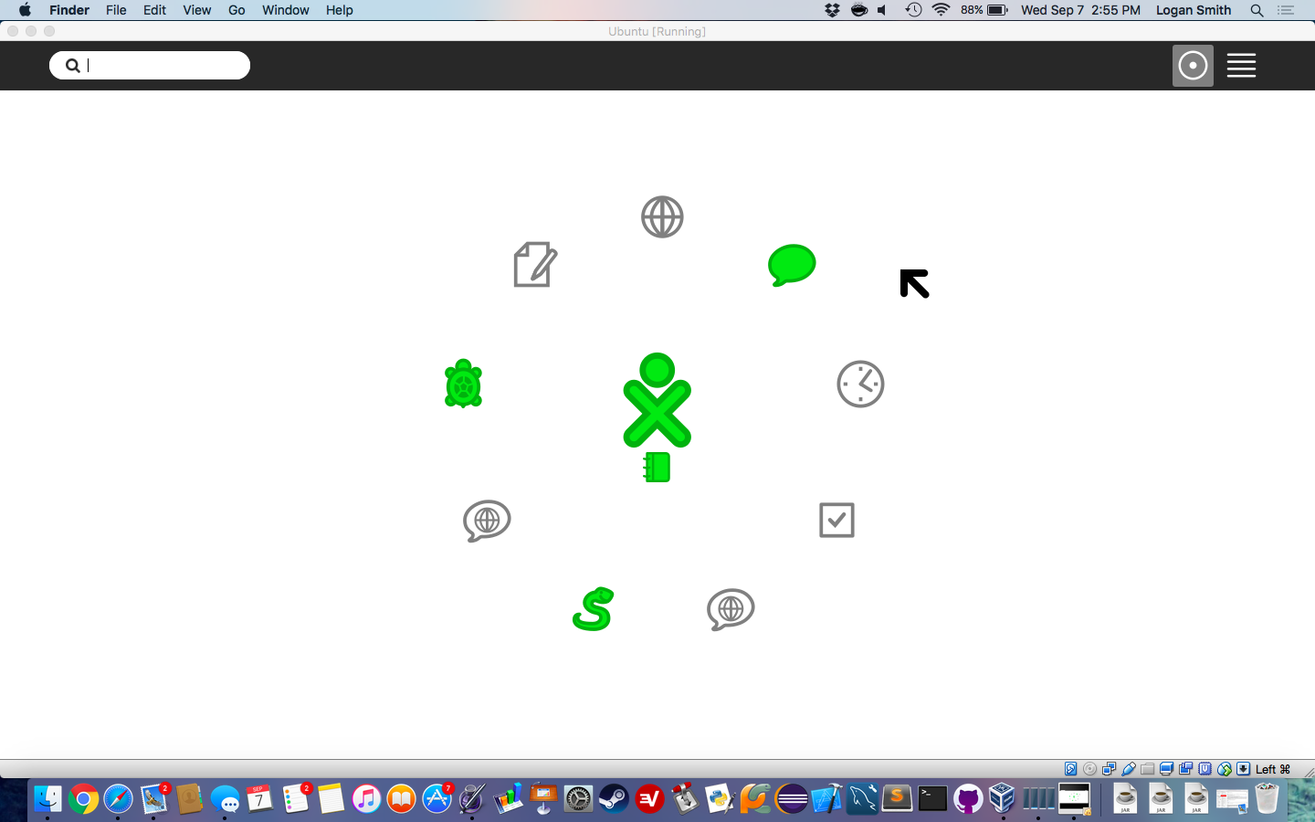

Slide 5
Making a Plan
Due to our unconventional compilation method, we could only use offline modules
Focused on the calculator functions:
Exponentiation
Addition
Division
Square root

Slide 6
Creating Test Case Templates
We needed these things from our test cases:
Test Case ID: *1*
Requirement being tested: *2*
Component being tested: *3* - *4*
Path to file: *5*
Method being tested: *6
Test input(s) including command-line arguments: *7*
Expected outcome(s): *8*

Slide 7
Creating Test Case Templates
Placeholder | Necessary Information | Notes
*1* | Test case ID number | Must match number in file name
*2* | Pertinent requirement | Each test case must be traceable to a requirement
*3* | Sugar Labs activity name
*4* | Activity python file
*5* | The path to the activity python file | This path will be from the home directory of the project formatted as “dir1/dir2/...dirn/file.py”
*6* | The method to be tested | Includes entire method signature
*7* | Parameters for the method call
*8* | Expected outcome

Slide 8
Sample Test Case
Test Case ID: 1
Requirement being tested:
Correct and accurate exponentiation
Component being tested:
Sugar labs calculator - functions.py
Path to file: TestAutomation/project/sugar-calculate/functions.py
Method being tested: pow(a, b)
Test input(s) including command-line arguments: 2, 10
Expected outcome(s): 1024

Slide 9

Automated Testing Framework
Our framework uses a set of five Python scripts
runAllTests.py
parseTestCase.py
runTestCase.py
myExceptions.py
progressBar.py
These Python scripts will execute our test cases and create a report with the results

Slide 10
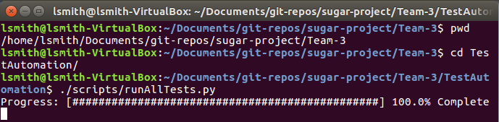
Using The Automated Testing Framework
Clone our repository and navigate to the TestAutomation directory
Use the command ./scripts/runAllTests.py

Slide 11
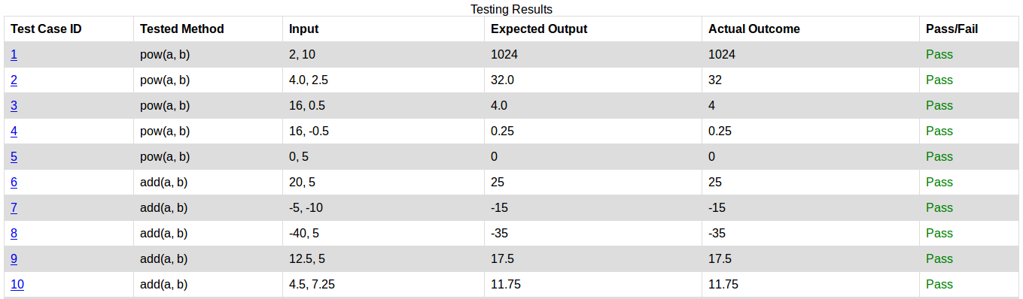
Viewing The Results

Slide 12
Fault Injection
Goal was to compromise source code of the project without breaking our testing framework
Inserted a fault into each function we tested

Slide 13
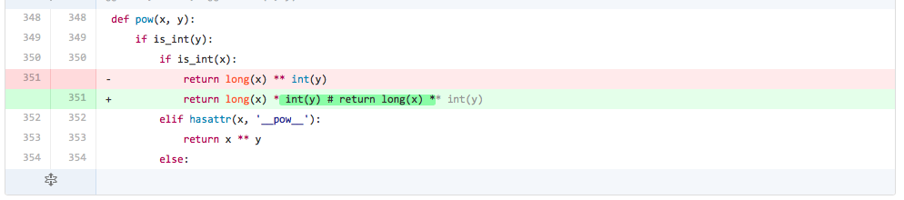
Sample Fault

Slide 14
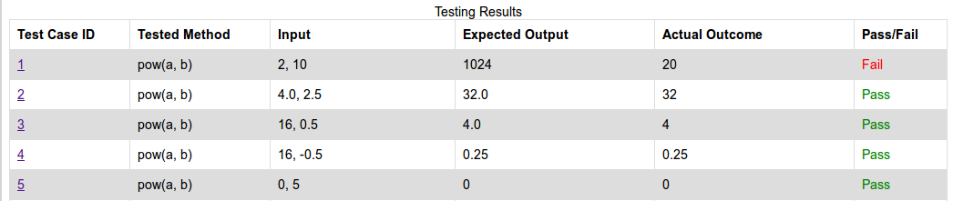
Faulty Report

Slide 15
Conclusion
Our Experiences
Sugar Labs is a wonderful piece of software
Like many open source projects, it’s documentation can be lacking
What We Learned:
Teamwork and communication
How to use Git and GitHub
Good practices for writing test cases
How to analyze the effects of changes in source code

