Slide 1
CSCI362: Software Engineering
Automated Testing Framework for OpenMRS
Ricky Ramos, Matthew Schwarz, Matthew Kay

Slide 2

About OpenMRS
OpenMRS is a medical record system written in Java, which focuses on giving health care providers a free and customizable electronic medical record system.
OpenMRS’s mission statement is to “improve healthcare delivery in resource-constrained environments, by creating a robust, scalable, user-driven, open source medical record system platform”.

Slide 3
About Our Testing Framework
Our testing framework is executed by a bash script named runAllTests.sh which is located in the scripts directory
The script parses the test case text files (located in testCases directory) and grabs the provided information from the text files
The script then uses this information to compile and run the test drivers, which run the actual tests for the methods that are being tested.
The result is then retrieved from the drivers, and the result, along with the information previously grabbed, is input into a HTML table and displayed in a browser to the user.

Slide 4
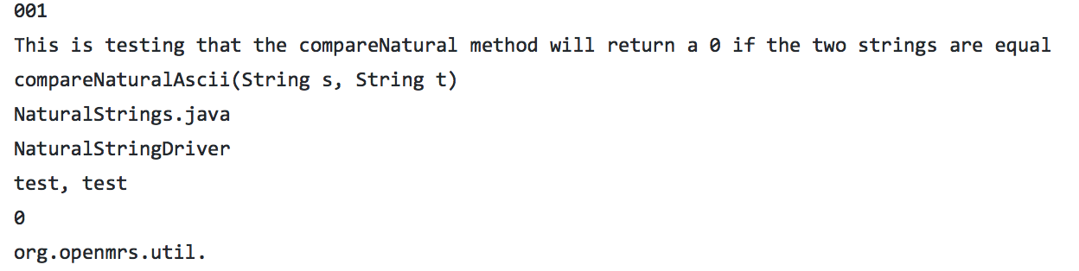
Test Case Input
Test Case ID
Requirement being tested
Component being tested
Class
Driver being used
Test Input(s)
Expected Result
package

Slide 5
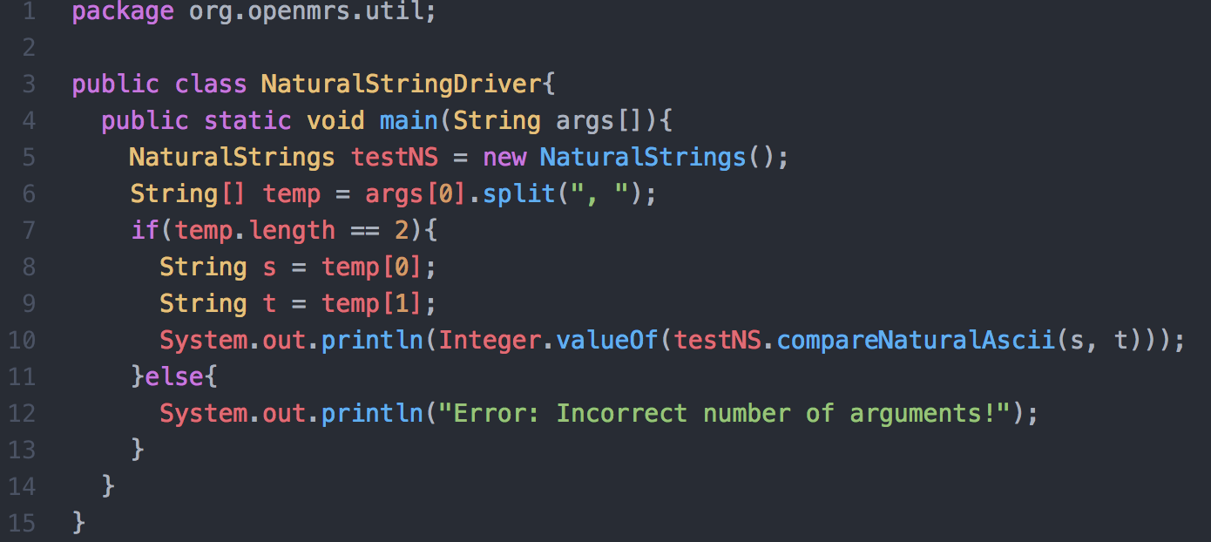
Driver for first 5 test cases: NaturalStringDriver
This driver runs the first five test cases using the method compareNaturalAscii(String s, String t).
The method the driver is testing takes two strings as inputs and returns 0 if the two strings are identical, returns a positive number if the first string lexicographically follows the second string (number is based on distance of ASCII characters), and a negative number if the first string lexicographically precedes the second string.
The method is case sensitive.

Slide 6
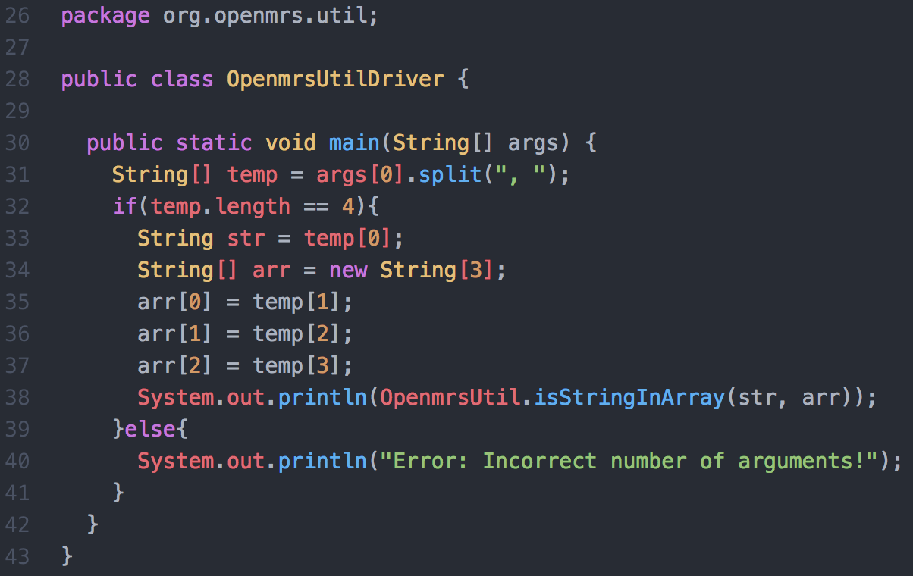
Driver for next 5 Test Cases: OpenmrsUtilDriver
This driver runs test cases 006-010 using the method isStringInArray(String str, String[] arr).
The method the driver is testing takes a string and a string array as inputs, and tests if the input string is in the array.
If the string is in the array, the method returns true.
If the string is not in the array, the method returns false.

Slide 7
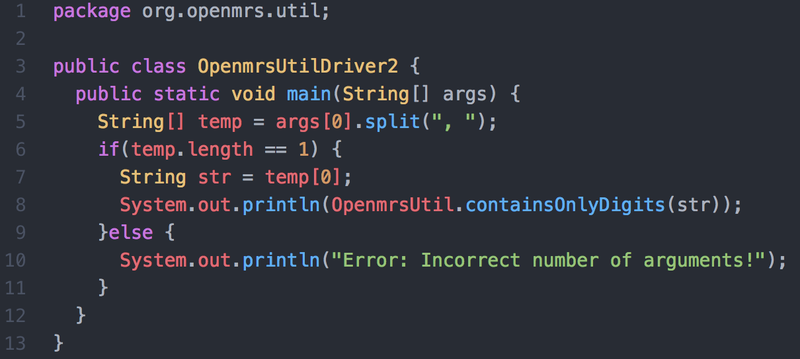
Driver for next 5 Test Cases: OpenmrsUtilDriver2
This driver runs test cases 011-015 using the method containsOnlyDigits(String str).
This method takes a string in as input and checks if the string is made up of only numerical digits
If the string contains only digits, then it returns true.
If the string contains letters, or other items that are not digits, then it returns false.

Slide 8
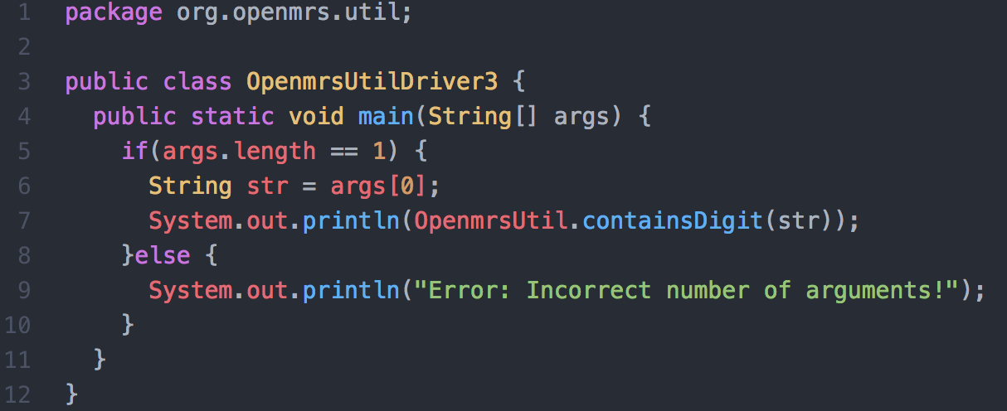
Driver for Next 5 Test Cases: OpenmrsUtilDriver3
This driver runs test cases 016-020 using the method containsDigit(String str).
This method takes a string in as input and tests whether or not the string contains a digit in it somewhere.
The method will return true if the string does contain at least one digit.
The method will return false if the string does not contain any digits in it.

Slide 9
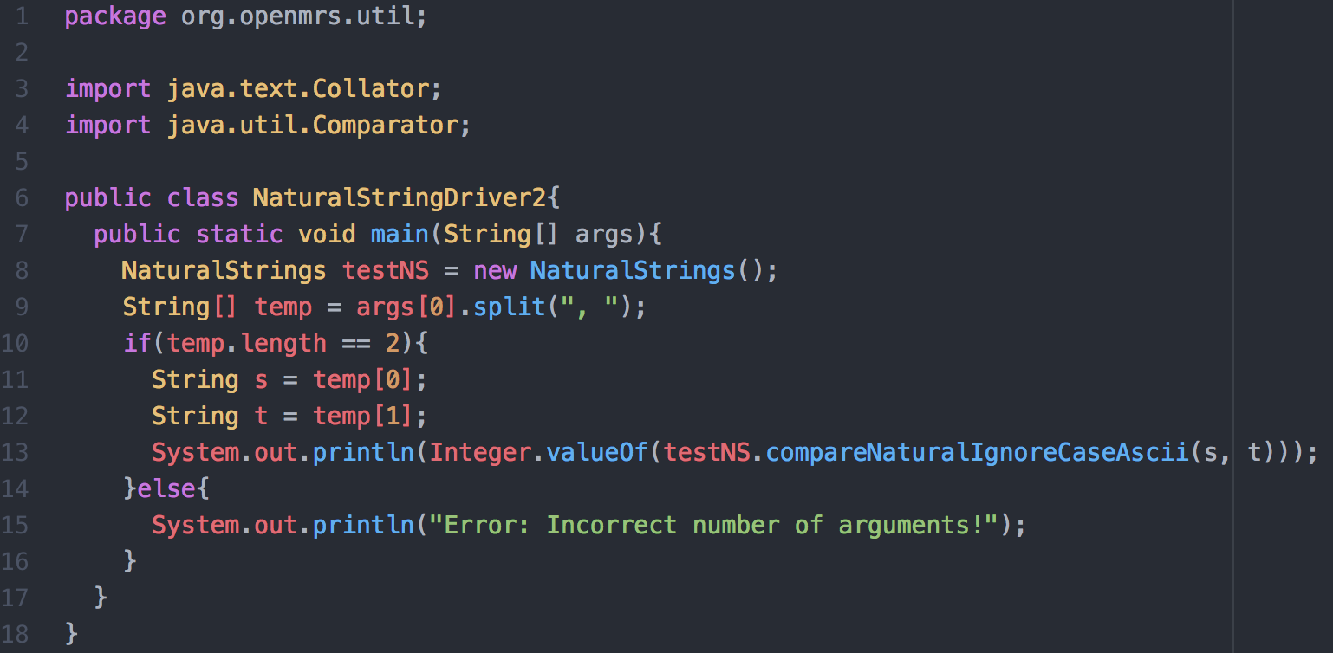
Driver for last 5 Test Cases: NaturalStringDriver2
This driver runs test cases 021-025 using the method compareNaturalIgnoreCaseAscii(String s, String t).
This method is very similar to the first driver (NaturalStringDriver) and performs the same function based on two input strings, with the exception that this method does not take the case of letters into count, where as NaturalStringDriver is case sensitive.
This means that inputs of tESt and test would return 0 meaning they are the same.

Slide 10
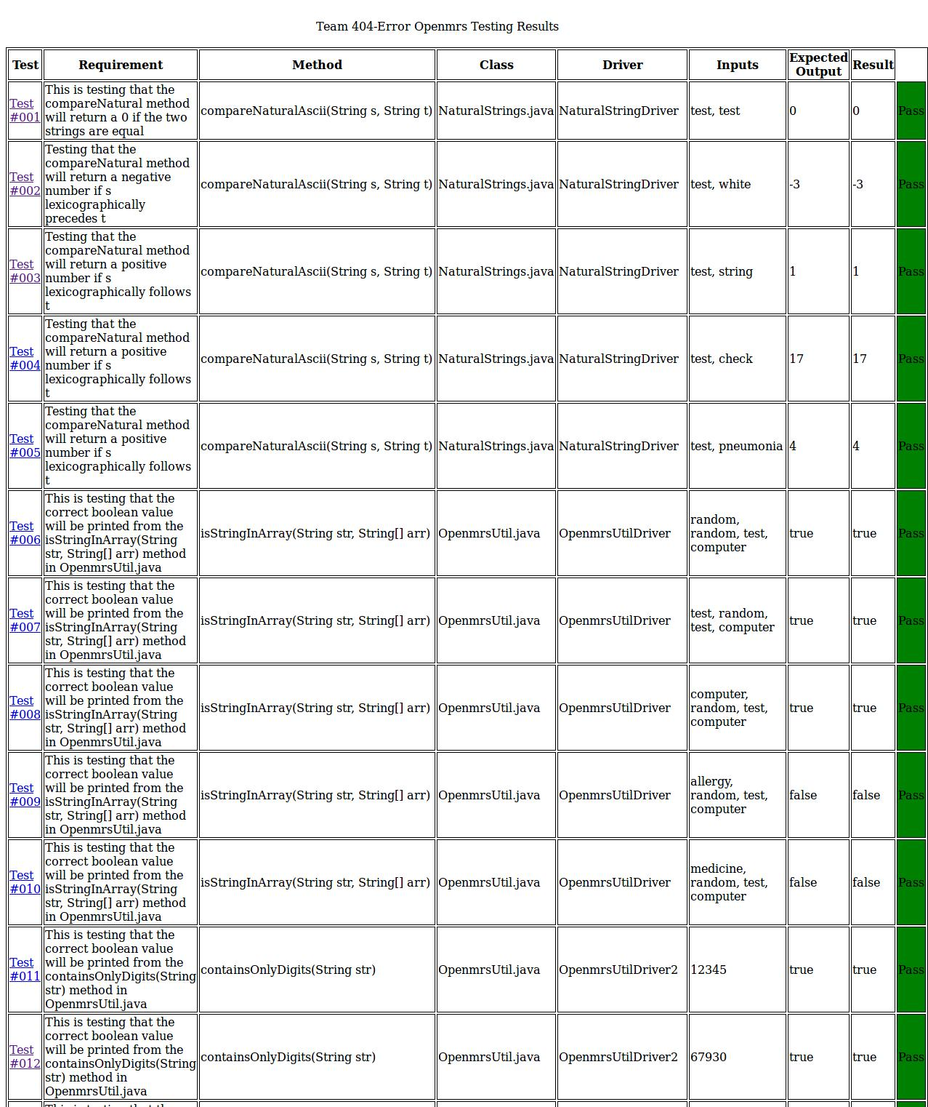
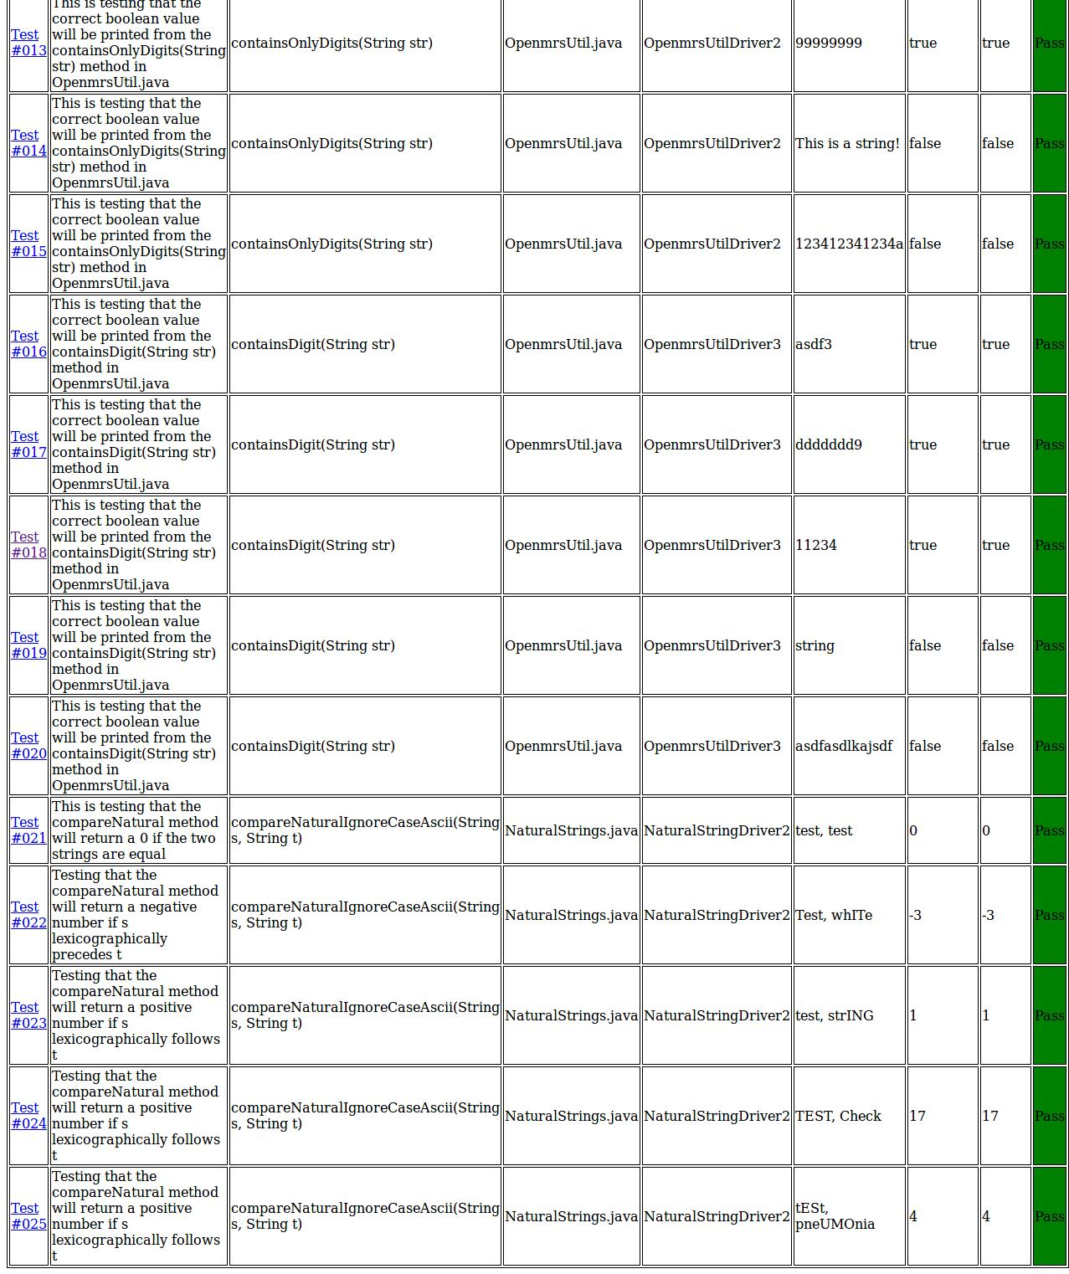

Slide 11
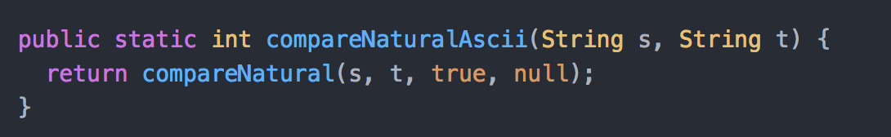
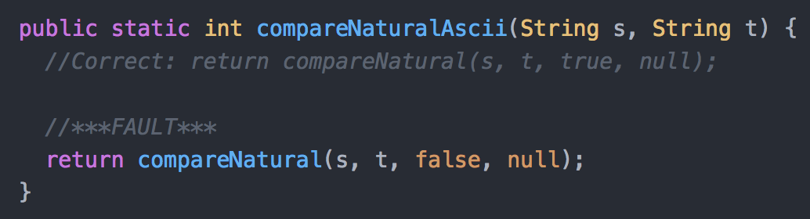
Fault Injection #1
Our first fault injection was for the compareNaturalAscii(String s, String t) method.
The third (boolean) parameter in the method called within compareNaturalAscii(String s, String t) was switched from true to false. That parameter deals with case sensitivity (true if you want it, false if you don’t).
The fault, in this case, had no effect on our test results because all of our test cases used input strings that were all already lowercase to begin with.
Test Cases: 001 - 005
Test Case Results:
Original: 5 Passed / 0 Failed
After Fault: 5 Passed / 0 Failed

Slide 12
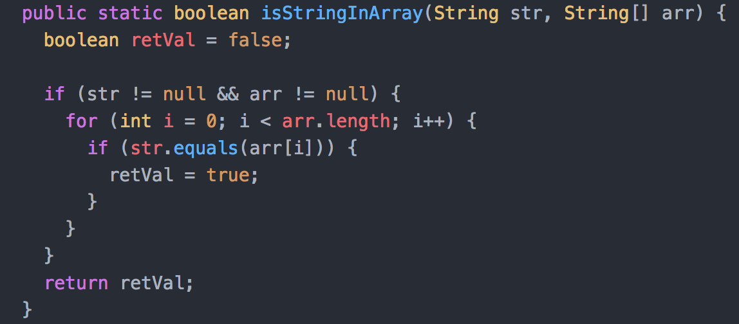
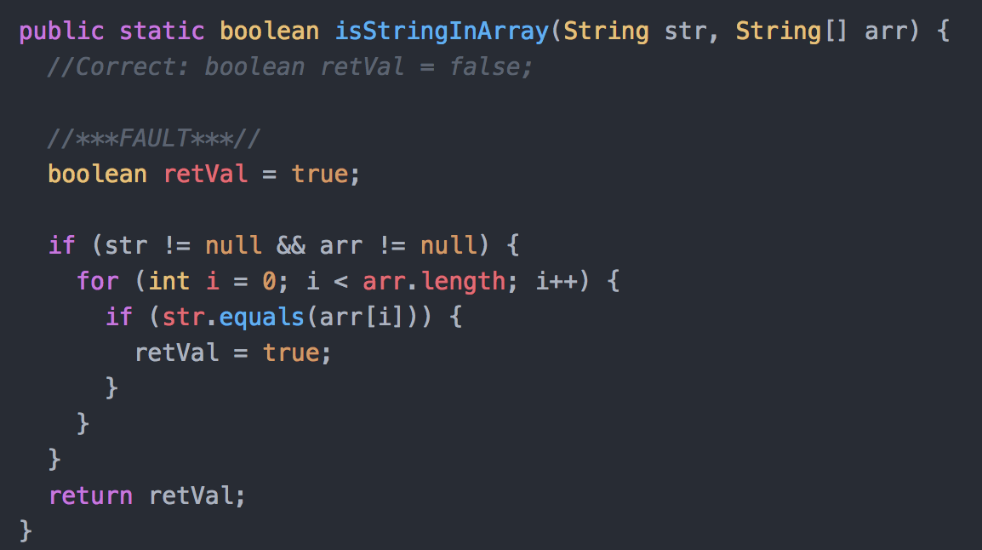
Fault Injection #2
Our second fault injection was for the isStringInArray(String str, String[] arr) method.
The initial return value (retVal) was changed from false to true. Essentially, this method will always return true, indicating that the input String is always within the input String array.
This fault caused 2 test cases to fail.
Test Cases: 006 - 010
Test Case Results:
Original: 5 Passed / 0 Failed
After Fault: 3 Passed (006,007,008) / 2 Failed (009,010)

Slide 13
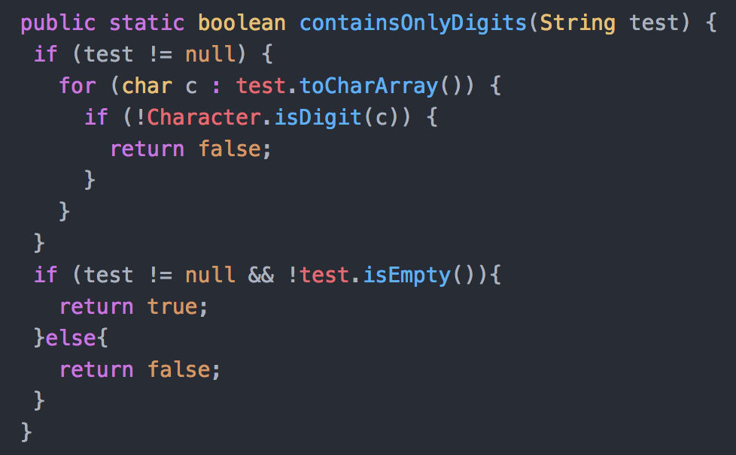
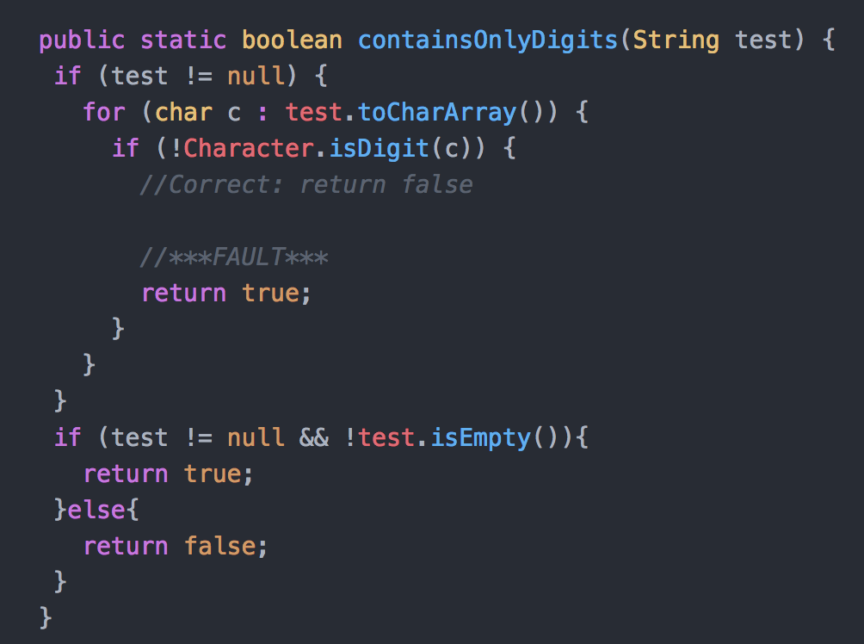
Fault Injection #3
Our third fault injection was for the containsOnlyDigits(String test) method.
The method was changed to return true if a character that wasn’t a digit was found within the string.
This fault caused 2 test cases to fail.
Test Cases: 011 - 015
Test Case Results:
Original: 5 Passed / 0 Failed
After Fault: 3 Passed (011,012,013) / 2 Failed (014,015)

Slide 14
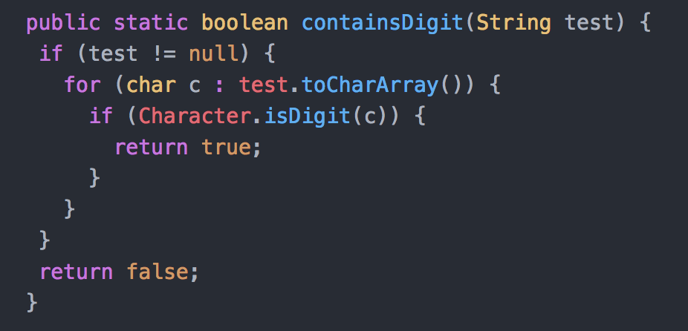
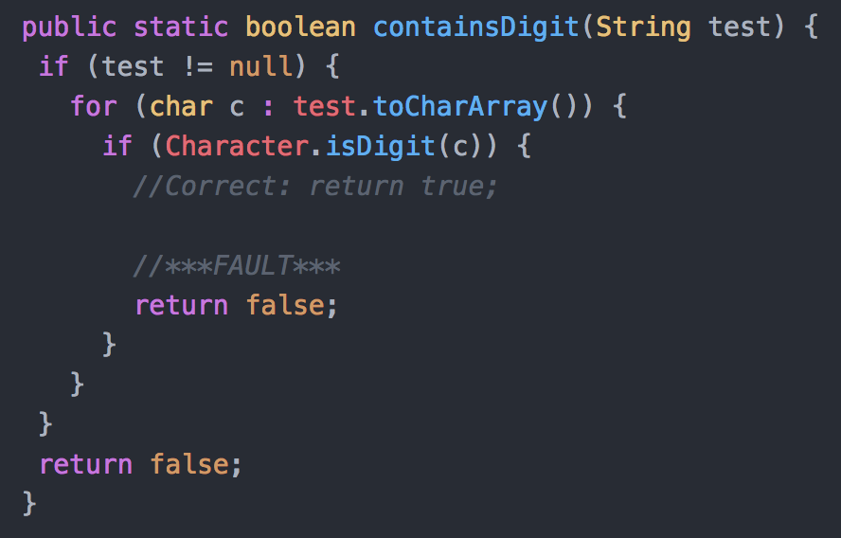
Fault Injection #4
Our fourth fault injection was for the containsDigit(String test) method.
The method was changed to return false if a character is a digit. The method will always return false.
This fault caused 3 of our test cases to fail.
Test Cases: 016 - 020
Test Case Results:
Original: 5 Passed / 0 Failed
After Fault: 2 Passed (019,020) / 3 Failed (016,017,018)

Slide 15
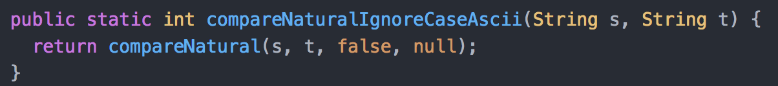
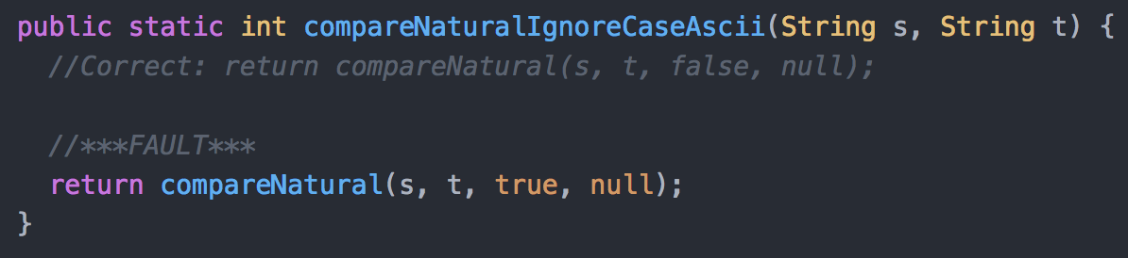
Fault Injection #5
Our fifth fault injection was for the compareNaturalIgnoreCaseAscii(String s, String t) method.
The third (boolean) parameter in the method called within compareNaturalIgnoreCaseAscii(String s, String t) was switched from false to true. That parameter deals with case sensitivity (true if you want it, false if you don’t).
This fault caused 1 of our test cases to fail.
Test Cases: 021 - 025
Test Case Results:
Original: 5 Passed / 0 Failed
After Fault: 4 Passed (021,023, 024, 025) / 1 Failed (022)

Slide 16
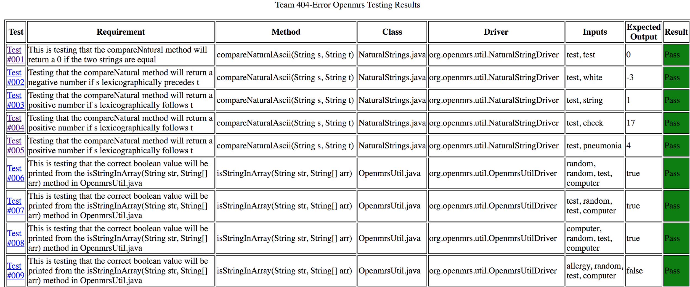
HTML
We kept our HTML table nice and simple.
We had eight columns (Test, Requirement, Method, Class, Driver, Inputs, Expected Output, and Result)
For our results column if the test case passed, the box turned green and if it failed it turned red.
For each test case, we created a link that brought you to the test case description.

Slide 17
Issues And Struggles
The first issue that our group encountered was getting our original project, TEAMMATES, to work due to the massive amount of external packages and libraries it used. This lead our group to transition to working on OpenMRS instead.
The second major issue that we had was getting the java classes inside of the OpenMRS project that we needed to run our drivers to compile and run. We had issues with this for a while, and solved it by realizing that we had to compile from the directory containing the package that the classes were in, not just the classes themselves.
The third issue we ran into was compiling the classes without directly stating the directory path in the script. We talked to Professor Bowring about this and he was extremely helpful. Afterwards, we were able to fix the issue by compiling from the information in the test case text files.

Slide 18
What We Learned
Our team didn’t have much experience with writing bash scripts, so this assignment helped us to learn how to do that, and how helpful it can be to automate things with scripts.
Our team gained extensive knowledge in writing tests to test code, and with developing an appropriate time table and testing plan.
We learned how to correctly compile and run java files from the terminal, and from a script.
We learned a lot about the importance of having a job for every team-member to perform, and the importance of planning ahead and not procrastinating in group projects.
Most importantly, we learned that proper communication is one of the most important things in group work.

Slide 19
END

