Slide 1
Automated Testing Framework for Tanaguru’s Contrast Finder
Cougars-Roar: Fabiola Atoche, Luke Bradley, Julian Smith & James Thurlow

Slide 2
Automated Testing Framework
Outline
Description of Tanaguru and Reasons for Choosing
Test Plan and Test Cases
The Program Itself
Issues, Experiences and Future Plans.

Slide 3

Tanaguru

Slide 4
Tanaguru
Automates several accessibility tests used for evaluating if a website falls under the international regulations of the WCAG (Web Content Accessibility Guidelines)
Can evaluate web page template drafts, individual pages, full sites, or web applications
Upholds 3 qualities - transparency, efficiency, and ease of use
Transparency - lets user know if there are any problems that could compromise results; gives users everything they need to know to make decisions
Efficiency - attempting to save time without cutting corners on results
Ease of use - makes understanding accessibility standards easy for the average user

Slide 5
Contrast Finder
Automated test provided by Tanaguru
Allows users to find contrasting colors for foregrounds and backgrounds of created sites
Makes sure that said contrast is higher than a minimum contrast ratio of 4.5:1 set by the WCAG
Inputs to find colors are either RGB decimal or hexadecimal values
If user-picked contrast does not meet minimum ratio, it gives a list of similar options that do meet the ratio for the user to choose instead

Slide 6
Why We Chose Tanaguru
Originally, we chose Sugar Labs due to its good documentation and active community
However, we had issues with building the Sugar Labs shell due to incompatibilities with the Linux/Ubuntu built-in software Fedora
Tanaguru was chosen due to our better familiarity with the language (Java) and deployment (Tomcat)
Good documentation, but was not as thorough as Sugar Labs

Slide 7
Test Plan
Purpose:
To specify the testing approach to test Tanaguru Contrast-Finder.
Scope:
This test plan is defined to test methods included in the Contrast-Finder module.
Objective:
Verify if the functionality of Contrast-Finder meets the specifications found on the Tanaguru GitHub documentation

Slide 8
Test Plan
Testing process:
Design and write 25 test cases.
Write “runAllTests” script to execute all test cases.
As tests are executed the results are evaluated as Passed/ Failed in the test report.
If a test is marked as Failed then both the method and test case need to be reviewed.

Slide 9
Test Plan
Tested Method:
Method getContrastRatio5DigitRound() from the ContrastChecker component
This method computes the ratio between two colors.
The inputs values are two strings containing pairs of RGB numbers, each within the range of 0 to 255.
This method was tested by using combination of extreme input values e.g. 0,0,0 and 255,255,255.
The method outputs were verify against calculated values.

Slide 10
Test Plan
Tested Method:
Method getLuminosity() from the ContrastChecker component
This method computes the luminosity of a color in RGB format.
The input value is a strings containing a RGB number, within the range of 0 to 255.
This method was tested by using combinations of extreme input values for the RGB components, e.g. 0,255,0 or 255,0,255.
The method outputs were verify against calculated values.

Slide 11
Test Plan
Tested Method:
Method calculate() from the DistanceCalculator component
This method computes the distance between two colors.
The inputs values are two strings containing pairs of RGB numbers, each within the range of 0 to 255
This method was tested by using combination of extreme input values e.g. 0,0,0 and 255,255,255.
The method outputs were verify against calculated values.

Slide 12
Test Plan
Tested Method:
Method rgb2hsl() from the ColorConverter component
This method converts RGB values to hsl values.
The input value is a string containing a RGB number.
This method was tested by using extreme values e.g. 0,0,0 or 255,255,255
The method outputs were verify against calculated values.

Slide 13
Test Plan
Tested Method:
Method hex2rgb() from the ColorConverter component
This method converts hex values to RGB values.
The input value is a string containing a six digit hexadecimal number that can be preceded by a ‘#’ sign.
A shorthand hex format is used when the digits are repeated in the pairs, e.g. 123 is short for 112233.
This method was tested by using extreme values e.g. #000000 or #FFFFFF
The RGB values are coded with 2 digits each, were converted from 00 to FF to 0 to 255 decimal.

Slide 14
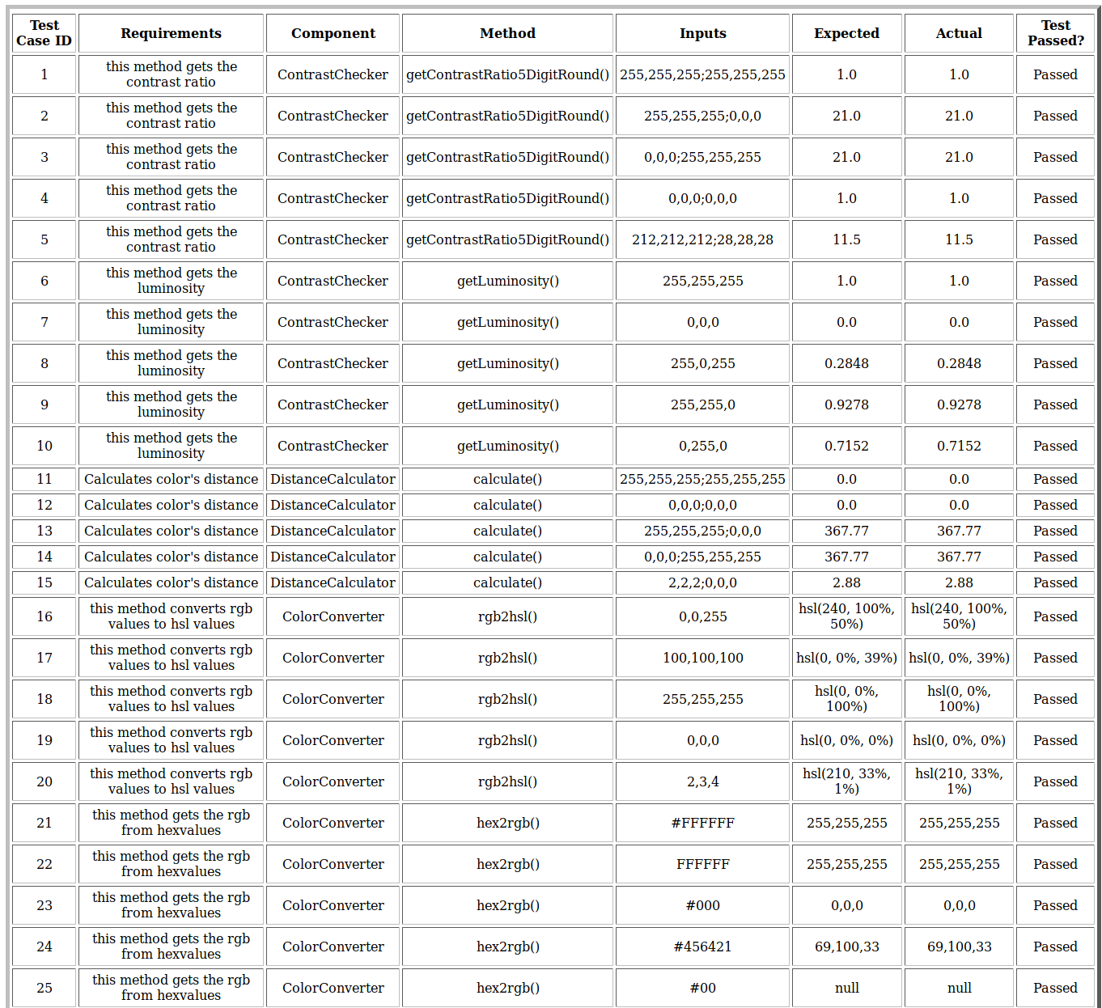
Test Cases Within Framework

Slide 15
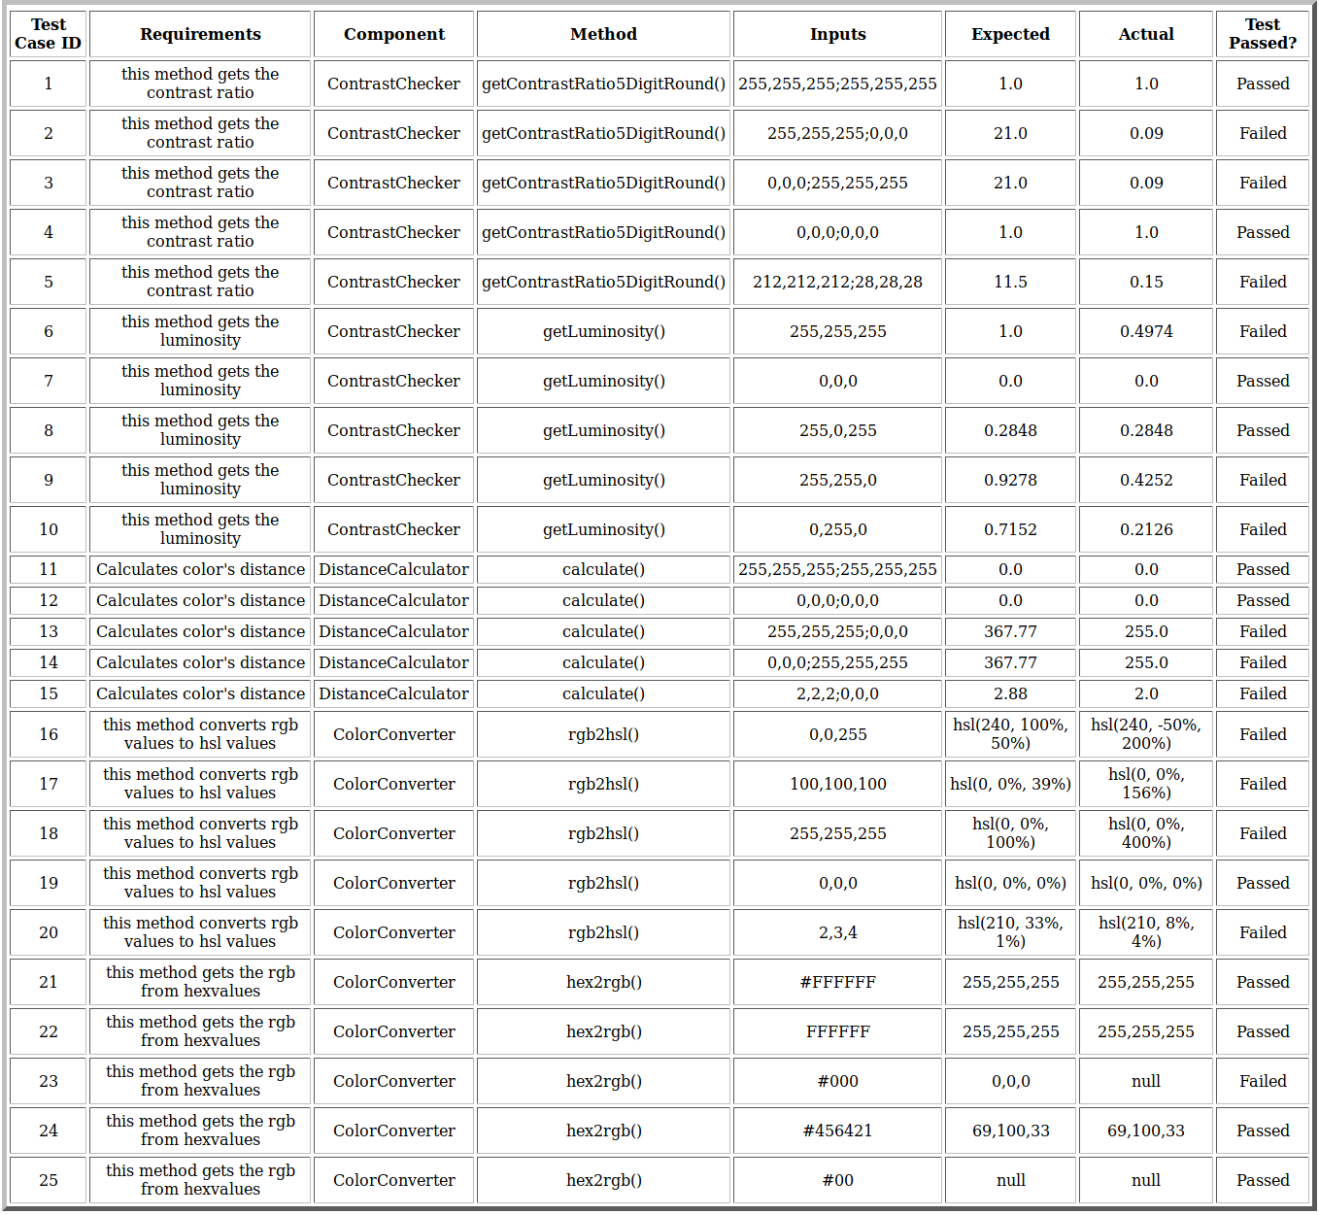
After Fault Injection

Slide 16
Goals for Automated Testing Framework Script
Primary Goal: wanted a script automatically capable of:
Cleaning up temp/extra files
Compiling drivers and components
Reading in templated test cases written as .txt files
Generating individual test case reports
Generating a table in HTML of all the test case reports
Additional Goal: wanted a script that was:
Readable with meaningful documentation
Easily executable
Easily updatable
Quick to complete execution

Slide 17




Requirements for Automated Testing Framework
GitHub
Java
Ubuntu
VirtualBox (optional)

Slide 18
How to use our Framework
In the Terminal type:
git clone https://github.com/CSCI-362-02-2017/Cougars-Roar.git
cd Cougars-Roar
make run
If the following error occurs (if any other error occurs please post an issue to our GitHub page):
./runAllTests.sh: line 10: javac: command not found ./runAllTests.sh: line 10: javac: command not found cat: '../temp/*': No such file or directory
Make sure java is installed on your machine:
sudo apt-get install default-jdk

Slide 19
To Add a New Test Case
Test Case Template:
// 1. test ID
// 2. requirement being tested
// 3. component being tested
// 4. method being tested
// 5. test input(s) separated by a semicolon
// 6. expected outcome(s)
// --END--

Slide 20
Limitations
Meeting up (scheduling conflicts, living situations)
Original switch from SugarLabs to Tanaguru (linux system problems)
Technical limitations
Getting the script to work in Terminal
Creating/Finding proper test cases
Tomcat and Webapp setup during build

Slide 21
What-if
CSS for table (better design)
More test cases for separate methods
When running test report, have it display results right away instead of restarting and starting again multiple times

Slide 22
What we learned
Github/Git
Scripting
Creating Test Cases/Reports and Testing
Modeling and design
Project Management concepts
Reading through software and understanding where things take place
Software team collaboration

